Slide 1
IAM / SSO Service
Building a Secure, Low-Budget IAM / SSO

Slide 2
Contact Info
Praveen Addepally
LinkedIn:
Sunil Ayyappankutty
LinkedIn: https://www.linkedin.com/in/sunilkutty
Anibal Velarde
LinkedIn: https://www.linkedin.com/in/anibalvelarde
Resources
GitHub: https://github.com/anibalvelarde/SSOExample

Slide 3
IAM – Identity and Access Management
Has to do with
Identity Management
On-boarding
Off-boarding
Application Access Management
SSO
Federation
Compliance (S-Ox)
And many others

Slide 4
SSO – Single Sign-On
Has to do with
Authentication
High Level Authorization

Slide 5
Build or Buy?
If you buy
Who are the players?
What are their offerings?
How to select one? Cloud? On-Prem?
(… and many other questions)
If you build
How to do it
You don’t!
Only for Education or Intellectual curiosity

Slide 6
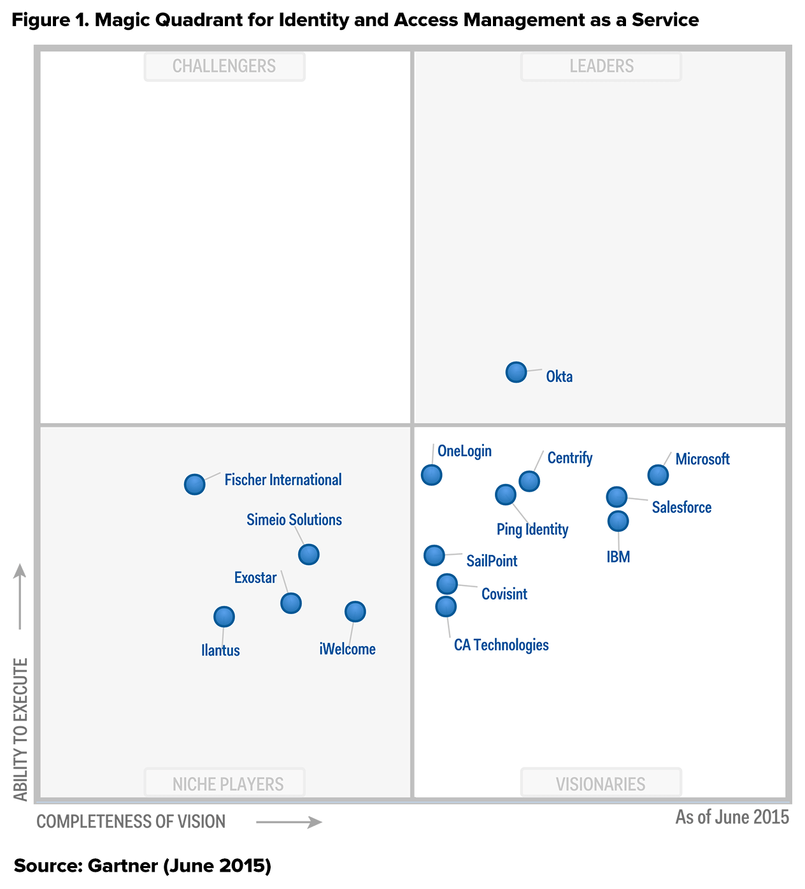
Gartner Magic Quadrant

Slide 7
Our constraints
Microsoft Shop
Active Directory
Access to new servers (Windows 2012 R2)
Microsoft-oriented Datacenter Environment
Budget ($45K)
Kind of low for an IAM/SSO solution
Analysis Paralysis
Very new domain for us

Slide 8
Before You Begin
Have a business case that can support a viable budget (you’ll need more than $45K)
Identify which types of identities you are targeting (internal, external, or federated)
If in a large corporate environment, find out to see if there are other corporate efforts to solve the IAM / SSO problem

Slide 9
Talking Protocols
SAML
WS-*
OAuth
Authorization Code
Implicit
Resource-Owner Pwd Creds
Client Credentials
OpenID Connect
Many more to come…

Slide 10
Talking Protocols We Chose to Use
SAML 2.0
WS-Fed
OAuth
Authorization Code
Implicit
Resource-Owner Pwd Creds
Client Credentials
OpenID Connect
Many more to come…

Slide 11
Talking Protocols – More Detail
SAML
XML
Version 1.x / 2.x
WS-Fed
Emits SAML Tokens
Works well with Microsoft solutions
SharePoint
Server-side web applications
OAuth – Implicit Workflow
JWT
Use it to secure a REST API
Client-side web applications

Slide 12
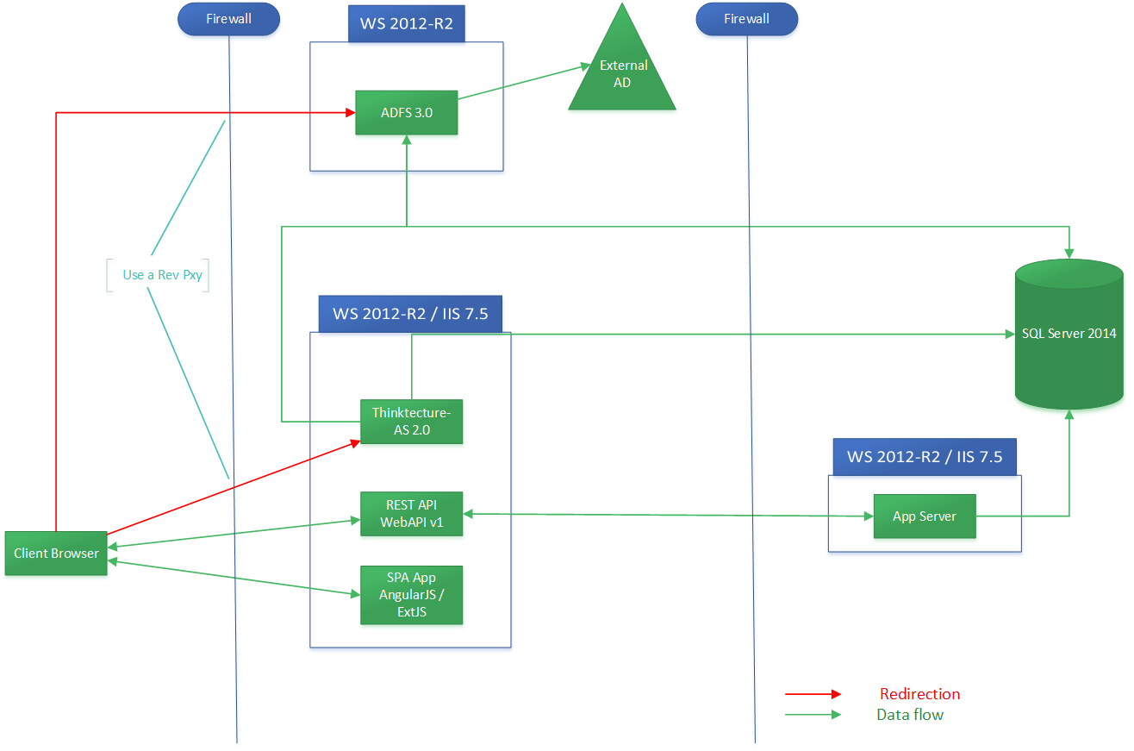
Architecture of Solution

Slide 13
DMZ
Reverse Proxy
Web Applications / REST API
ADFS 3.0
Do Not Recommend Using ADFS 2.0
Oauth
Thinktecture’s Authorization Server 2.0
Thinktecture’s Identity Server 3.0
Active Directory

Slide 14
Back-End
Application Server
Internal Web App / REST API
ADFS
Active Directory
Database

Slide 15
Architecture of Solution

Slide 16
Working Example – Server-Side Web App

Slide 17
Working Example – Client-Side Web App

Slide 18
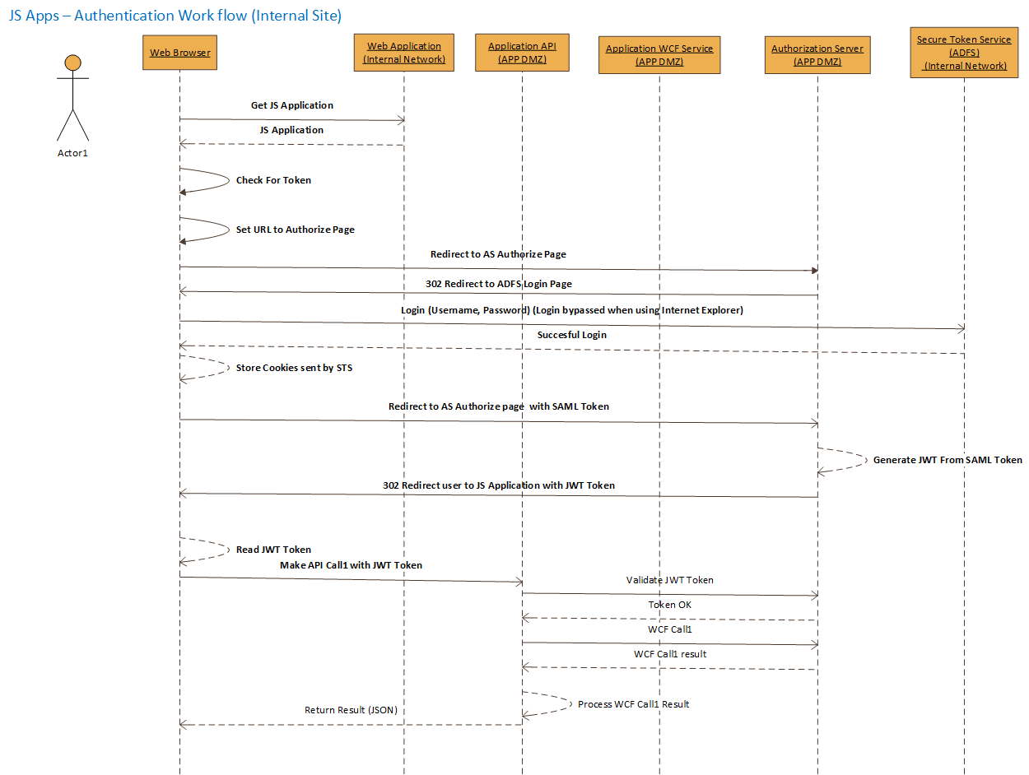
Client-Side Web App SSD

Slide 19
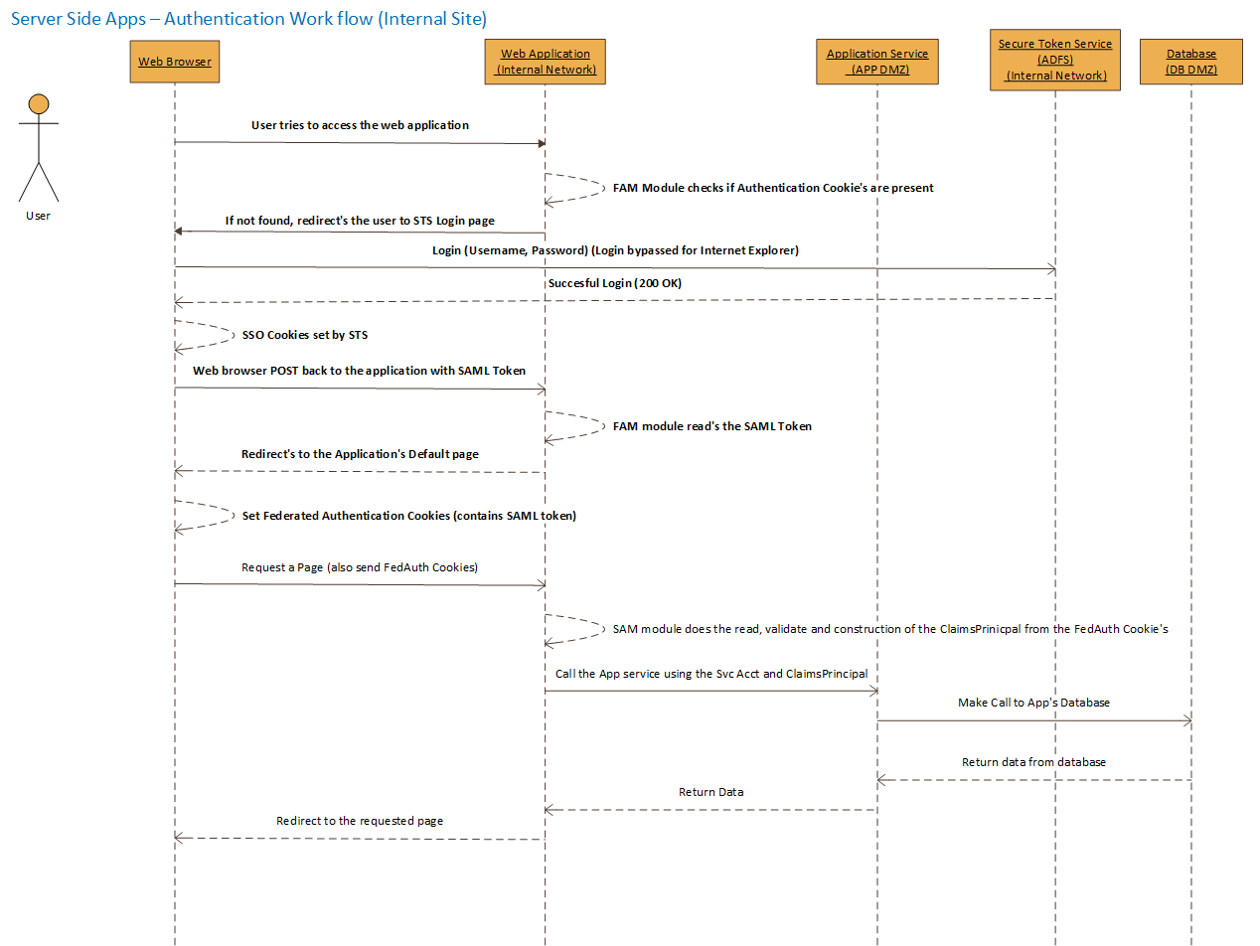
Server-Side Web App SSD

Slide 20
More References…
ADFS
Configuration
Thinktecture
GitHub
Configuration
Domain Knowledge
Least Privilege
Oauth
Others…

