Slide 1
Building Secure, low-budget iam/sso Service
TCCC 19 – Fall 2015

Slide 2
Contact Info
Praveen Addepally
LinkedIn: https://www.linkedin.com/in/pravinady
Sunil Ayyappankutty
LinkedIn: https://www.linkedin.com/in/sunilkutty
Anibal Velarde
LinkedIn: https://www.linkedin.com/in/anibalvelarde

Slide 3
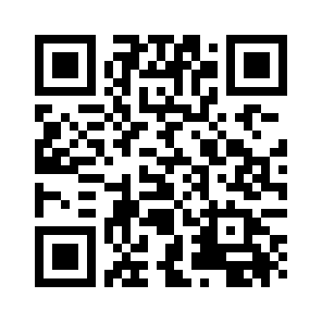
Github url
https://github.com/anibalvelarde/SSOExample

Slide 4
IAM – Identity and Access Management
Has to do with
Identity Management
On-boarding
Off-boarding
Application Access Management
Management of User Access to Applications
Federation
Compliance (S-Ox)
And many others

Slide 5
SSO – Single Sign-On
Has to do with
Authentication
High Level Authorization

Slide 6
Basic terminology
IDP
Identity Provider
Stores information about the identity of a user
AD, LDAP, a Database
STS
Secure Token Server
Has access to one or more IDPs
Emits security tokens (STS)
RP or SP
Reliant Party or Service Provider

Slide 7
Build or Buy?
If you buy
Who are the players? [Ping, Net.IQ, Microsoft, Stormpath, and many more]]
What are their offerings? [Reverse Proxy, STS, IDP, ID Stores, Admin Tools, Monitoring, Reporting, etc.]
How to select one? Cloud? On-Prem?
(… and many other questions)
If you build
How to do it
You don’t!
Only for Education or Intellectual curiosity

Slide 8
Build or buy?
Other Issues
Single Log Out
Criticisms
Reduced Sign-On
Larger negative impact when credentials are compromised
Authentication service becomes a highly-critical service
Settings for SSO Tokens [Sliding Windows, Access Tokens]
And others…

Slide 9
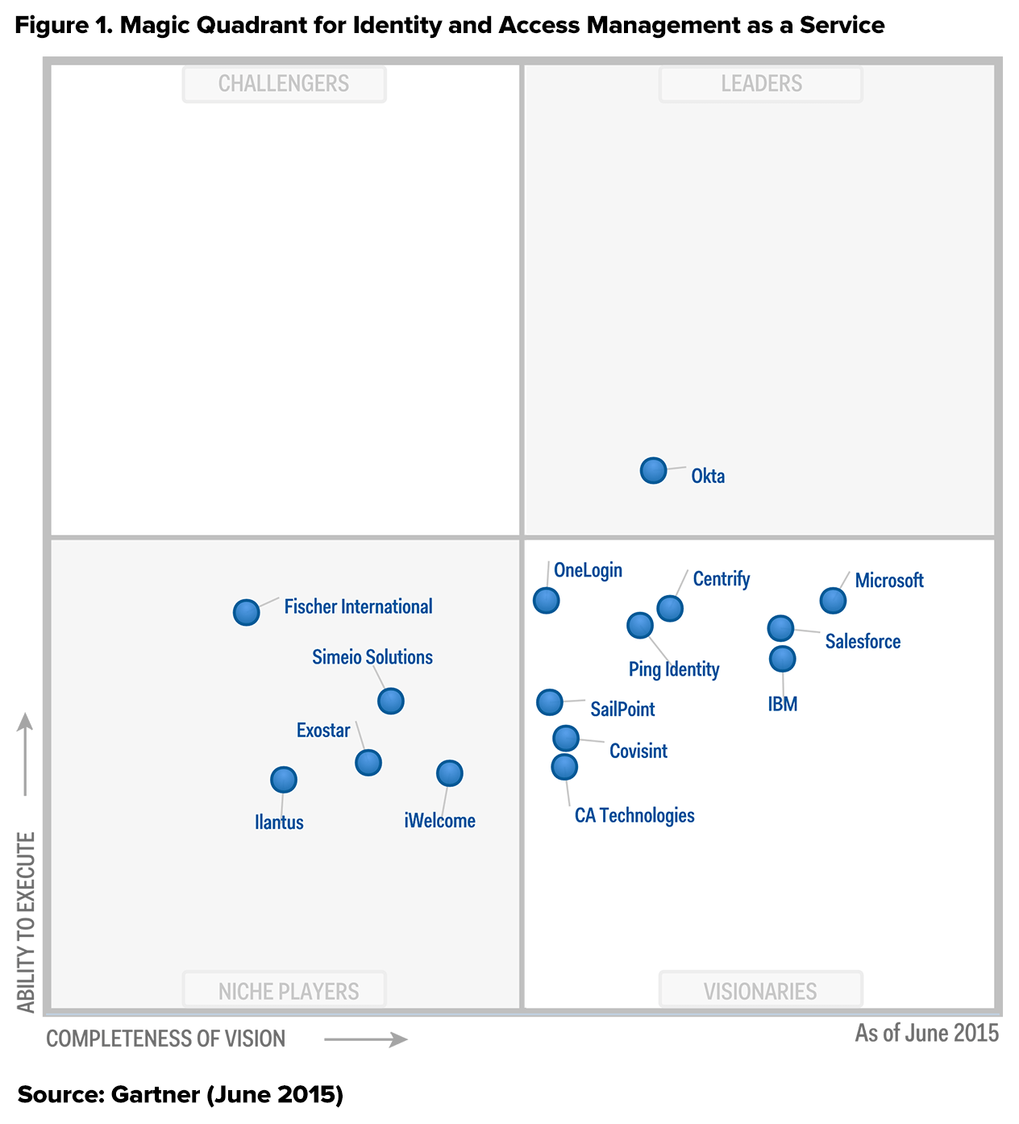
Gartner Magic Quadrant

Slide 10
Our constraints
Microsoft Shop
Active Directory
Access to new servers (Windows 2012 R2)
Microsoft-oriented Datacenter Environment
Budget ($45K)
Kind of low for an IAM/SSO solution
Analysis Paralysis
Very new domain for us

Slide 11
Before You Begin
Have a business case that can support a viable budget (you’ll need more than $45K)
Identify which types of identities you are targeting (internal, external, or federated)
If in a large corporate environment, find out to see if there are other corporate efforts to solve the IAM / SSO problem
Find out if you have a Security Risk Assessment group in your organization. They will want to know what you are doing and you will need their support.

Slide 12
Talking Protocols
SAML – Security Assertion Markup Language
WS-* - Web Security [many other sub protocols]
Oauth - Open Protocol for Secure Authorization
Authorization Code
Implicit
Resource-Owner Pwd Creds
Client Credentials
OpenID Connect
Many more to come…

Slide 13
Talking Protocols We Chose to Use
SAML 2.0
WS-Fed
OAuth
Authorization Code
Implicit
Resource-Owner Pwd Creds
Client Credentials
OpenID Connect
Many more to come…

Slide 14
Talking Protocols – More Detail
Protocols
SAML
Emits SAML Tokens
Version 1.x / 2.x
WS-Fed
Emits SAML Tokens
Works well with Microsoft solutions
OAuth – Implicit Workflow
Emits JWT (Json Web Token)
Use it to secure a REST API
Client-side web applications

Slide 15
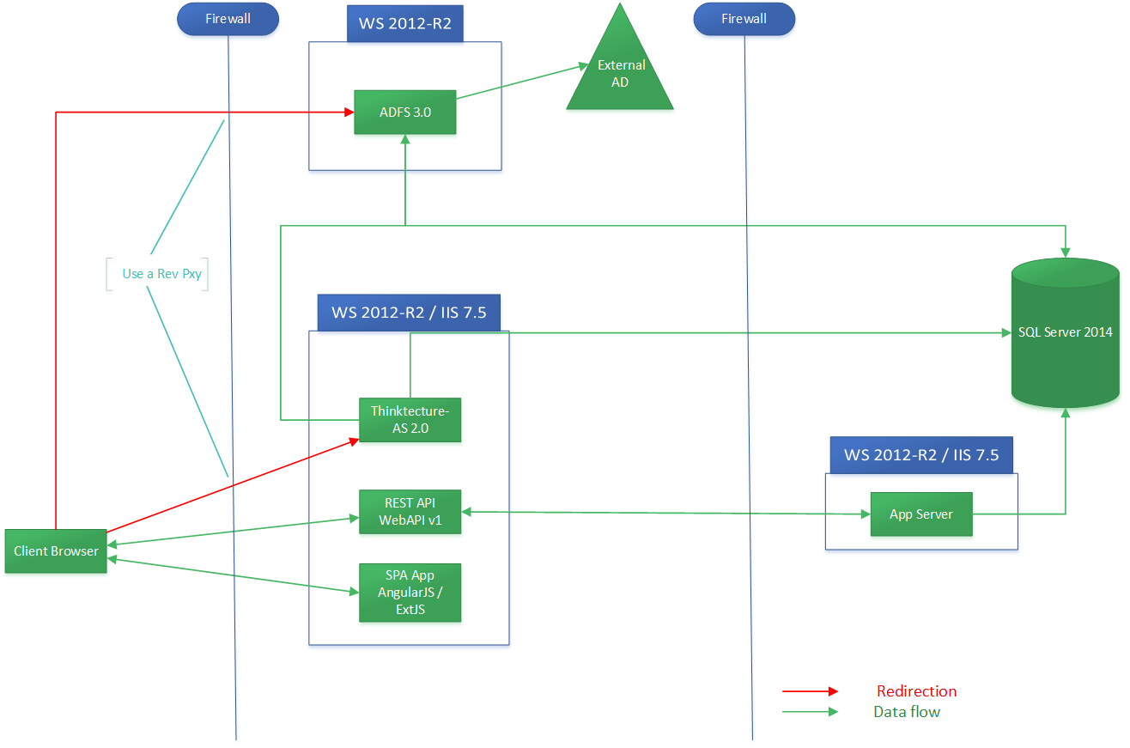
Architecture of Solution

Slide 16
DEMO #1 – client-side Web app (spa)

Slide 17
Working Example – Client-Side Web App

Slide 18
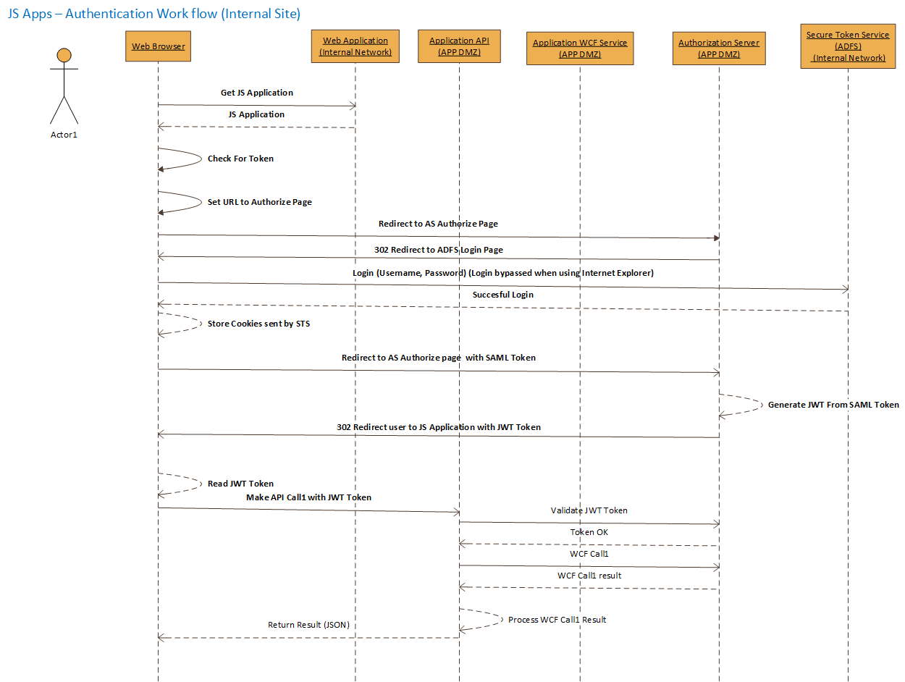
Client-Side Web App SSD

Slide 19
Demo #2 – server-side Web app

Slide 20
Working Example – Server-Side Web App

Slide 21
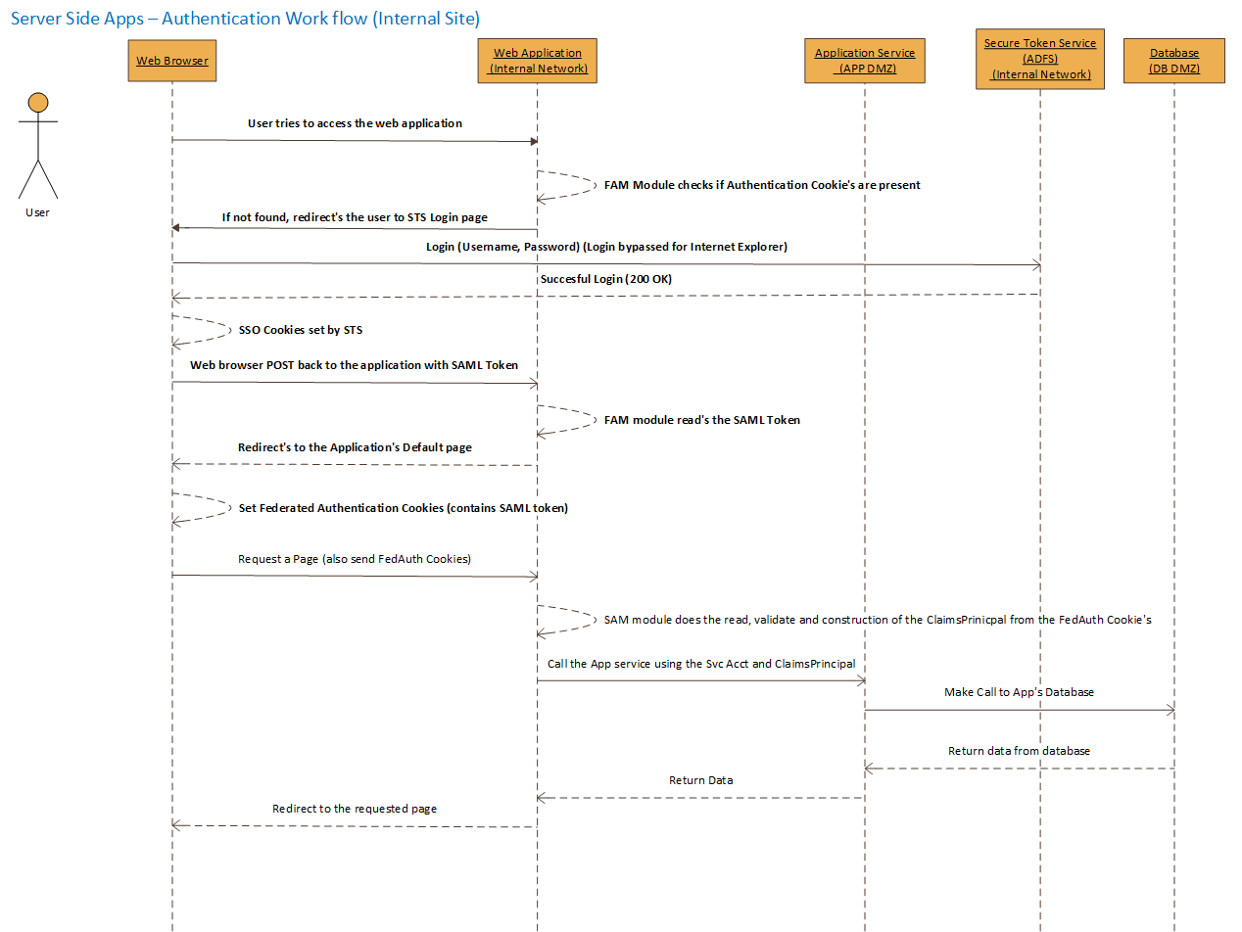
Server-Side Web App SSD

Slide 22
In Conclusion
Keep Researching / Investigating / and Learning
Remember the “Before You Begin” aspects
Know your AD instance
Stand up ADFS
Stand up Oauth Service
Build your app with “Claims-Awareness” in mind
Setup life-cycle environments separate from what you already have (DEV, QA, PROD)
Understand the implications of choosing this path (Criticisms of SSO)

Slide 23
References…
ADFS
Installation
http://bit.ly/1wZFG06
Claims Rule Language
http://bit.ly/1Bse84u
Multi-factor Authentication
http://bit.ly/1MYHy4p

Slide 24
More references…
Thinktecture Authorization Server
Source Code
https://github.com/IdentityModel/AuthorizationServer
Configuration
https://github.com/IdentityModel/AuthorizationServer/wiki
Thinktecture Identity Server (Supports OpenID Connect)
https://github.com/IdentityServer/IdentityServer3

Slide 25
Even more references…
OAuth specification
https://tools.ietf.org/html/rfc6749
SAML Specification
http://saml.xml.org/saml-specifications
Auth0
https://auth0.com/
Helpful Tools
https://www.samltool.com/decode.php
http://www.jwt.io
http://www.telerik.com/fiddler (for PC)
http://www.charlesproxy.com/ (for Mac)

