Slide 1
Quality of Software
What can we do about it?

Slide 2
Who is responsible for the quality of the software you produce?
You are!

Slide 3

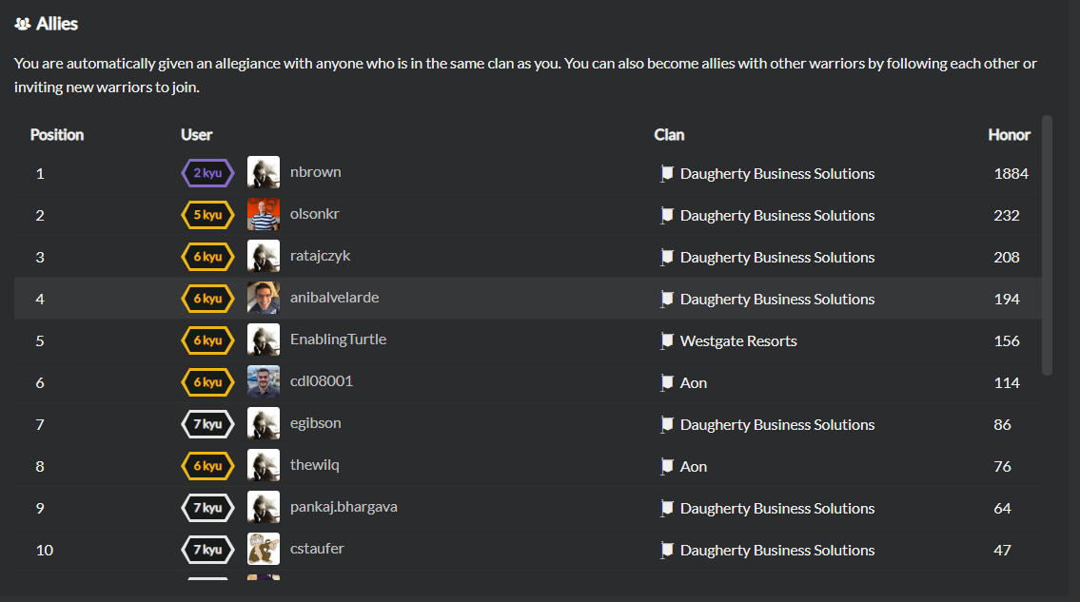
How can you get better at producing quality software?
Practice
Practice
Practice
Practice some more…
www.CodeWars.com
There are other alternatives

Slide 4

How to level-up your skills with Software Quality?
Understand the common sources of software problems
Code Smells
Understand best practices to fix them
Refactor
My tooling of choice for this is
Refactoring Guru

Slide 5
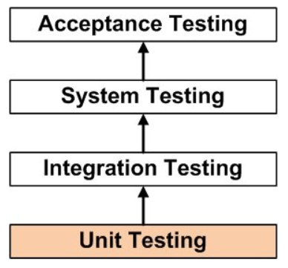
What do you do when you find bug in your code? - a happy path -
Ideally you:
Appropriate testing library
Create a test to reproduce/expose the bug
Change your code to make your test pass!

Slide 6
Characteristics of Unit Tests
Focus on small fragments of logic at a time
Execute fast ~ average 20 milliseconds per test
Have clear structure
// arrange
// act
// assert
Help you determine usability of your code
Assist with refactoring
Dev team must be able to trust a Unit Test library’s accuracy

Slide 7
Mocks - Complements to Unit Testing
What are mocks?
Why mock?
What are some common mocking frameworks?
JavaScript
Java
.NET
A lot of the time, it will depend on what our clients work with.

Slide 8
Demo Time…
Let’s check out some examples:
Microsoft’s VS Code
https://github.com/microsoft/vscode/blob/master/src/vs/editor/test/common/services/modelService.test.ts#L39
Oracle’s Database Programming Interface for C/C++
https://github.com/oracle/odpi/blob/master/test/TestNumbers.c#L270
Anibal’s bitwise-stor JavaScript Library
https://github.com/anibalvelarde/bitwise-stor/blob/master/src/index.test.js#L77

Slide 9
How about the other types of test?
A good set of definitions can be found at:
www.softwaretestingfundamentals.com

Slide 10
Difficulties with testing adoption
Some times those who pay for a Software project have reservations
Overheard somewhere, at a software development shop, right at this minute:
“You mean you need to create non-feature code to finish the feature code?”
The process seems, at first glance, counter intuitive
It requires a mindset change at various levels
Personal
Team
Org-wide
Anyone has some stories to share?

Slide 11
A word about “Education”
“Education” comes from a couple of Latin Root Words
Educare – To train or to mold
Educere – To lead forth
The second one raises an interesting question: Which way is forth?
As consultants, we are called to lead forth. We need to make sure we understand which way is forth.

Slide 12
Which way is forth?
Learn to discern Truth
Learn to discern what is Good
Where those 2 intersect, there you will find Beauty
In tech, learning to discern between Principles and Styles is key

