Slide 1
Customer Business Value Assessment Db2 AI Editions Genius Hub April 2026

Slide 2
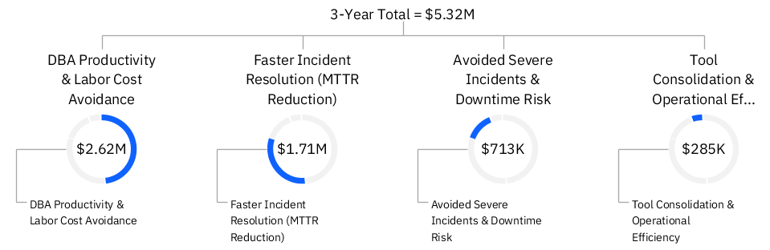
Genius Hub empowers <Customer> to save $10M over three years
Benefits | Year 1 | Year 2 | Year 3 | 3-Year Total
Avoided Severe Incidents & Downtime Risk | $225,000 | $237,500 | $250,000 | $712,500
DBA Productivity & Labor Cost Avoidance | $826,200 | $872,100 | $918,000 | $2,616,300
Faster Incident Resolution (MTTR Reduction) | $540,000 | $570,000 | $600,000 | $1,710,000
Tool Consolidation & Operational Efficiency | $90,000 | $95,000 | $100,000 | $285,000
Benefit | $1,681,200 | $1,774,600 | $1,868,000 | $10,000,000
2

Slide 3
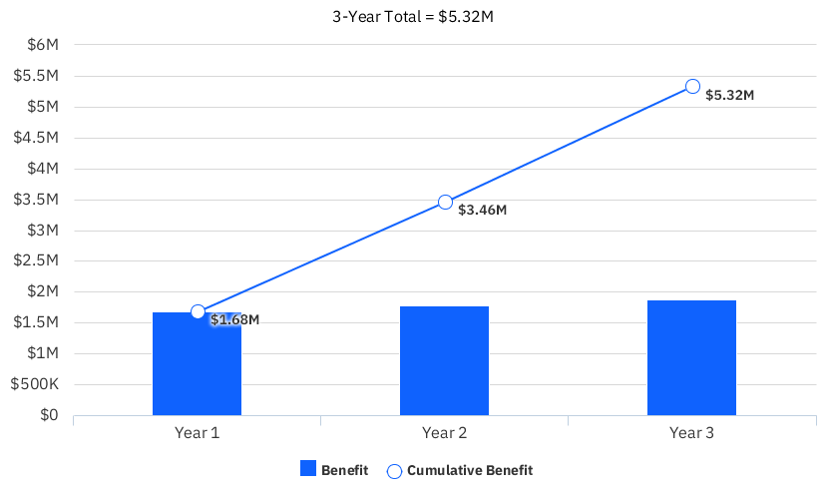
3-year Business case summary
The 3-year total benefits are estimated at $5.32M with net benefits of $5.32M and a 3-year ROI of 0.0%.
$5.32M
3-Year Total Benefits
0.0%
ROI
Immediate
Payback Period
$367K
3-Month Cost of Delay
Benefits | Year 1 | Year 2 | Year 3 | 3-Year Total
Benefits | $1,681,200 | $1,774,600 | $1,868,000 | $5,323,800
Investment | --- | --- | --- | ---
Net Benefit | $1,681,200 | $1,774,600 | $1,868,000 | $5,323,800
$4.4M
Net Present Value
3

Slide 4
The cost of doing nothing
Why Now?
Projected cash stream from investing in IBM
With every quarter of inaction, <Customer> forfeits
$367K
in business benefits based on the net present value of IBM platform.
Assumed cash stream resulting from doing nothing
* Source: Harvard Business Review, “Innovation Killers”
How Financial Tools Destroy Your Capacity to Do New Things
By Clayton M. Christensen, Stephen P. Kaufman, and Willy C. Shih
NOTE: The cost of doing nothing is calculated as:
Net Present Value (NPV) of Net Benefits/(Finance Horizon years * 4 Quarters per year)
4

Slide 5
Key assumptions
The projected benefits presented in this document are driven by the following assumptions. The details on the calculated benefits for each quantified outcome are outlined further in the Appendix.
Key Assumption | Value
Benefit Realization ramp (Years 1-3) | 90%, 95%, 100%
# of Data Base Administrators (DBAs) supporting enterprise workloads | 20
“All-in” DBA annual pay | $180,000
% of DBA time spent on operations | 85%
Reduction in manual operational effort driven by Db2 Genius Hub | 30%
Material Db2 performance or availability incidents, per year | 40
Average business impact, per material Db2 performance or availability incident | $50,000
Reduction in time to resolution | 30%
# of tools supporting Db2 today | 4
Reducible overhead cost, per tool | $25,000
# of high-severity SEV-1 Db2 incidents, per year | 2
Average cost per SEV‑1 in financial services industry | $250,000
Reduction in SEV‑1 occurrence | 50%
5

Slide 6
Executive summary
Enabling Customer to deliver on its vision with potential to realize $5.32M over 3 years.
Strategic Objectives
Solutions
This report, developed by IBM in collaboration with <Customer>, leverages information provided by <Customer>, publicly available information, and industry standards to summarize the approximate quantified business impact offered to <Customer> by the following solution(s):
Value Proposition
From our collaborative assessment, <Customer> can realize the following value:
Beyond these quantified benefits, there are many qualitative benefits associated with the investment.
Organizations need to continuously optimize operations to reduce costs and improve performance.
Modern business demands seamless, data-driven processes that enhance employee and customer experiences.
Innovation requires tools that eliminate inefficiencies and enable people to focus on higher-value work.
$5.32M
3-Year Benefits
Db2 AI Editions
Genius Hub
Immediate
Payback Period
$4.4M
Net Present Value
Key Benefits and Estimated Impact
0.0%
Return on Investment
6

Slide 7
Appendix

Slide 8
$2.62M
A | Db2 DBAs supporting enterprise workloads | 20
B | "All-in"DBA annual pay | $180,000
C | % of DBA time spent on operations | 85%
D | Reduction in manual operational effort driven by Db2 Genius Hub | 30%
E | Total DBA labor cost | $3,600,000
F | Operational portion | $3,060,000
 |  | Year 1 | Year 2 | Year 3
G | Benefit Realization | 90% | 95% | 100%
 | Annual Benefit | $826,200 | $872,100 | $918,000
3-year total benefit
DBA Productivity & Labor Cost Avoidance
Same staff supports more growth, higher‑value work (optimization, data initiatives), or avoids incremental hiring.
IBM Genius Hub Product Page

Slide 9
$1.71M
A | Material Db2 performance or availability incidents, per year | 40
B | Average business impact, per incident | $50,000
C | Reduction in time to resolution | 30%
D | Annual incident cost | $2,000,000
 |  | Year 1 | Year 2 | Year 3
E | Benefit Realization | 90% | 95% | 100%
 | Annual Benefit | $540,000 | $570,000 | $600,000
3-year total benefit
Faster Incident Resolution (MTTR Reduction)
Reduced business disruption, fewer escalations, improved internal SLAs.
IBM Genius Hub Product Page

Slide 10
$712K
A | # of high-severity SEV-1 Db2 incidents, per year | 2
B | Average cost per SEV‑1 in financial services industry | $250,000
C | Reduction in SEV‑1 occurrence | 50%
D | Baseline SEV‑1 cost | $500,000
 |  | Year 1 | Year 2 | Year 3
E | Benefit Realization | 90% | 95% | 100%
 | Annual Benefit | $225,000 | $237,500 | $250,000
3-year total benefit
Avoided Severe Incidents & Downtime Risk
Higher system resilience and reduced operational risk in regulated environments.
IBM Genius Hub Product Page

Slide 11
$285K
A | # of tools supporting Db2 today | 4
B | Reducible overhead cost, per tool | $25,000
 |  | Year 1 | Year 2 | Year 3
C | Benefit Realization | 90% | 95% | 100%
 | Annual Benefit | $90,000 | $95,000 | $100,000
3-year total benefit
Tool Consolidation & Operational Efficiency
Combined licensing, infrastructure, and admin overhead that can be reduced via a single, unified Db2 Genius Hub console
IBM Genius Hub Product Page

Slide 12
Annual Benefit per Value Driver
DBA Productivity & Labor Cost Avoidance annual benefits are estimated at $918K
Benefits | Description | Estimated Annual Benefit
DBA Productivity & Labor Cost Avoidance | Same staff supports more growth, higher‑value work (optimization, data initiatives), or avoids incremental hiring. | $918K
Faster Incident Resolution (MTTR Reduction) annual benefits are estimated at $600K
Benefits | Description | Estimated Annual Benefit
Faster Incident Resolution (MTTR Reduction) | Reduced business disruption, fewer escalations, improved internal SLAs. | $600K
Avoided Severe Incidents & Downtime Risk annual benefits are estimated at $250K
Benefits | Description | Estimated Annual Benefit
Avoided Severe Incidents & Downtime Risk | Higher system resilience and reduced operational risk in regulated environments. | $250K
Tool Consolidation & Operational Efficiency annual benefits are estimated at $100K
Benefits | Description | Estimated Annual Benefit
Tool Consolidation & Operational Efficiency | Combined licensing, infrastructure, and admin overhead that can be reduced via a single, unified Db2 Genius Hub console | $100K
12

Slide 13
Case for change
Why Change?
Why Now?
Why IBM?
Organizations need to continuously optimize operations to reduce costs and improve performance.
Modern business demands seamless, data-driven processes that enhance employee and customer experiences.
Innovation requires tools that eliminate inefficiencies and enable people to focus on higher-value work.
Rising costs and resource pressures make operational improvements more urgent than ever.
Digital transformation is accelerating, and waiting risks falling behind competitors already modernizing.
The rapid maturity of AI and automation technologies enables tangible ROI today, not years from now.
IBM proves its solutions to validate impact before delivering them to clients.
The approach provides tested, real-world insights and best practices that reduce adoption risk.
IBM delivers innovation backed by scale, security, and proven enterprise-grade outcomes.
13

