Slide 1
STUDENT PROJECT | NLP, MACHINE LEARNING AND DEEP LEARNING
Flipkart Reviews
Sentiment Analysis
30,000
6
Streamlit
reviews
models compared
live demo
Notes:
[0:30] Good morning, everyone. My project is a sentiment analysis system for Flipkart-style product reviews. It takes a review written by a customer and decides whether it is Positive, Neutral or Negative. Over the next ten minutes I will show you the data, how I cleaned and prepared the text, the six models I compared, and a live app. One thing to listen for: my most important result is not a high score. It is why a perfect score here would be misleading.

Slide 2
Business problem and objective
Customers write far more reviews than anyone can read. A sentiment model labels each review Positive, Neutral or Negative so teams can track product perception, delivery experience and service quality automatically.
30,000
62 / 20 / 18
Macro-F1
reviews, 25 columns, synthetic Flipkart-style data
percent Positive, Neutral, Negative
primary metric for three unequal classes
Notes:
[0:45] Why does this matter? A big platform receives far more reviews than any team can read. If a model can label each review automatically, the company can track product perception, delivery experience and service quality at scale. The dataset has 30,000 reviews and 25 columns, and the target has three classes. The mix is uneven: about 62 percent Positive, 20 percent Neutral and 18 percent Negative. Because the classes are uneven, plain accuracy can flatter a model, so my main metric is macro-F1, which gives each class equal weight.

Slide 3
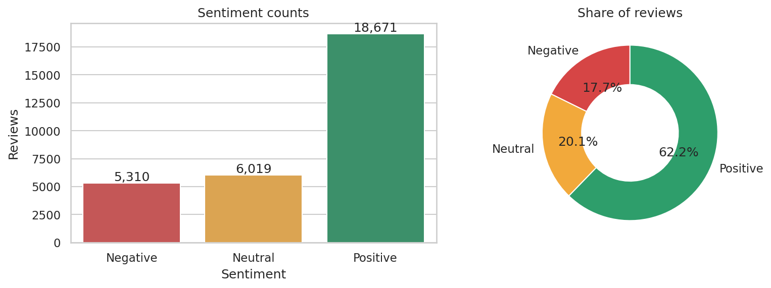
Dataset: 30,000 reviews, 25 columns
Data quality
Missing: summary 240, city 300, payment 150
No duplicate Review_ID or true duplicate rows
No invalid prices, ratings or dates
Nothing dropped; blanks filled
Positive 18,671 (62.2%) Neutral 6,019 (20.1%) Negative 5,310 (17.7%)
Notes:
[0:45] This chart shows the class balance: 18,671 Positive, 6,019 Neutral and 5,310 Negative reviews. On data quality, only three columns had missing values: review summary, customer city and payment method, with 240, 300 and 150 blanks. I filled them with an empty string or 'Unknown' and dropped nothing. There were no duplicate review IDs, no true duplicate rows, and no invalid prices, ratings or dates. So the table itself is clean. The interesting problems are in what the columns mean, and that is the next two slides.

Slide 4
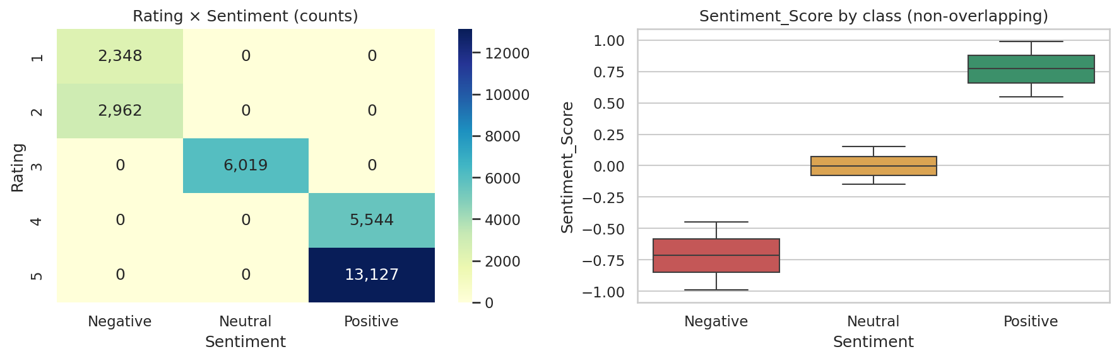
Finding 1: Rating gives away the label
Target leakage. Sentiment is a direct function of Rating, and Sentiment_Score separates the classes with no overlap. Both columns are excluded; every model uses review text only.
Notes:
[1:00] This is the first key finding. Look at the heatmap on the left: every rating maps to exactly one sentiment. Ratings 1 and 2 are always Negative, 3 is always Neutral, 4 and 5 are always Positive. The sentiment score on the right separates the classes with no overlap at all. That is called target leakage. If I fed Rating into a model, it would score 100 percent without reading a single word. So I removed Rating and Sentiment_Score from every model. All models use the review text only. A real project should always check for this before training.

Slide 5
Finding 2: the text is template-built
960
30
95.4%
unique review texts out of 30,000
sentiment phrases, 10 per class, plus 32 aspect phrases
of test reviews have an exact twin in training
Example: "perfect purchase, loved it" + "size was accurate" = one Positive review. A negative phrase can pair with a positive aspect, so the sentiment phrase carries the signal.
Notes:
[1:00] The second finding is about the text. Out of 30,000 reviews there are only 960 unique review texts. Each one is a sentiment phrase, like 'perfect purchase, loved it', plus a neutral aspect phrase, like 'size was accurate'. There are just 30 sentiment phrases, ten per class, and 32 aspect phrases. The consequence is big: if I split the data randomly, 95.4 percent of test reviews have an exact twin in the training set. The model can memorize instead of learn. That is why every model reaches 100 percent on a random split, and why I built a harder test, which I will show on slide 9.

Slide 6
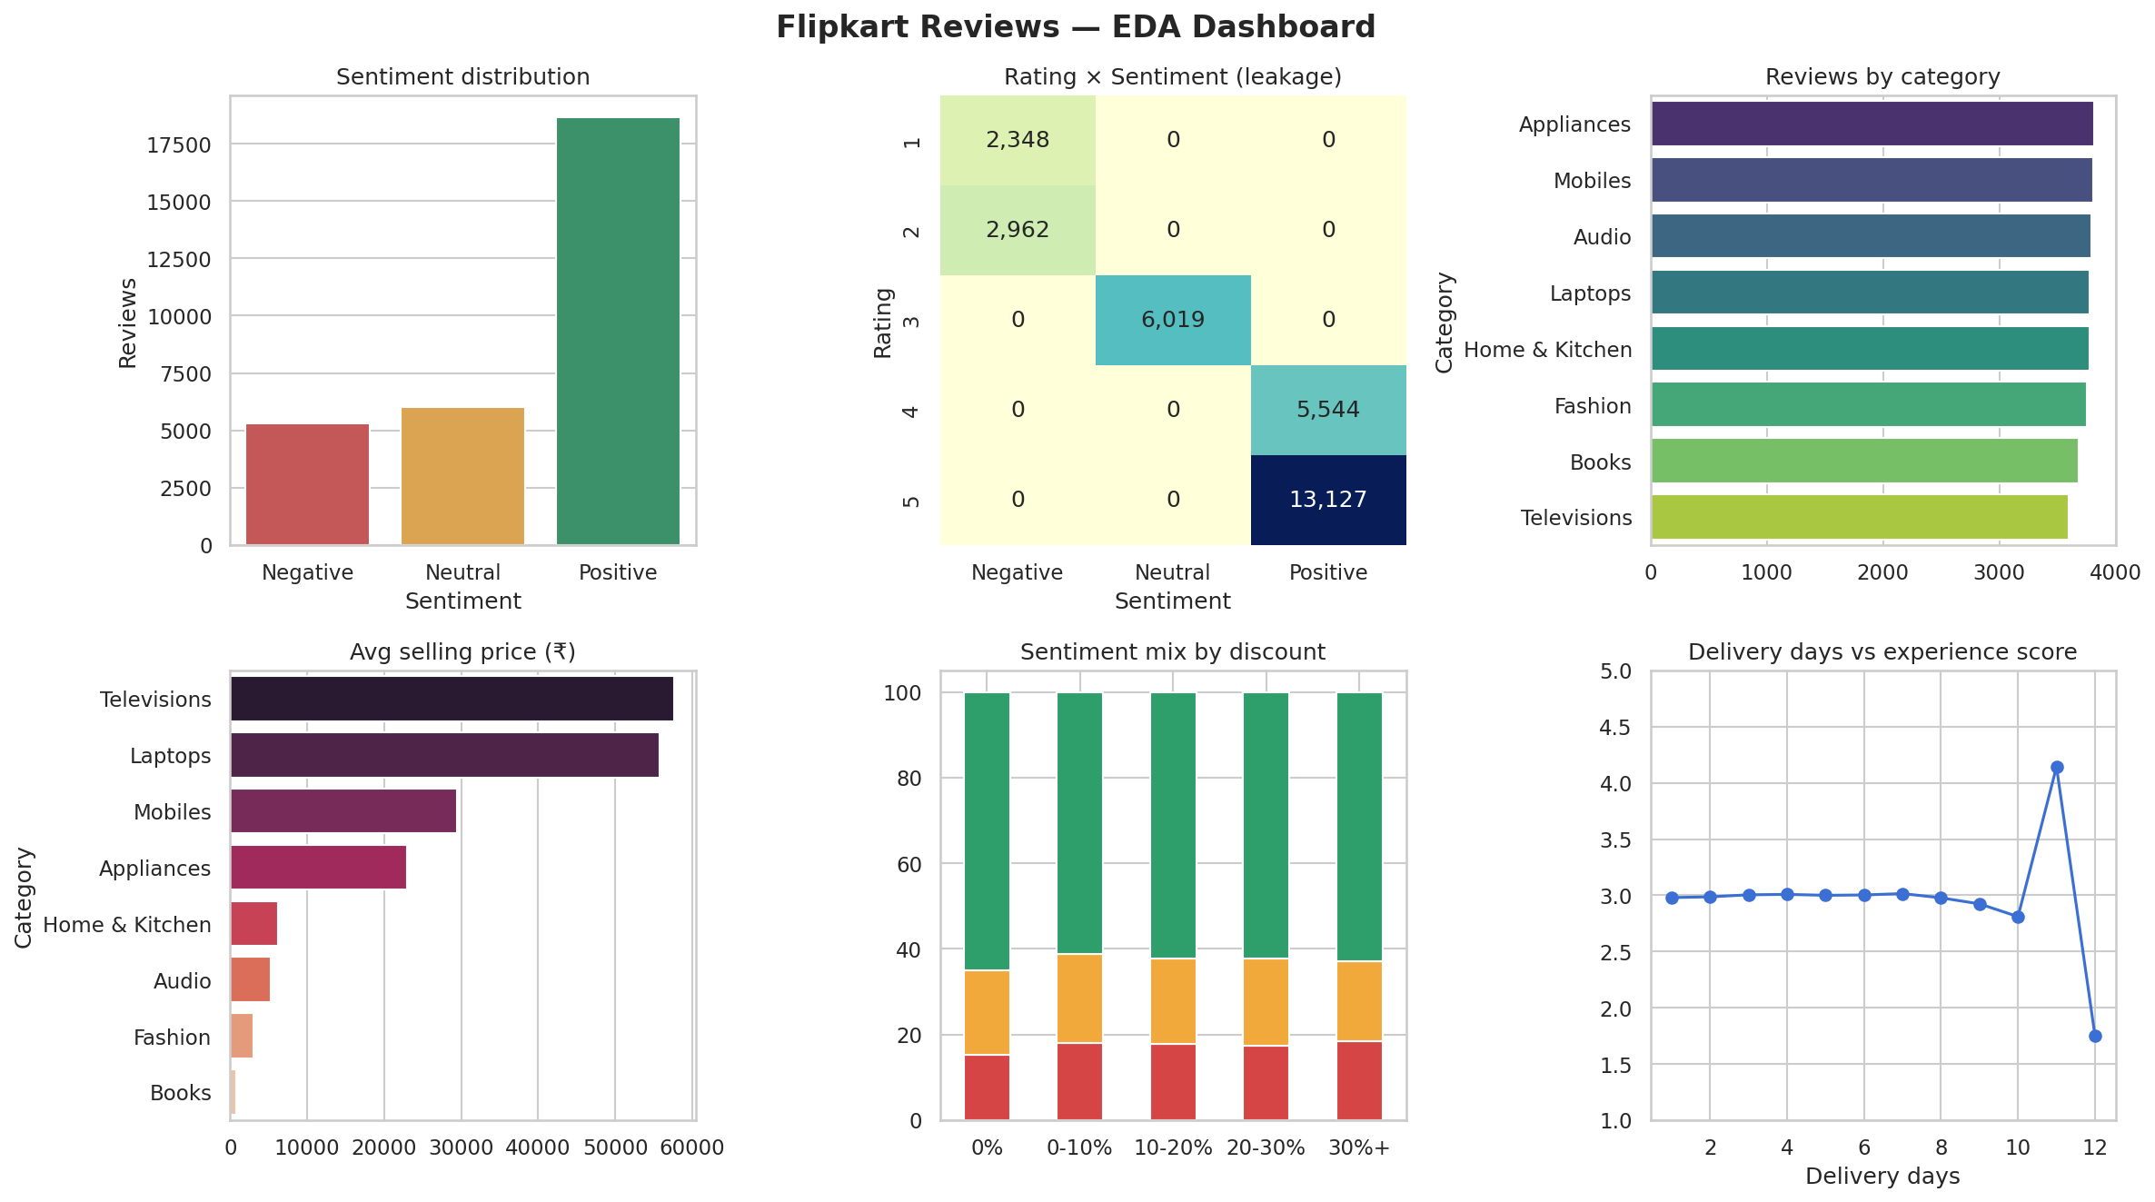
Exploratory analysis at a glance
Category volume is balanced: 3,595 to 3,814 reviews
Televisions and Laptops have the highest prices
Discount: p = 0.10, no effect on sentiment
Verified purchase: p = 0.72, same mix
Delivery days: no link to experience score
Notes:
[0:45] This dashboard summarizes the exploration. Categories are balanced, between about 3,600 and 3,800 reviews each. Televisions and laptops are the most expensive, books the cheapest. I also tested whether business factors affect sentiment. Discount has no significant effect, with p equal to 0.10. Verified purchase makes no difference either, p equal to 0.72. Delivery days show no link to the experience score; the spikes at 11 and 12 days come from only 14 and 4 reviews. So in this dataset, the text is the only real signal, which justifies a text-based model.

Slide 7
NLP pipeline
1
2
3
4
5
Combine
Clean
Filter
Normalize
Vectorize
Review_Summary plus Review_Text
Lowercase, strip symbols, tokenize with NLTK
Remove stop words, keep no / nor / not
Porter stems or WordNet lemmas
TF-IDF, or integer sequences for Keras
Nothing is fitted on test data: vectorizers and vocabularies are built from training rows only.
Notes:
[0:45] Here is how raw text becomes model input. Step one: combine the review summary and review text. Step two: lowercase, strip symbols and tokenize with NLTK. Step three: remove stop words, but I deliberately keep 'no', 'nor' and 'not', because dropping them would turn 'not good' into 'good'. Step four: normalize words, comparing stemming and lemmatization. Step five: convert to numbers, using TF-IDF for the classical models and integer sequences for the neural networks. The same functions run in the notebook and in the live app, so training and prediction never drift apart.

Slide 8
Choosing the text representation
Selected: lemmatized
116-word vocabulary, 7.5 tokens per review
Ties with stemming at 0.921
Words stay readable for explanations
Stop-word removal alone scored lowest: it can drop negations
Notes:
[0:45] I did not pick the preprocessing by habit; I tested four versions with Logistic Regression. Cleaned only scored 0.846 macro-F1, stop-word removal 0.825, stemming 0.921 and lemmatization 0.921. Notice that stop-word removal alone was worst, because it can delete negations. Stemming and lemmatization tied, so I chose lemmatization, since its words stay readable and are easier to explain. One caution: on a random split all four scored 1.000, so only the harder test could separate them.

Slide 9
Evaluation design
Random 80/20 split
Unseen-phrase hold-out
Stratified: 24,000 train, 6,000 test. Every model reaches macro-F1 1.000, so it cannot rank them.
3 phrases per class never appear in training. Measures whether a model learned language or memorized templates.
Primary metric: macro-F1. Supporting: accuracy, precision, recall, per-class F1 and confusion matrices.
Notes:
[1:00] This slide explains how I measured the models fairly. The first test is the standard stratified 80/20 split, 24,000 reviews to train and 6,000 to test, as the assignment requires. But we saw it is saturated. So I added a second test, the unseen-phrase hold-out. I take 3 of the 10 sentiment phrases in each class, 9 of 30 in total, remove them from training completely, and test on them. Now the model must understand wording, not recognize a template. I repeat this with 5 random choices of held-out phrases and report the average and spread.

Slide 10
Six models, one fair test
0.930
Logistic Regression, unseen phrases
0.959
LSTM, unseen phrases
Notes:
[1:15] Here are all six models. The grey bars are the random split: every model gets 1.00. The blue bars are the honest test, and now they separate. Naive Bayes is weakest at 0.70, then Linear SVM at 0.81, Embedding plus Dense at 0.83, BiLSTM at 0.88, Logistic Regression at 0.93 and LSTM at 0.96. The LSTM looks best, but the run-to-run spread is about 0.037, which is as large as its lead over Logistic Regression. So they are statistically tied. Logistic Regression trains in 0.1 seconds and saves at 52 kilobytes, against 12 seconds and 175 kilobytes for the LSTM. That is why I recommend Logistic Regression.

Slide 11
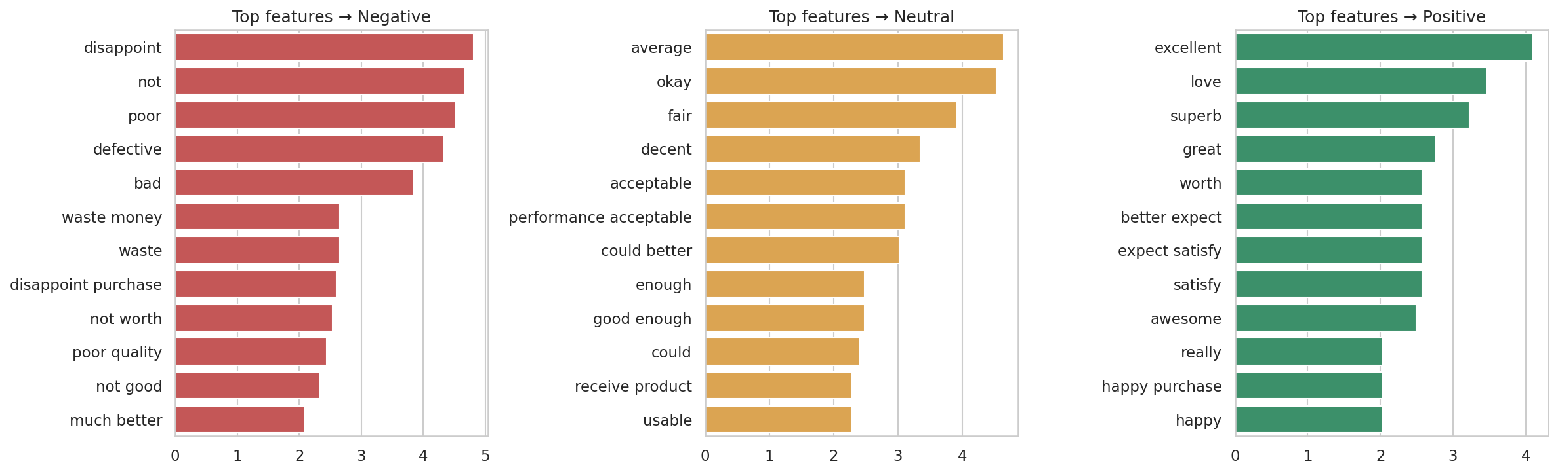
Tuned Logistic Regression
Words drive the labels. Best settings: C = 1, unigrams plus bigrams. Class weighting and oversampling lowered the unseen-phrase score (0.853 and 0.815 against 0.930), so no imbalance correction is used.
Notes:
[0:50] For the recommended model I tuned settings with GridSearchCV, using folds that keep whole phrases together so tuning is also honest. The best setting was C equal to 1 with unigrams plus bigrams. The chart shows the words with the biggest weights: 'disappoint', 'not', 'poor' and 'defective' push toward Negative; 'average', 'okay' and 'decent' toward Neutral; 'excellent', 'love' and 'superb' toward Positive. I also tested imbalance fixes. Class weighting scored 0.853 and oversampling 0.815, both worse than doing nothing at 0.930, so I did not use them.

Slide 12
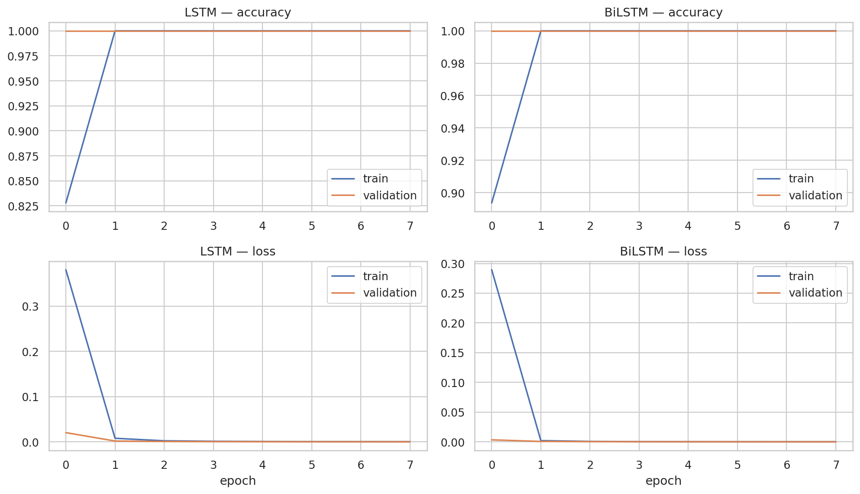
Deep learning: LSTM and BiLSTM
Unseen phrases
Embedding + Dense: 0.834
BiLSTM: 0.881
LSTM: 0.959 (best)
No visible overfitting, but the validation split is too easy to show it
Notes:
[0:50] On the deep learning side I built an Embedding plus Dense network, an LSTM and a BiLSTM in Keras, with a vocabulary of 118 tokens and a maximum length of 10. The training curves on the left converge within a few epochs, with no gap between training and validation. That looks perfect, but it is actually a warning: the validation set shares templates with the training set, so it cannot reveal overfitting. On unseen phrases the scores were 0.834, 0.959 and 0.881. The simplest recurrent model did best, which is reasonable for such short reviews.

Slide 13
Live demo: Streamlit app
New review | Logistic Reg. | LSTM
Loved it | Perfect purchase, loved it | Positive 99% | Positive 100%
Waste of money | Stopped working | Negative 100% | Negative 100%
Not good at all, would not buy again | Negative 100% | Negative 100%
Great quality but late and damaged | Negative 63% | Positive 100%
What the app does
Scores one review with either model, or both side by side
Flags when the models disagree
Scores a whole CSV and exports results
Shows model comparison and data charts
The highlighted mixed review has no single right label. The LSTM is 100% sure anyway, so confidence is not accuracy.
Notes:
[1:30] I built a Streamlit dashboard with seven pages. In the analyzer you type a review, choose Logistic Regression, the LSTM or both, and get a label, confidence and the words that drove the decision. Now the table: clear reviews get correct answers from both models. The highlighted mixed review, 'great quality but late and damaged', is the interesting one. Logistic Regression says Negative at 63 percent; the LSTM says Positive at 100 percent. Both cannot be right, and there may be no single right label. So confidence is not accuracy, and the app warns when the two models disagree. [DEMO: open the app, click the Mixed review example, choose Compare both, press Analyze.]

Slide 14
Conclusions and next steps
What we found
Next steps
Rating and Sentiment_Score leak the label and stay out of the models
Random-split 1.000 reflects template overlap, not skill
On unseen phrases LR (0.930) and LSTM (0.959) are tied; NB (0.697) and SVM (0.808) trail
Recommended: Logistic Regression with lemmatized TF-IDF
Train on real Flipkart reviews and repeat the unseen-phrase test
Add pretrained embeddings or fine-tune BERT
Add aspect-level sentiment for mixed reviews
Calibrate confidence; add SHAP explanations
Notes:
[1:00] To conclude. One: Rating and Sentiment_Score leak the label and must stay out of the features. Two: a random-split score of 100 percent reflects template overlap, not skill; the honest range is 0.70 to 0.96. Three: Logistic Regression and the LSTM are tied on unseen phrases, and I recommend Logistic Regression for speed, size and interpretability. The limits are clear: the data is synthetic and template-built, so real reviews with sarcasm or mixed opinions will be harder. Next steps are to train on real Flipkart reviews, try pretrained embeddings or BERT, add aspect-level sentiment and calibrate the confidence. Thank you; I am happy to take questions.

