Slide 2
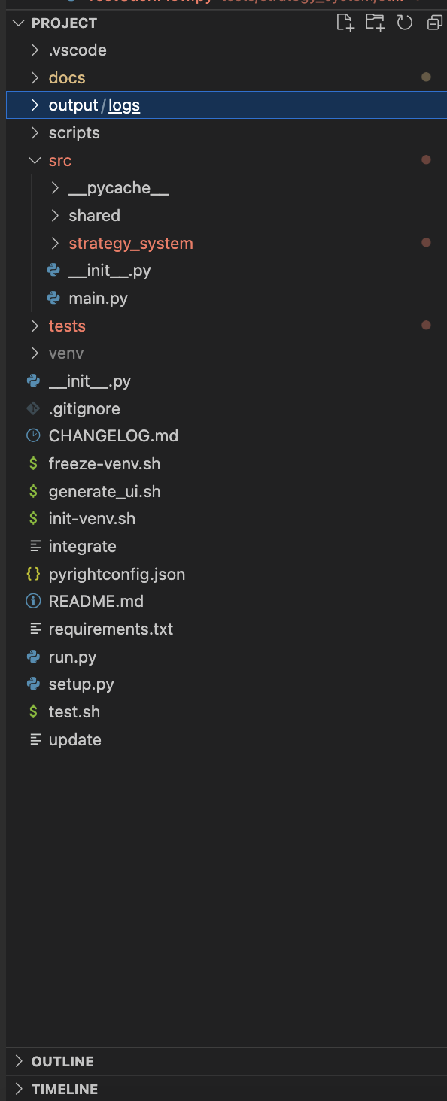
The ”src” directory
Main Code for the Project
Strategy System is found inside this folder and all of the classes in its sub folder
Shared contains the GlobalSettings Class where settings global to the system are stored

Slide 3
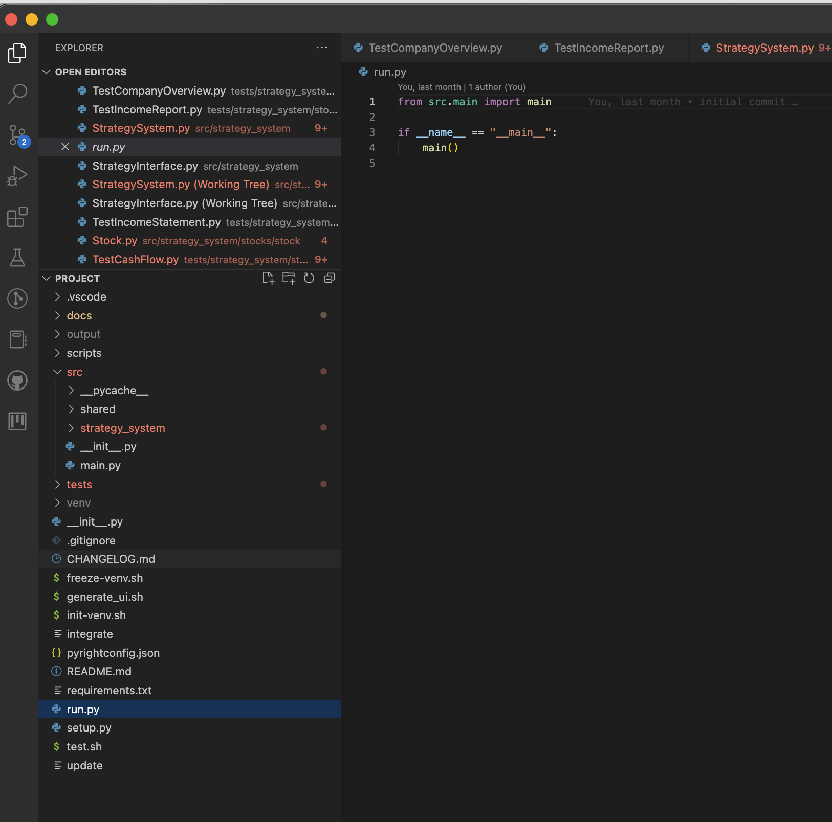
Run.py
Program Entry Point…..

Slide 4
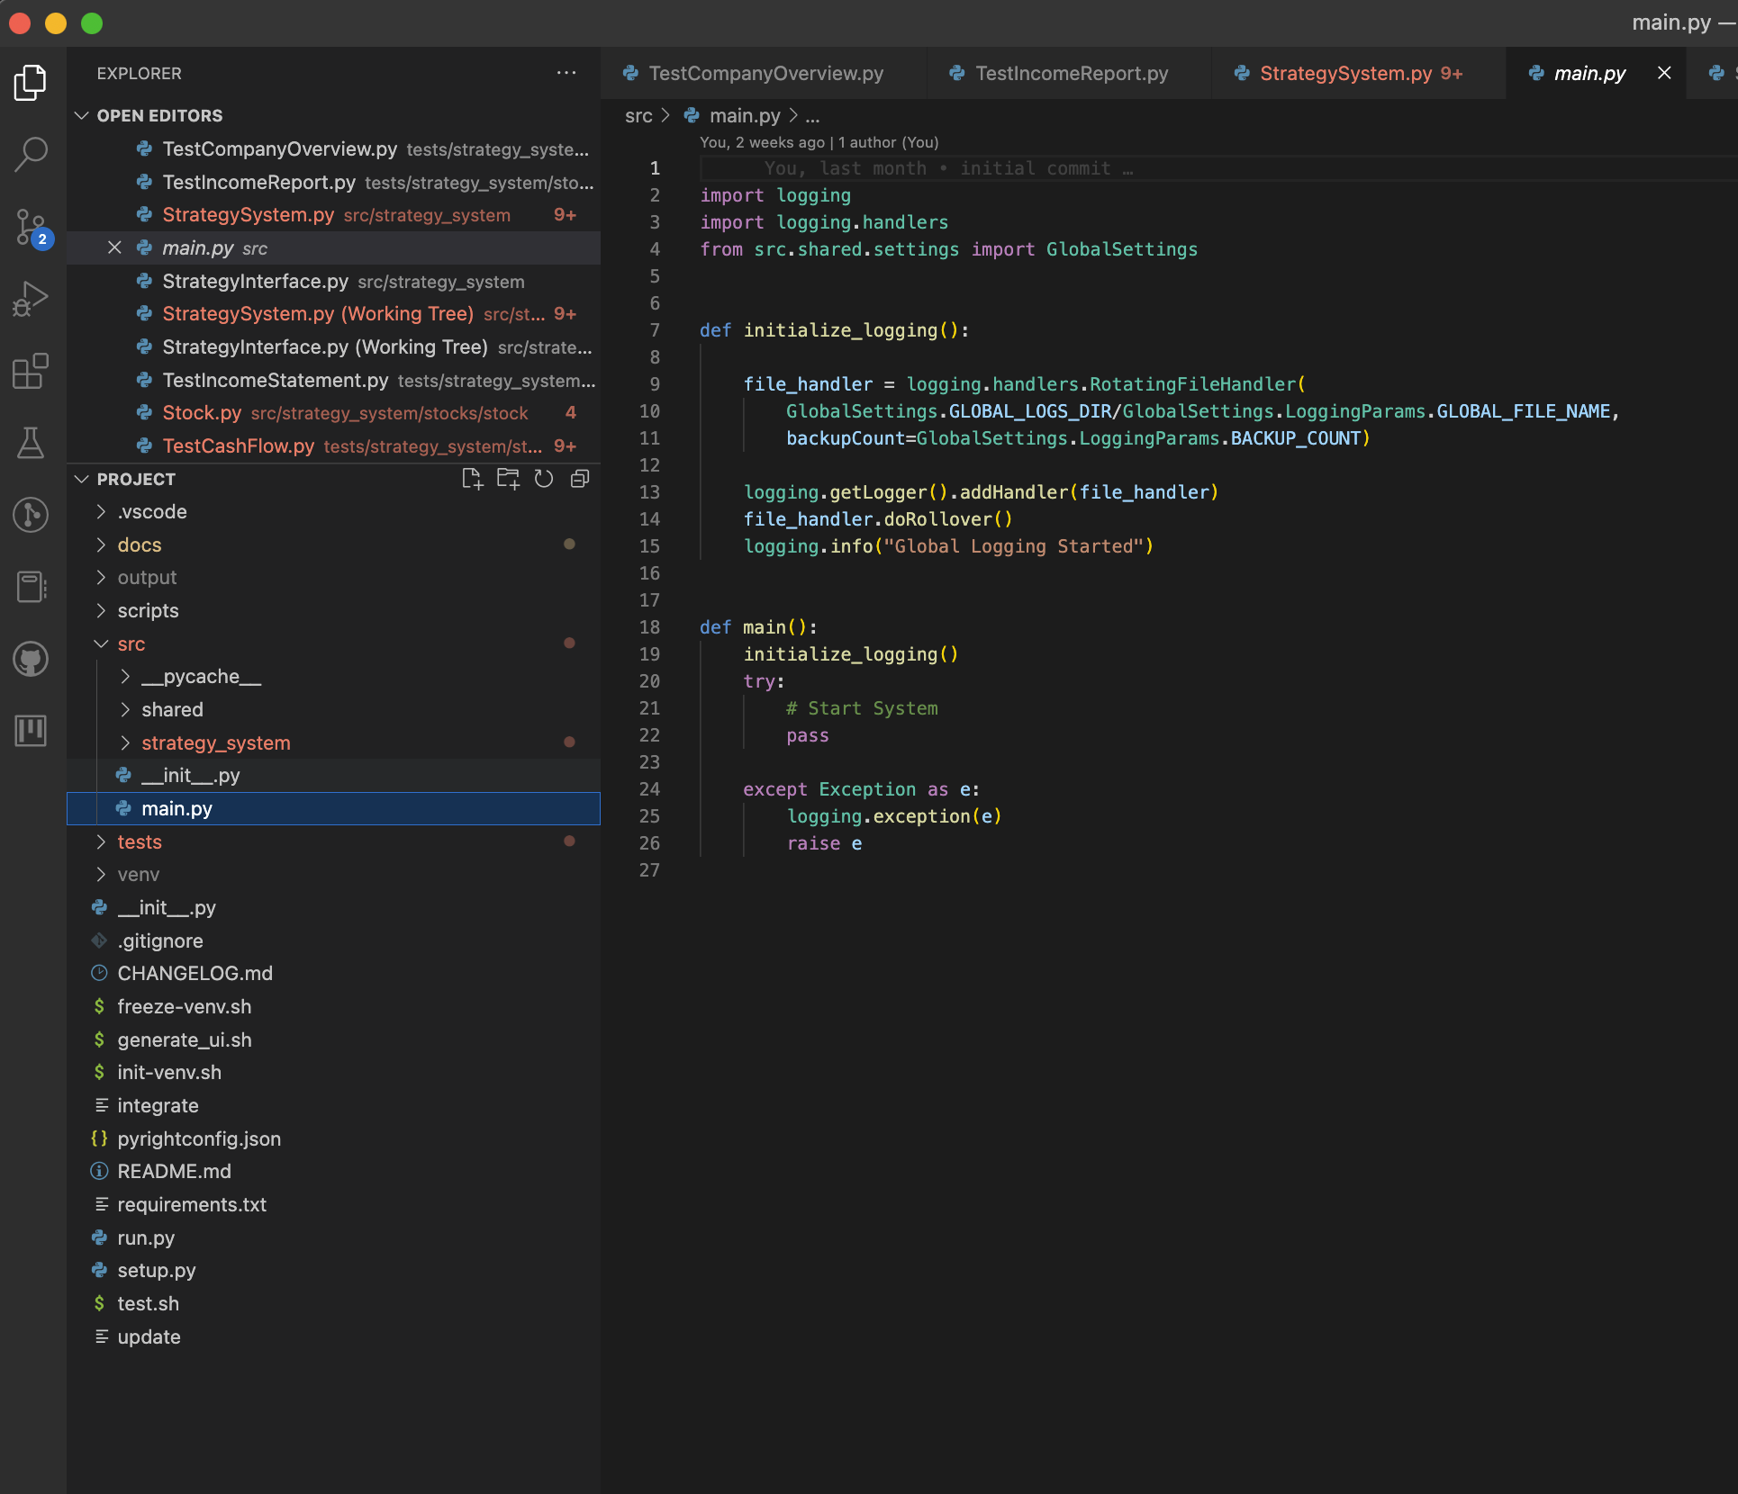
Src/main.py
One level of abstraction lower for program entry point.
Catches all exceptions thrown by the system and logs them.
Responsible for global initializations.

Slide 5
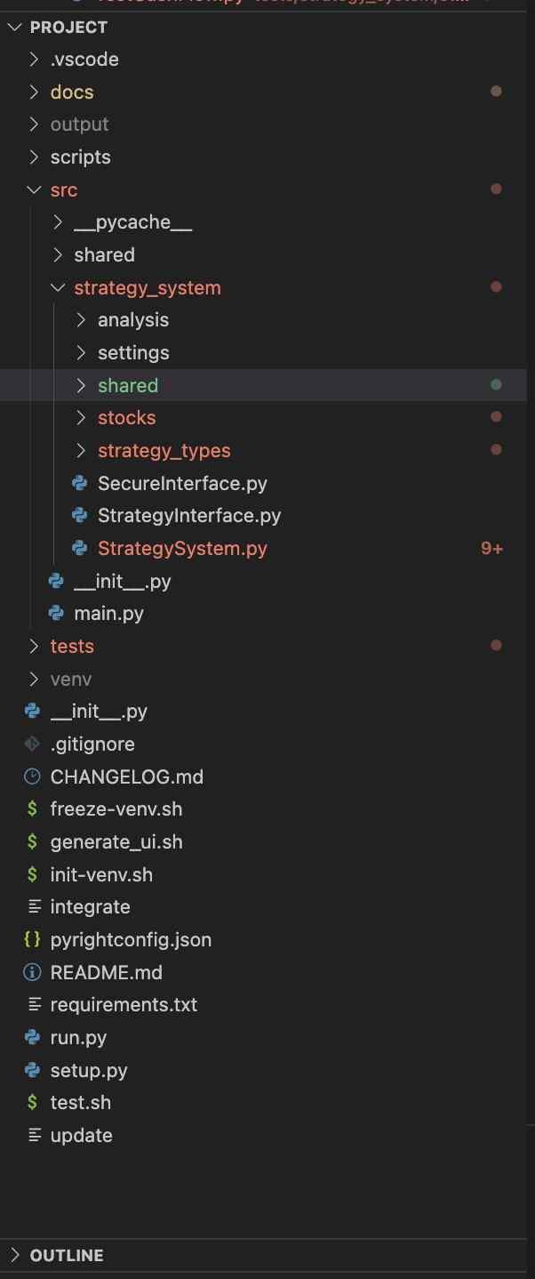
Src/strategy_system
The system comprises of:
Strategies:
Rebalancing
Value Investing
Analysis
Rebalancing
Value Investing
Stocks
Company Overview
Income Statements
Balance Sheets
Cashflow Statements
Earnings Statements
Settings
Analysis Settings
Strategy Settings

Slide 6
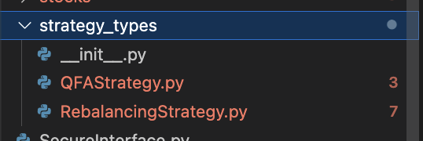
Src/strategy_system/strategy_types
QFAStrategy: A class that manages multiple Quantitative fundamental Analyses, in the form of a list QFAnalyzers.
RebalancingStrategy: A class that manages multiple Rebalancing Analyses, in the form of a list RebalancingAnalyzers.

Slide 7
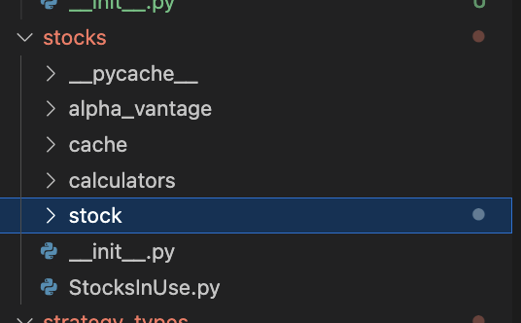
Src/strategy/system/stocks
Stocks:
Alpha_vantage: obtains the data from Alpha Vantage Client.
cache: Manages cached data from the alpha vantage client
Calculators: Completes additional calculations on stocks as required by the Strategies and/or Analyzers

