Slide 1
Testing software
Adrian Nicoś
adrian.nicos@gmail.com
https://github.com/anicos

Slide 2

What is Software Testing?

Slide 3
What is Software Testing?
Software testing is a set of processes aimed at investigating, evaluating and ascertaining the completeness and quality of computer software.
The objectives of these processes can include:
  Verifying software completeness in regards to functional/business requirements
  Identifying technical bugs/errors and ensuring the software is error-free
  Assessing usability, performance, security, localization, compatibility and installation
Notes:
Testowanie oprogramowania to zestaw procesów mających na celu zbadanie, ocenę i stwierdzenie kompletności i jakości oprogramowania komputerowego.
Cele tych procesów mogą obejmować:
-Weryfikacja kompletności oprogramowania pod względem wymagań funkcjonalnych / biznesowych
-Identyfikacja technicznych błędów / błędów i zapewnienie, że oprogramowanie jest wolne od błędów
-Ocena użyteczności, wydajności, bezpieczeństwa, lokalizacji, kompatybilności i instalacji

Slide 4
Why is Software Testing Important?
software bugs could be expensive or even dangerous
software bugs can potentially cause monetary and human loss
better design and decomposition of code
Notes:
-Błędy oprogramowania mogą być kosztowne lub nawet niebezpieczne
-błędy oprogramowania mogą potencjalnie powodować straty pieniężne i ludzkie – wyobraźmy sobiesamochód autonoamiczny

Slide 5

Examples
Nissan cars have to recall over 3 million cars from the market due to software failure in the airbag sensory detectors. There has been reported two accident due to this software failure.
Defective sensors might incorrectly think that an adult is a child or classify the seat as empty, thus turning off the air bag.

Slide 6


Examples
In 2015 fighter plane F-35 fell victim to a software bug, making it unable to detect targets correctly.
Ejecting might kill you

Slide 7
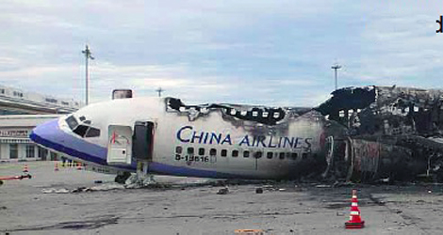
Examples
China Airlines Airbus A300 crashed due to a software bug on April 26, 1994, killing 264 innocent live

Slide 8
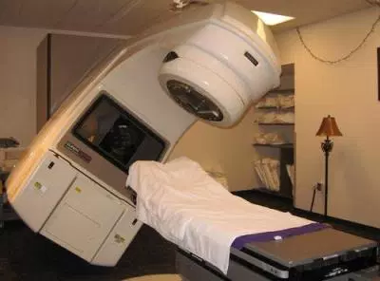
Examples
In 1985, Canada's Therac-25 radiation therapy machine malfunctioned due to software bug and delivered lethal radiation doses to patients, leaving 3 people dead and critically injuring 3 others.

Slide 9

Examples
In April of 1999, a software bug caused the failure of a $1.2 billion military satellite launch, the costliest accident in history

Slide 10
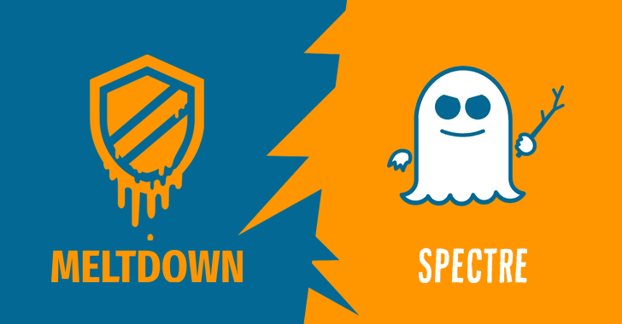
Examples
Meltdown & Spectre

Slide 11
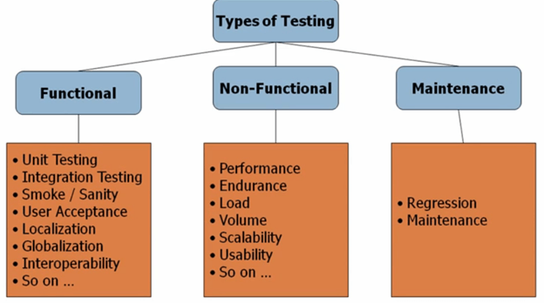
Types of Software Testing
Notes:
-Smoke Testing, also known as “Build Verification Testing”
-User Acceptance Testing – UAT is a type of testing performed by the Client.This testing happens in the final phase of testing before moving the software application to Market or Production environment.
- Localization testing is performed to verify the quality of a product's localization for a particular target culture/locale. Na przykład lokalizacja content-u
-Globalization Testing - when that particular product can be run independent of its geographical and cultural environment. Przykład Mithsubishi Motero
-Interoperability testing is to prove that end-to-end functionality between (at least) two communicating systems is as required by the standard(s) on which those systems are based.
-Endurance testing, non-functional testing involves examining the system if it can withstand a huge load for a longer period of time, Memory leaks
load testing that simulates real-world load on any software, application, or website. It examines how the system behaves during normal and high loads
Volume testing is done to analyze the system performance by increasing the volume of data in the database
Usability testing A/B testing

Slide 12

Black Box vs White Box

Slide 13
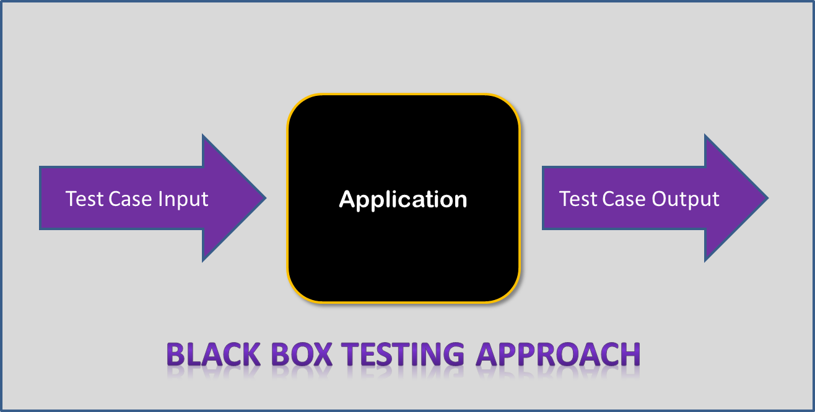
Black Box

Slide 14
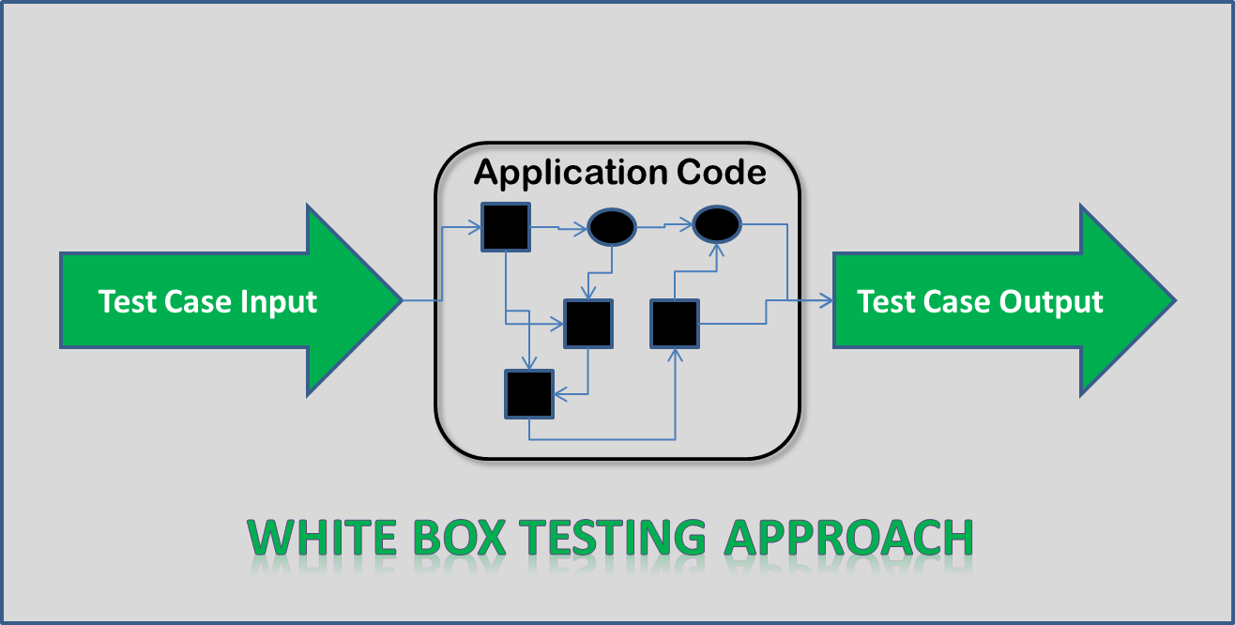
White Box

Slide 15
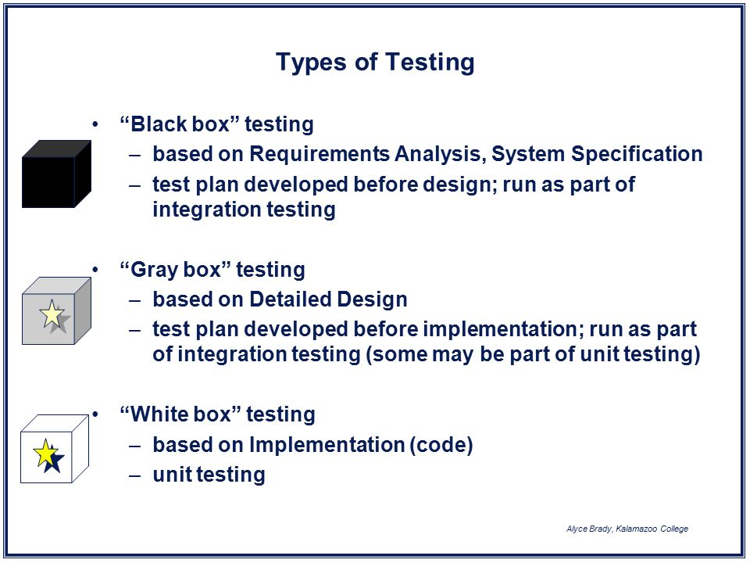
Type of testing

Slide 16
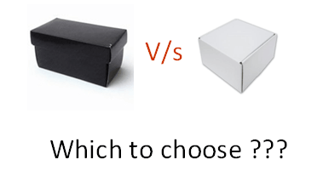
Which to choose?

Slide 17
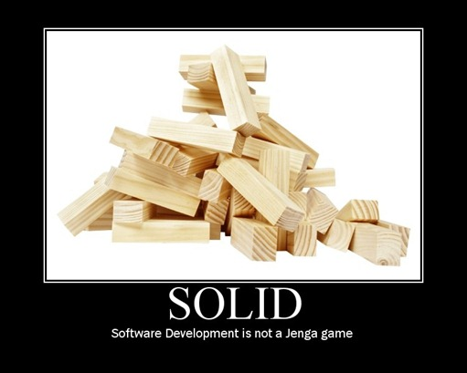
SOLID

Slide 18
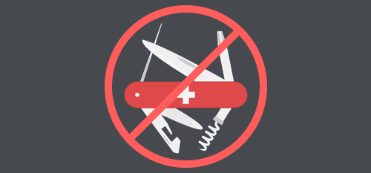
Single responsibility principle
The single responsibility principle states that every module or class should have responsibility over a single part of the functionality provided by the software, and that responsibility should be entirely encapsulated by the class. All its services should be narrowly aligned with that responsibility.
Robert C. Martin expresses the principle as, "A class should have only one reason to change."

Slide 19
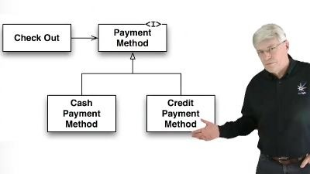
Open/closed principle
“software entities … should be open for extension, but closed for modification.”

Slide 20
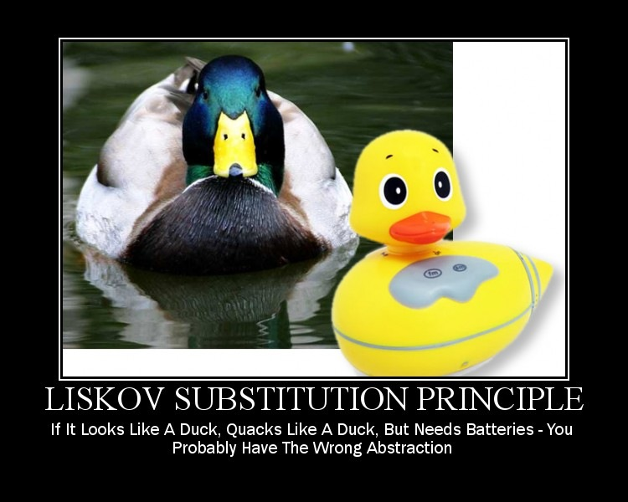
Liskov substitution principle
objects in a program should be replaceable with instances of their subtypes without altering the correctness of that program

Slide 21
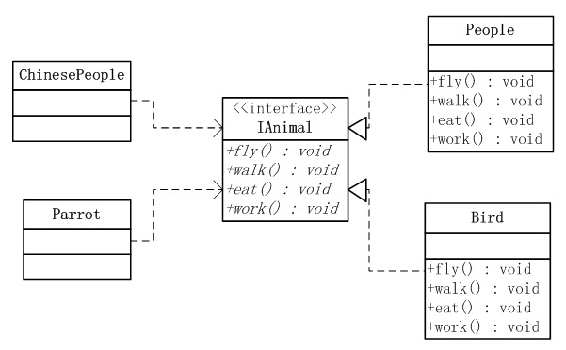
Interface segregation principle
“many client-specific interfaces are better than one general-purpose interface.”
Notes:
Serwis do zapisu – nie tworzymy jednego tylko zorientowany na...

Slide 22
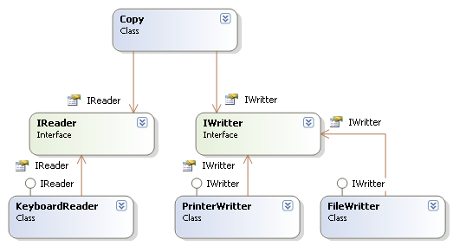
Dependency Inversion Principle
Class should depend on abstractions (e.g interface, abstract classes), not specific details (implementations).

Slide 23
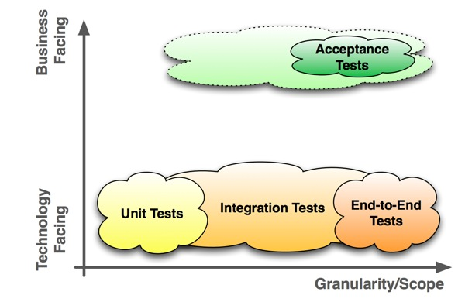
Unit tests
Unit Testing is a level of software testing where individual units/ components of a software are tested. The purpose is to validate that each unit of the software performs as designed.

Slide 24
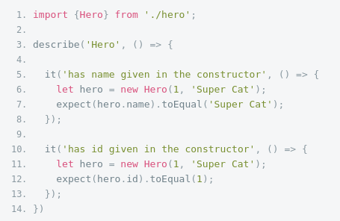
Unit test – example

Slide 25
Unit test – good practice
Always Write Isolated Test Cases
  The order of execution has to be independent between test cases. This gives you the chance to rearrange the test cases in clusters (e.g. short-, long-running) and retest single test cases.

Slide 26
Unit test – good practices
Use a Naming Convention for Test Cases
  A clear naming convention like: <Method-Name Under Test>_<Scenario>_<Expected-Outcome>. This helps to avoid comments and increases the maintainability and in the case a test fails you know faster what functionality has been broken.

Slide 27
Naming convention
it('should extract number from array of GoldPrice', inject([GoldPriceCalculator], (testObj: GoldPriceCalculator) => {
/*given*/
let goldPrices: GoldPrice[] = [new GoldPrice('01', 1)]
/*when*/
const result: Number = testObj.extractPrice(goldPrices);
/*then*/
expect(result).toEqual(1);
}));

Slide 28
Unit test – good practices
Use the Arrange-Act-Assert Style or Given-When-Then Style
  use separated blocks ("ARRANGE", "ACT" and "ASSERT") help to improve maintainability and use comments to mark these blocks. An alternative is the ("given", "when" and "then") style. This gives more structure to your unit tests.

Slide 29
Unit test – good practices
Structure All Test Cases
  Like Short-/Long-Running, Integration-/Unit-tests, but don't use test suits to control order of execution. When you have hundreds of test cases you don't like to wait several minutes till all tests are ready. Especially integration test may be slow, so separate them from the unit tests.

Slide 30
Unit test – good practices
Use Descriptive Messages in Assert Methods
  Describe the WHY and not the WHAT, not like Assert.assertEquals( a, b, "must be equal"). This helps to avoid to much comments in the test cases and increases the maintainability.

Slide 31
Unit test – good practices
Measure Code Coverage to Find Missing Test Cases
  Best indicator to find out what is not tested, but don't be to sure that the code works.
  istanbul-js

Slide 32
Unit test – good practices
Don't Forget to Refactor the Test Code
  Also maintain your test code (especially when after refactoring the code under test).

Slide 33
Unit test – good practices
Limit Use of Mocks
  In some cases absolutely necessary, but with better design stubs should be enough.

Slide 34
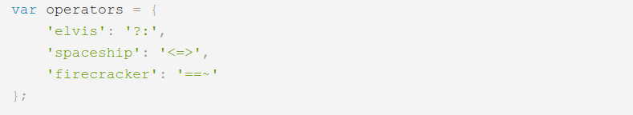
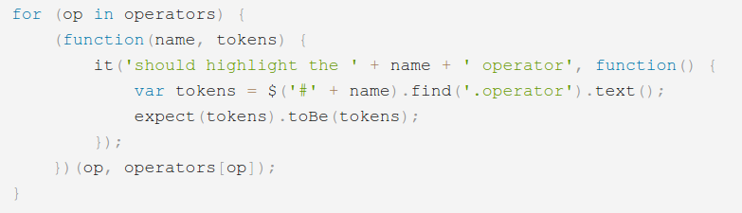
Unit test – good practices
Use Parameterized Tests
  They can help avoid code duplication and the best is the business gives you the data.

Slide 35
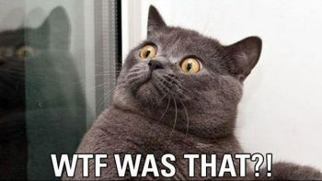
TDD

Slide 36
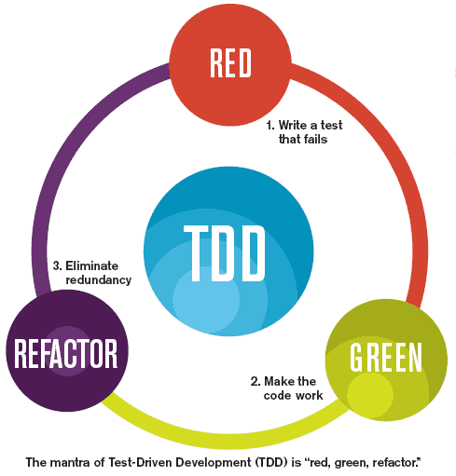
TDD

Slide 37
Benefits of TDD
Helps in the understanding of the requirements, since you have to understand them and also what the system should do in order to write down tests.
Provides a clear goal in the development, that is, to make all tests to pass.
Increases the visibility of what is or not ready, since the tests are generally more reliable indicators of progress than something “implemented, but not tested”.
The automation enables Continuous Integration with some level of guarantee the system won’t break, since all unit tests can be executed over and over as regression tests.
Better code !!!

Slide 38

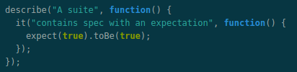
Useful frameworks
The most important functions you can find here: https://jasmine.github.io

Slide 39
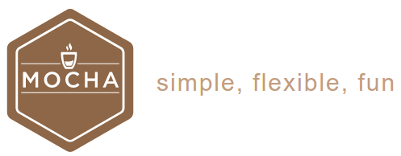
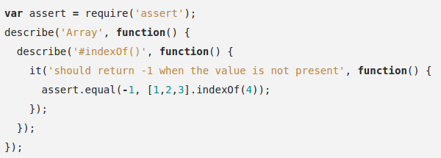
Useful frameworks

Slide 40


Useful frameworks

Slide 41

Useful frameworks

Slide 42
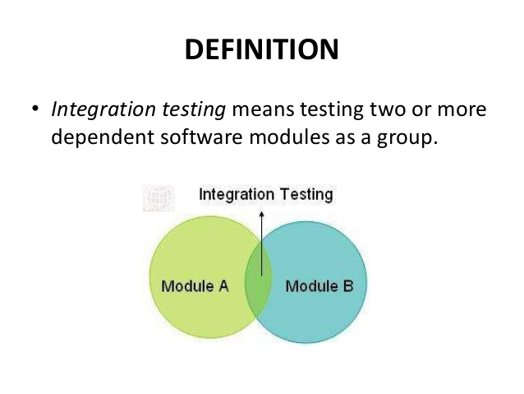
Integration testing

Slide 43
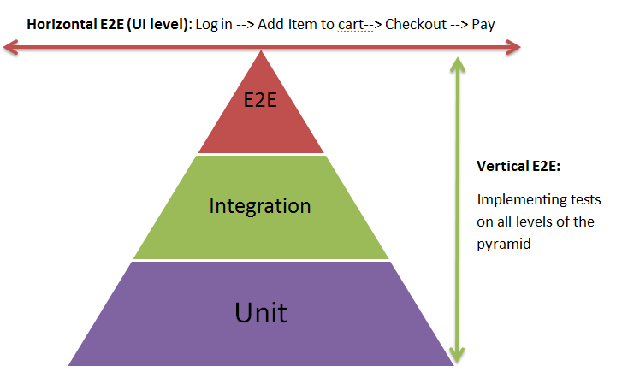
End-to-end tests

Slide 44
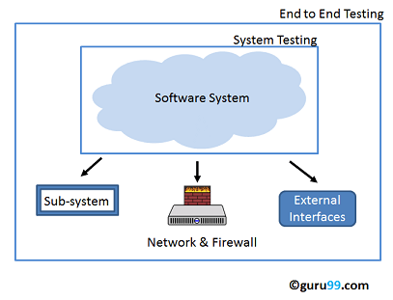
End-to-end tests

Slide 45
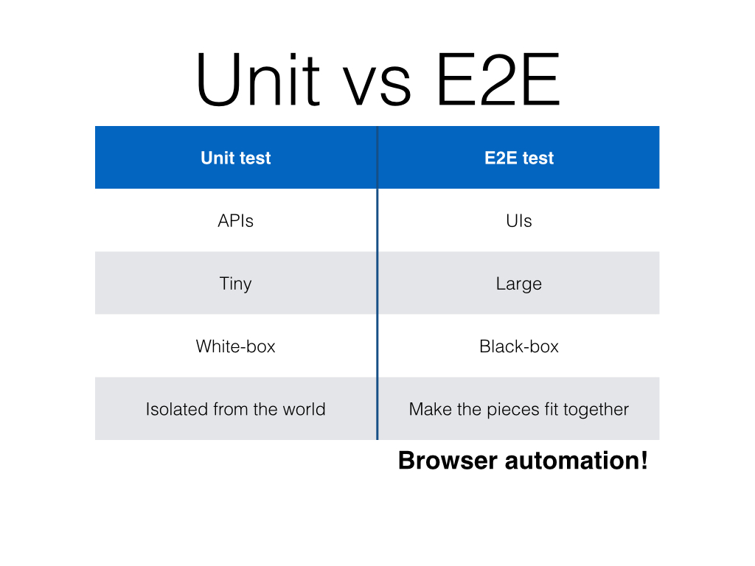
End-to-end tests

Slide 46

E2E framework

Slide 47
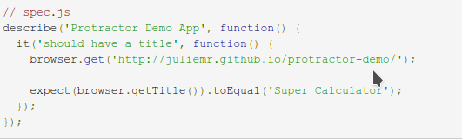
Protractor example
http://juliemr.github.io/protractor-demo/

Slide 48
Protractor example
import { browser, element, by } from 'protractor';
describe('QuickStart E2E Tests', function () {
let expectedMsg = 'Hello Angular';
beforeEach(function () {
browser.get('');
});
it('should display: ' + expectedMsg, function () {
expect(element(by.css('h1')).getText()).toEqual(expectedMsg);
});
});

Slide 49
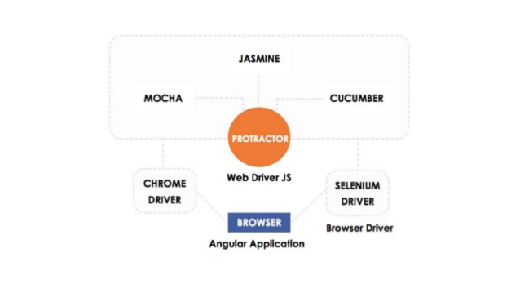
How it's work

Slide 50

Penetration testing

Slide 51
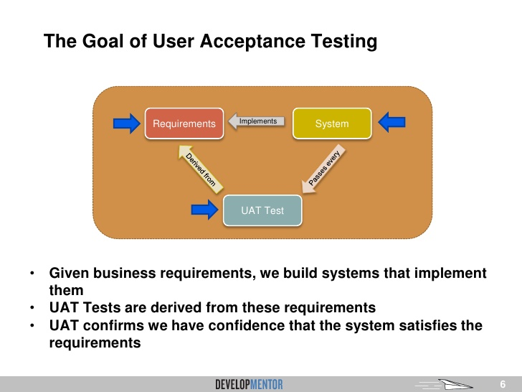
Acceptance testing

Slide 52
Acceptance testing
User acceptance test (UAT) criteria (in agile software development) are usually created by business customers and expressed in a business domain language. These are high-level tests to verify the completeness of a user story or stories 'played' during any sprint/iteration.

Slide 53
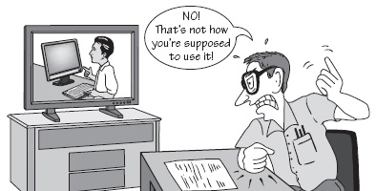
Usability testing

Slide 54
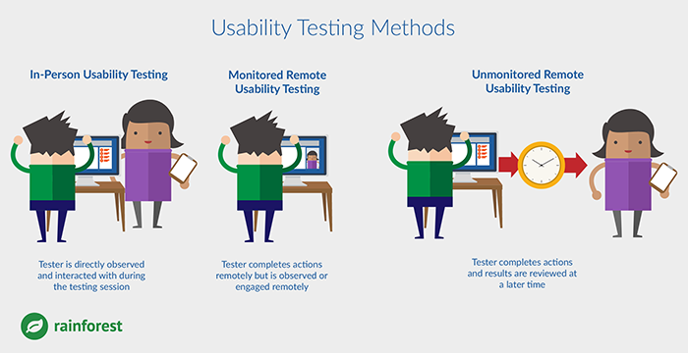
Usability testing

Slide 55
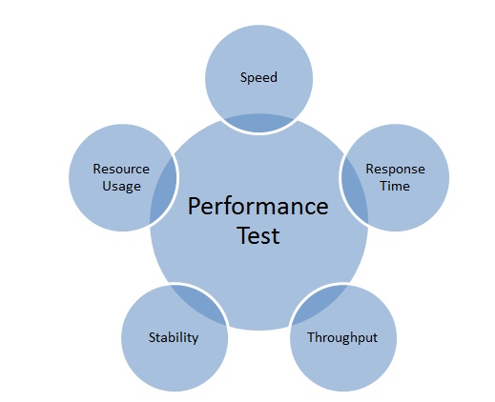
Performance testing

Slide 56


Useful frameworks

