Slide 1
Tuning Ohai

Slide 2
Objectives
After completing this module, you should be able to:
Describe how you configure the node to automatically load ohai plugins
Describe how to enable ohai hints
Describe how to remove plugins that you do not want executed
Describe where you can fine more information about better Ohai performance
Notes:
After completing this module you will be able to

Slide 3
Run Ohai Smoother
There are a few more things to learn about Ohai that could help increase performance.
Configure the node to automatically load ohai plugins
Enable ohai hints
Remove plugins that you do not want executed
Choose only the plugins you want executed

Slide 4
Node Configuration File
All nodes have a configuration file that contain details about node, overrides, and other data. This is the client.rb file on the node.

Slide 5
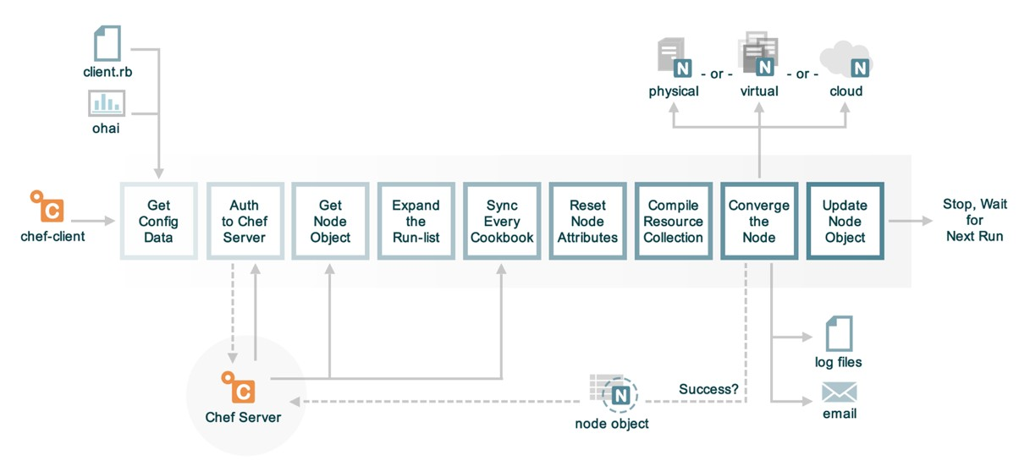
The Anatomy of a chef-client Run

Slide 6
chef-client cookbook
The chef-client cookbook contains a number of useful recipes:
service (default)
Run chef-client as a service, converging at a periodic interval
delete_validation
Remove the organization validation key [SECURITY ISSUE]
config
Define node configuration
https://supermarket.chef.io/cookbooks/chef-client

Slide 7
Viewing the chef-client config Recipe
~/cookbooks/chef-client/recipes/config.rb
# ... OTHER RESOURCES ...
template "#{node['chef_client']['conf_dir']}/client.rb" do
source 'client.rb.erb'
owner d_owner
group node['root_group']
mode '0644'
variables(
chef_config: node['chef_client']['config'],
chef_requires: chef_requires,
ohai_disabled_plugins: node['ohai']['disabled_plugins'],
start_handlers: node['chef_client']['config']['start_handlers'],
report_handlers: node['chef_client']['config']['report_handlers'],
exception_handlers: node['chef_client']['config']['exception_handlers']
)
Notes:
Source code for chef-client cookbook: https://github.com/chef-cookbooks/chef-client
Link to chef-client::config.rb https://github.com/chef-cookbooks/chef-client/blob/master/recipes/config.rb

Slide 8
~/cookbooks/chef-client/templates/default/client.rb.erb
# ... OTHER STATEMENTS ...
<% unless node["ohai"]["plugin_path"].nil? -%>
ohai.plugin_path << "<%= node["ohai"]["plugin_path"] %>"
<% end -%>
<% unless @ohai_disabled_plugins.empty? -%>
ohai.disabled_plugins = [<%= @ohai_disabled_plugins.map { |k| k.match(/:/) ? k.gsub(/^:/, '').to_sym.inspect : k.inspect }.join(",") %>]
<% end -%>
# ... OTHER STATEMENTS ...

Slide 9
The Work
Add the chef-client cookbook to your cookbook collection
Provide attributes in a wrapper cookbook, role, or environment for:
node['ohai']['plugin_path']
Add chef-client cookbook to every node's run list

Slide 10
Run Ohai Smoother
There are a few more things to learn about Ohai that could help increase performance.
Configure the node to automatically load ohai plugins
Enable ohai hints
Remove plugins that you do not want executed
Choose only the plugins you want executed

Slide 11
Not all Node Plugins are Executed
Some of the plugins will not automatically run against your node. This is particularly true of the cloud provider plugins. As the node does not often know the environment in which is being run.

Slide 12
Ohai Hints
For those plugins that are not executed you can leave them a hint file that will ensure they are executed.

Slide 13
The Work
Add the ohai cookbook to your cookbook collection
Define a recipe that uses the ohai cookbook's ohai_hint resource
Add this recipe to every node's run list
https://github.com/chef-cookbooks/ohai

Slide 14
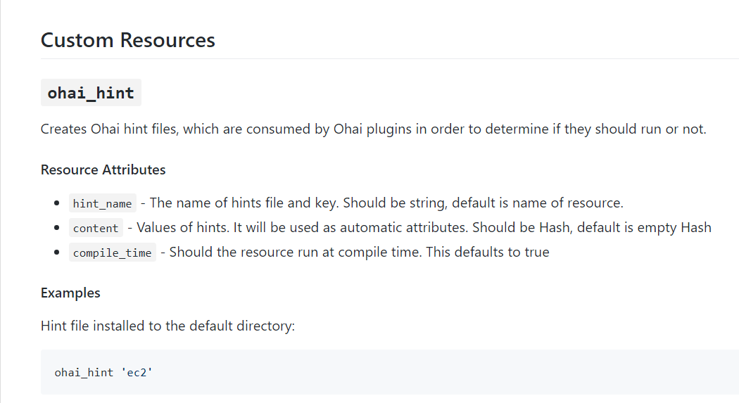

Slide 15
Run Ohai Smoother
There are a few more things to learn about Ohai that could help increase performance.
Configure the node to automatically load ohai plugins
Enable ohai hints
Remove plugins that you do not want executed
Choose only the plugins you want executed

Slide 16
~/cookbooks/chef-client/templates/default/client.rb.erb
<% unless node["ohai"]["plugin_path"].nil? -%>
ohai.plugin_path << "<%= node["ohai"]["plugin_path"] %>"
<% end -%>
<% unless @ohai_disabled_plugins.empty? -%>
ohai.disabled_plugins = [<%= @ohai_disabled_plugins.map { |k| k.match(/:/) ? k.gsub(/^:/, '').to_sym.inspect : k.inspect }.join(",") %>]
<% end -%>
https://github.com/chef-cookbooks/chef-client/blob/master/templates/default/client.rb.erb

Slide 17
Viewing the chef-client config Recipe
~/cookbooks/chef-client/recipes/config.rb
template "#{node['chef_client']['conf_dir']}/client.rb" do
source 'client.rb.erb'
owner d_owner
group node['root_group']
mode '0644'
variables(
chef_config: node['chef_client']['config'],
chef_requires: chef_requires,
ohai_disabled_plugins: node['ohai']['disabled_plugins'],
start_handlers: node['chef_client']['config']['start_handlers'],
report_handlers: node['chef_client']['config']['report_handlers'],
exception_handlers: node['chef_client']['config']['exception_handlers']
)

Slide 18
The Work
Add the chef-client cookbook to your cookbook collection
Select attributes you want to remove
Find the name of the plugin that provides those attributes
Provide attributes in a wrapper cookbook, role, or environment for:
node['ohai']['disabled_plugins']
Add chef-client cookbook to every node's run list

Slide 19
Run Ohai Smoother
There are a few more things to learn about Ohai that could help increase performance.
Configure the node to automatically load ohai plugins
Enable ohai hints
Remove plugins that you do not want executed
Choose only the plugins you want executed

Slide 20
Whitelist Node Attributes
When it seems like you are disabling far too many plugins and you want to consider attacking it from the other side:
https://docs.chef.io/ohai.html#whitelist-attributes

Slide 21
Run Ohai Smoother
There are a few more things to learn about Ohai that could help increase performance.
Configure the node to automatically load ohai plugins
Enable ohai hints
Remove plugins that you do not want executed
Choose only the plugins you want executed

Slide 22
Q&A
What questions can we answer for you?

