Slide 1

Introduction to Anaconda

Slide 2
What is Anaconda
Python is a versatile language that you can use on the back end, front end, or full stack of a web application. While the standard Python library has a lot of functionality, there are many times when we need modules and libraries that are not part of the standard library. That's where Anaconda comes in. Anaconda Python is the perfect platform for beginners who want to learn Python. It's easy to install, and you can get started quickly with the included Jupyter Notebook. Plus, Anaconda Python has many features and libraries that you can use for your projects.

Slide 3
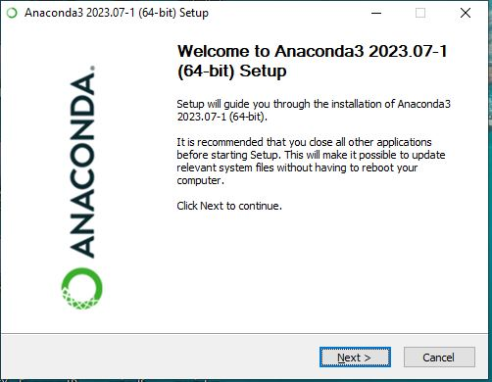
Installation Of Anaconda

Slide 4
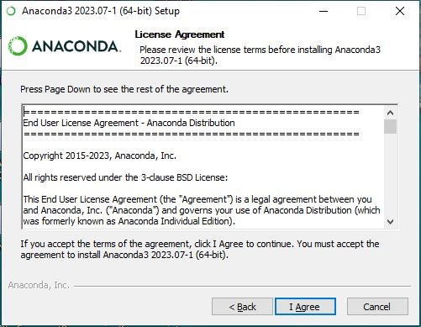

Slide 5
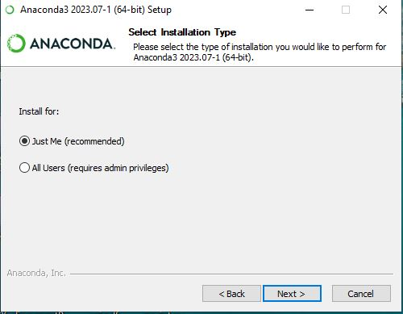

Slide 6
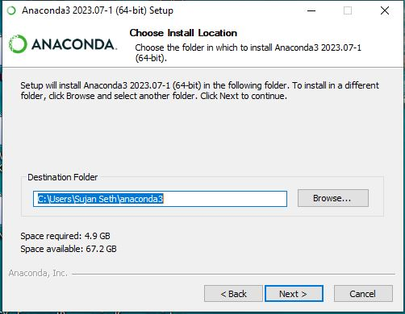

Slide 7
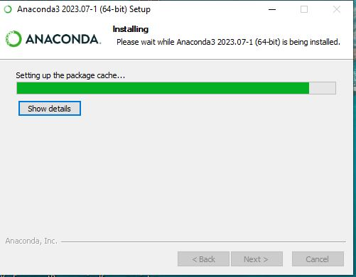

Slide 8
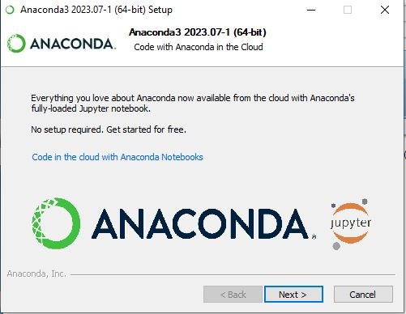

Slide 9
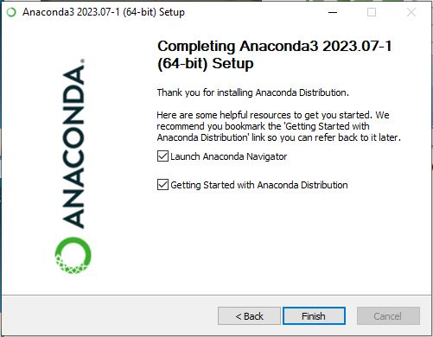

Slide 10
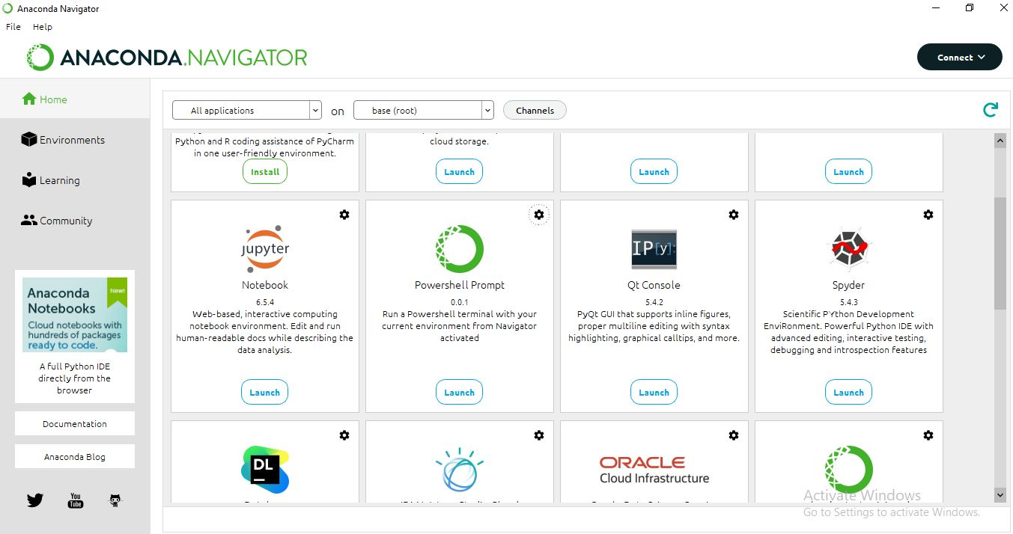
Click On Here To Start

Slide 11
Thank You very much for attending this presentation
If you have any question you are free to ask

