Slide 1
Data Quality & FCR Analysis
Client: Sirius Corp.
Notes:
Presentation Feedback:
More organization especially with cleaning data slide
More methodical in your approach
Presenting to clients whereas Observe.ai just analyzes the client’s business
Much more WFM verbiage
Don’t pin blame on anyone - not PC or good to do in corporate

Slide 2
Business Goals
Enhance FCR
Reduce repeat calls (all channels)
Notes:
Reputational damage sounds extreme
Don’t say aesthetics
FCR you said was how many interactions per case, which is incorrect
Kept saying first caller rate and not first call resolution rate
Work out the chi squared explanation, good at end but rough in the beginning
Increase business acumen and sound more professional - use more business terms
First interaction resolution rate - keep consistent with FCR
Good job with more WFM words
Stop saying our

Slide 3
Analysis Process
Understand the data
Cleaning the data
Exploring relationships
Hypothesis Creation & Testing
Findings & Recommendations
Notes:
Understand the Data
Cleaning the Data
Find relationships between 1st & repeat calls to other metrics
Come up with Hypothesis and test them
Synthesize findings with storytelling and recommendations

Slide 4
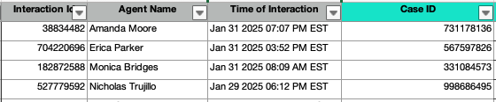
Understand the Data
Top Level
Contact channel (call, email, web chat) by interaction ID
Granular Level
Additional qualitative/quantitative metrics about the call characteristics

Slide 5
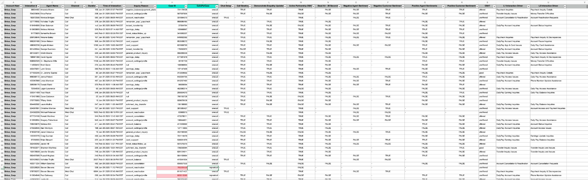
Cleaning the Data
Remove/Handle Missing values
Ensure Consistency and Format
Correct Data Entry Errors
Convert Data Types Correctly
Ensure Corrupted Data
Handle Outliers
Notes:
Correcting Rows for proper column format
Cleaning/Formatting columns and blank cells
Created ‘Number of Calls’ column for FCR calculation
Got rid of negative ‘Duration’ values
See ‘Appendix’ for more details

Slide 6
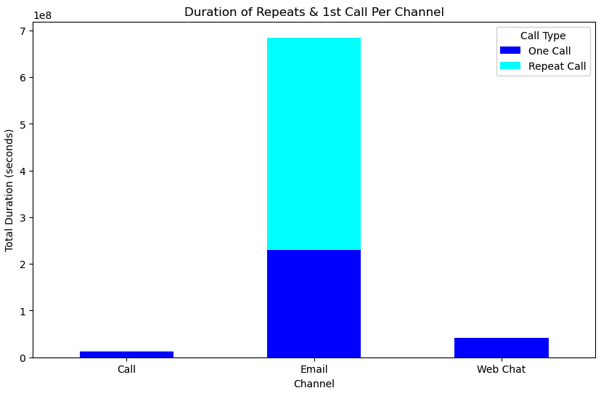
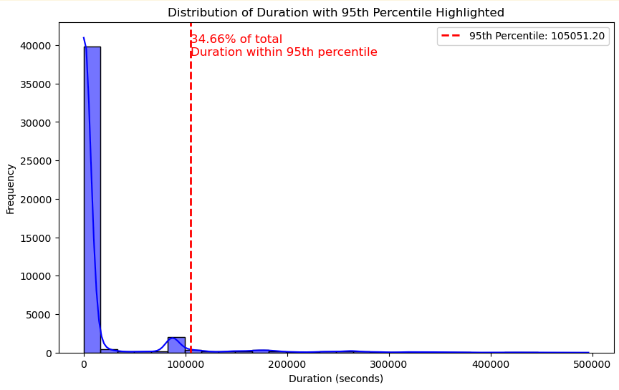
(Cont.) Outlier Data for ‘Duration’
Include ‘Email’ channel ‘Duration’ outliers in data
Notes:
I initially removed outlier times for ‘Duration’
90th percentile had 34.66% of Duration
Later found out this was due to ‘Email’ + ‘Web Chat’ channels
I ran the analysis again, keeping outlier data

Slide 7
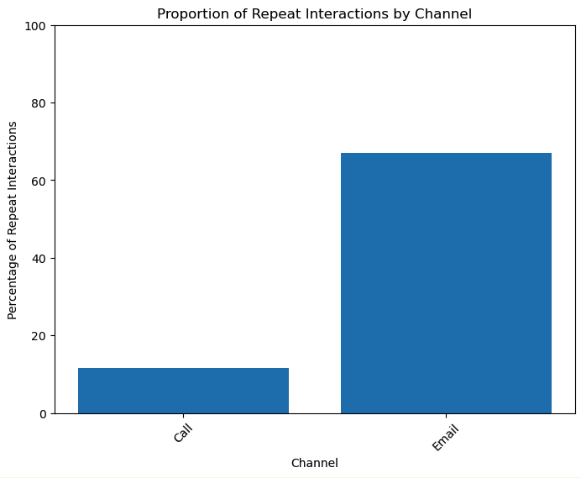
Defining: FCR (First Call Resolution) Rate
FCR Rate
91.07%
Highest Repeats
Email
Notes:
First Call Resolution Rate is at 91.07%
Calculated by finding number of ‘Interaction IDs’ in each ‘Case ID’
Then, finding the proportion of:
Single ‘Interaction IDs’ per ‘Case ID’ / (Single ‘Interaction IDs’ per ‘Case ID’ + multiple ‘Interaction IDs’ per ‘Case ID’)
Email has the most amount of repeats
Call ~12%, Email ~72%, and Webchat 0.01%

Slide 8
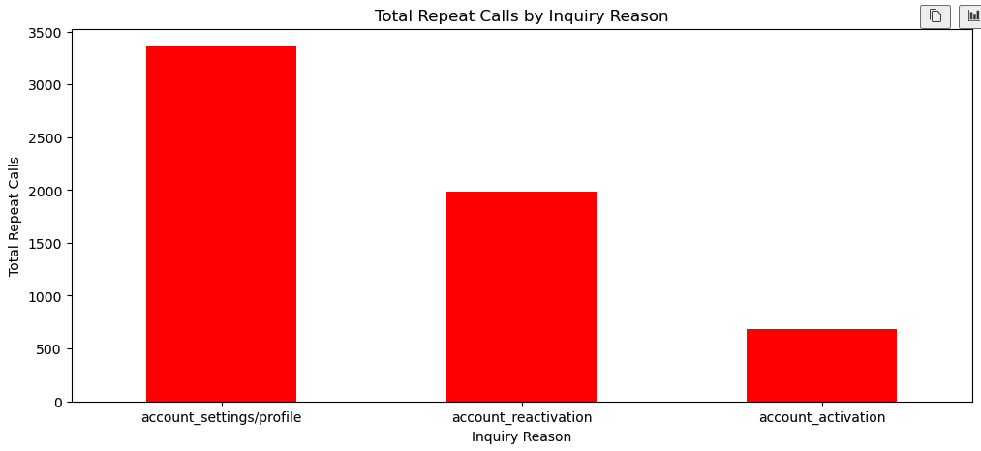
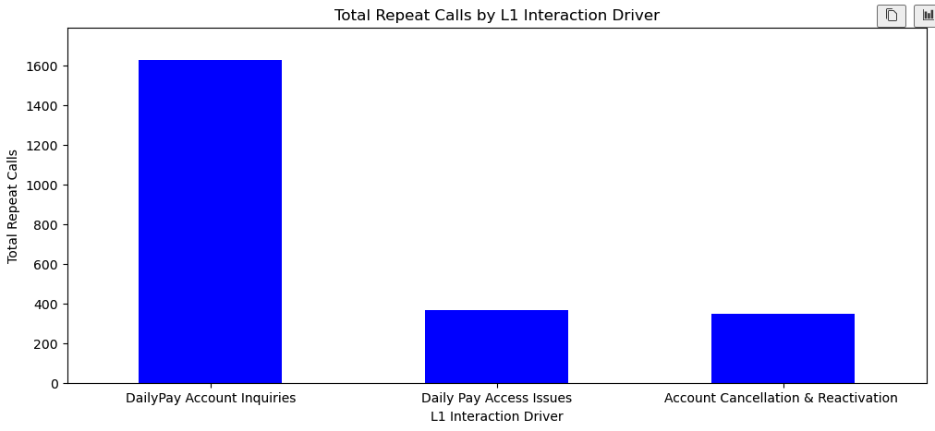
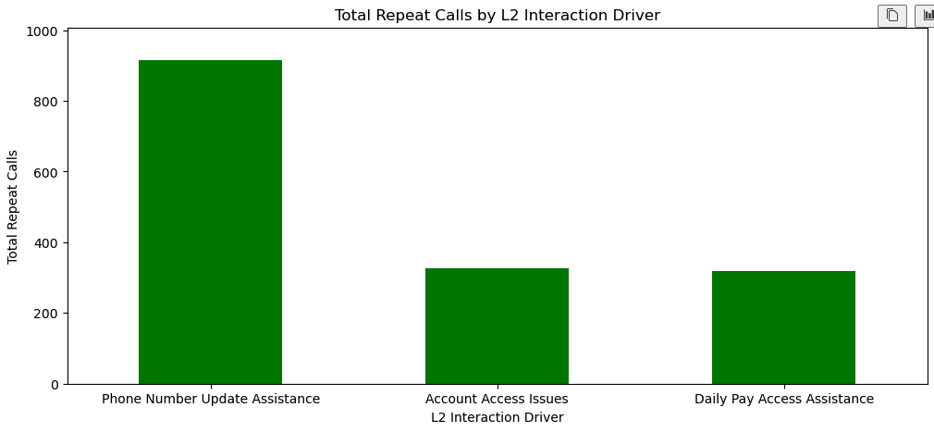
Relationships in Data (Qualitative)
Drivers of Repeat Calls:
Inquiry Reason: Account Reactivation/Setting up profile
L1 Interaction: DailyPay Account Inquiry
L2 Interaction: Phone Number Update Assistance

Slide 9
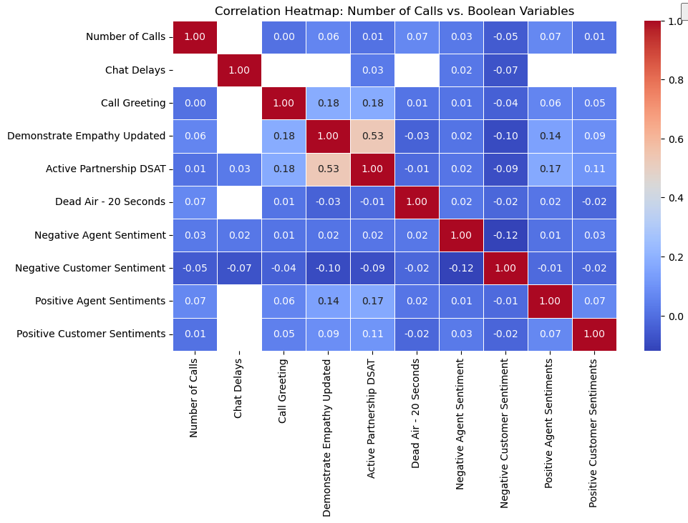
Relationships in Data (Quantitative)
Negligible correlation between repeat calls and ML sentiment data types
Notes:
Negligible correlation between repeat calls and ML sentiment data types
Under a 0.1 correlation, very low
Other Findings:
Repeat Calls longer on average
Occur mostly at 12pm UST
CSAT highest in ‘Offered’, then ‘Unoffered’

Slide 10
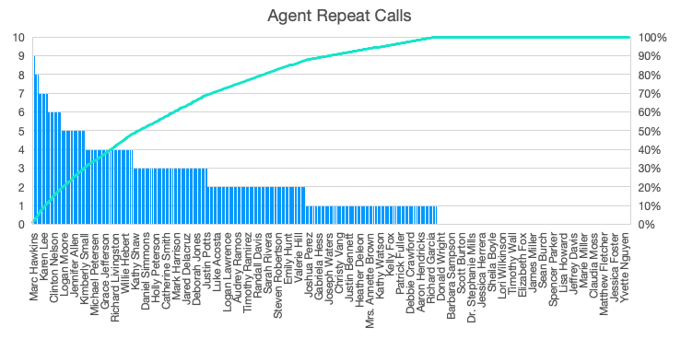
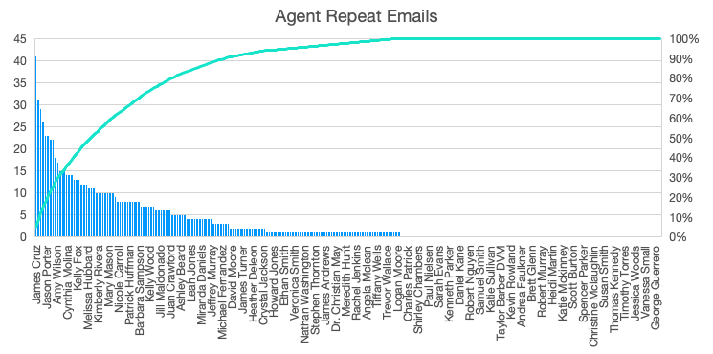
(Cont.) Relationships in Data (Quantitative)
17% of the Call Agents have 50% of repeat Phone Calls
5% of the Email Agents have 50% of repeat Emails

Slide 11
Hypothesis:
Are Agent Repeat calls Statistically Significant?
Is the concentration of repeats to a small minority of agents statistically significant?
Used a Chi-squared test to conclude that repeat calls are disproportionately concentrated among a few agents.
(See Appendix for detailed breakdown)
Notes:
Are agent repeats abnormal in a statistical significant amount?
Null Hypothesis (H₀): Repeat calls are evenly distributed among agents, and any variation observed is due to random chance.
Chi-Square Statistic: 11209.78, p-value: 0.0
We reject the null hypothesis (H₀) and conclude that repeat calls are disproportionately concentrated among a few agents.

Slide 12
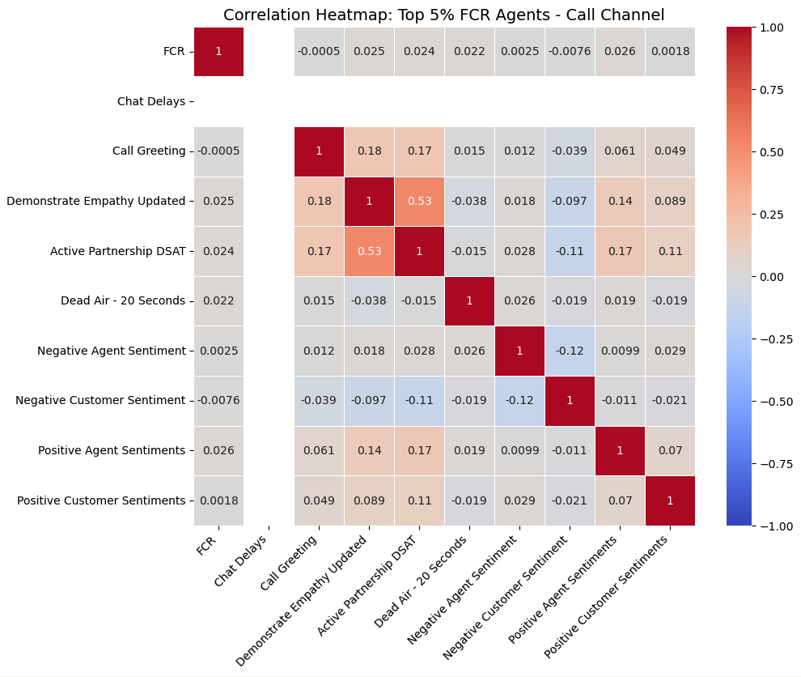
‘Call’ Correlation Quality Check
Agents in the top 5% of FCR
Demonstrate Empathy
Active Partnership DSAT
Positive Agent Sentiment
Overall weak correlation
Dead Air - 20 sec
Notes:
Negligible correlation between repeat calls and ML sentiment data types
Under a 0.1 correlation, very low
Other Findings:
Repeat Calls longer on average
Occur mostly at 12pm UST
CSAT highest in ‘Offered’, then ‘Unoffered’

Slide 13
Understanding Findings
Summary of finding for repeat interaction drivers:
Main customer issues revolve around troubleshooting profile settings
Emails are the bulk of the repeat drivers
Emails have the highest amount of duration
A concentrated amount of agents experience a very high amount repeat communications
Notes:
What is most likely happening, summarized:
“Customers trying to diagnose their account settings over email for their phone number, and are continuously facing issues which increases the duration of their case. A small minority of agents are carrying out these interactions, primarily in the email channel.”

Slide 14
Recommendations
1
2
Reduce Repeat Call:
Train agents on how to troubleshoot issue
Have agents utilize calling for resolving issues
Change reporting of repeat “emails” in the data
Increase FCR:
Encourage customers with issues to call for diagnosis
Optimize call routing with IVR
Implement a better settings user interface (UI)
Notes:
To reduce 2nd repeat call:
Implement a better user interface (UI) for ‘account settings’ to reduce contact rate
Train agents on how to troubleshoot profile settings more effectively on email
Rely more on calls for troubleshooting profile settings instead of email
To increase 1st interaction resolution rate:
Increase the use of the ‘calls’ communication channel rather than ‘email’
Have clear troubleshooting directives for agents solving customer profile settings issues
Increase troubleshooting steps for ‘account settings’ inquiry since FCR is 68% in this category

Slide 15
Data Needed for Future Analysis
Agent Categories
Workload Per Agent
Customer Type (New vs. Returning)
Financial context, $/hour per agent
Notes:
1) Agent Categories
Understanding the call volume per agent group can help us understand if the group is equipped to deal with these types of calls
Understanding if this is the correct agent group to receive this call and if they should instead transfer for one call troubleshooting
2) Workload Per Agent
Allows insights into agent bandwidth to see if certain agents are overburdened (high Occupancy), therefore resulting in high repeat interactions
3) Customer Type (New vs. Returning)
Understanding if the customers interaction history is skewed towards having more repeat interactions, helping us understand if repeats are instead caused by the customer behavior

Slide 16
Appendix

Slide 17
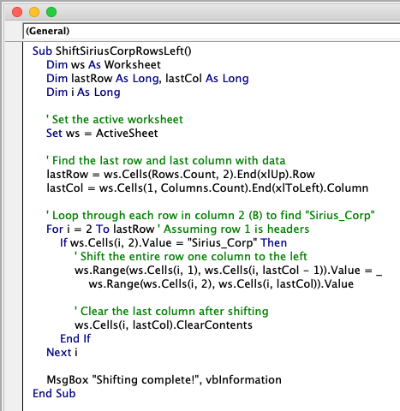
Appendix: Data Cleaning
Specific Cleaning tactics:
VBA macro used for sorting rows to correct columns:
For the ‘Inquiry Reason’ column, changing the ‘null’ and ‘-‘ values to ‘UNKNOWN’
‘L1’ and ‘L2’ interaction drivers will have blank cells marked as ‘other’
Strip the column names to remove front/back whitespace
Cleaning the “Time of Interaction” column to get datetime
Created column ‘Case Duplicate’ to indicate whether a case occurred in multiple interactions, indicating that a repeat call took place
Replaced negative values with ‘null’ in the Duration section
Replaced ‘-’ with ‘None’ for all quantitative observe.ai ML data which was labeled ‘TRUE’, ‘FALSE’, and ‘-’

Slide 18
Appendix | Hypothesis:
Agent Repeat Statistically Significant?
Are agent repeats abnormal in a statistical significant amount?
Null Hypothesis (H₀): Repeat calls are evenly distributed among agents, and any variation observed is due to random chance.
Chi-Square Statistic: 11209.78, p-value: 0.0
We reject the null hypothesis (H₀) and conclude that repeat calls are disproportionately concentrated among a few agents.
Notes:
Are agent repeats abnormal in a statistical significant amount?
Null Hypothesis (H₀): Repeat calls are evenly distributed among agents, and any variation observed is due to random chance.
Chi-Square Statistic: 11209.78, p-value: 0.0
We reject the null hypothesis (H₀) and conclude that repeat calls are disproportionately concentrated among a few agents.

