Slide 1


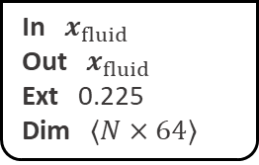


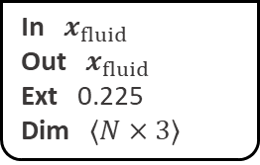

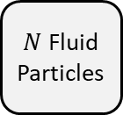
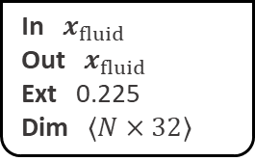


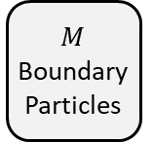
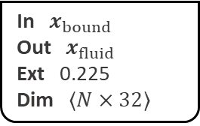
Input Layer
Hidden Layer 1
Hidden Layer 2
Output Layer
CConv
Concat
$M$ Boundary Particles
In $x_{bound}$
Out $x_{fluid}$
Ext 0.225
Dim $⟨N×32⟩$
CConv
CConv
CConv
In $x_{fluid}$
Out $x_{fluid}$
Ext 0.225
Dim $⟨N×64⟩$
In $x_{fluid}$
Out $x_{fluid}$
Ext 0.225
Dim $⟨N×64⟩$
In $x_{fluid}$
Out $x_{fluid}$
Ext 0.225
Dim $⟨N×3⟩$
$$f_{bound}$$
CConv
FC
FC
FC
In $x_{fluid}$
Out $x_{fluid}$
Ext 0.225
Dim $⟨N×32⟩$
ReLU
Dim $⟨N×64⟩$
Dim $⟨N×64⟩$
Dim $⟨N×3⟩$
$N$ Fluid
Particles
$$f_{fluid}$$
FC
Output
+
ReLU
+
ReLU
+
Dim $⟨N×32⟩$

