Slide 1
Predicting Reddit Success
Can AI Predict Which Posts Go Viral?

Slide 2
The Challenge
What makes a Reddit post go viral?
132K
867
5 Years
Posts Analyzed
Subreddits
of Data

Slide 3
Our Mission
Predict high engagement posts BEFORE they go viral
Using only information available at post time
⚡ No future data
⚡ No engagement metrics
⚡ Pure content + context

Slide 4
The Dataset
1,058
39
100%
Avg Upvotes
Avg Comments
Data Retained
✨ Zero data loss through smart preprocessing

Slide 5
What We Used to Predict
Text
Context
Timing
• 1,000 TF-IDF features
• Title analysis
• Top 20 subreddits
• Community patterns
• Hour, day, month
• Temporal trends
1,026 total features

Slide 6
The AI Showdown
Random Forest
🏆
72.2%
Gradient Boosting
71.6%
Logistic Regression
70.8%
Hybrid Model
51.2%

Slide 7
🏆 Random Forest Wins
72.2%
F1-Score
✓ Balanced precision & recall
✓ Handles non-linear patterns
✓ Robust to overfitting
Top Features
Year: 22.5%
Month: 19.2%
Subreddit: 15.0%

Slide 8
Crushing the Competition
Random Guessing 50.2% +44%
Subreddit Only 38.6% +87%
Our Model 72.2% 🎯

Slide 9
Why This Matters
📈 Content Strategy
Optimize posting time & format
🎯 Early Detection
Spot viral posts before they blow up
🧠 Platform Intelligence
Understand engagement drivers

Slide 10
Next Level
🤖 BERT embeddings for deeper text understanding
📸 Image content analysis
💬 Full post content (not just titles)
🔮 Real-time prediction API

Slide 11
The Bottom Line
72% accuracy predicting viral posts
Using zero future information
✨ We can predict engagement before it happens

Slide 12
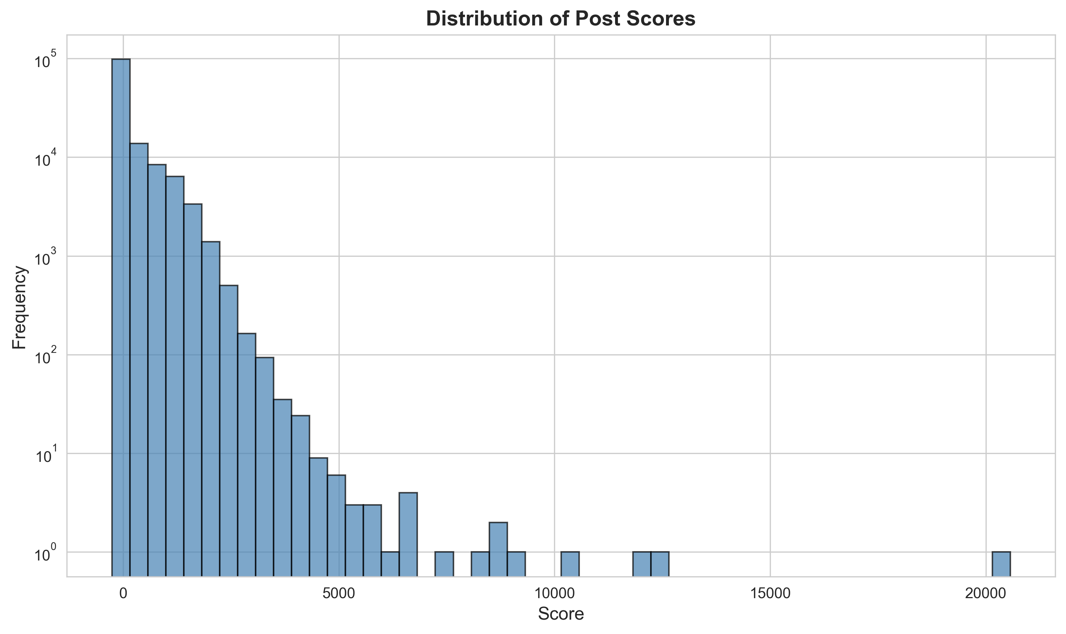
Score Distribution

Slide 13
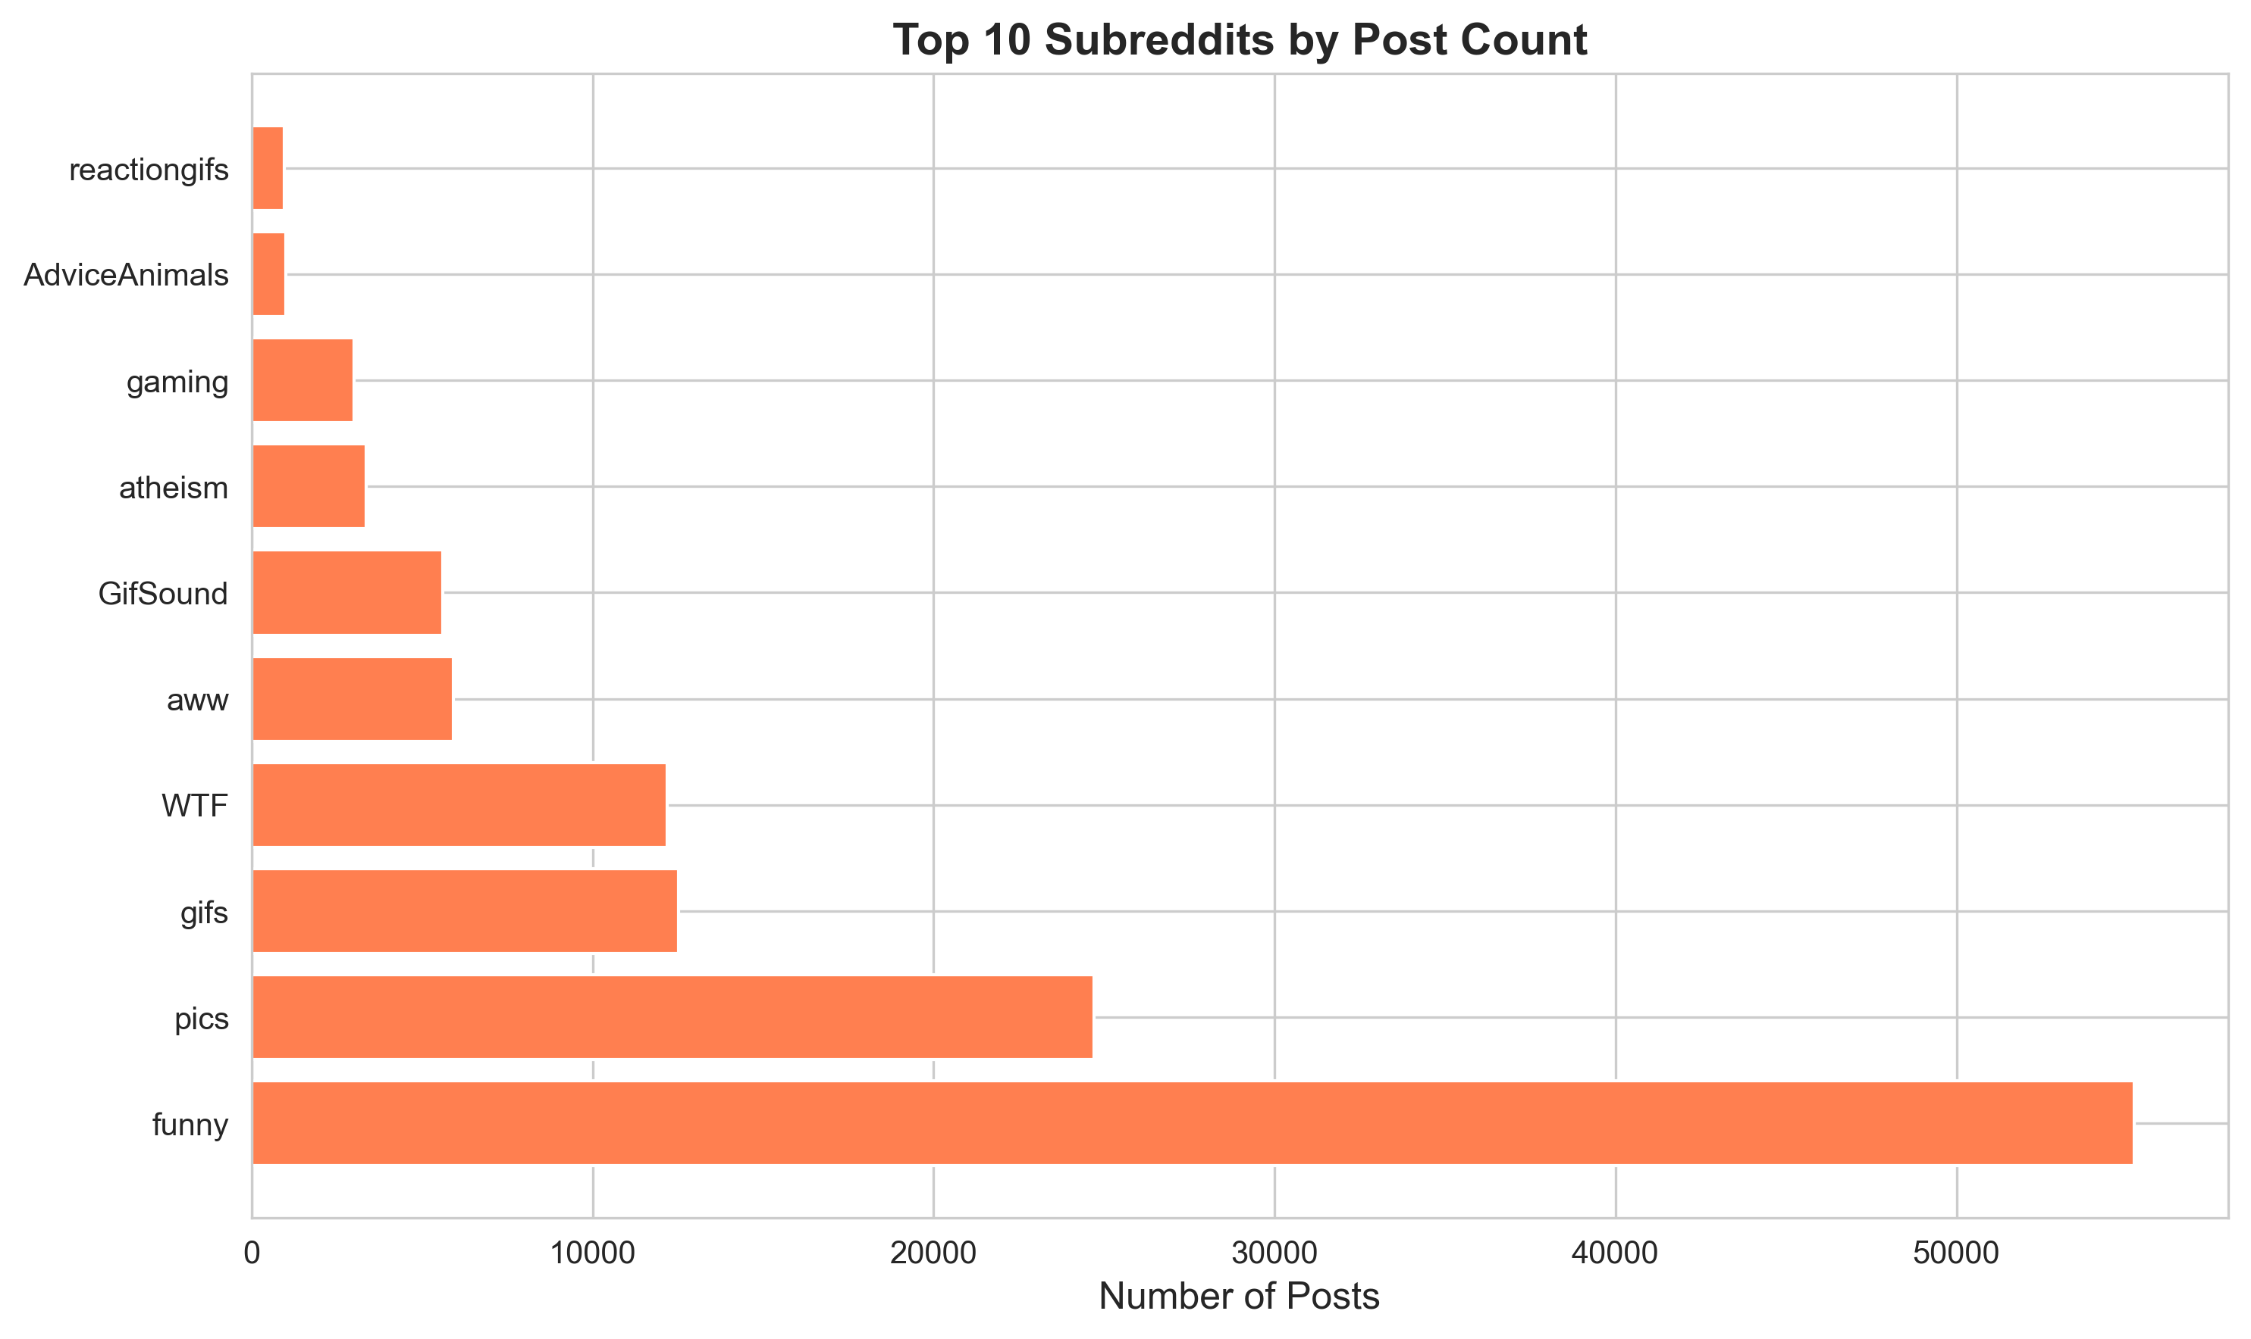
Top Subreddits

Slide 14
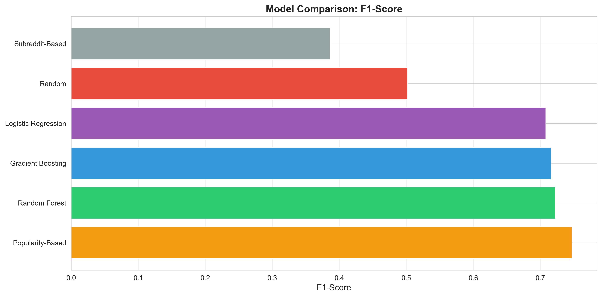
Model Performance Comparison

Slide 15
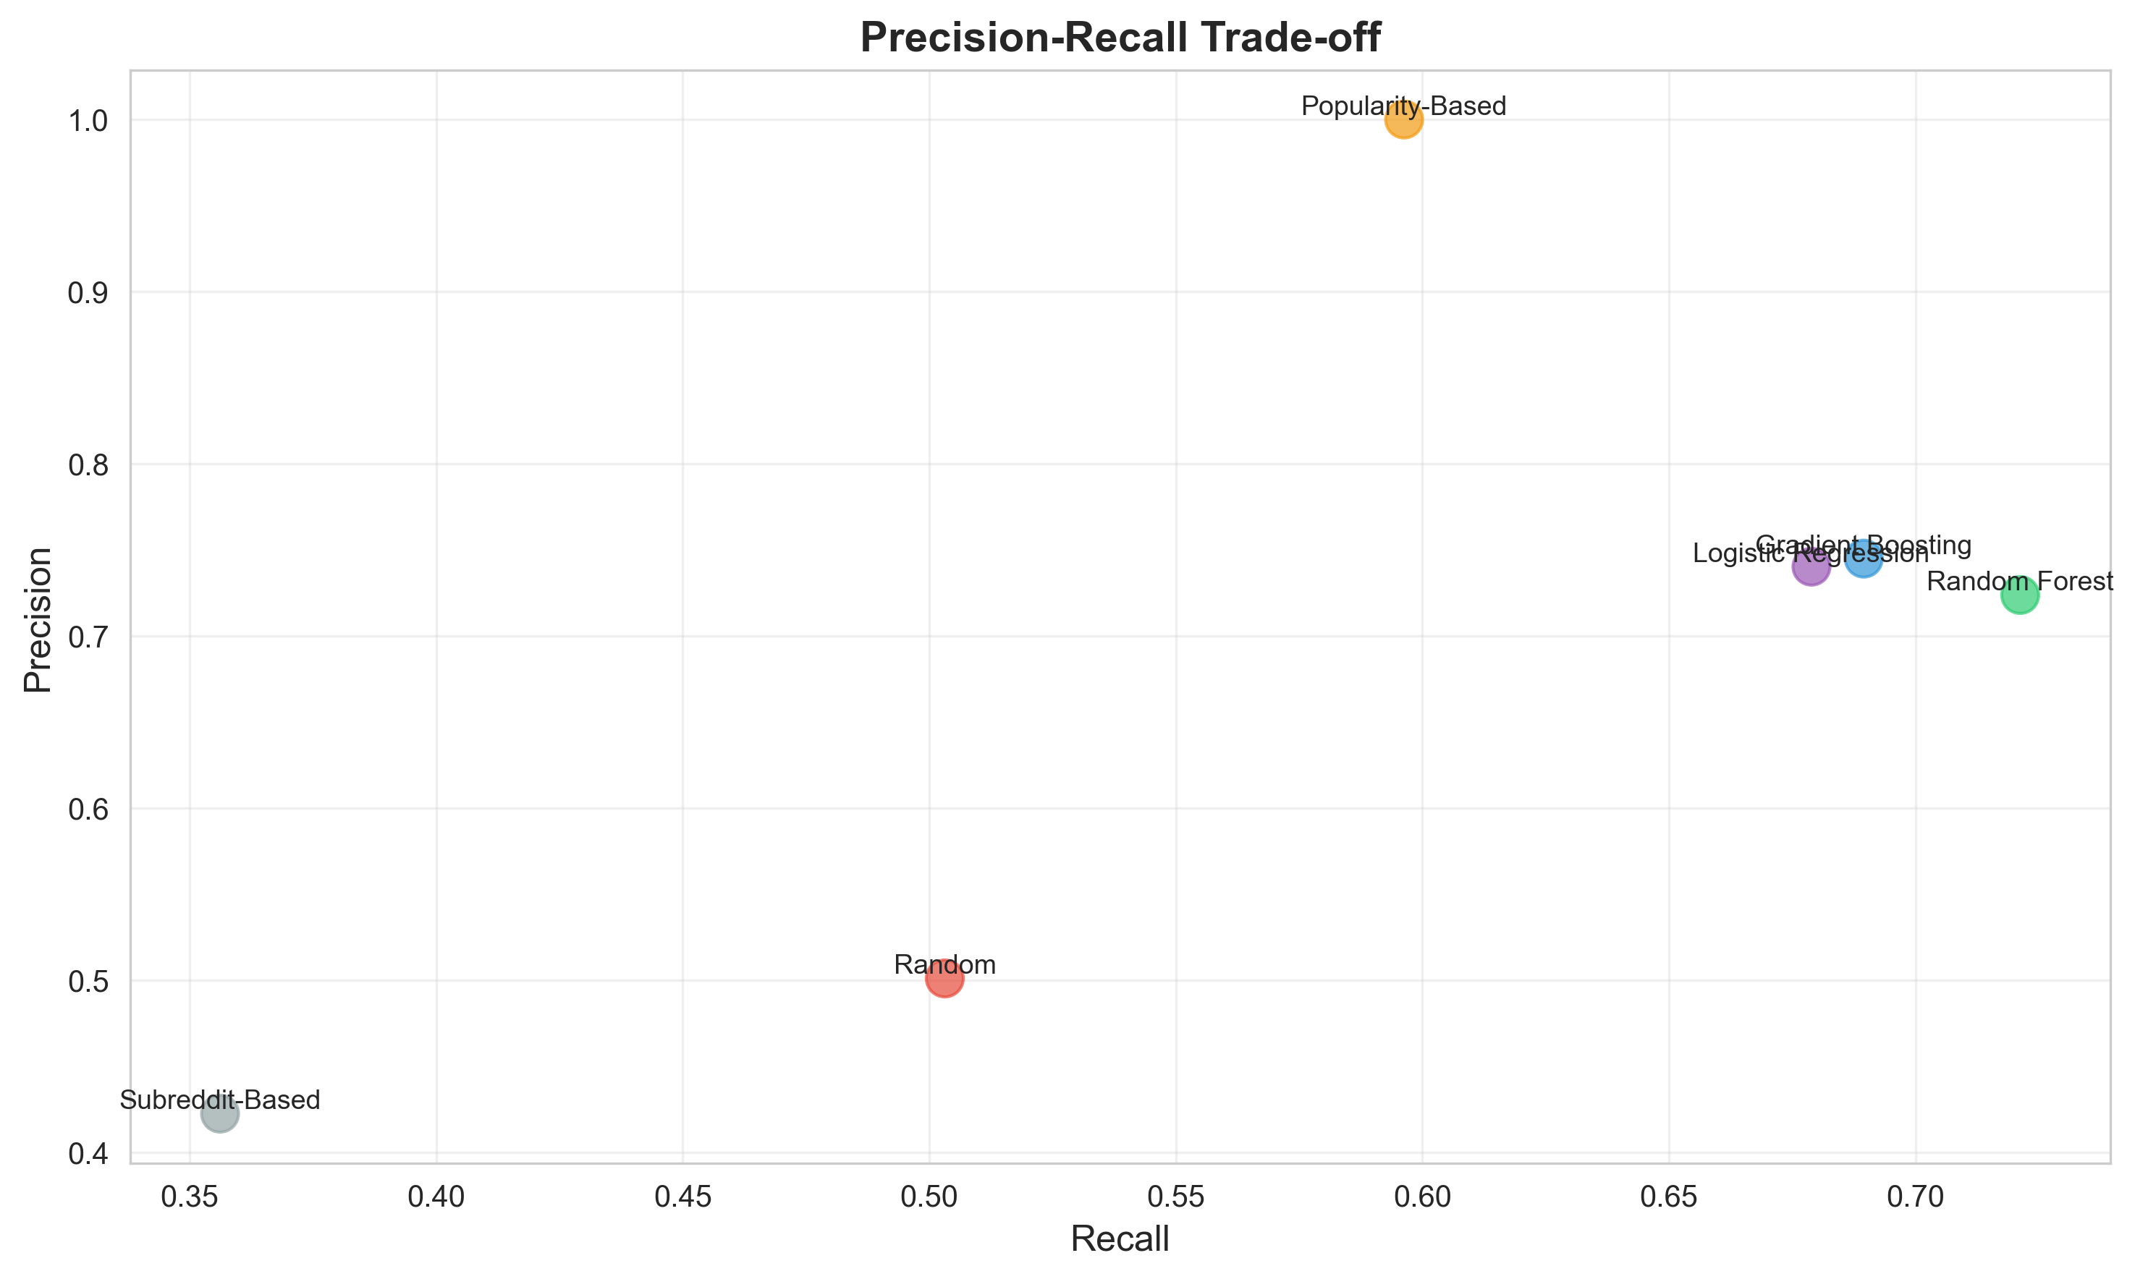
Precision-Recall Trade-off

Slide 16
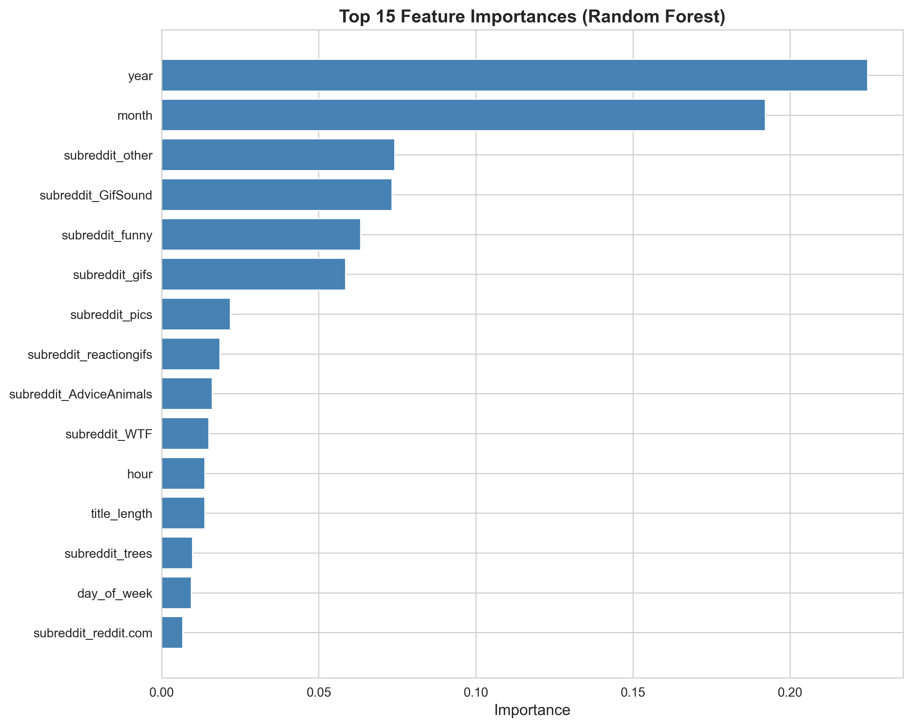
Feature Importance

Slide 17
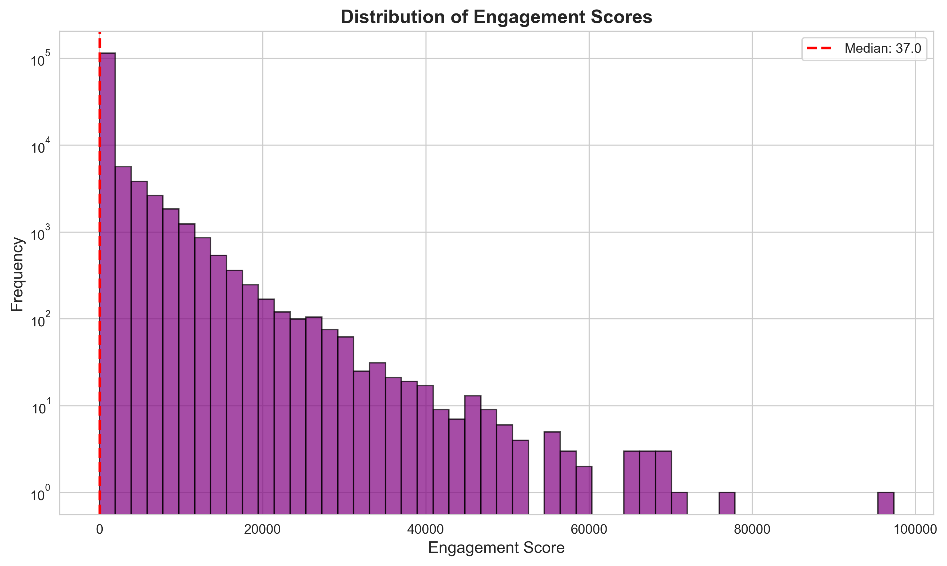
Engagement Distribution

Slide 18
Thank You!
Questions?

