Slide 1
A Learning-based Model of Central Bank Bailout Decision-making
Anirudh Suresh
Harvard ’20
July 2017

Slide 2
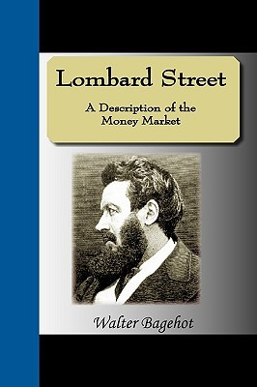
1. Some Historical Context
Bagehot’s dictum
LOLR function of the central bank (CB)
Revisal of convention during 2008 financial crisis
Possibility that insolvent banks’ bankruptcies could irreparably damage financial system
Termed “systemic risk,” “too big to fail,” “too interconnected to fail,” etc.
Posner and Casey (2015)

Slide 3
2. Questions of Interest
Is there a way to quantify moral hazard in cases of bailout consideration of distressed, insolvent banks?
Moral hazard—the increase in risk-taking tendencies due to CB lenience
Does there exist an optimal policy for CBs in playing the role of the lender of last resort (LOLR)?
What role can agent learning play in a model of bailout decision-making?

Slide 4
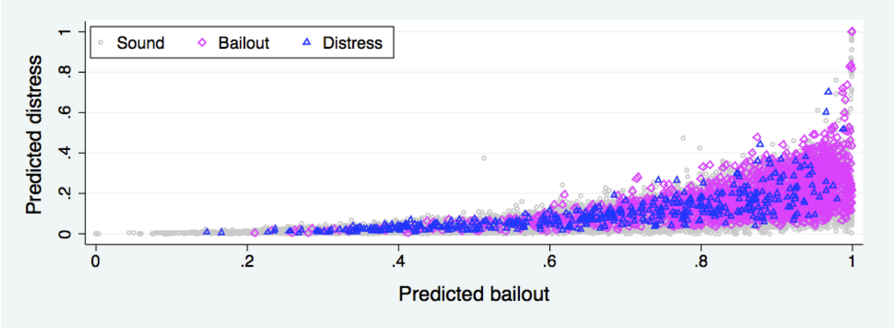
3. Scholarly Attempts to Improve Bailout Policymaking
Dam and Koetter 2010

Slide 5
3. Scholarly Attempts to Improve Bailout Policymaking (cont.)
Bailout context
Dam and Koetter (2010): uses empirical data from German financial sector to determine tradeoff between CB lenience and moral hazard
Freixas (2000): conditionality—an upper bound of bank debt past which the CB should not bail out
Cordella and Yeyati (2003): argues for ex-ante commitment to bailout only in situations of macroeconomic shock to outweigh negative consequences of moral hazard
Acharya (2009): pins systemic risk to correlation of assets
Methodolgoical techniques applied to monetary policy (inflation-unemployment game)
Lu et al (2016): uses Bayesian learning to argue against full commitment
Hemmati et al (2010): uses reinforcement learning to reveal learning and behavior of banks to optimal CB cheating

Slide 6
4. Model
Three main objectives
Analyze the tradeoff between systemic and individual risks
Diagnose an optimal CB lender of last resort (LOLR) policy
Understand effect of sudden country-wide increase in investment volatility
Heterogeneous commercial banks
Reinforcement learning (RL) represents bank agents’ learning
Single central bank agent acting as LOLR
Balance between financial stability and moral hazard/waste of government funds
Notes:
Analyze tradeoffs, see what affects the severity of the tradeoffs
Menu of investment opportunities that differ in risk levels, banks don’t know true riskiness and they make decisions based on their successes and failures

Slide 7
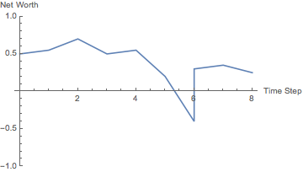
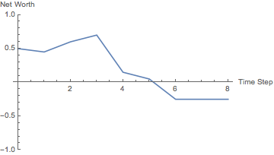
4. Model—Commercial Banks
Bailout
Banks
1
Least Risky
N(0, v₁)
.
.
.
1
Increasing v_{j}
D
Most Risky
N(0, v_{D})
2
.
.
.
.
.
.
.
.
.
1
Least Risky
N(0, v₁)
.
.
.
N
D
Most Risky
N(0, v_{D})
Bankruptcy
Unknown to banks
Author’s calculations
Notes:
N commercial banks, D investment package options for each at every time step t
Investment package j has payout normally distributed with mean c_{j} and variance v_{j}
Payout for bank i at time t having chosen package j, B_{i,t} ~ N(c_{j} ,v_{j})
Banks start with some initial net worth NW_{i,t}, updated at each time step t depending on B_{i,t}
If NW_{i,t} < 0, bank i distressed
CB decision on whether to bail out
If bailed out, bank i pulled out of debt and given some small amount of money z
Otherwise, bank i removed from simulation and replaced with another bank

Slide 8
4. Model—Commercial Banks (cont.)
Systemic risk¹
Modeled as correlation of assets (investment package choices) based on Acharya (2009)
Greater correlation with distressed bank → greater hit on net worth in case of bankruptcy
Learning²
Each investment action has a reward (usually the value of the payout)
If the reward is positive, serves as reinforcement to take that action in the future. If negative, serves as a penalty discouraging future pursuit of that action.
Learning usually individual and unique to each bank’s actions, but social learning takes place in case of distress

Slide 9
4. Model—Commercial Banks (cont.)
i
Time steps
1
2
3
. . .
Actions
2
4
1
. . .
Payouts
+0.5
-0.75
-0.25
. . .
Likelihood of action in future
++
---
-
. . .

Slide 10
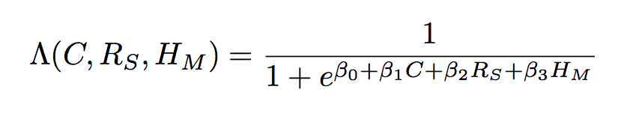
4. Model—Central Bank
CB decides whether to bail out distressed banks according to a logistic objective function:
Where
C = literal cost to CB of bailing out
R_{S} (systemic risk) = represented by correlation of assets³
H_{M} (moral hazard) = n_{bailout} / n_{distress}

Slide 11
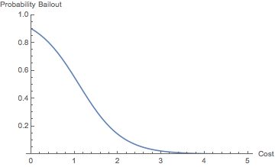
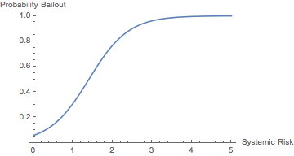
4. Model—Central Bank (cont.)
Probability of bailout with respect to cost
Probability of bailout with respect to systemic risk
Author’s calculations

Slide 12
5. Calibration, Convergence, and Parameter Choice
Parameter choice
N = 15
D = 3
T = 500
v = [0.04, 0.25, 1.0]
Chosen to allow for simplicity in analysis and breadth for aggregation
Other parameters are set based on various strategies, including estimating which ones give reasonable output ranges and using machine learning conventions.⁴

Slide 13
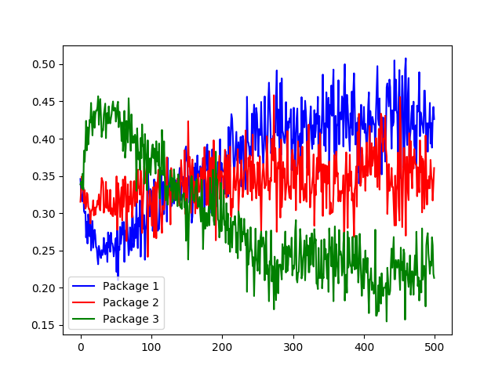
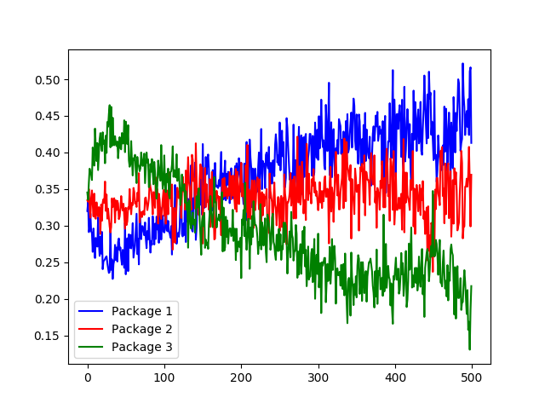
5. Calibration, Convergence, and Parameter Choice (cont.)
With no social learning:
A_{E} = [6.3371, 5.2443, 3.4186]
With high social learning:
A_{E} = [8.9693, 4.6913, 1.3394]
Author’s calculations

Slide 14
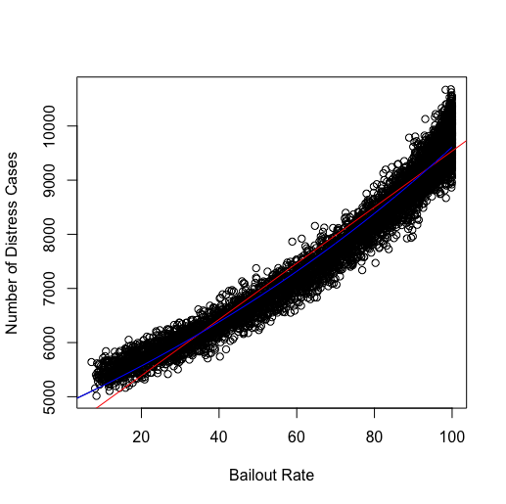
6. Quantification of Moral Hazard—Moral Hazard
Simulation run over different combinations of βs from objective function
Yields relationship between bailout rate—representing CB harshness—and number of distress cases—standing for moral hazard
Exponential fit (blue) indicates that for a 1% increase in bailout rate, number of distress cases rises by 0.6848%
Similar in magnitude to empirical analysis: 0.2% increase in distress probability for 1% increase in bailout probability
Author’s calculations
Dam and Koetter 2010

Slide 15
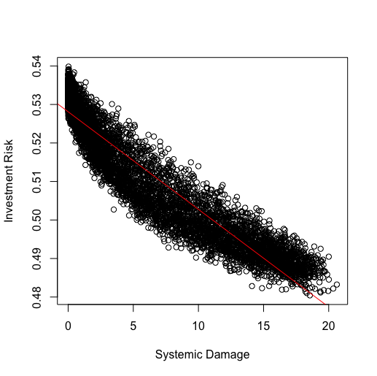
6. Quantification of Moral Hazard—Risk Tradeoff
Investment risk is defined as the proportion of banks expected to choose each package multiplied by the volatility of that package⁵
As CB bails out more, it decreases amount of systemic damage but also incentivizes risk-taking on the part of the commercial banks
Author’s calculations
Notes:
Systemic risk is fundamentally a measure of correlation, so it is fundamentally different from investment risk; also central bank bailing out more often

Slide 16
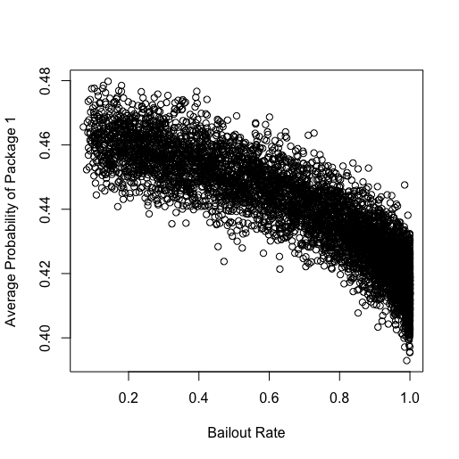
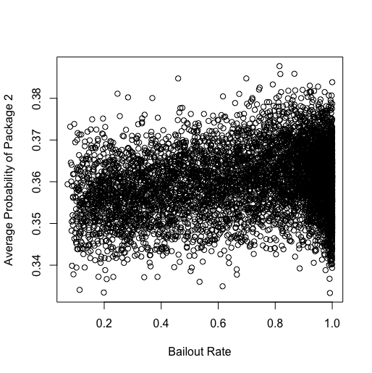
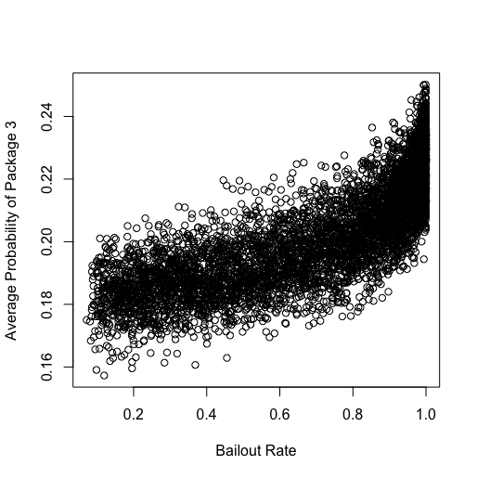
6. Quantification of Moral Hazard—Visualizing Moral Hazard
Least Risky
Intermediately Risky
Most Risky
Probability of each level of investment risk with respect to bailout rate
Author’s calculations

Slide 17
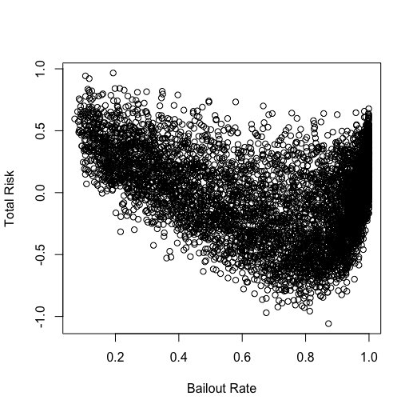
7. Optimization of Bailout Policy
Optimal policy defined as minimizing total risk (combination of systemic and investment risk)⁶
“Optimal” β = [-6, 4, -7, 1]
Translates to “optimal” bailout rate of 87.23%
50 lowest risk: average optimal bailout rate of 78.14%
Dam and Koetter’s empirical data: on average, 81% of German banks bailed out
Pay more attention to systemic risk than moral hazard and cost
Author’s calculations
Notes:
We don’t want to focus too much on these numbers. We realize that they are very close, but of course future work is to see what drives optimal value, understand whether it’s robust
One of the key takeaways is not the literal bailout rate number but the point where the optimality was attained is at a point where you pay a lot of attention to systemic risk and not much to others.

Slide 18
8. Examinations of the Effects of Asset Volatility
Modulate v to represent different levels of asset volatility
A. v = [0.01, 0.0625, 0.25]; established market (e.g. U.S.)
B. v = [0.04, 0.25, 1.0]; emerging market (e.g. Indonesia)
C. v = [0.16, 1.0, 4.0]; developing market (e.g. Cameroon)
β = [-6, 4, -7, 1]
Case | Bailout Rate | Distress Count | Systemic Damage | Investment Risk | CB Money | Expected Counts
A | 94.23% | 12253 | 2.0316 | 0.4930 | 57.97 | [5.32, 5.20, 4.48]
B | 87.59% | 17478 | 12.6540 | 0.4513 | 92.49 | [6.38, 5.53, 3.09]
C | 80.04% | 22824 | 56.3698 | 0.3709 | 122.28 | [9.18, 4.42, 1.40]

Slide 19
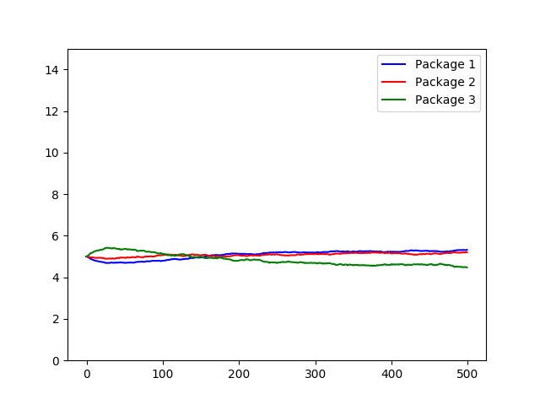
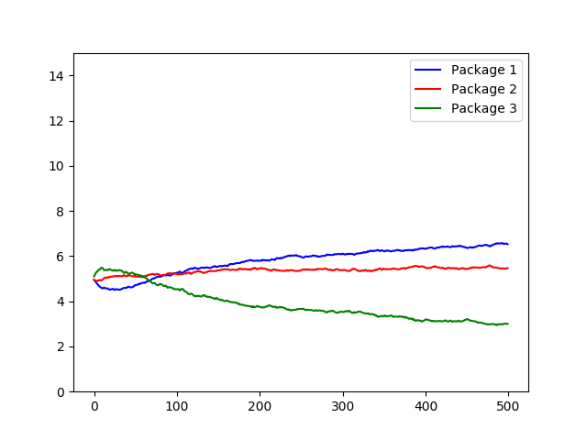
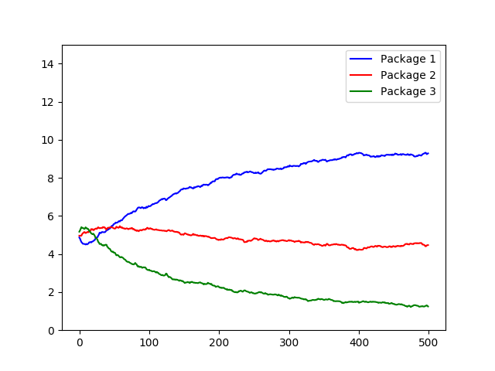
8. Examinations of the Effects of Asset Volatility (cont.)
Test Case A
Test Case B
Test Case C
Less volatile
More volatile
Author’s calculations

Slide 20
8. Examinations of the Effects of Asset Volatility (cont.)
How about country-wide risk premium?: what if v changes suddenly at t = 500?
D. v = [0.01, 0.0625, 0.25]; at t = 500, multiplied by volshock
volshock | Bailout rate | Bailout rate pre- | Bailout rate post- | n_{distress} | n_{distress} pre- | n_{distress} post-
0.25 | 94.50% | 94.31% | 97.25% | 13055 | 12219 | 836
4 | 90.90% | 94.38% | 86.85% | 24681 | 13289 | 11392
16 | 86.40% | 94.51% | 80.26% | 29921 | 12886 | 17035

Slide 21
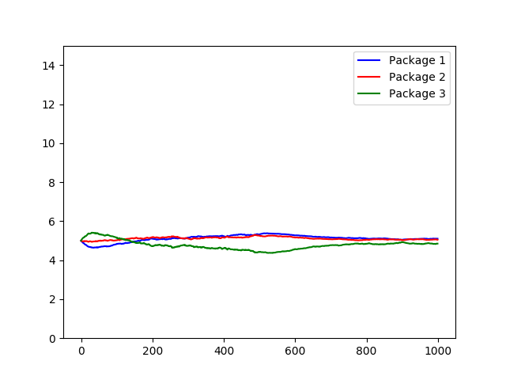
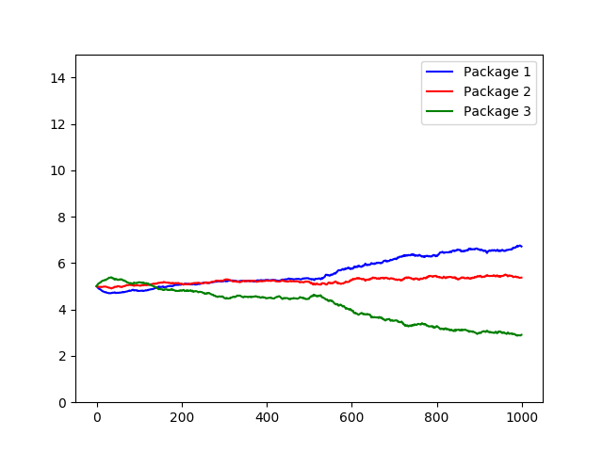
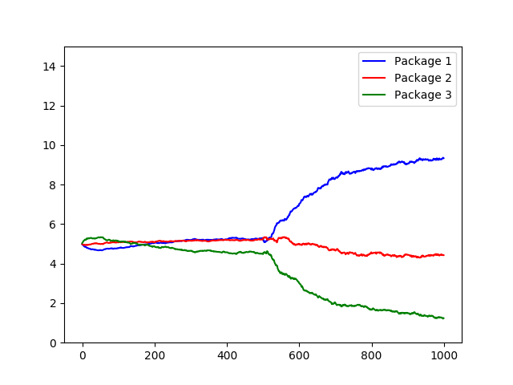
8. Examinations of the Effects of Asset Volatility (cont.)
vol_shock = 0.25
vol_shock = 4
vol_shock = 16
Decreasing shock
Increasing shock
Author’s calculations

Slide 22
9. Conclusion
Model provides a heterogeneous system that allows for clear visualization of learning and behavior patterns.
Displays natural tradeoffs in a quantifiable manner
Ease of experimentation for causal inference
Learning → rational decision-making and adaptation patterns by banks
Future directions
Combine with empirical data, such as that from Dam and Koetter to compare model results on tradeoffs
Consider non-linear shocks to asset volatility
Further study optimal policy recommendation
“Too big to fail”

Slide 23
10. Acknowledgements

Slide 24
Bibliography
Acharya, Viral V. "A Theory of Systemic Risk and Design of Prudential Bank Regulation." Journal of Financial Stability 5 (2009): 224-55. Web. 15 June 2017.
Cordella, Tito, and Eduardo Yeyati. "Bank Bailouts: Moral Hazard vs. Value Effect."Journal of Financial Intermediation 12 (2003): 300-30. Web. 15 June 2017.
Dam, Lammertjan, and Michael Koetter. "Moral Hazard Implications of Bank Bail-Outs." SSRN Electronic Journal (2010): n. pag. Web. 15 June 2017.
Freixas, Xavier. "Optimal Bail Out Policy, Conditionality and Constructive Ambiguity."SSRN Electronic Journal (2000): n. pag. Web. 15 June 2017.
Hemmati, Mahdi, Masoud Nili, and Nasser Sadati. "Reinforcement Learning of Heterogeneous Private Agents in a Macroeconomic Policy Game." Lecture Notes in Economics and Mathematical Systems Progress in Artificial Economics (2010): 215-26. Web. 15 June 2017.
"Lombard Street." Goodreads. Goodreads, n.d. Web. 17 July 2017. <http://www.goodreads.com/book/show/443427.Lombard_Street>.
Lu, Yang K., Robert G. King, and Ernesto Pasten. "Optimal Reputation Building in the New Keynesian Model." Journal of Monetary Economics 84 (2016): 233-49. Web. 15 June 2017.
Posner, Eric A., and Anthony Casey. "A Framework for Bailout Regulation." Notre Dame Law Review 91.2 (2015): 479-536. Web. 15 June 2017.

Slide 25
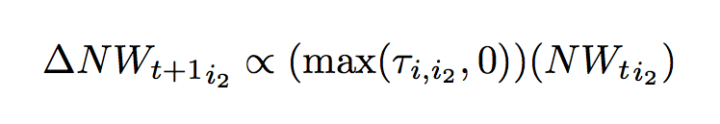


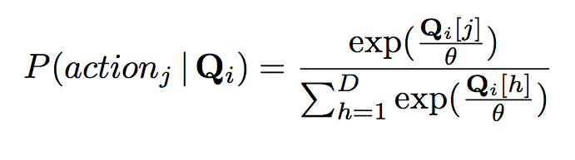
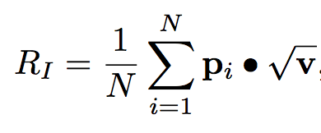
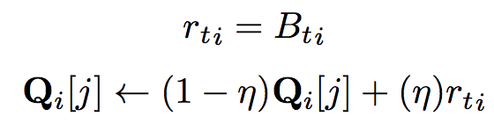

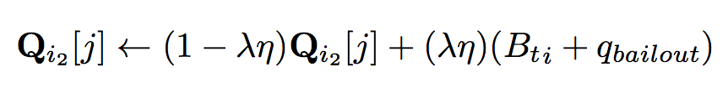
Math Appendix
1:
2:
3:
4: tables on next page
5:
6:
Where B_{t,i} refers to bank i’s payout at t
Individual Learning
Social Learning

Slide 26
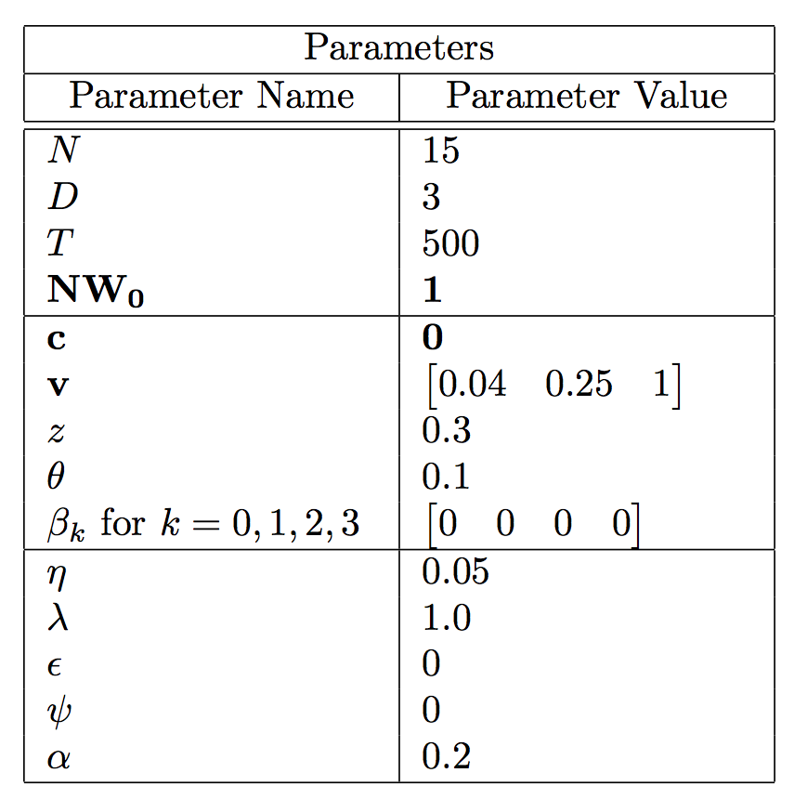
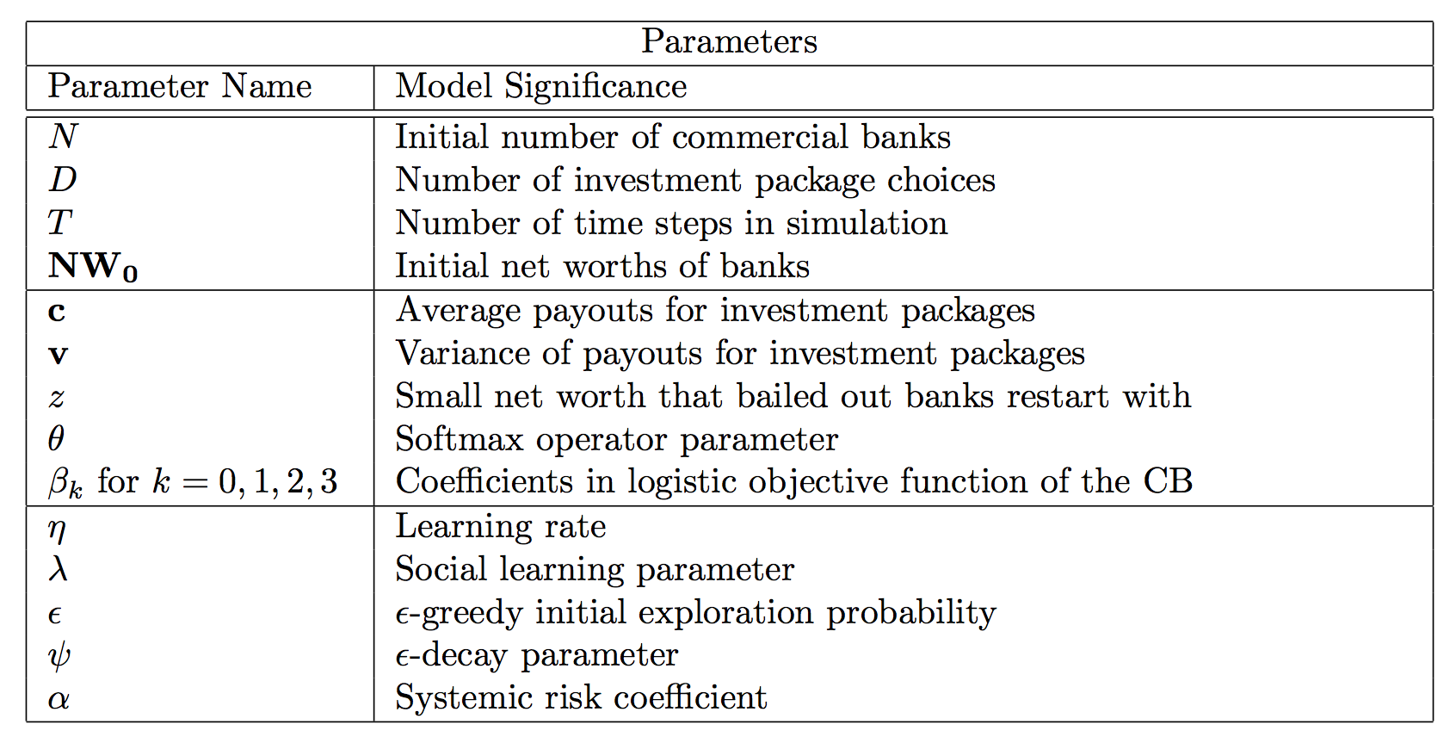
Math Appendix (cont.)

