Slide 1
UPI Transaction
Analysis
A business-focused view of digital payment activity
Transaction Overview • Customer Insights • Bank Insights
Project Type: Data Analytics | Business Intelligence
Tools: Power BI, Power Query, DAX
Dataset Period: 2024
Prepared by: Anija Babu

Slide 2
Project introduction & objective
UPI is a high-volume digital payment channel. Transaction-level analytics can help teams understand what succeeds, what fails, and where attention is needed.
BUSINESS PROBLEM
Large amounts of transaction data are difficult to understand without clear visuals.
Failed transactions and unusual activity can be difficult to identify.
Comparing transaction trends across months, banks, states, and transaction types takes time.
An interactive dashboard makes the data easier to understand and helps identify important patterns quickly.

Slide 3
Project introduction & objective
PROJECT OBJECTIVES
Build an interactive Power BI report to summarize UPI transaction activity.
Analyze transaction trends over time.
Compare transaction behavior across customer groups.
Identify popular merchant categories and spending patterns.
Analyze transaction activity across different states.
Compare bank performance based on transaction success rates.
Provide meaningful insights to support better business decisions.

Slide 4
Project introduction & objective
EXPECTED VALUE
Helps us easily track transactions.
understand which customer groups and states have the most transactions.
identify payment failures, and find areas that need improvement.
Key questions addressed
How many transactions occur, what is their value, and how does activity change over time?
Which age groups, states, devices and merchant categories contribute most?
How do banks compare on successful transaction count, success rate and transaction value?

Slide 5
Dataset Source & Overview
Source: Kaggle — UPI Transactions 2024 Dataset
Dataset page: kaggle.com/datasets/skullagos5246/upi-transactions-2024-dataset
RECORDS
TIME PERIOD
FIELD COUNT
FORMAT
250,000
2024
17
CSV
upi_transactions_2024.csv
IMPORTANT COLUMNS
EXPECTED DATA TYPES
• transaction_id, timestamp, transaction_type, merchant_category
• amount, transaction_status, fraud_flag
• sender_age_group, receiver_age_group, sender_state
• sender_bank, receiver_bank, device_type, network_type
• ID / categories: Text
• timestamp: Date/Time; amount: Decimal number
• fraud_flag: Boolean or categorical; status/type: Text

Slide 6
Data Cleaning & Transformation
POWER QUERY
01 PROFILE
02 STANDARDIZE
03 TYPE SAFELY
Check column quality, distribution, errors and null counts.
Trim text, clean whitespace
Parse timestamp; set amount to decimal; preserve IDs as text.
04 VALIDATE
05 DERIVE
Check duplicate transaction IDs, invalid amounts and impossible dates.
Create Date, Day, and Month fields.

Slide 7
Data Modeling
RELATIONSHIPS & STRUCTURE
Date table(dim)
Date / Year / Month
One-to-many (1:*)
upi_transactions_2024(fact)
Transaction ID • Transaction Date
Amount • Status • Type
Customer, merchant, bank attributes
The project uses a simple data model consisting of:
Date Dimension: Enables analysis by year, month and date.
Fact Table: Stores UPI transaction details for analysis.
Relationship: Connects transaction dates with the calendar table.
Purpose: Supports time-based filtering and monthly transaction analysis.

Slide 8
From data model to business story
HOW THE THREE PAGES WORK TOGETHER
From a structured data model to meaningful business insights, this project explores UPI transaction data through three analytical perspectives.
01 — Transaction Overview
Understanding transaction trends, volumes, values, and overall payment performance.
02 — Customer Insights
Exploring customer behavior, spending patterns, and transaction preferences.
03 — Bank Insights
Evaluating bank-wise transaction performance, success rates, and payment activity.
Each page answers a different business question while using the same transaction data and date model.
Use slicers and tooltips to move from a high-level result to a more specific comparison.
07

Slide 9
Key DAX Measures
MEASURES THAT POWER THE OVERVIEW PAGE
Transaction Metrics
Total Transaction Count: Counts distinct transaction IDs using DISTINCTCOUNT().
Successful Transactions: Uses CALCULATE() to count transactions with a SUCCESS status.
Total Transaction Amount: Calculates the total transaction value using SUM().
Bank Success Rate: Calculates the percentage of successful transactions using DIVIDE().
2. Customer Insights
Most Active Age Group: Uses SUMMARIZECOLUMNS(), TOPN(), and MAXX() to identify the age group with the highest transaction count.
Customer State: Identifies the state with the highest number of transactions using virtual tables and ranking logic.
3.Merchant Analysis
Merchant Spending Percentage: Uses DIVIDE(), CALCULATE(), and ALLSELECTED() to calculate each merchant category's share of total spending.
4. Dynamic State Ranking
Top States by Transaction Amount: Uses RANKX(), ALL(), and IF() to rank states by transaction amount and dynamically display the Top N states using a What-if parameter slicer.
07

Slide 10
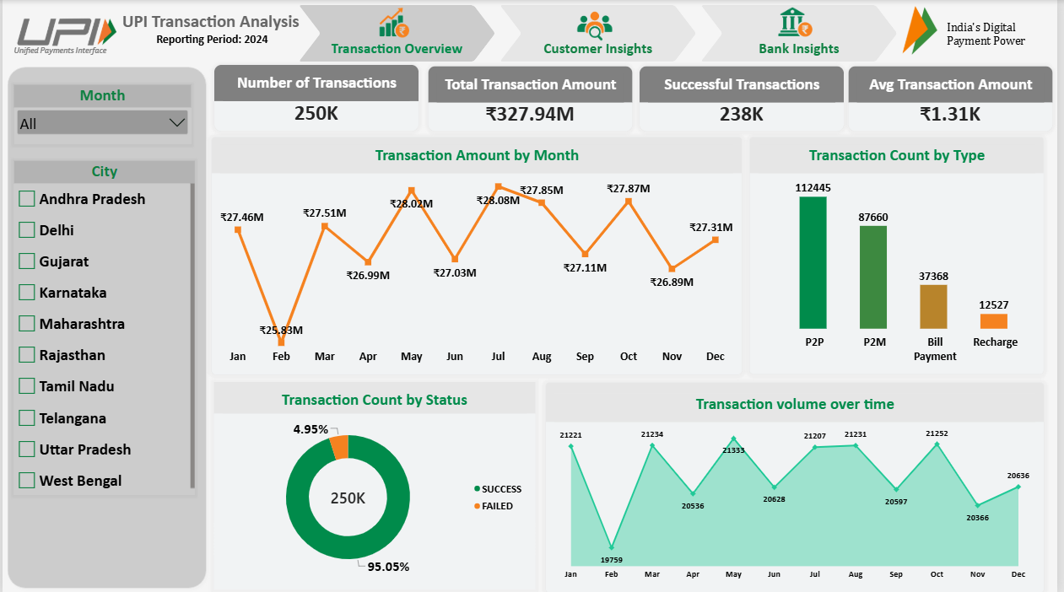
Dashboard Page 1 — Transaction Overview
HOW MUCH ACTIVITY HAPPENED, AND HOW DID IT PERFORM?
08

Slide 11
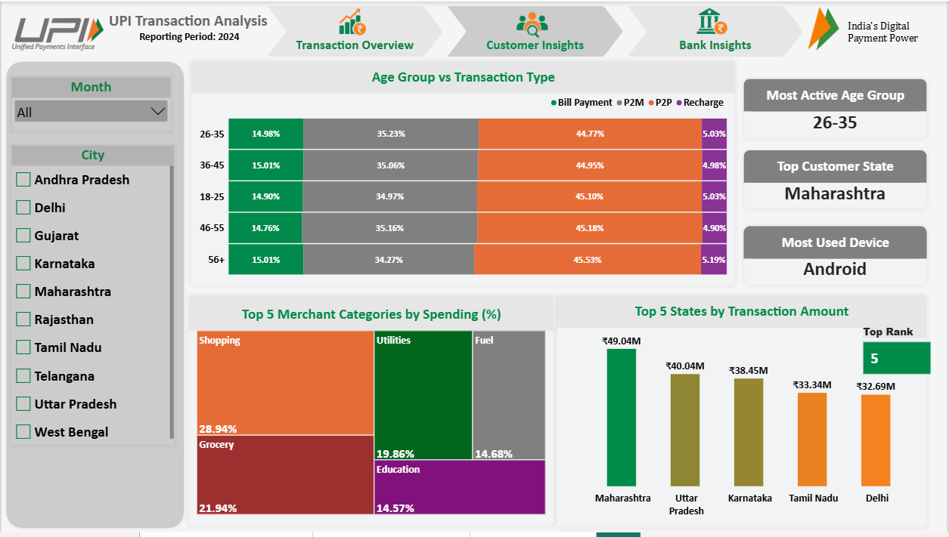
Dashboard Page 2 — Customer Insights
WHO IS USING UPI, AND WHERE IS ACTIVITY CONCENTRATED?
10

Slide 12
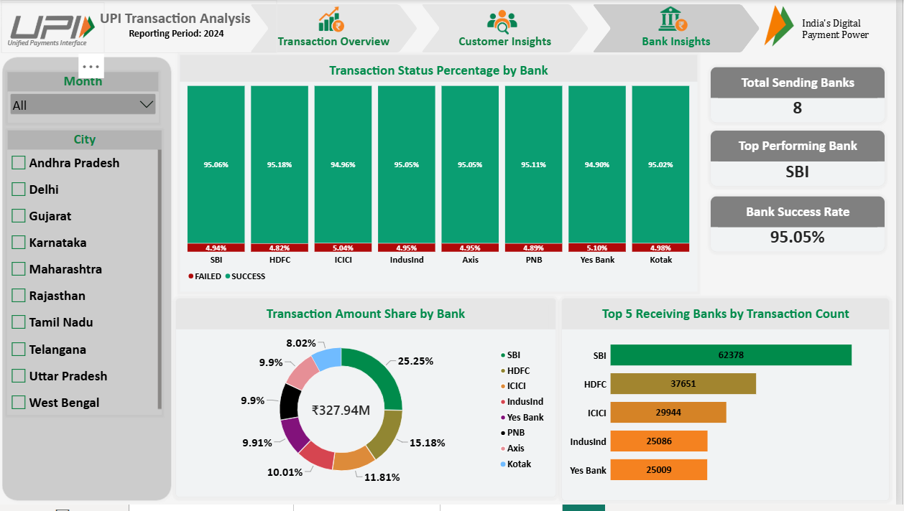
Dashboard Page 3 — Bank Insights
COMPARE BANK ACTIVITY AND THE SUCCESS OF TRANSACTIONS
12

Slide 13
Key analysis — the story across all three pages
SIMPLE, CONNECTED FINDINGS
1. Overall activity
2. Customer patterns
3. Bank patterns
The dashboard summarizes transaction volume, total value, average amount and payment outcomes.
Age group, state, device and merchant-category views show where transactions and value are concentrated.
Bank cards and charts compare successful transaction counts, success rates and value contribution.
What we can reasonably conclude
The report makes it easier to see the overall scale of activity and compare transaction outcomes.
Ranked visuals help prioritize the largest states and merchant categories for further review.
Tooltips and slicers let a viewer investigate details instead of relying only on headline totals.
14

Slide 14
Business insights & recommendations
TURN OBSERVATIONS INTO PRACTICAL NEXT STEPS
Review failed transactions
Plan for busy periods
Focus on leading segments
Explore failures by bank, transaction type, device and network to find patterns worth investigating.
Use monthly trends to identify periods of higher activity and plan monitoring or support accordingly.
Use state rankings and merchant-category shares to decide which segments to examine more closely.
What this dashboard supports
Provides one dashboard to track transaction volume, amount, and success rate.
Makes it easy to compare customer groups, merchant categories, and bank performance.
Helps identify patterns and areas for further investigation, but does not confirm the exact reasons behind transaction failures or customer behavior.
15

Slide 15
Conclusion — from transactions to decisions
This project turns transaction records into a simple three-part story: what happened, who contributed, and how banks performed.
Transaction Overview
Customer Insights
Bank Insights
Understand scale, value, trends and success/failure.
Understand leading age groups, states, devices and merchant categories.
Compare successful activity, success rates and bank value share.

Slide 16
THANK YOU

