Slide 1
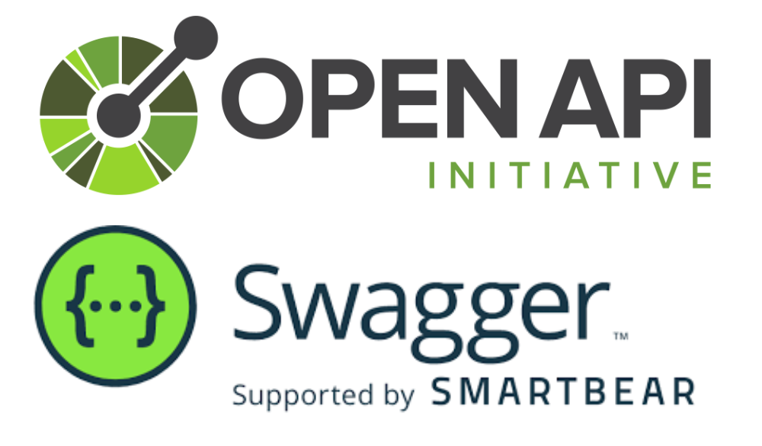
OpenAPI/Swagger specification
Reference: https://swagger.io/specification/
The OpenAPI Specification (OAS) defines a standard, language-agnostic interface to RESTful APIs, allowing both humans and computers to discover and understand the service’s capabilities without access to source code, documentation, or through network traffic inspection.
When properly defined, a consumer can understand and interact with the remote service with minimal implementation logic.
An OpenAPI definition can then be used by documentation generation tools to display the API, code generation tools to generate servers and clients in various programming languages, testing tools, and many other use cases.

Slide 2

Swagger UI generator:
https://swagger.io/tools/swagger-ui/
OpenAPI code generator tool:
https://openapi-generator.tech/docs/installation/

Slide 3
Command to run Swagger UI with local open API spec:
docker run -p 80:8080 -e SWAGGER_JSON=/foo/openapi.yaml -v <path-to openapi.yaml>:/foo swaggerapi/swagger-ui
Command to generate Golang server stub :
openapi-generator generate -i <path-to-openapi.yaml> -g go-server -o ./go-server --api-name-suffix petStore
Command to generate Python flask server stub :
openapi-generator generate –I <path-to-openapi.yaml> -g python-flask -o ./python-server --api-name-suffix petStore

