Slide 1
Model Prediction F1 racing

Slide 2
GOAL:
Forecast 5 future lap times for a F1 driver for a specific race using data from 2014-2023
APPROACH:
Statistical Learning
Machine Learning
ERROR METRICS:
RMSE (Root Mean Squared Error)
MAE (Mean Absolute Error)
STEPS:
Data Aggregation
Data Visualization
Model Selection
Model Tuning
Comparison of Models

Slide 3
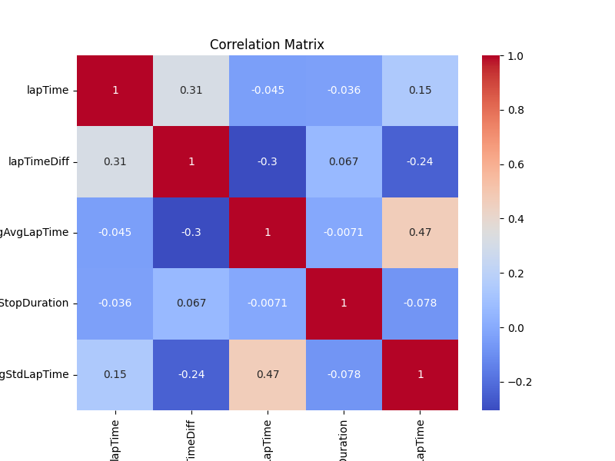
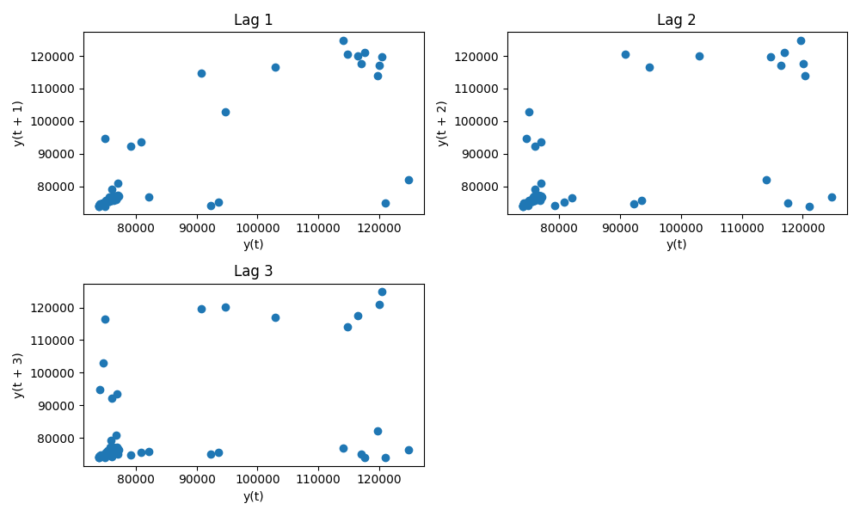
Data Visualization
Moderate positive and negative correlation among some variables
If lag plot is linear, we can infer that the underlying structure is of the autoregressive model and autocorrelation is present
If lag plot is of elliptical shape, we can say that the underlying structure represents some continuous periodic function
Not clear from the lag plots the distribution of the data

Slide 4
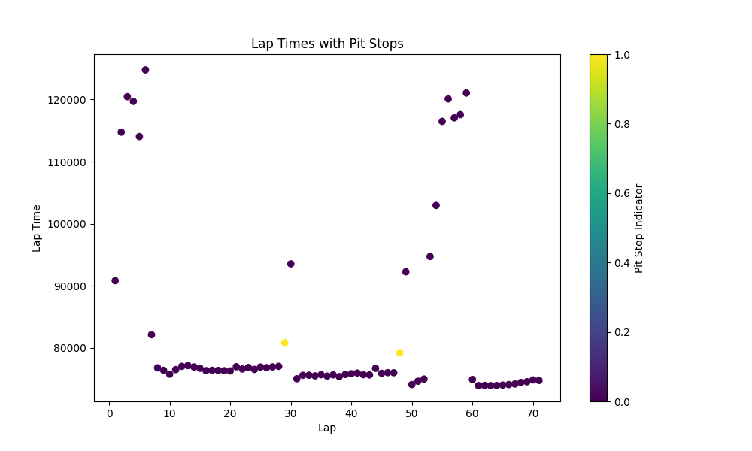
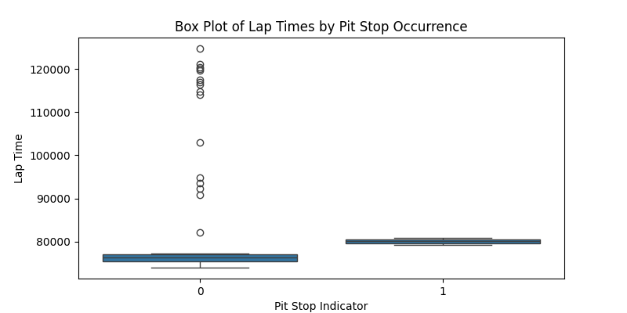
Data Visualization
The presence of sudden peaks in the lap times can be attributed to pit stops during the race. These pit stops lead to abrupt increases in lap times compared to the general trend. By incorporating pit stop information into our dataset, we effectively capture and explain these periodic spikes in lap times.

Slide 5
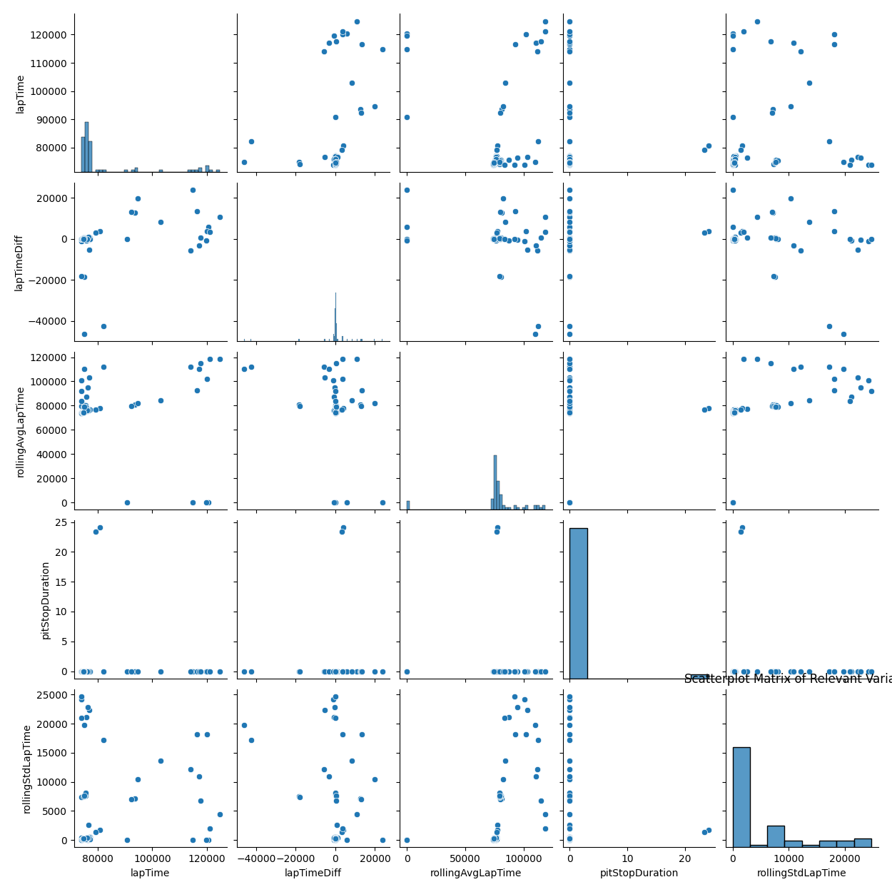
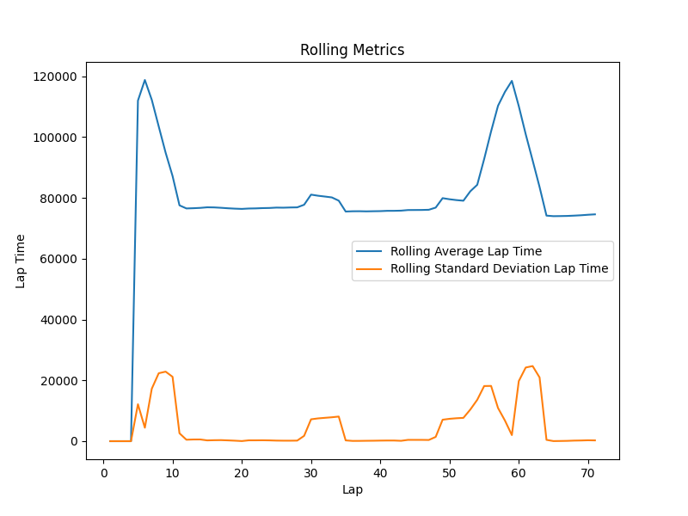
Data Visualization
The rolling average lap time captures the overall trend and smoothens out the short-term fluctuations
The rolling standard deviation, on the other hand, measures the variability of lap times within a sliding window

Slide 6
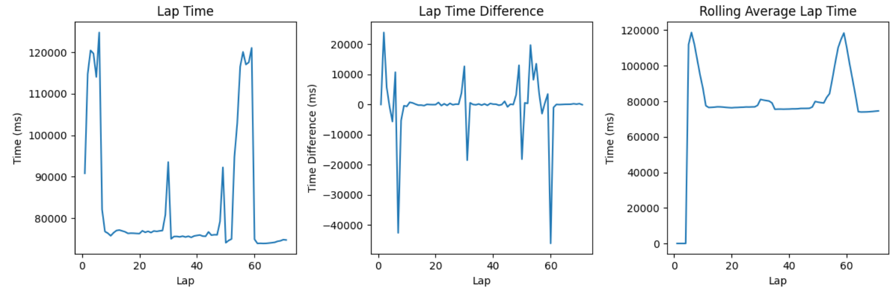
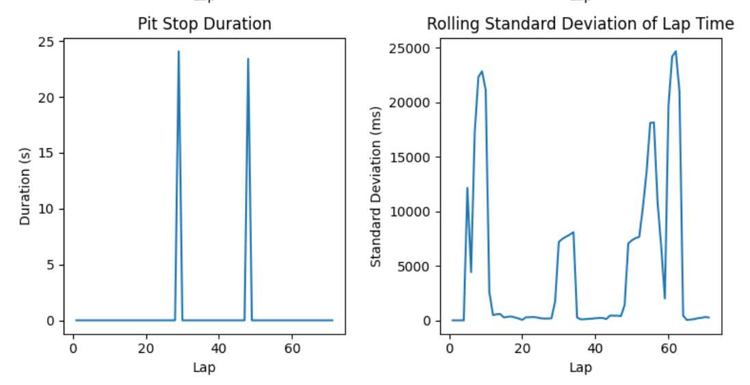
Data Visualization
We can observe that the standard deviation remains relatively constant, and the mean does not exhibit significant shifts over time
Additionally, there is an absence of strong seasonality patterns indicating stationarity

Slide 7
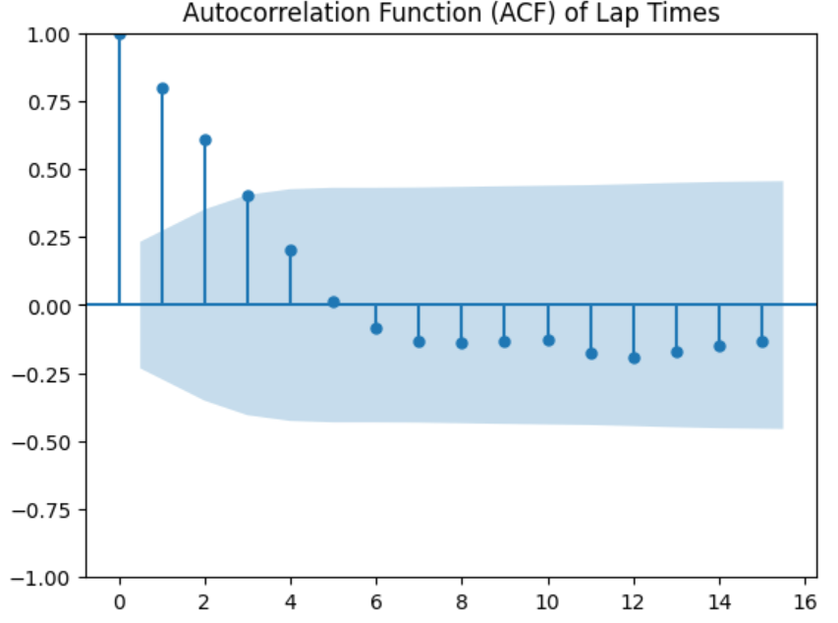
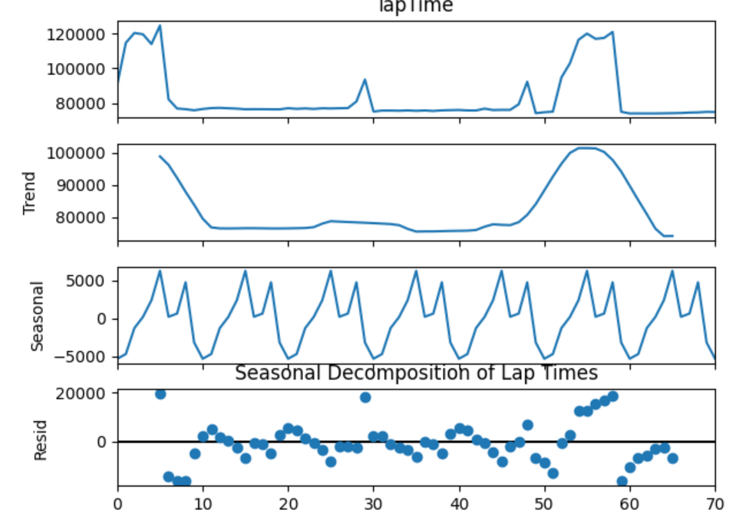
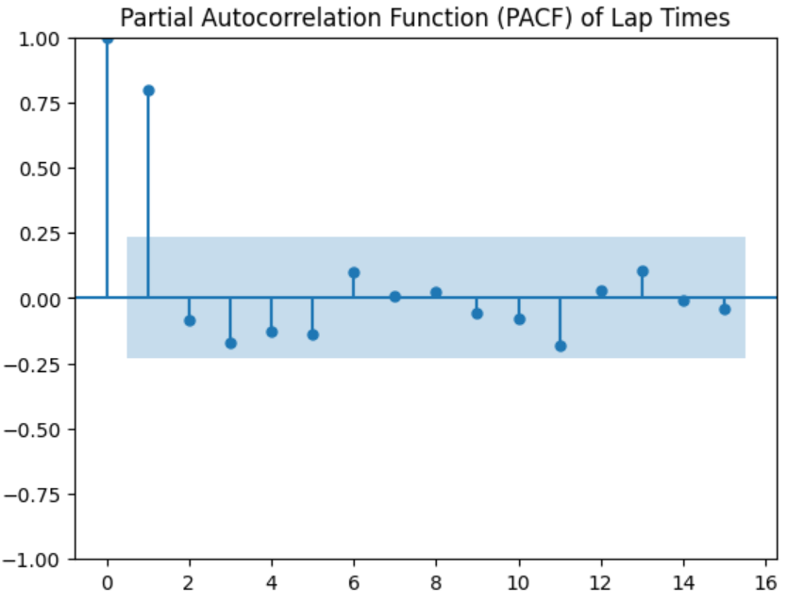
Data Visualization
ADF test used for stationarity
One variable is found non-stationary and is made stationary by using differences
From ACF plots it can be seen that high correlation values with the few initial lags of lap times

Slide 8
Error Metrics for Models
RMSE and MAE as evaluation metrics is appropriate for this regression task of predicting lap times
RMSE gives a higher penalty to larger errors, while MAE is more interpretable and less sensitive to outliers.
Data has few examples and hence advanced auto-regression methods like VAR or deep learning methods like Attention based LSTMs won’t be needed and simpler models can suffice
Multivariate time series forecasting and for this both these models can function well. (due to less data, ARIMA can conduct good multivariate predictions even though it is mainly good for univariate settings).

Slide 9
ARIMA Model Specification
Best Hyperparameters with lowest RMSE in train set:
(p,d,q) = (2,1,0) ARIMA(2, 1, 0) model
Test RMSE = 0.009
Test MAE = 0.007

Slide 10
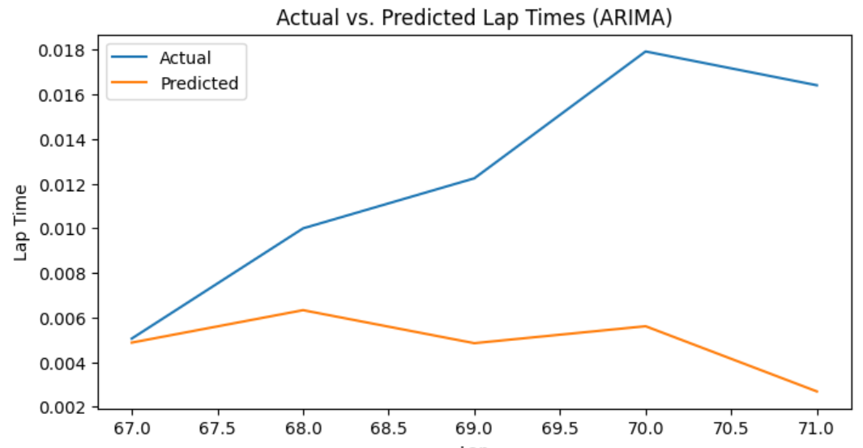
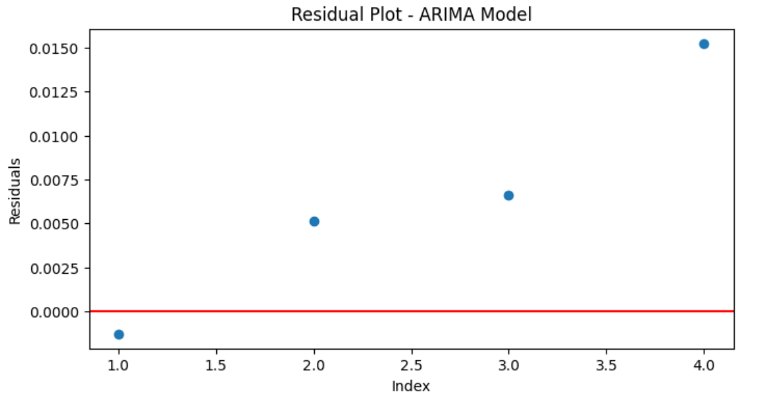
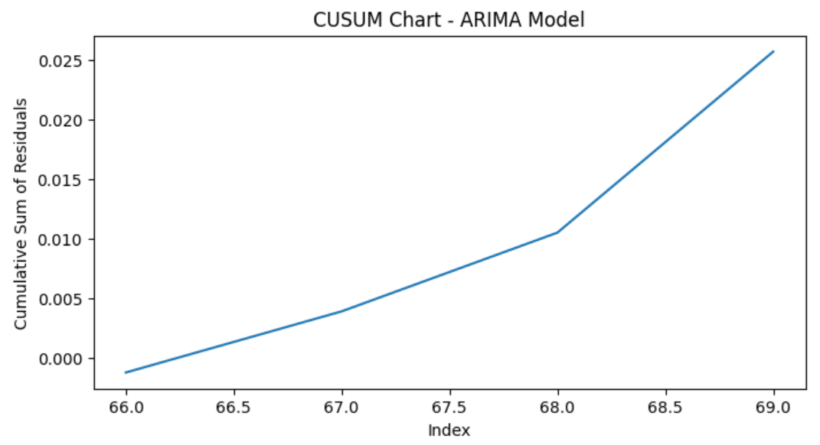
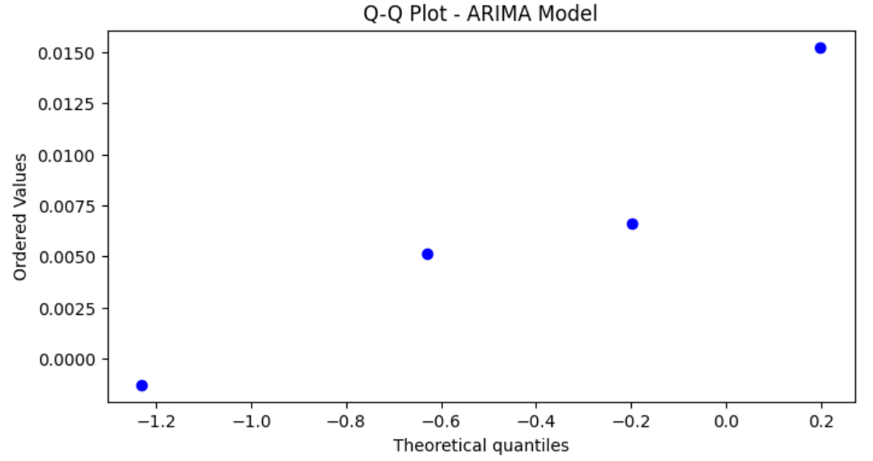
ARIMA Model Results
CUSUM chart and test is used to monitor whether a process is drifting away from its mean. The cumulative sums stay within a region near the expected value of zero
Q-Q plot can be used to quickly check the normality of the distribution of residual errors - here it can be compared to Gaussian distribution

Slide 11
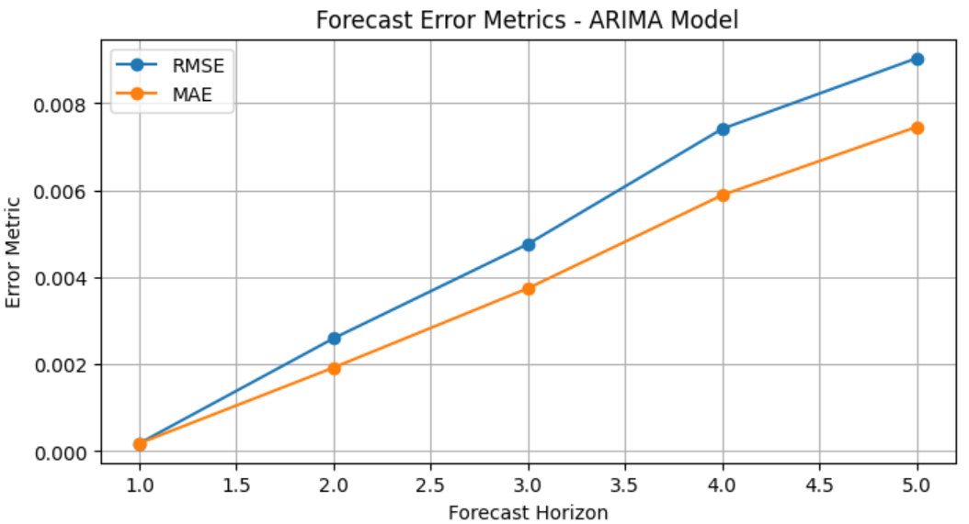
ARIMA Model Results

Slide 12
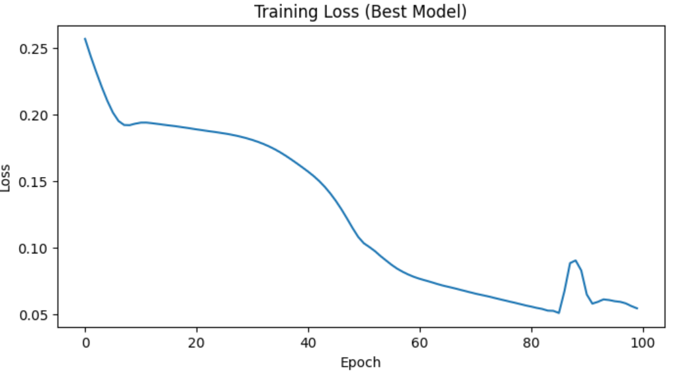
LSTM Model Specification
hidden_dim = 32
num_layers = 2
num_epochs = 100
batch_size = 16
window_sizes = [5, 10, 15, 20]
Best Window Size = 20
Best RMSE = 0.0393
Test RMSE = 0.0641
Test MAE = 0.0526

Slide 13
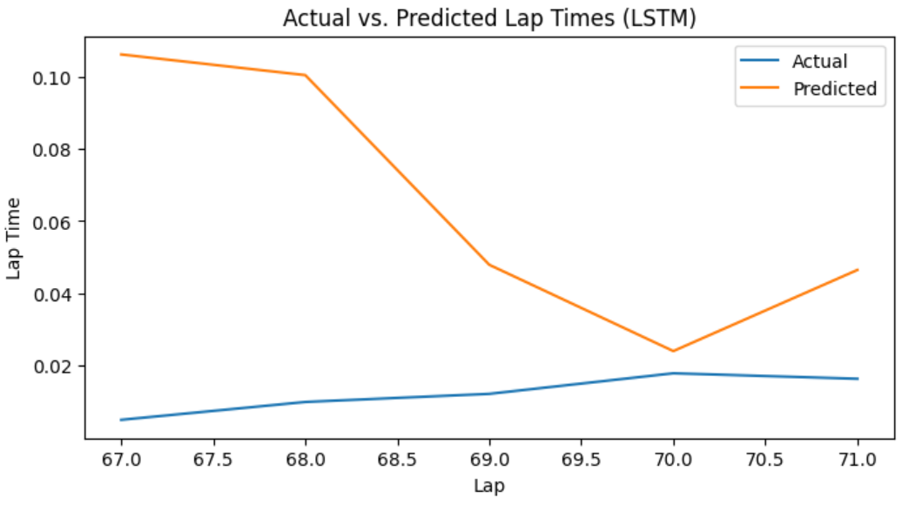
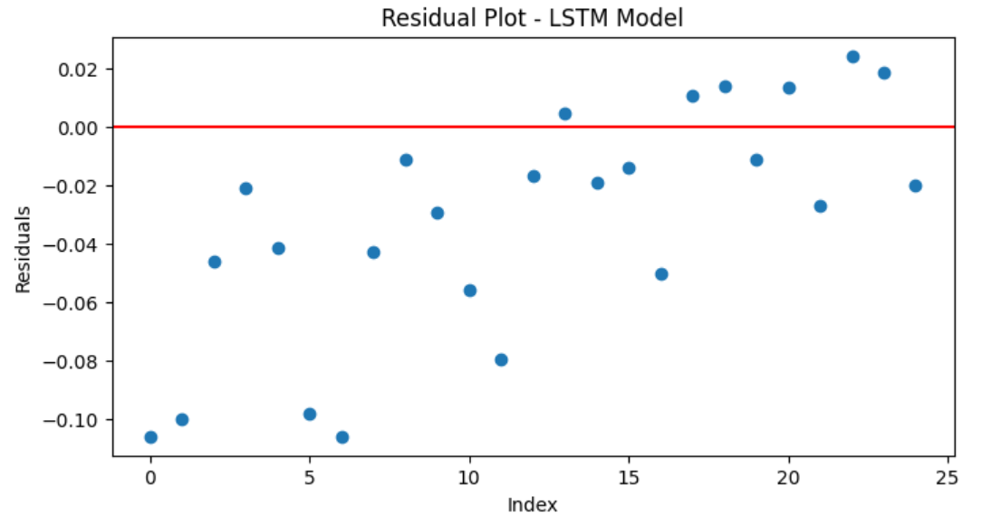
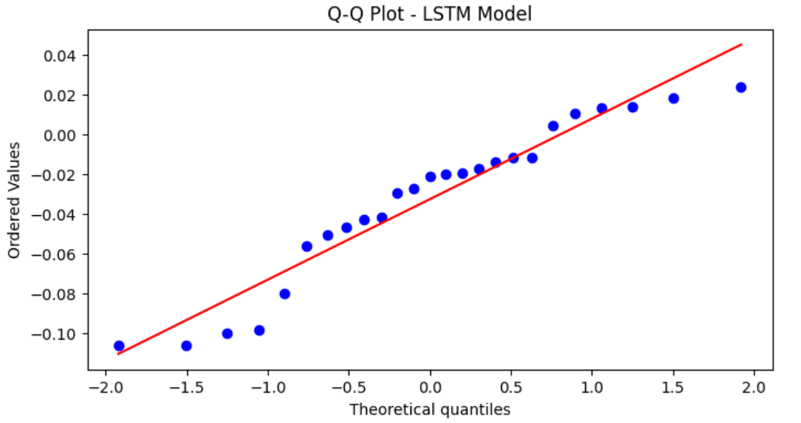
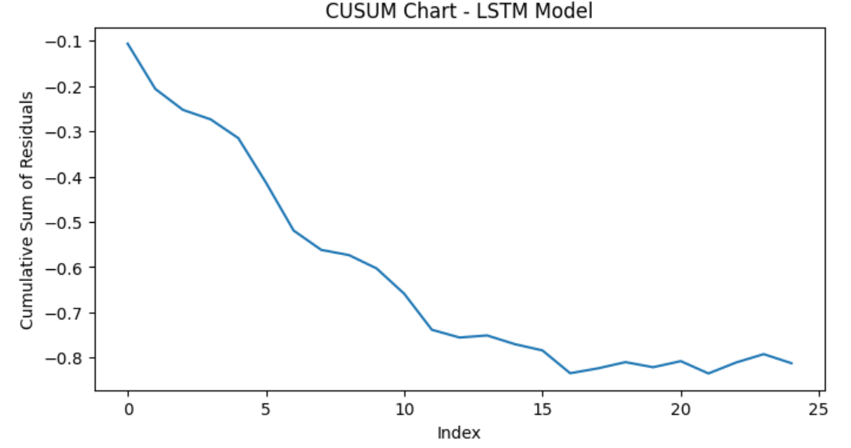
LSTM Model Results

Slide 14
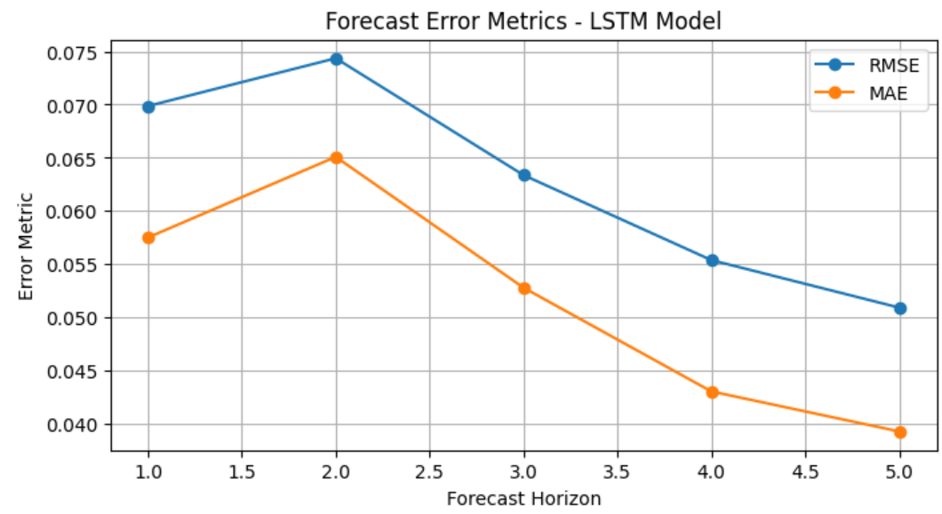
LSTM Model Results

Slide 15
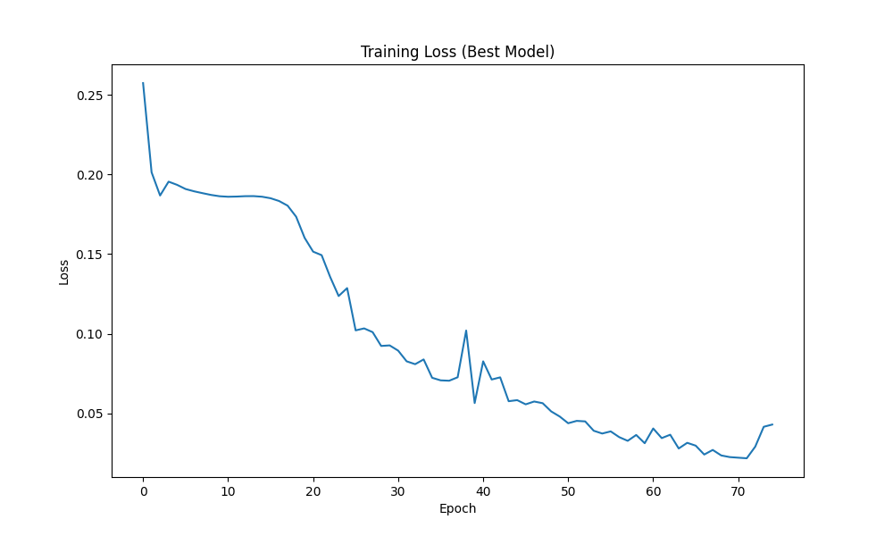
LSTM Model Tuning (Optuna)
hidden_dim = 52
num_layers = 4
learning rate = 0.003
num_epochs = 100
batch_size = 16
Best Window Size = 19
Best RMSE = 0.0167
Test RMSE = 0.0227
Test MAE = 0.02117

Slide 16
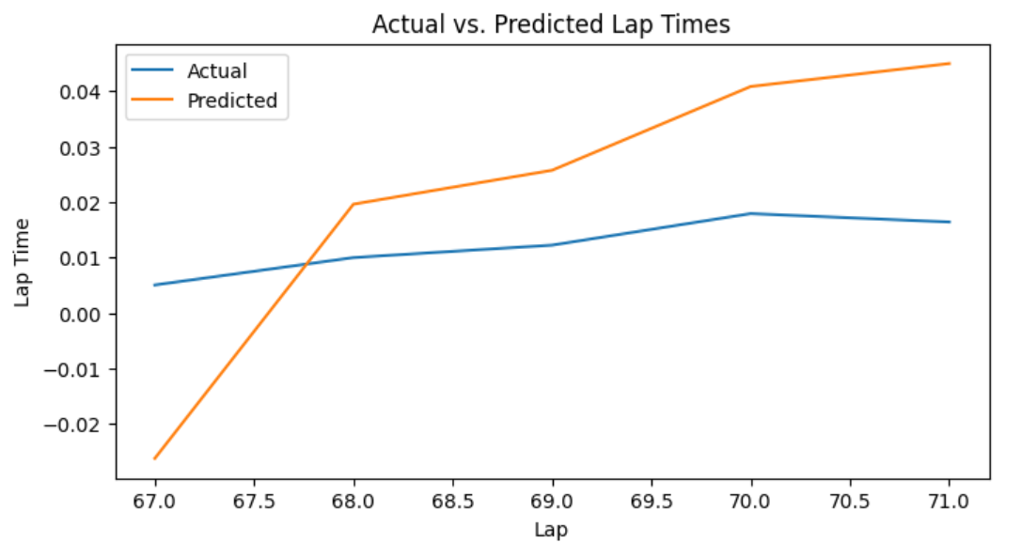
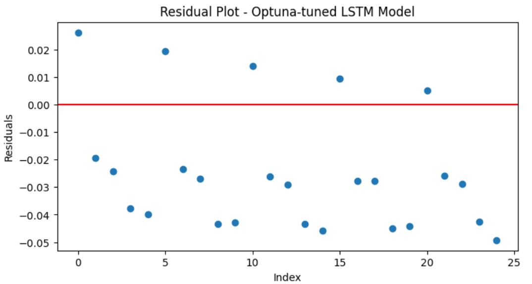
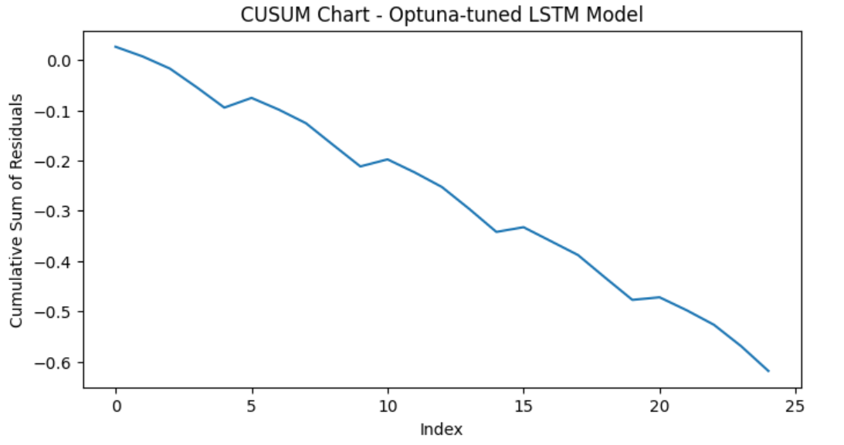
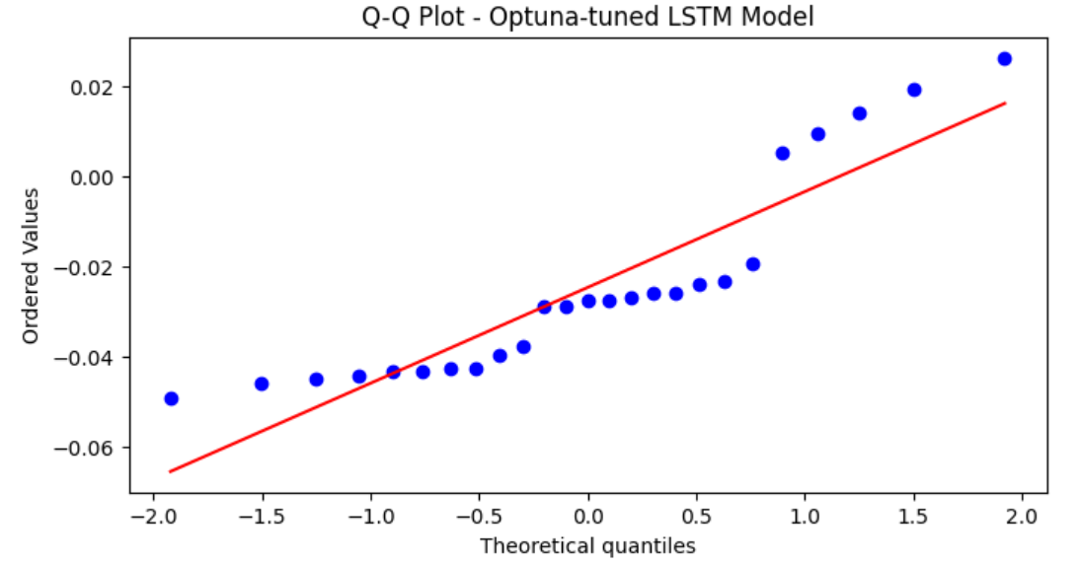
LSTM Model Results (with hyperparameter tuned - Optuna)

Slide 17
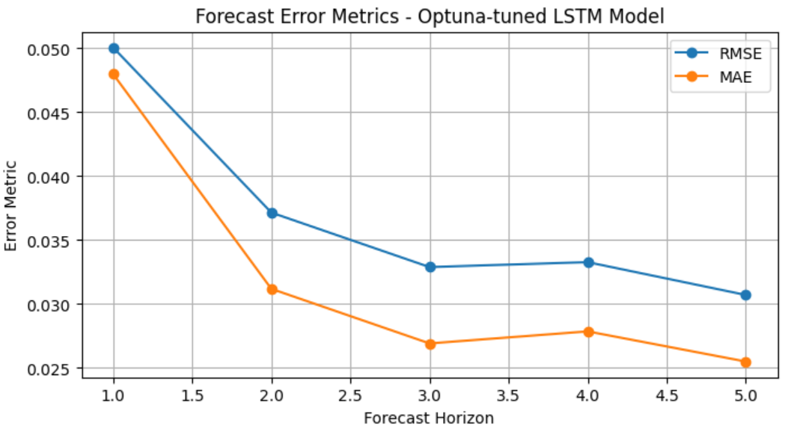
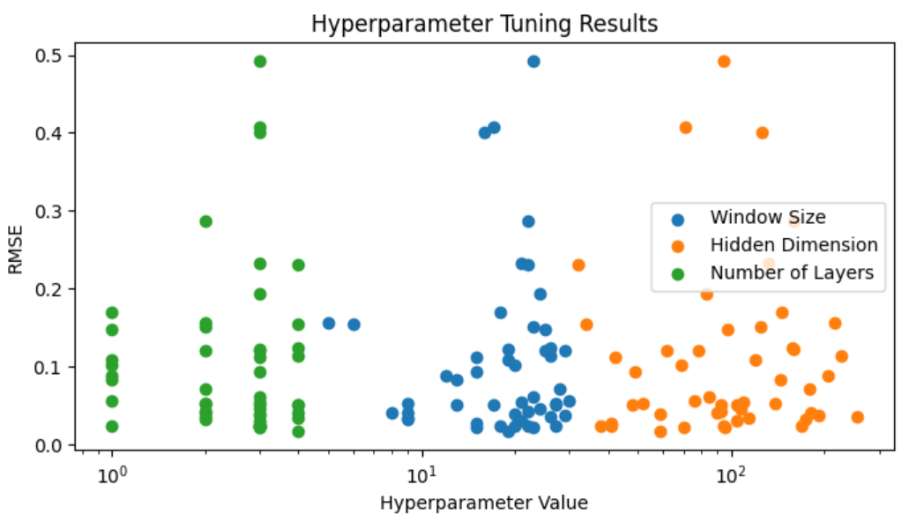
LSTM Model Results (with hyperparameter tuned)
Hyperparameter Tuning results from Optuna

Slide 18
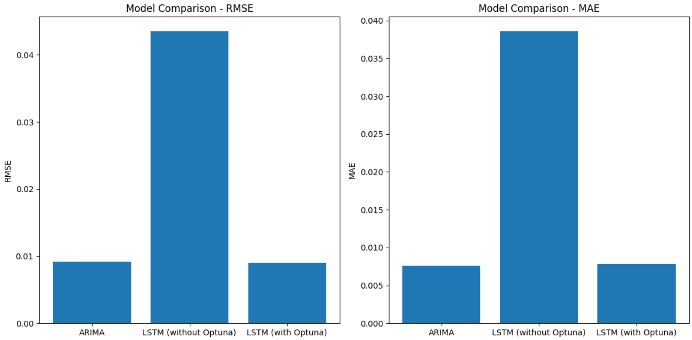
Model Comparison
Model | RMSE | MAE
ARIMA | 0.0091 | 0.0075
LSTM | 0.0434 | 0.0385
LSTM (Optuna Tuned) | 0.0089 | 0.0078

Slide 19
Summary
Stationarity - Any non-stationarity was addressed through differencing
Logical feature elimination - Irrelevant features were logically eliminated from the initial dataset by removing columns that did not vary with changing lap numbers or provide useful information about lap times
Feature engineering - New variables like lap time differences, rolling averages, and rolling standard deviations were created to capture trends, seasonality, and variability in lap times. Pit stop indicators and durations were also incorporated to better explain periodic lap-time spikes
Normalizing and de-normalizing data - Min-max normalization was applied to scale the features to a common range, Use of window size and its tuning - For the LSTM model, the optimal window size (number of previous lags) was determined through systematic tuning, evaluating performance across different window lengths
Hyperparameter tuning with Optuna - Automated hyperparameter tuning using Optuna library was employed for the LSTM
RMSE and MSE metrics - Model accuracy was evaluated using the RMSE and MAE on the held-out test set. RMSE penalizes larger errors more heavily, while MAE is more interpretable and robust to outliers

Slide 20
Summary
Most of the data series were stationary
RMSE and MAE have lower values for ARIMA vs LSTM but similar when we tune LSTM with Optuna
ARIMA is much faster than LSTM in terms of convergence and fitting
LSTM might perform better with more data
LSTM hyper parameters were optimized with Optuna rather than Grid Search

Slide 21
Thank You

