Slide 1
Text Classification using CNN+GloVe

Slide 2
Major Steps
Data Collection
Data Pre-processing
Data Annotation
Embedding Model Generation
Classification Model Training & Verification

Slide 3
Classification Model Training
Convolutional Neural Network (CNN):
Input Layer: A sentence tokenized into words, then converted into embeddings.
Convolutional Layer: Filters of different sizes applied to these embeddings.
Max-Pooling Layer: Reduction of the feature maps.
Fully Connected Layer: Final classification based on pooled features.

Slide 4
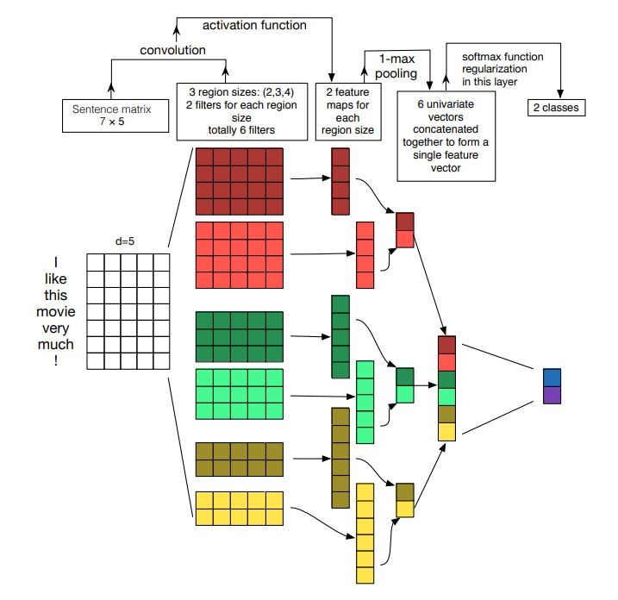

Slide 5
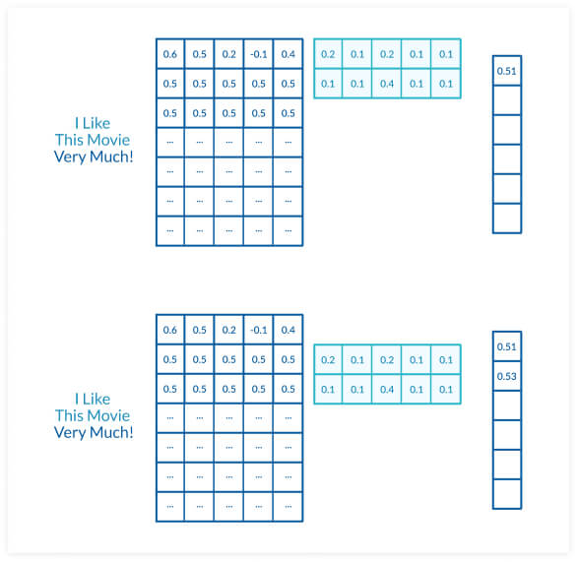

Slide 6
Details in Colab …

