Slide 1
Text to Feature Representation: Embedding Model Generation, Evaluation & Feature Representation
Dr. Md. Rajib Hossain
Senior Software Engineer in R & D
TigerIT BD LTD.
Cell: +8801720596038
Email: rajcsecuet@gmail.com

Slide 2
Word Embeddings(1/3)
Idea: Learn embeddings from words based on semantic, syntactic, and context-aware meanings, and represent them as vectors.
Need to have a function W(word) that returns a vector encoding that word.
Input: Unlabelled Corpus ( e.g., [w₁, w₂, …, w_{V}], where V = number of words in corpus)
Output: Embedding Model ( i,.e., V x N ), where N=embedding dimension

Slide 3
Word Embeddings(2/3)
Corpus: Large structured collection of text data used for training, evaluating, and analyzing language models and algorithms
Syntactic meaning: Refers to the structure of a word and sentence
The cat sleeps on the mat follows grammatical rules.
Do, Doing
Semantic meaning: Refers to the meaning of words and sentences
The cat sleeps on the mat means that a cat is resting on a mat.
Beautiful, Lovely

Slide 4
Word Embeddings(3/3)
Context : Refers to the surrounding text or information that influences the meaning of a word or sentence
I ate an apple vs. Apple released a new iPhone, context helps determine whether "apple" refers to a fruit or the tech company

Slide 5
Embedding Methods (1/2)
Traditional:
One-hot Encoding
Bag of Words
TF-IDF
Non-Contextual:
Word2Vec (Prediction-based/ Neural Embeddings)
FastText (Sub-word with Prediction-based/ Neural Embeddings)
GloVe (word-word correlation & Matrix Factorization)

Slide 6
Embedding Methods (2/2)
Contextual (Transformer-based Language Model):
BERT (Pre-training of Deep Bidirectional Transformers for Language Understanding)
ELECTRA (Pre-training Text Encoders as Discriminators Rather Than Generators)
RoBERTa (A Robustly Optimized BERT Pretraining Approach)
Large Language Models (Generative AI):
GPT
Llama

Slide 7
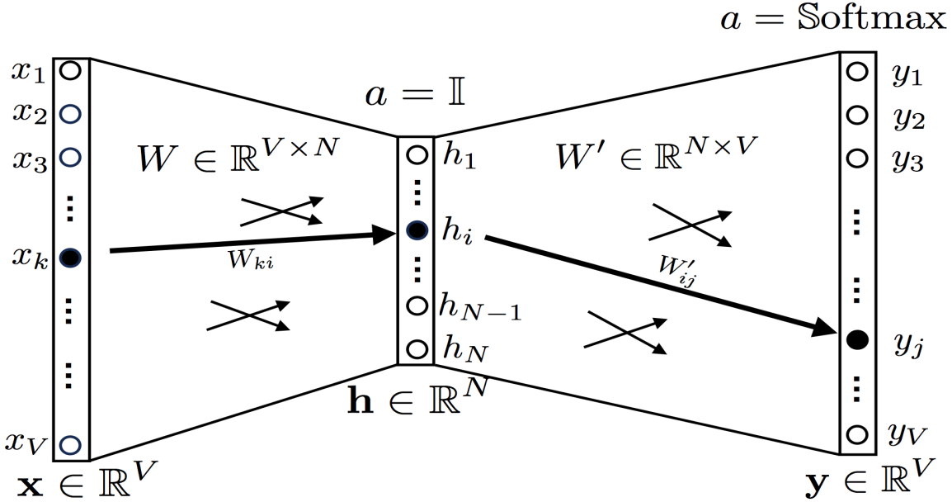
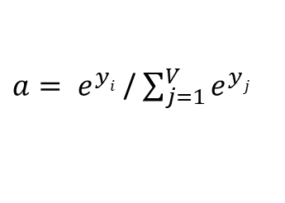
Word2Vec (1/8)
Basic Structure:
Impactful Hyperparameters:
Window: Maximum distance between the current and predicted word within a sentence.
min_count: Ignores all words with total frequency lower than this.
Embedding dimension (N)
Trainable Matrix: W & W’
$a= e^{yi}$ / $\sum_{j=1}^{V}{e^{yj}}$

Slide 8
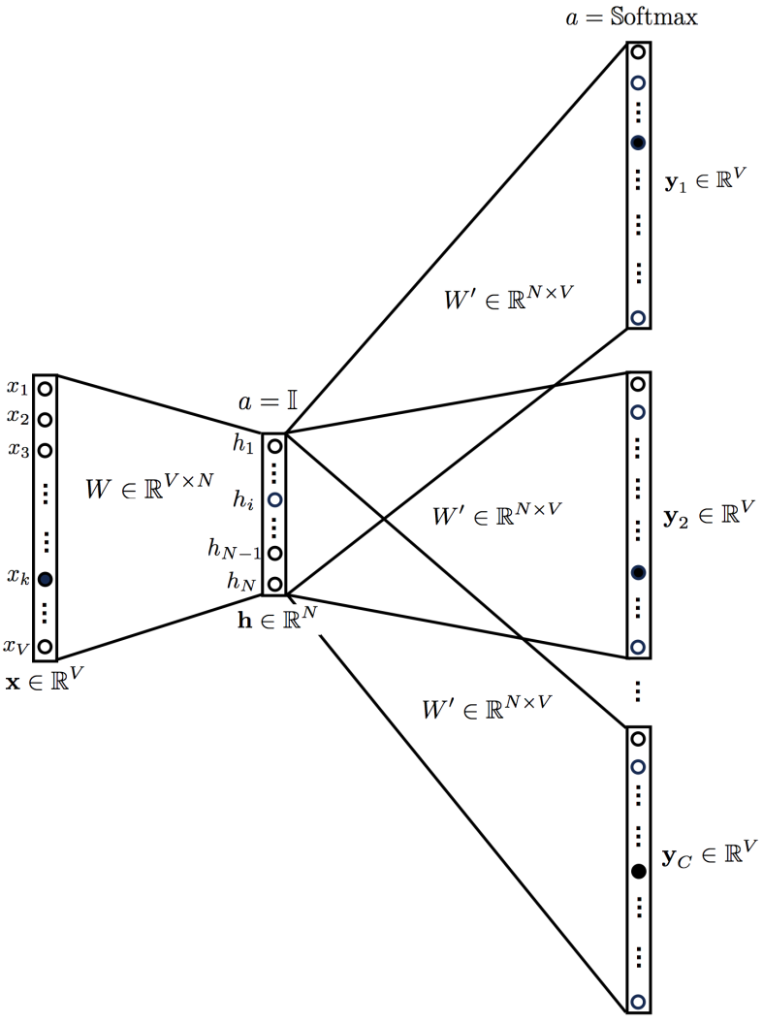
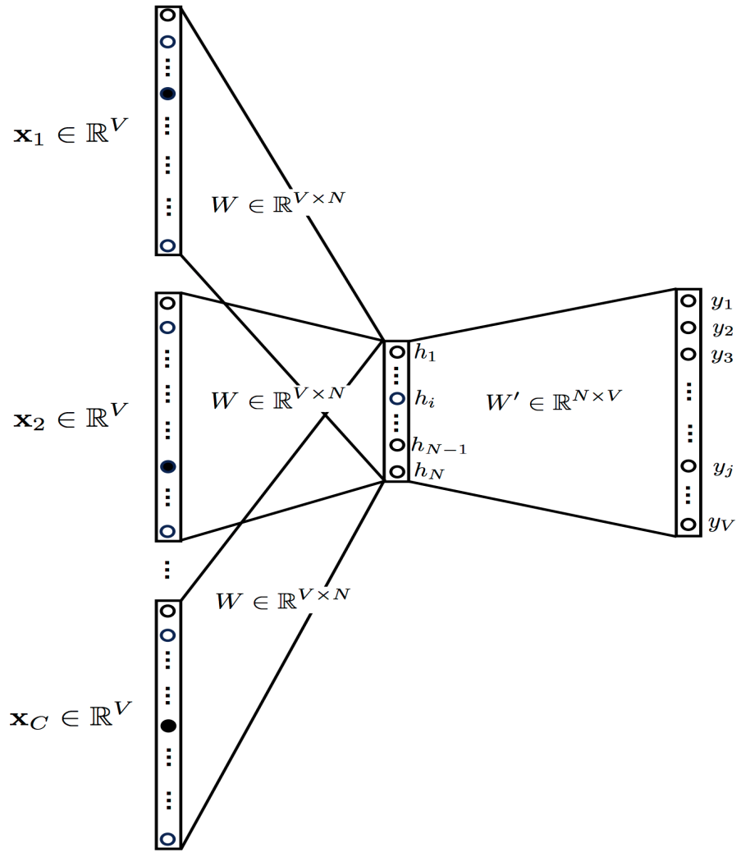
Word2Vec (2/8)
Variants:
CBOW
Skip-Gram

Slide 9


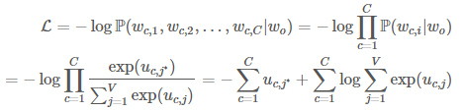
Word2Vec (3/8)
Objective Function for Skip-Gram (loss):

Slide 10
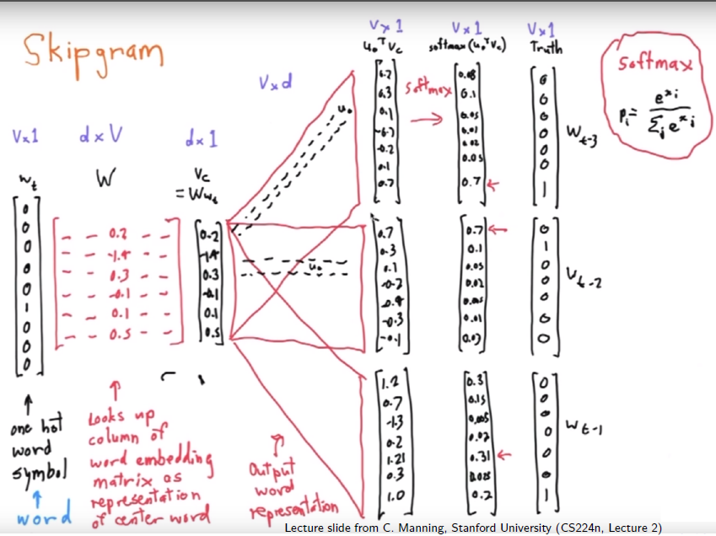
Word2Vec (4/8)
Example:

Slide 11
Word2Vec (5/8)
Python Scripting:
Installations command for Ubuntu
Step1: Install Numpy
pip install numpy‑1.13.1+mkl‑cp34‑cp34m‑win32.whl
Step2: Install SciPy
pip install scipy‑0.19.1‑cp34‑cp34m‑win32.whl
Step3:
pip install gensim‑2.3.0‑cp34‑cp34m‑win32.whl

Slide 12
Word2Vec (6/8)
Python Scripting:
Train Word2Vec
from gensim.test.utils import common_texts
from gensim.models import Word2Vec
model = Word2Vec(sentences=common_texts, vector_size=100, window=5, min_count=2, workers=8)
model.save("word2vec.model")

Slide 13
Word2Vec (7/8)
Python Scripting:
Test Word2Vec
model = Word2Vec.load("word2vec.model")
vector = model.wv['computer']
sims = model.wv.most_similar('computer', topn=10)
URL: https://radimrehurek.com/gensim/models/word2vec.html

Slide 14
Word2Vec (8/8)
Example:
Word | Dimension 1 | Dimension 2 | Dimension 3 | ... | Dimension N
King | 0.23 | -0.15 | 0.84 | ... | 0.56
Queen | 0.11 | -0.20 | 0.90 | ... | 0.45
Man | 0.30 | -0.12 | 0.80 | ... | 0.50
... | ... | ... | ... | ... | ...

Slide 15
GloVe: Global Vectors for Word Representation
GLoVe: Unsupervised learning algorithm used to generate word embeddings based on global word-word co-occurrence statistics from a corpus.
Details: https://nlp.stanford.edu/projects/glove/

Slide 16
FastText
https://pypi.org/project/fasttext/
https://radimrehurek.com/gensim/models/fasttext.html

Slide 17
Applications
Next word Prediction
Semantic Similarity
Syntactic Similarity
Relatedness
Text Classification
Machine Translation
Information Retrieval
Recommendation Systems
Named Entity Recognition
Semantic Search

Slide 18
Embedding Model Evaluation
Intrinsic Evaluation
Spearman
Pearson
Cosine Similarity
https://aclanthology.org/2020.icon-main.61.pdf
https://www.sciencedirect.com/science/article/pii/S0957417421008174

