Slide 1
University management system Presented By M K Omar (232061005-CSIT) Abdul Kader Anik (232071075-CSE) Shahajadi Akter (232071110-CSE) Barisha Hyder (232061010-CSIT) Miftahul Jannat Trishna (232061011-CSIT) Saeeda Muhtasima Binte Shahid (232071095-CSE) Submitted to Md. Akram Hossain Lecturer dept of CSE & CSIT

Slide 2
Introduction In modern universities, managing various academic and administrative tasks efficiently is crucial for smooth operations. A University Management System (UMS) is a software solution designed to handle student records, course management, faculty details, attendance tracking, and other essential university functions. This project, developed by we, aims to create a comprehensive and user-friendly management system using C++ with Qt 5.12.12 and an SQL database. The system provides a structured and automated approach to managing university activities, reducing manual work and minimizing errors.

Slide 3
The system is designed with students and faculty in mind, ensuring seamless interaction between users and administrative functions. Students can register for courses, view academic records, and semester result, while faculty members can manage class schedules, track student progress, and others records. Additionally, role-based authentication ensures secure access to different features based on user privileges.

Slide 4
Detailed Design Document: University Management
System
A Detailed Design Document (DDD) outlines the technical details of a system, serving as a blueprint for developers. It includes class diagrams, interface specifications, and design patterns, bridging the gap between design and implementation. This document details the design of a University Management System.

Slide 5
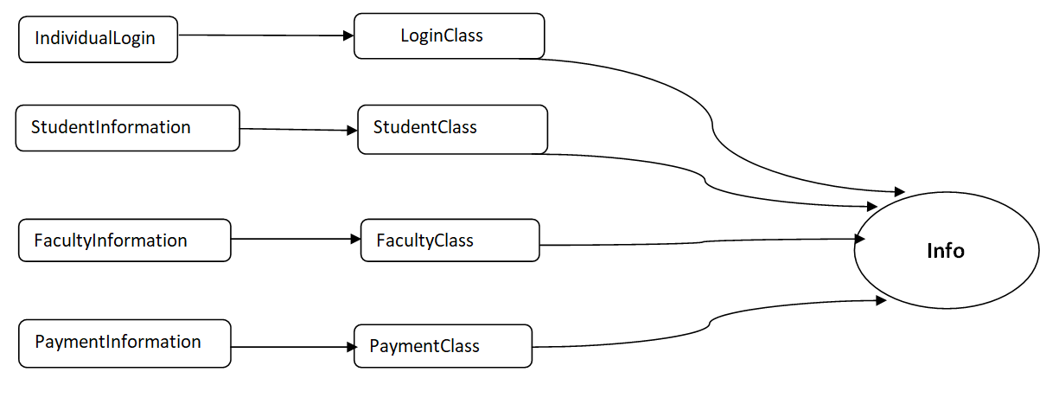
Proposed Conceptual Class Diagram

Slide 6
Specify Interfaces
Interfaces define contracts for classes, promoting loose coupling and flexibility. In this system, we propose the following interfaces:
UserAuthentication: Defines methods for user login and authentication (e.g., login(), logout(), verifyCredentials()). Implementations: StudentUser, FacultyUser, AdminUser.
DataPersistence: Defines methods for data storage and retrieval (e.g., save(), load(), update(), delete()). Implementations: DatabaseStorage, FileStorage (for potential future flexibility).

Slide 7
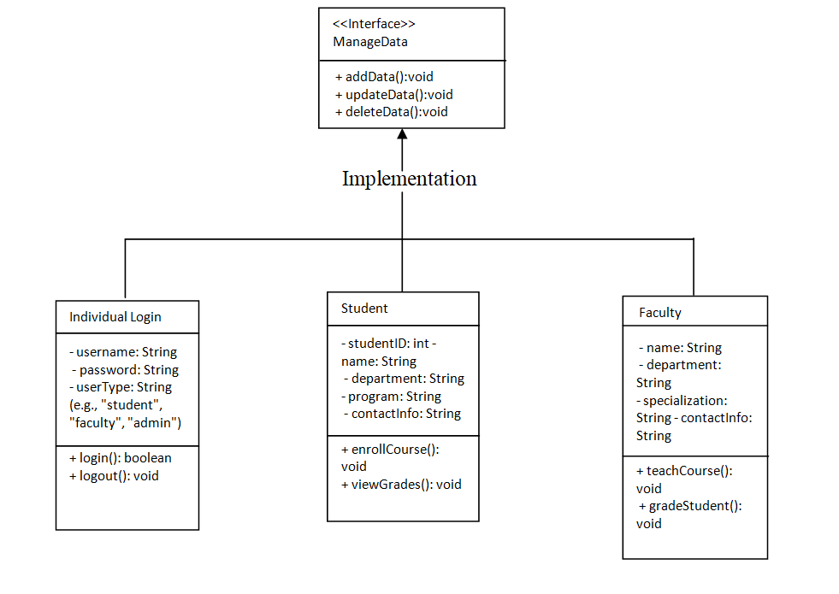

Slide 8
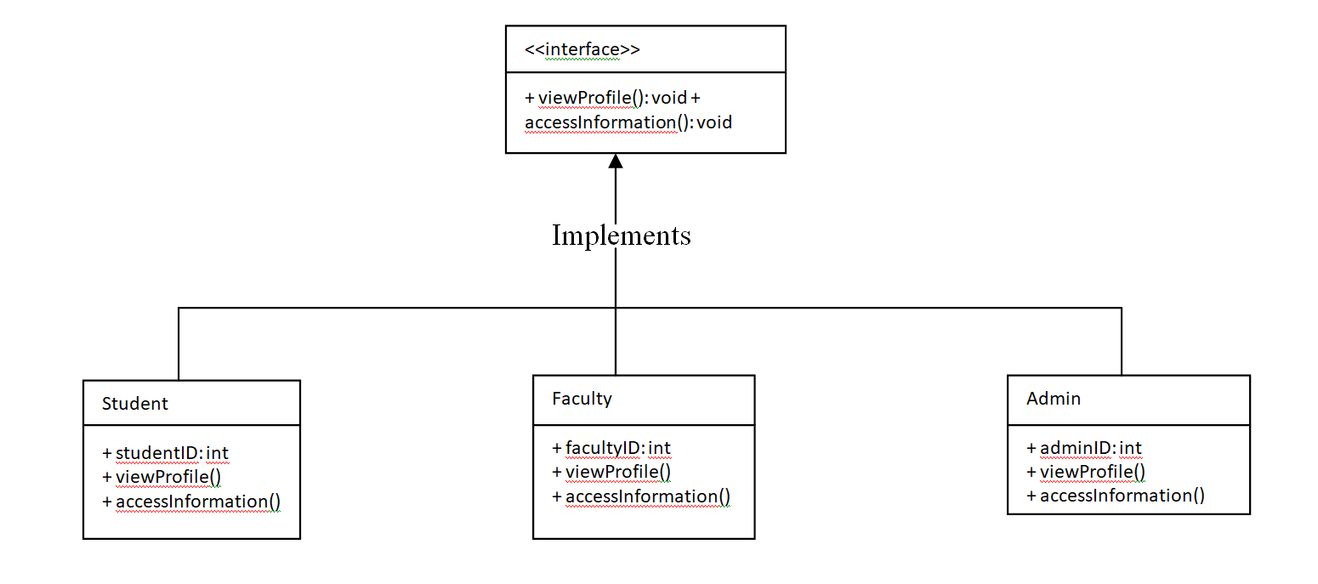
Insertdata interface

Slide 9
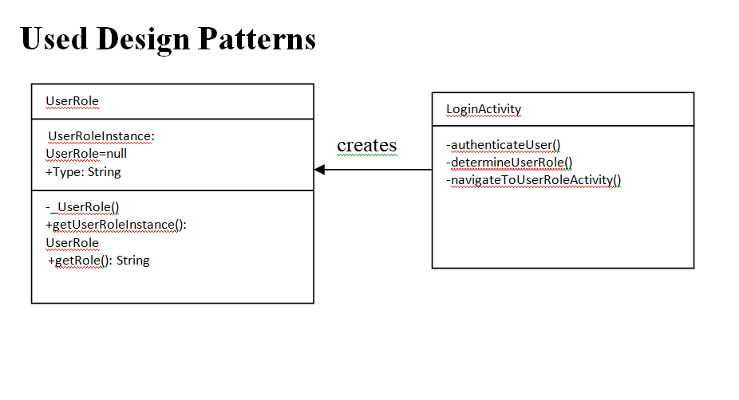
Singleton Design Pattern
The Singleton pattern ensures that a class has only one instance and provides a global point of access to it. This is useful for managing resources like database connections.

Slide 10
University Management System Feasibility Study
Introduction
A feasibility study evaluates the practicality and potential success of a
proposed system. In software development, it is crucial for determining
whether the system aligns with performance, technical, and financial
requirements. The objective of this document is to analyze whether the
proposed University Management System (UMS) is viable and to
recommend the best solution.
Key goals of this feasibility study:
1. To assess the system’s ability to meet operational and technical needs.
2. To evaluate the financial feasibility of implementing the system.
3. To explore challenges and opportunities, ensuring a robust
implementation strategy.

Slide 11
Background
Opportunities:
1. Streamlining processes through automation.
2. Providing a centralized platform for academic and administrative activities.
3. Enhancing student and faculty satisfaction with real-time access to information.
4. Enabling data-driven decision-making through analytics and reporting.
Challenges:
1. Inefficiency in managing student and faculty data.
2. Manual processes causing delays in admissions, fee management, and result processing.
3. Lack of integration between departments, leading to data silos.
4. Difficulty in tracking academic and administrative performance.

Slide 12
Outline of the System
The University Management System (UMS) aims to provide a
comprehensive platform for managing university operations efficiently.
The main components and functionalities include:
Student Management: Admission, enrollment, and academic record
tracking.
2. Faculty Management: Recruitment, payroll, and performance
evaluation.
3. Course Management: Curriculum design, scheduling, and attendance
tracking.

Slide 13
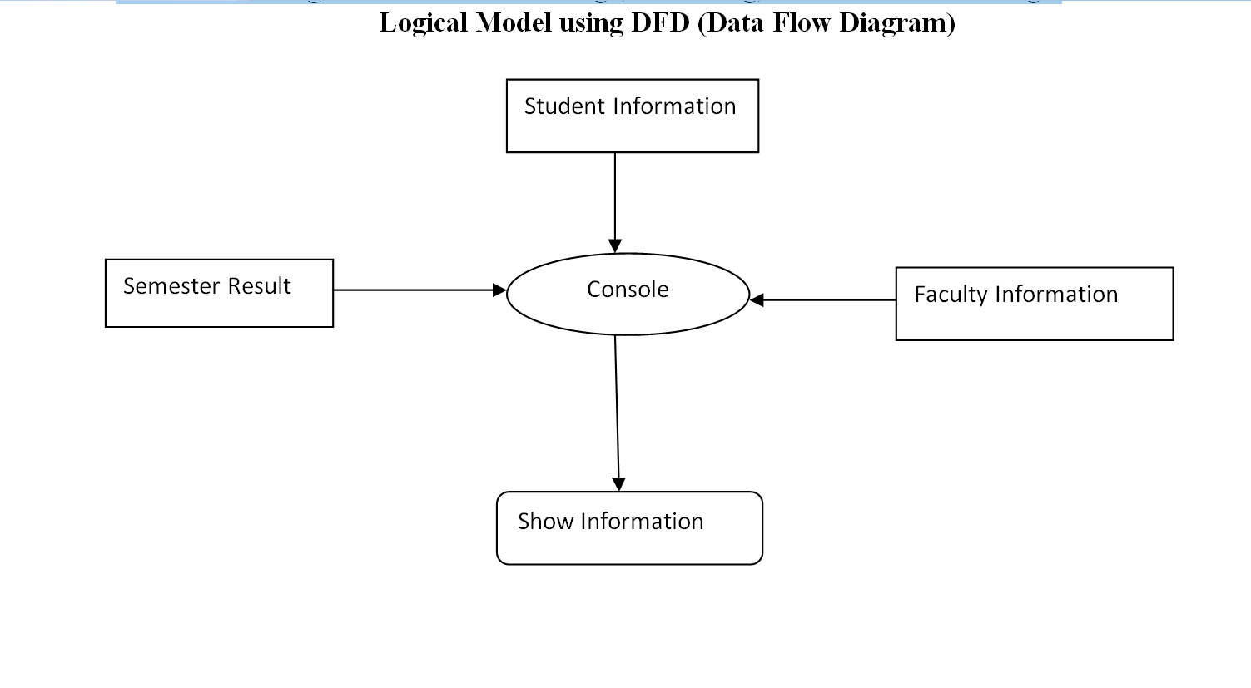

Slide 14
Methodology
The feasibility study evaluates three core aspects:
Technical Feasibility:
1. Assessing the availability of required technologies (e.g., cloud-based platforms, databases).
2. Ensuring compatibility with existing infrastructure and scalability for future needs.
Operational Feasibility:
1. Evaluating ease of use for students, faculty, and administrative staff.
2. Determining whether the system meets the university’s operational goals.
Economic Feasibility:
1. Calculating the costs of development, deployment, and maintenance.
2. Estimating the return on investment (ROI) through efficiency gains and reduced operational costs.

Slide 15
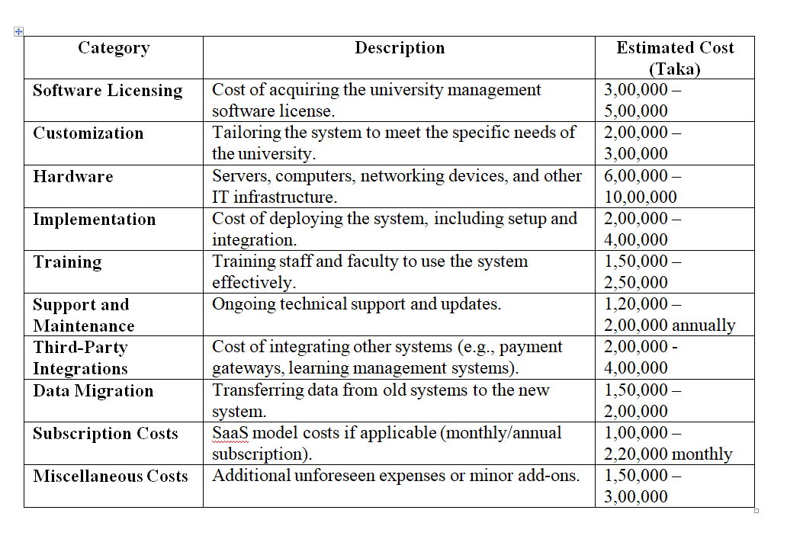
Overview of Alternatives

Slide 16
Total Estimated Cost
Initial Setup Cost: 20,50,000 – 35,70,000(taka)
Annual Recurring Cost: 1,20,000 – 2,00,000(taka)

