Slide 1
ACADEMIC PROJECT DEFENSE
Intelligent Fraud Transaction Detection
and AML Case Management
A dual-mode, research-guided platform for anomaly discovery, supervised fraud classification, explainable risk scoring, and governed investigation.
Md. Mydul Islam Anik • MIT Project • August 2026
Supervised By: Dr. B M Mainul Hossain
Institute of Information Technology (IIT), University of Dhaka
Notes:
Open by framing this as a complete investigation platform, not only a classifier. The defense will separate measured evidence from demo-only values.

Slide 2
THE PROBLEM
02
Fraud monitoring fails when one constraint is solved in isolation
01
Labels are often absent
03
Real-time decisions must stay fast
A new client may have transactions but no reviewed fraud outcomes.
Millions of rows belong in offline training—not inside one transaction request.
02
Fraud is rare and time-dependent
04
A score must be explainable
Random splits and plain accuracy can hide leakage and missed fraud.
AML staff need reasons, policy versions, cases, and auditable outcomes.
Design question
How can one system learn before labels exist, improve after labels arrive, scale to bank volumes, and still explain every decision?
INTELLIGENT FRAUD TRANSACTION DETECTION
Notes:
Use this slide to establish the four problems the architecture must solve together.
[Sources]
- https://fraud-detection-handbook.github.io/fraud-detection-handbook/Chapter_4_PerformanceMetrics/Summary.html
- https://proceedings.mlr.press/v151/bach-nguyen22a.html
[/Sources]

Slide 3
RESEARCH-GUIDED APPROACH
03
Published methods shaped the design—not the claimed results
01
Fraud Detection Handbook
Chronological evaluation, rare-event metrics, reproducible simulator
02
Isolation Forest + autoencoder literature
Complementary unsupervised anomaly views
03
Random Forest, Extra Trees, XGBoost
Robust nonlinear supervised baselines
04
Excess-Mass and anomaly-evaluation research
Label-free comparison without calling it fraud accuracy
Research determines the protocol. Project measurements determine the conclusion.
INTELLIGENT FRAUD TRANSACTION DETECTION
Notes:
Make the distinction explicit: the project follows journal and handbook methods, but does not present published authors' numbers as its own.
[Sources]
- https://github.com/Fraud-Detection-Handbook/fraud-detection-handbook
- https://doi.org/10.1109/ICDM.2008.17
- https://doi.org/10.1007/s10994-006-6226-1
- https://doi.org/10.1145/2939672.2939785
- https://proceedings.mlr.press/v38/goix15.html
- https://arxiv.org/abs/1607.01152
- https://proceedings.mlr.press/v151/bach-nguyen22a.html
[/Sources]

Slide 4
DATASET PROVENANCE
04
The main supervised benchmark preserves chronology and rarity
TRANSACTIONS
FRAUD ROWS
CUSTOMERS
CALENDAR SPAN
264,500
2,340
749
183 days
Adapted simulator rows
0.8847% prevalence
Complete histories
Apr–Sep 2018
Source
Leakage-safe split
Fraud Detection Handbook
simulated-data-transformed
70% train → 10% calibrate → 20% untouched test
Terminal identity is mapped to Location. Fraud labels and scenario identifiers are never model inputs.
Thresholds are chosen on calibration only; the newest period reports final performance.
INTELLIGENT FRAUD TRANSACTION DETECTION
Notes:
Explain why rarity and chronological splitting matter. The fraud scenario identifier remains diagnostic metadata only.
[Sources]
- https://fraud-detection-handbook.github.io/fraud-detection-handbook/Chapter_3_GettingStarted/SimulatedDataset.html
- https://fraud-detection-handbook.github.io/fraud-detection-handbook/Chapter_3_GettingStarted/BaselineModeling.html
[/Sources]

Slide 5
DUAL-MODE ARCHITECTURE
05
One setting changes the learning path; the operational workflow remains
UNSUPERVISED
SUPERVISED
SHARED OPERATIONS
When labels are absent
When reviewed labels exist
The rest of the system does not reset
Isolation Forest
XGBoost
Customer behaviour
Autoencoder
Class-Balanced Random Forest
Peer behaviour
Behavioral Cluster Outlier
Extra Trees
AML rules
EM-AUC, score shape, stability
Risk policy and cases
PR-AUC, precision, recall, F1
STR workflow and audit
This avoids forcing a client without labels to pretend supervised accuracy exists.
INTELLIGENT FRAUD TRANSACTION DETECTION
Notes:
The Settings page chooses the mode. Uploaded labelled rows support supervised learning; null labels are excluded. Unsupervised evidence remains available for clients without reviewed outcomes.

Slide 6
LAYERED RISK DECISION
06
The final 0–100 score combines four independently explainable layers
Customer behaviour
Peer behaviour
ML ensemble
AML rules
Personal amount, velocity, novelty, confidence
Occupation-age peers with fallback hierarchy
Selected supervised or unsupervised detectors
Deterministic structuring, velocity, sanctions, turnover
0–1 normalized
0–1 normalized
0–1 normalized
0–1 normalized
Final score
Σ (component score × configured weight) × 100
= 100%
MEDIUM creates a case. HIGH creates a case and prepares draft STR output. Model votes stay visible as diagnostics; policy weights determine the decision.
INTELLIGENT FRAUD TRANSACTION DETECTION
Notes:
Emphasize that model votes alone do not equal the final score. Each component is normalized, weighted, versioned, and explainable.

Slide 7
UNSUPERVISED EVIDENCE
07
Behavioral Cluster Outlier gives the strongest current label-free separation
BEST EM-AUC
89.2 / 100
Behavioral Cluster Outlier
LOWEST ANOMALY RATE
0.82%
412 of 50,000 rows
FASTEST TRAINING
1.31 s
Isolation Forest
EM-AUC evaluates anomaly-score structure; it is not fraud precision or recall.
INTELLIGENT FRAUD TRANSACTION DETECTION
Notes:
These are current measured values on the 50,000-row unlabeled snapshot. Explain why EM-AUC and anomaly rate are appropriate before confirmed labels exist.
[Sources]
- https://proceedings.mlr.press/v38/goix15.html
- https://arxiv.org/abs/1607.01152
- https://doi.org/10.1109/ICDM.2008.17
- https://doi.org/10.1145/2689746.2689747
[/Sources]

Slide 8
GROWTH COMPARISON PROTOCOL
08
Every model is retested as the oldest history grows
Oldest transactions first
The timestamp order never changes; only the amount of available history grows.
10%
25%
50%
100%
Early signal
Emerging pattern
Stability check
Full history
What the matrix reveals
Does quality improve, decline, or oscillate?
Does anomaly/classification volume stabilize?
What is the training and scoring cost?
Which model remains credible at production scale?
INTELLIGENT FRAUD TRANSACTION DETECTION
Notes:
The comparison uses oldest-first 10%, 25%, 50%, and 100% partitions with the same chronological holdout logic. Results are cached by immutable snapshot so reopening a page does not rerun training.
[Sources]
- https://fraud-detection-handbook.github.io/fraud-detection-handbook/Chapter_3_GettingStarted/BaselineModeling.html
- https://proceedings.mlr.press/v151/bach-nguyen22a.html
[/Sources]

Slide 9
SUPERVISED PROTOCOL
09
Supervised models are calibrated for rare-event decisions—not raw accuracy
01
XGBoost
Gradient boosting for nonlinear interactions
02
Class-Balanced Random Forest
Robust bagged benchmark under imbalance
03
Extra Trees
Randomized splits for diversity and efficiency
Operating-point rule
Choose the threshold on calibration data to maximize recall while maintaining at least 70% calibration precision. Report once on the untouched newest 20%.
INTELLIGENT FRAUD TRANSACTION DETECTION
Notes:
The threshold is not manipulated to force 90% precision. It is chosen once on calibration data under an explicit business constraint, then evaluated on untouched data.
[Sources]
- https://doi.org/10.1145/2939672.2939785
- https://doi.org/10.1023/A:1010933404324
- https://doi.org/10.1007/s10994-006-6226-1
- https://fraud-detection-handbook.github.io/fraud-detection-handbook/Chapter_4_PerformanceMetrics/TopKBased.html
[/Sources]

Slide 10
STRONGEST REPRODUCIBLE RESULT
10
Extra Trees exceeds 70% precision and recall on the untouched period
PR-AUC
PRECISION
RECALL
F1
73.3%
74.8%
71.8%
73.2%
Ranking quality
323 / 432 alerts
323 / 450 frauds
Balanced operating point
Untouched newest 52,900 transactions
True negative
False positive
Why this matters
Actual legitimate
52,341
109
The result remains credible under 0.8847% fraud prevalence, chronological separation, and a threshold chosen before the final test period.
False negative
True positive
Actual fraud
127
323
INTELLIGENT FRAUD TRANSACTION DETECTION
Notes:
This is the strongest reproducible benchmark in the project. It demonstrates a useful precision-recall operating point without claiming deployment readiness.
[Sources]
- https://github.com/Fraud-Detection-Handbook/fraud-detection-handbook
- https://doi.org/10.1007/s10994-006-6226-1
[/Sources]

Slide 11
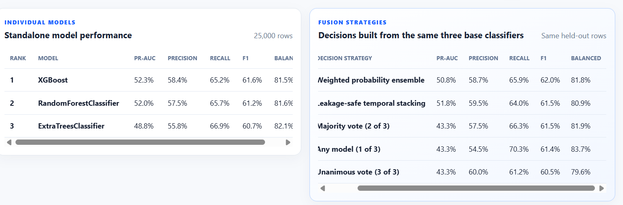
FUSION EVIDENCE
11
Fusion is useful only when measured—it does not automatically beat one model
Measured conclusion
Weighted probability ensemble
58.7% precision
65.9% recall
62.0% F1
The fusion result is close to—not clearly better than—the strongest standalone classifier on this 25,000-row integration snapshot.
Temporal stacking remains a research comparison but is removed from production-model selection.
INTELLIGENT FRAUD TRANSACTION DETECTION
Notes:
Use this slide to demonstrate scientific honesty. Ensembles can improve robustness, but correlated errors and weak calibration can prevent a gain. Production therefore uses weighted registered base classifiers.

Slide 12
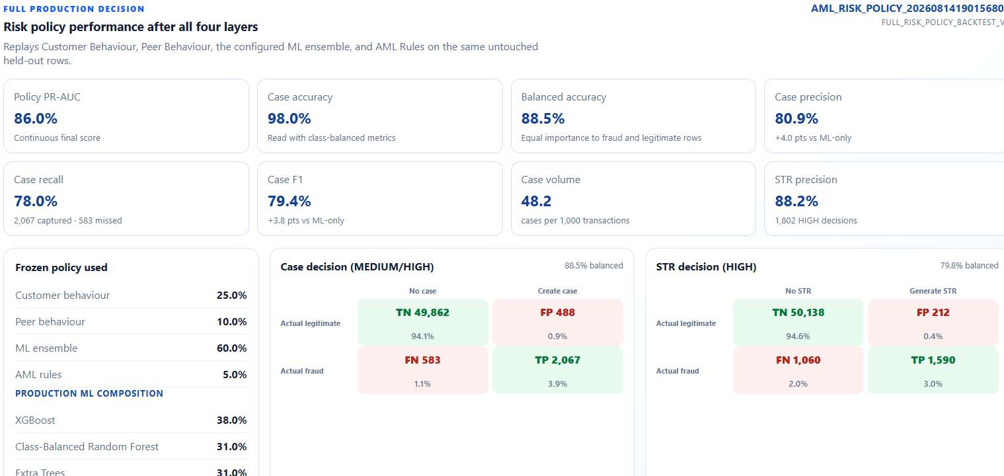
FULL POLICY REPLAY
12
The current four-layer policy needs calibration before deployment
CASE PRECISION
80.9%
99 false positives
CASE RECALL
78.0%
118 frauds missed
Customer, peer, and rules improve explanation and AML control.
INTELLIGENT FRAUD TRANSACTION DETECTION
Notes:
The frozen policy used 25% customer behaviour, 10% peer behaviour, 60% ML, and 5% AML rules. The limitation is reported rather than hidden. Next work is calibration on a separate validation period and optimizing case/STR thresholds by investigator capacity.

Slide 13
SCALABILITY DESIGN
13
Offline learning and online scoring are separated to bound latency and memory
1
2
3
4
Commit transaction
Read point-in-time features
Score loaded artifacts
Commit decision
Persist once; keep the decision path short
Bounded history and loaded profile state
No retraining inside the request
Create case/STR work after scoring
Offline training
Keyset export to immutable Parquet parts
Compact bounded features avoid the earlier 19.8 GiB one-hot allocation
Checksummed snapshots and versioned candidate artifacts
Kafka is the next transport layer—not the governance store
INTELLIGENT FRAUD TRANSACTION DETECTION
Notes:
The 264,500-row pipeline uses compact bounded features and immutable snapshots. Kafka can distribute committed transaction events and isolate back pressure, but SQL Server remains the audit and governance system of record.

Slide 14
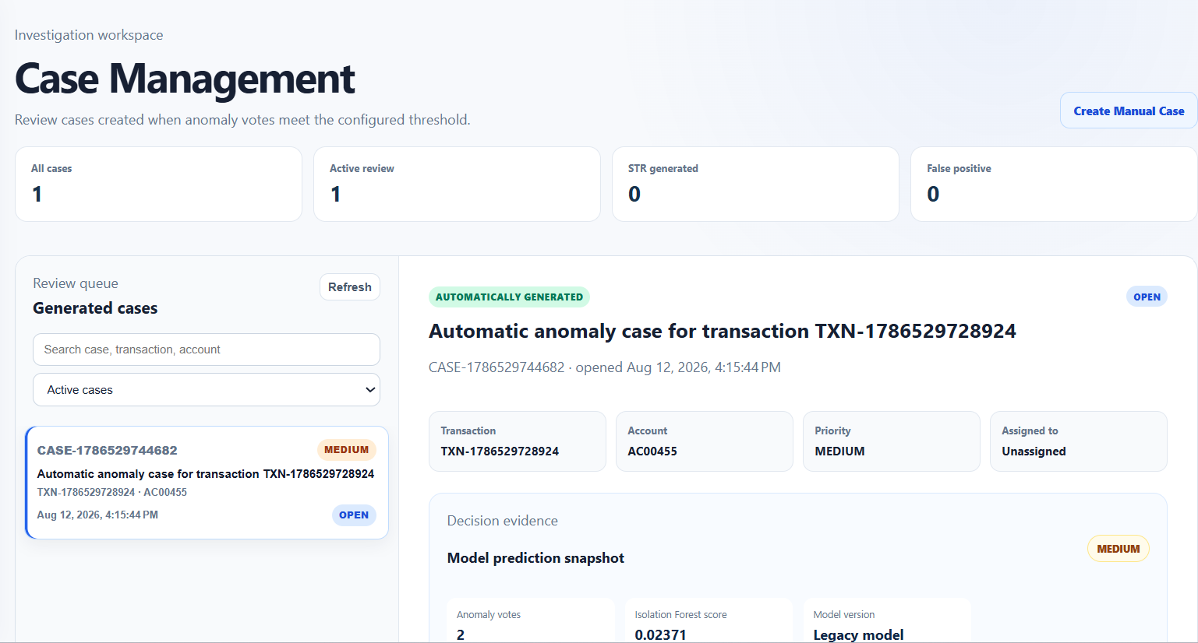
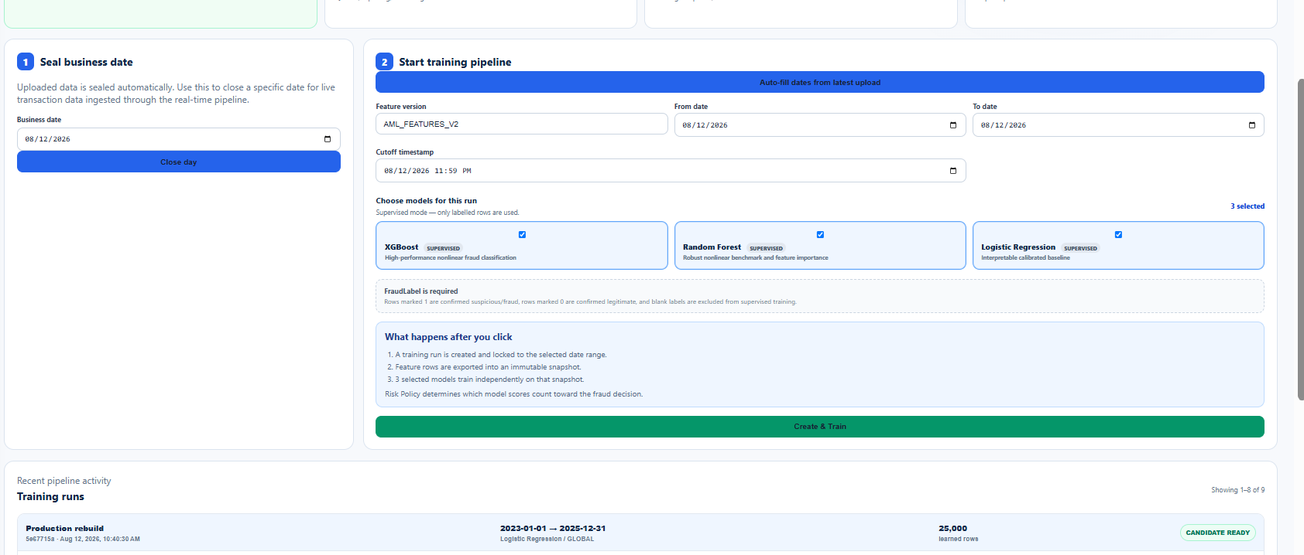
END-TO-END WORKFLOW
14
The prototype closes the loop from data to investigation
Upload & validate
→
Freeze snapshot
→
Train & compare
→
Configure policy
→
Score transaction
→
Review case / STR
JWT roles protect administration; model registry and policy versions preserve auditability; pagination keeps investigations usable at scale.
INTELLIGENT FRAUD TRANSACTION DETECTION
Notes:
Walk through the administrator and analyst experience. Training creates candidates but does not silently activate them. MEDIUM creates a case; HIGH prepares draft STR output.

Slide 15
CONCLUSION
15
The project proves a credible architecture—and exposes the next research target
PROVEN
NOT YET PROVEN
Dual-mode learning before and after labels exist
Live-bank generalization
Oldest-first growth comparison with cached evidence
Production false-positive cost
74.8% precision and 71.8% recall on the strongest reproducible benchmark
Fairness across customer segments
Explainable four-layer scoring, cases, and draft STR workflow
Regulatory acceptance of generated STR XML
Next research milestone
Calibrate customer, peer, ML, and rule weights on a separate validation period—then prove improvement on an untouched future window.
INTELLIGENT FRAUD TRANSACTION DETECTION
Notes:
Close by resolving the opening question: the architecture works, the strongest supervised model crosses 70% precision and recall, and the remaining weakness is specifically the calibration of the full layered policy—not an unexplained failure.

