Slide 1
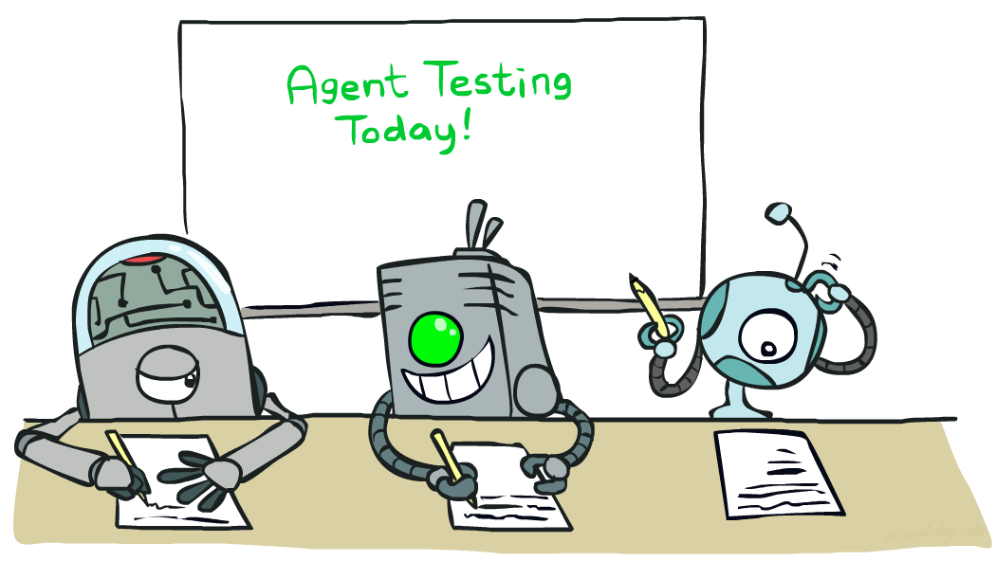

CS 188: Artificial Intelligence
Naïve Bayes
Instructors: Dan Klein and Pieter Abbeel --- University of California, Berkeley
[These slides were created by Dan Klein and Pieter Abbeel for CS188 Intro to AI at UC Berkeley. All CS188 materials are available at http://ai.berkeley.edu.]
Notes:
Please retain proper attribution, including the reference to ai.berkeley.edu. Thanks!

Slide 2
Machine Learning
Up until now: how use a model to make optimal decisions
Machine learning: how to acquire a model from data / experience
Learning parameters (e.g. probabilities)
Learning structure (e.g. BN graphs)
Learning hidden concepts (e.g. clustering)
Today: model-based classification with Naive Bayes

Slide 3

Classification

Slide 4
Example: Spam Filter
Input: an email
Output: spam/ham
Setup:
Get a large collection of example emails, each labeled “spam” or “ham”
Note: someone has to hand label all this data!
Want to learn to predict labels of new, future emails
Features: The attributes used to make the ham / spam decision
Words: FREE!
Text Patterns: $dd, CAPS
Non-text: SenderInContacts
…
Dear Sir.
First, I must solicit your confidence in this transaction, this is by virture of its nature as being utterly confidencial and top secret. …
TO BE REMOVED FROM FUTURE MAILINGS, SIMPLY REPLY TO THIS MESSAGE AND PUT "REMOVE" IN THE SUBJECT.
99 MILLION EMAIL ADDRESSES
FOR ONLY $99
Ok, Iknow this is blatantly OT but I'm beginning to go insane. Had an old Dell Dimension XPS sitting in the corner and decided to put it to use, I know it was working pre being stuck in the corner, but when I plugged it in, hit the power nothing happened.

Slide 5




Example: Digit Recognition
Input: images / pixel grids
Output: a digit 0-9
Setup:
Get a large collection of example images, each labeled with a digit
Note: someone has to hand label all this data!
Want to learn to predict labels of new, future digit images
Features: The attributes used to make the digit decision
Pixels: (6,8)=ON
Shape Patterns: NumComponents, AspectRatio, NumLoops
…
0
1
2
1
??

Slide 6
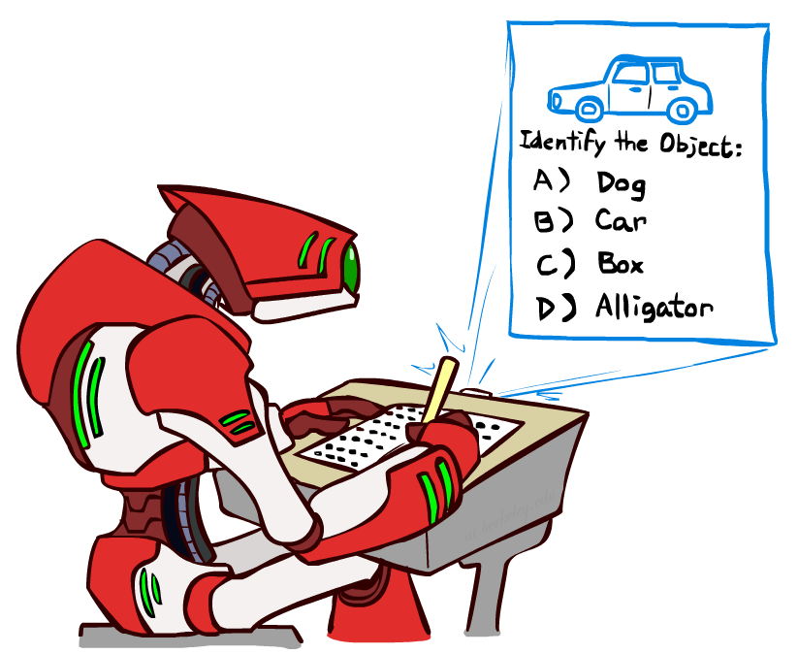
Other Classification Tasks
Classification: given inputs x, predict labels (classes) y
Examples:
Spam detection (input: document,
classes: spam / ham)
OCR (input: images, classes: characters)
Medical diagnosis (input: symptoms,
classes: diseases)
Automatic essay grading (input: document,
classes: grades)
Fraud detection (input: account activity,
classes: fraud / no fraud)
Customer service email routing
… many more
Classification is an important commercial technology!

Slide 7

Model-Based Classification
Model-based approach
Build a model (e.g. Bayes’ net) where both the label and features are random variables
Instantiate any observed features
Query for the distribution of the label conditioned on the features
Challenges
What structure should the BN have?
How should we learn its parameters?

Slide 8

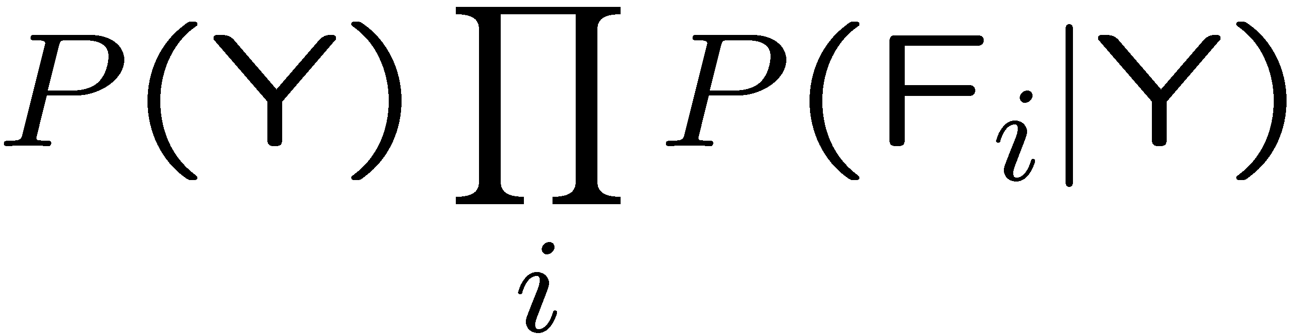

General Naïve Bayes
A general Naive Bayes model:
We only have to specify how each feature depends on the class
Total number of parameters is linear in n
Model is very simplistic, but often works anyway
Y
|Y| parameters
F₁
F₂
F_{n}
|Y| x |F|^{n} values
n x |F| x |Y| parameters
P(Y, F1, F2, … Fn) = P(Y) * P(F1 | Y) * P(F2|Y) * … * P(Fn|Y)
Notes:
why are we using conditional instead of full join
fundamental tradeoff between statistical efficiency and the expressive power of your model

Slide 9
General Naïve Bayes
How many params?
Notes:
why are we using conditional instead of full join
fundamental tradeoff between statistical efficiency and the expressive power of your model

Slide 10
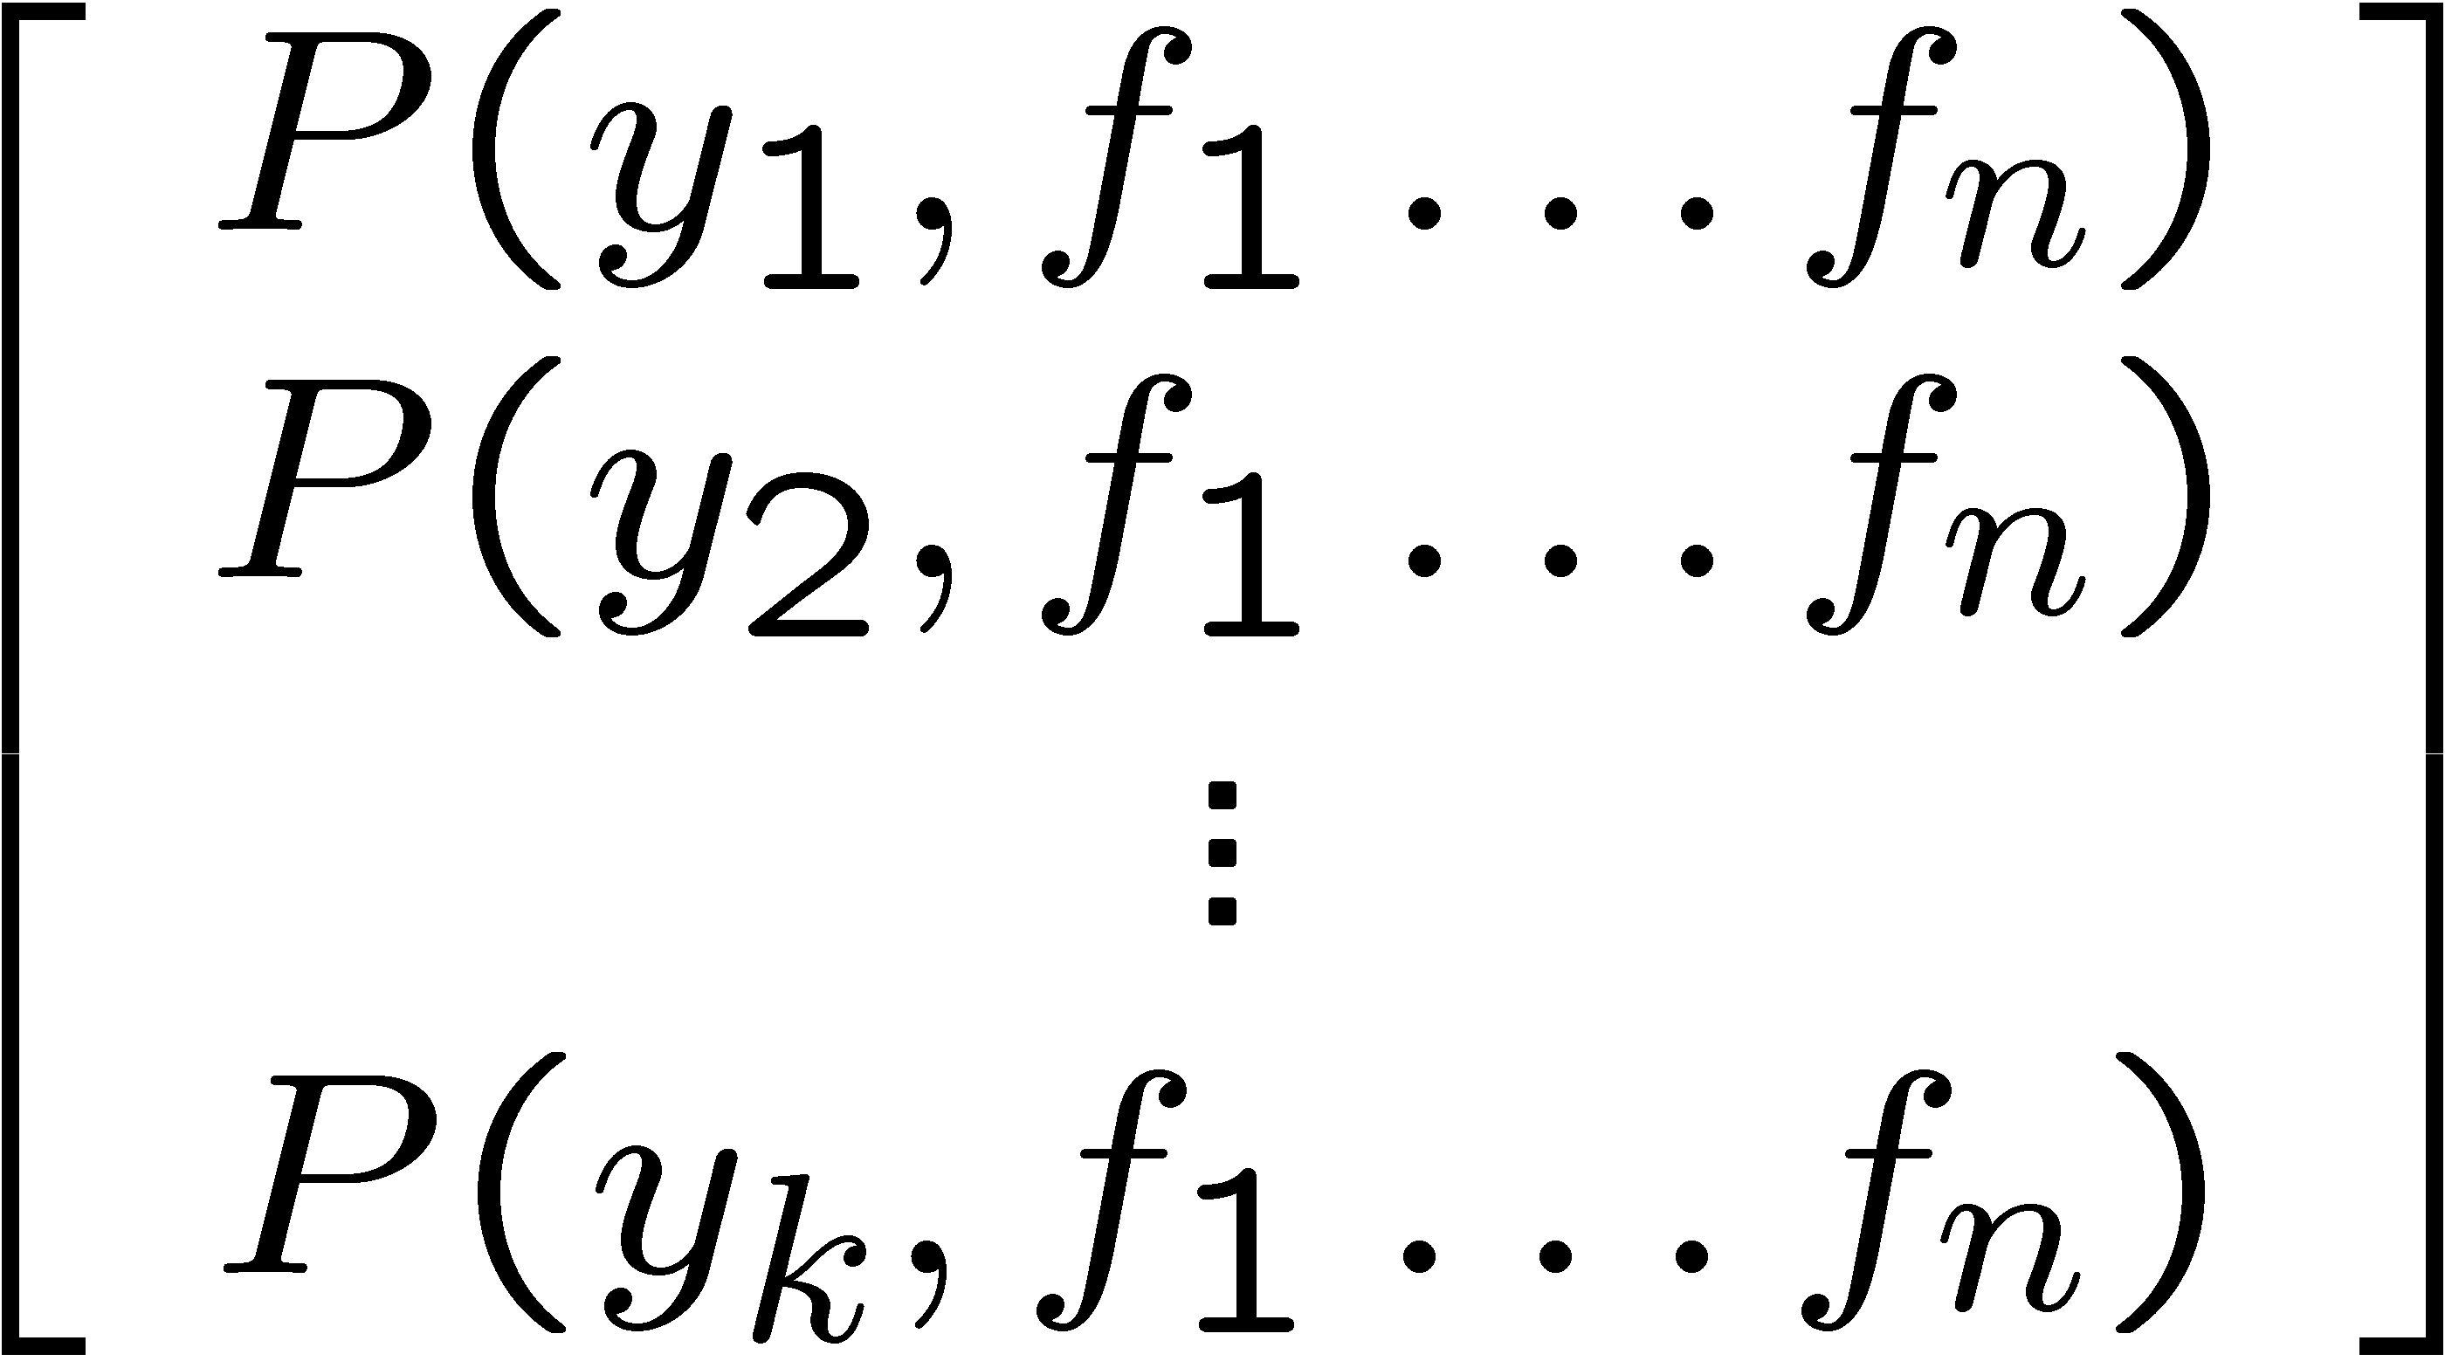
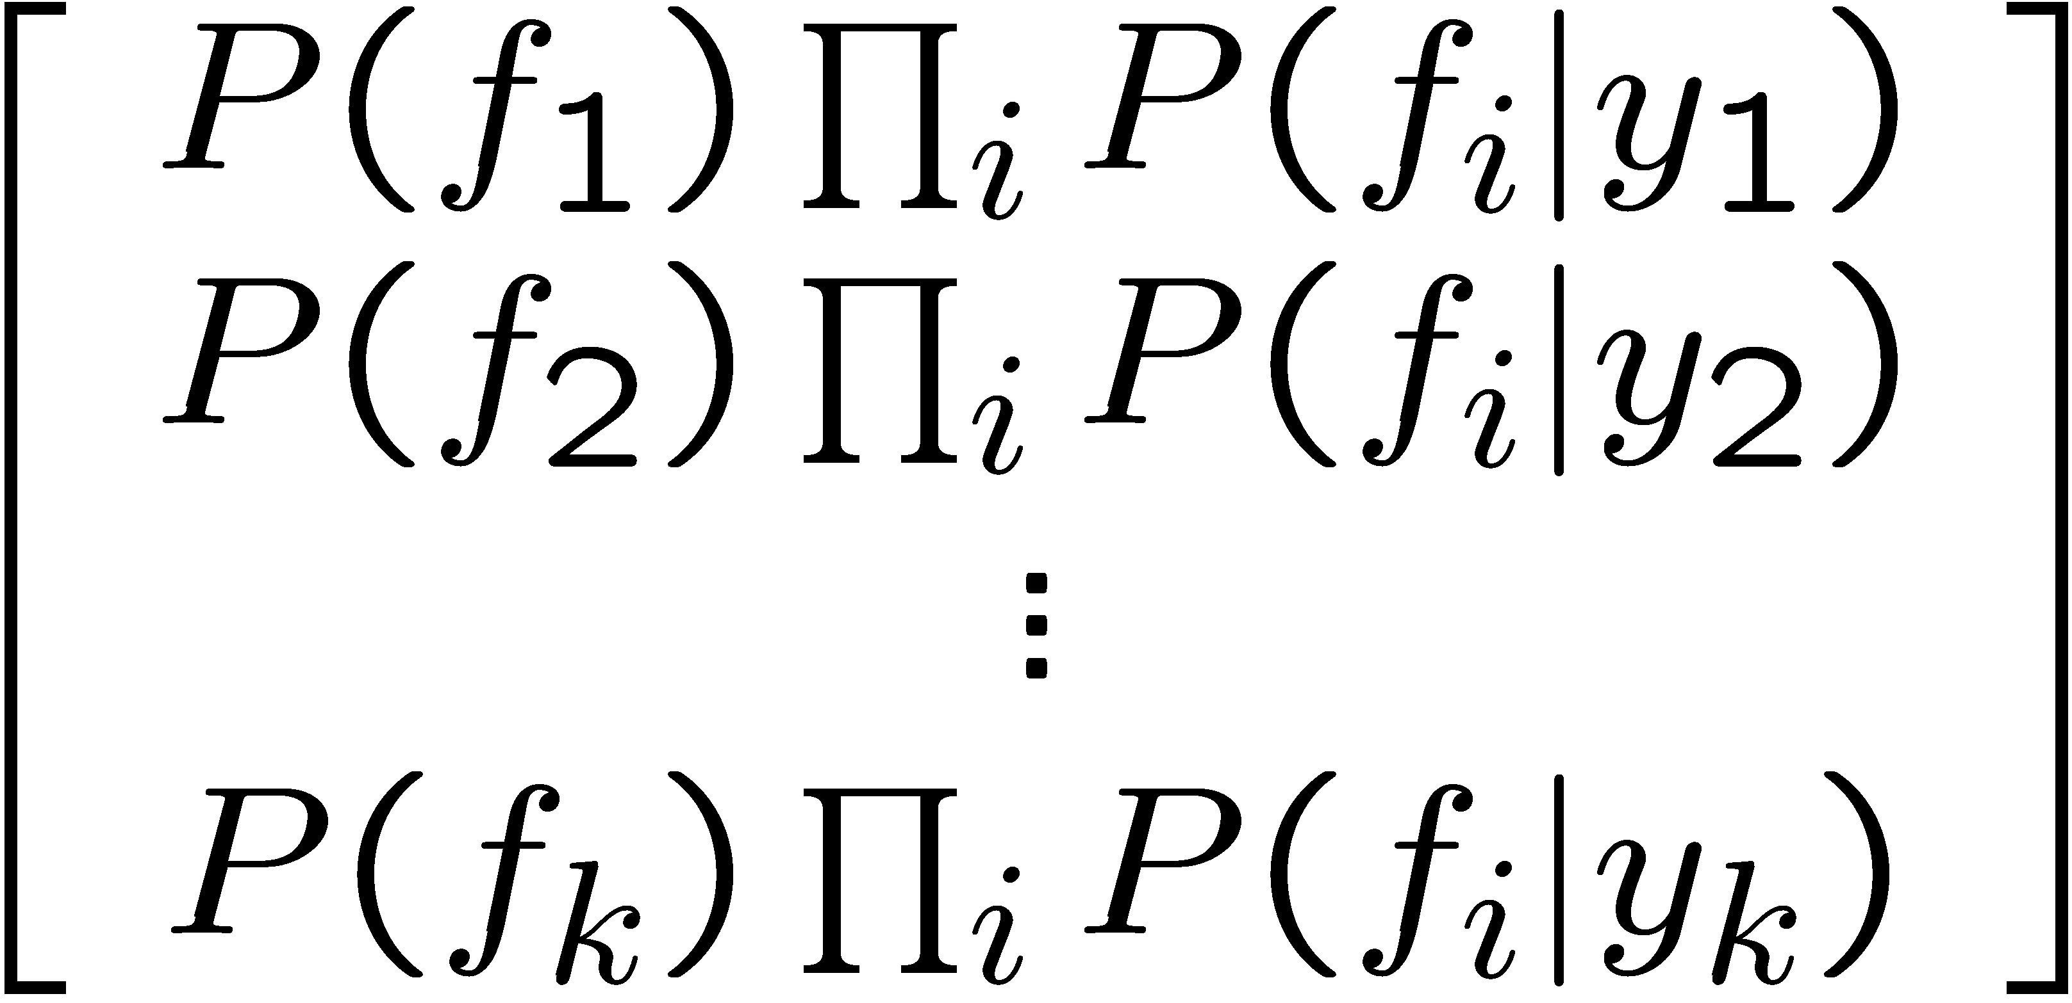

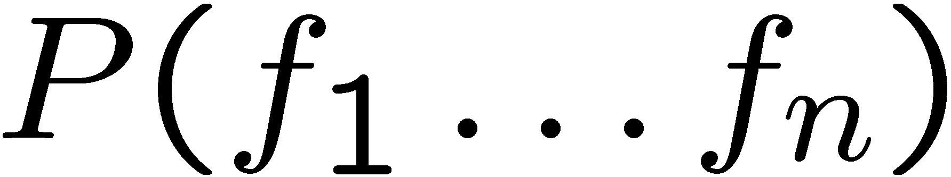
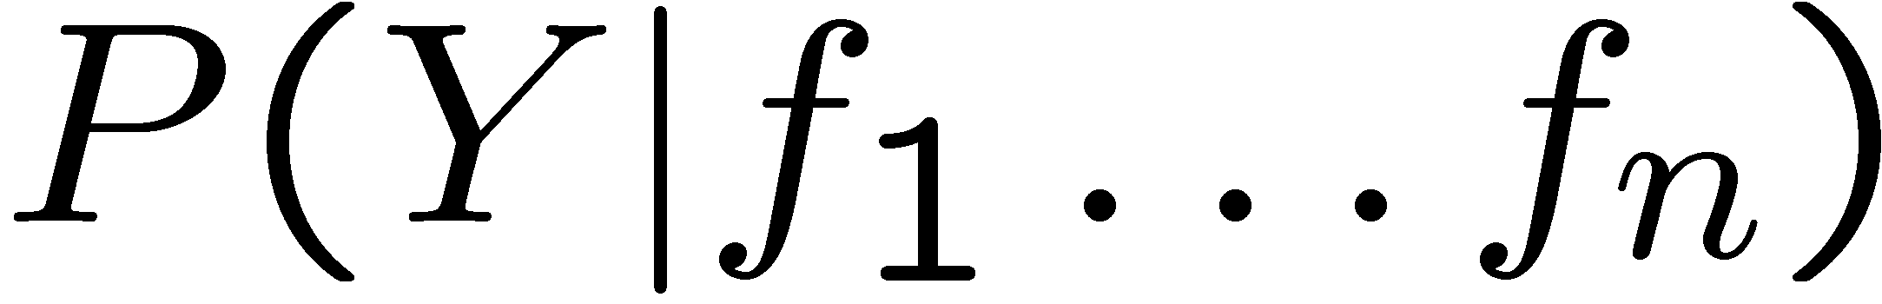
Inference for Naïve Bayes
Goal: compute posterior distribution over label variable Y
Step 1: get joint probability of label and evidence for each label
Step 2: sum to get probability of evidence
Step 3: normalize by dividing Step 1 by Step 2
+

Slide 11
General Naïve Bayes
What do we need in order to use Naïve Bayes?
Inference method (we just saw this part)
Start with a bunch of probabilities: P(Y) and the P(F_{i}|Y) tables
Use standard inference to compute P(Y|F₁…F_{n})
Nothing new here
Estimates of local conditional probability tables
P(Y), the prior over labels
P(F_{i}|Y) for each feature (evidence variable)
These probabilities are collectively called the parameters of the model and denoted by θ
Up until now, we assumed these appeared by magic, but…
…they typically come from training data counts: we’ll look at this soon

Slide 12
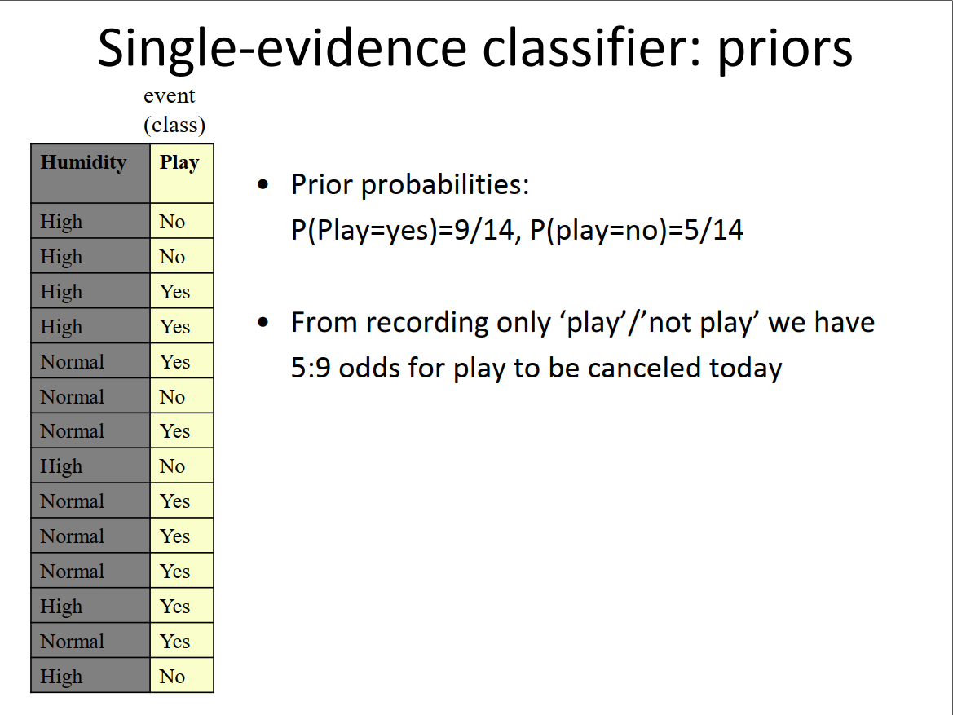

Slide 13
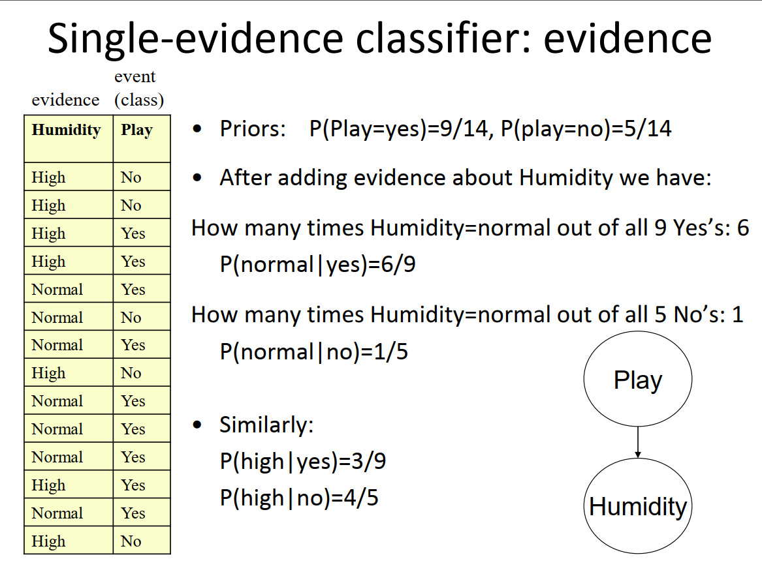

Slide 14
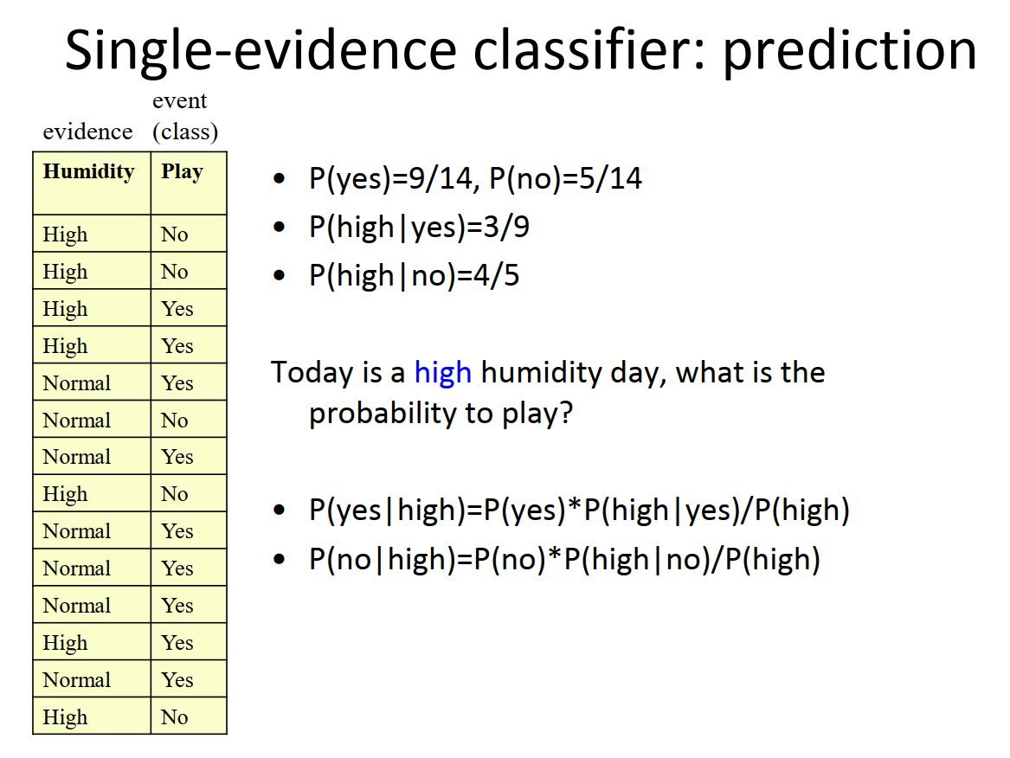

Slide 15
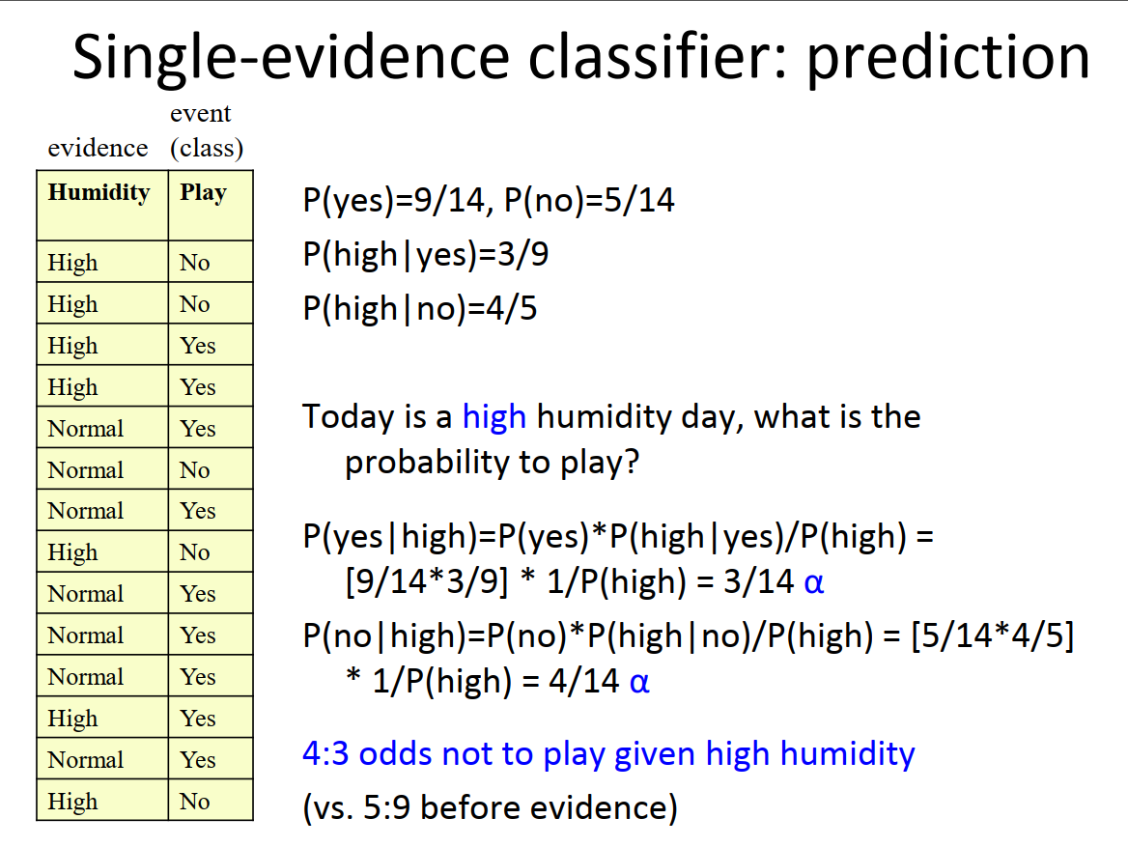

Slide 16
P(Y|f1, f2, …. fn) = ?
= P(Y, f1, f2, …. , fn)/P(f1, … fn)
prop… P (Y, f1, f2, … fn)
P(yes, f1, … fn) = P(yes)P(f1|yes)P(f2|yes)…P(fn|y)
= 0.002
P(no, f1, … fn) = P(n) P(f1|n)…P(fn|n) = 0.001
Y
F₁
F₂
F_{n}
yes | 0.002
no | 0.001

Slide 17
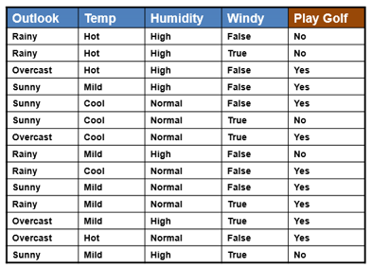
Example
Today is Sunny, Hot, Humidity Normal and No wind. What is probability of playing golf?

Slide 18
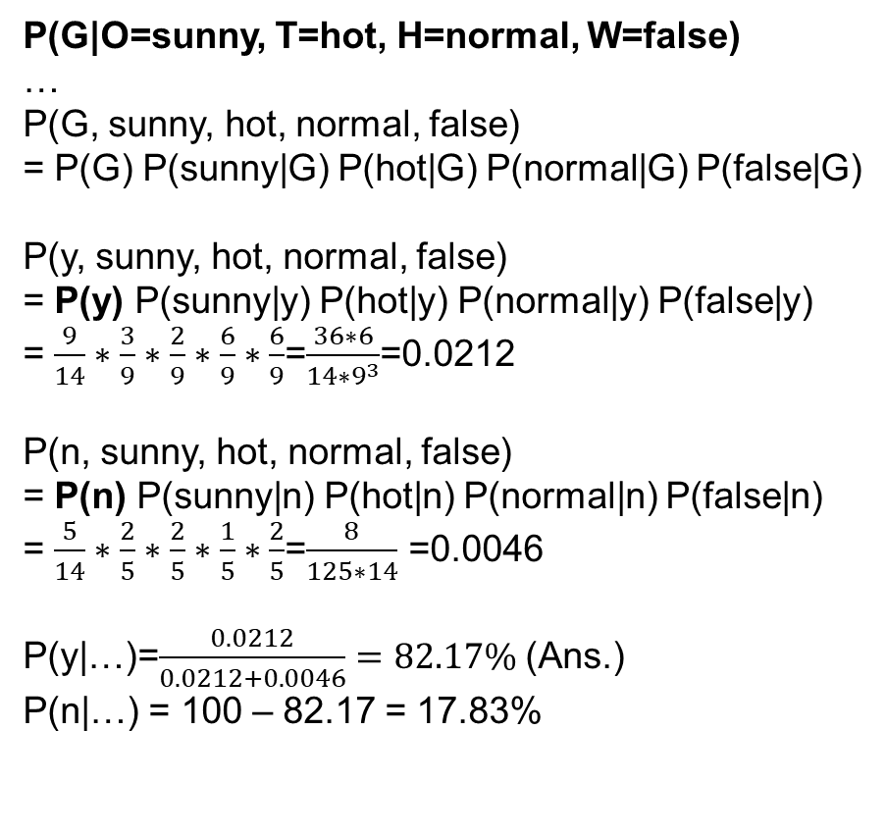
Example
G
Today is Sunny, Hot, Humidity Normal and No wind. What is probability of playing golf?
P(G|O=sunny, T=hot, H=normal, W=false)
…
P(G, sunny, hot, normal, false)
= P(G) P(sunny|G) P(hot|G) P(normal|G) P(false|G)
P(y, sunny, hot, normal, false)
= P(y) P(sunny|y) P(hot|y) P(normal|y) P(false|y)
= $\frac{9}{14}∗\frac{3}{9}∗\frac{2}{9}∗\frac{6}{9}∗\frac{6}{9}$=$\frac{36∗6}{14∗9^{3}}$=0.0212
P(n, sunny, hot, normal, false)
= P(n) P(sunny|n) P(hot|n) P(normal|n) P(false|n)
= $\frac{5}{14}∗\frac{2}{5}∗\frac{2}{5}∗\frac{1}{5}∗\frac{2}{5}$=$\frac{8}{125∗14}$ =0.0046
P(y|…)=$\frac{0.0212}{0.0212+0.0046}=82.17\%$ (Ans.)
P(n|…) = 100 – 82.17 = 17.83%
O
T
H
W
P(y)=9/14, P(n)=5/14
P(sunny|y) = 3/9
P(sunny|n) = 2/5
P(hot|y) = 2/9
P(hot|n) = 2/5
P(false|y) = 6/9
P(false|n) = 2/5
P(normal|y) = 6/9
P(normal|n) = 1/5

Slide 19
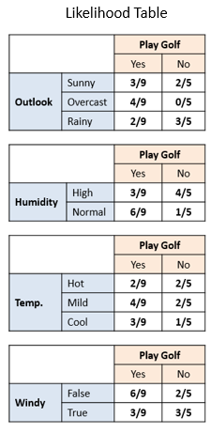
Example
Today is Sunny, Hot, Humidity Normal and No wind. What is probability of playing golf?

Slide 20
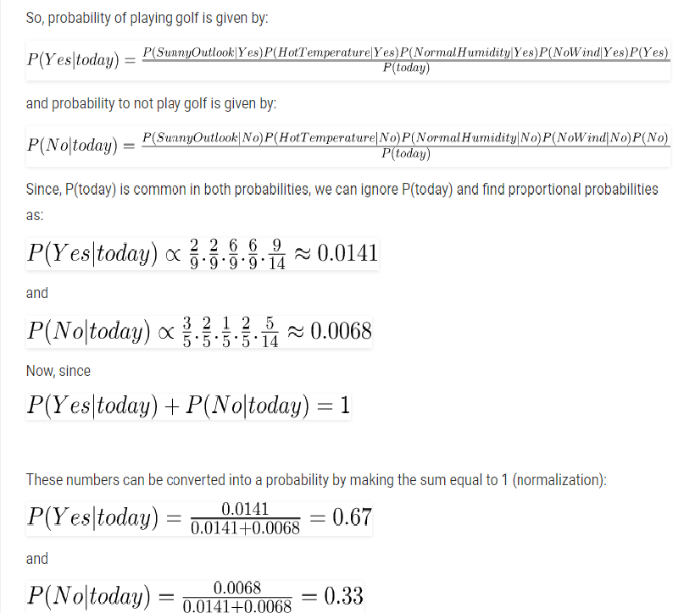




Example
$$\frac{3}{9}$$
0.0212
$$\frac{2}{5}$$
0.0046
$\frac{0.0212}{0.0212+0.0046}≈$ 0.8217
$\frac{0.0046}{0.0212+0.0046}≈$ 0.1783

Slide 21
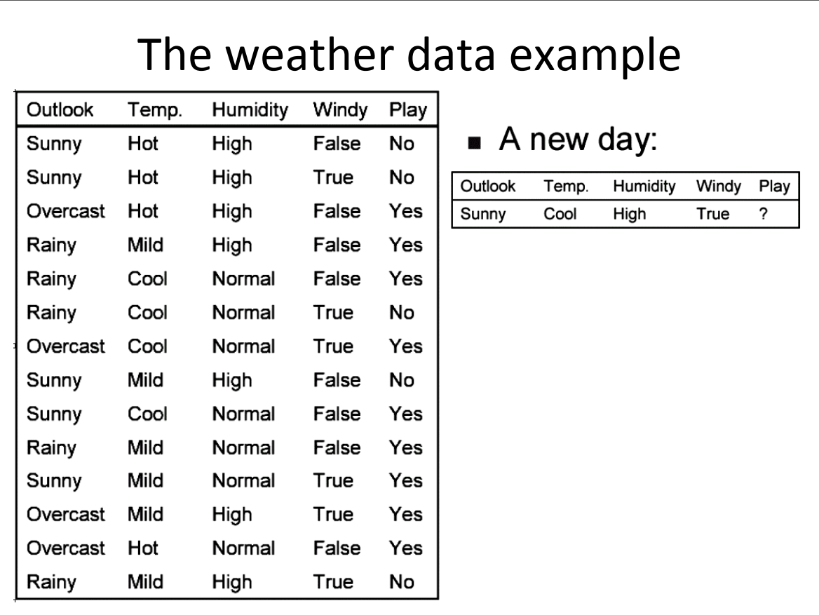

Slide 22
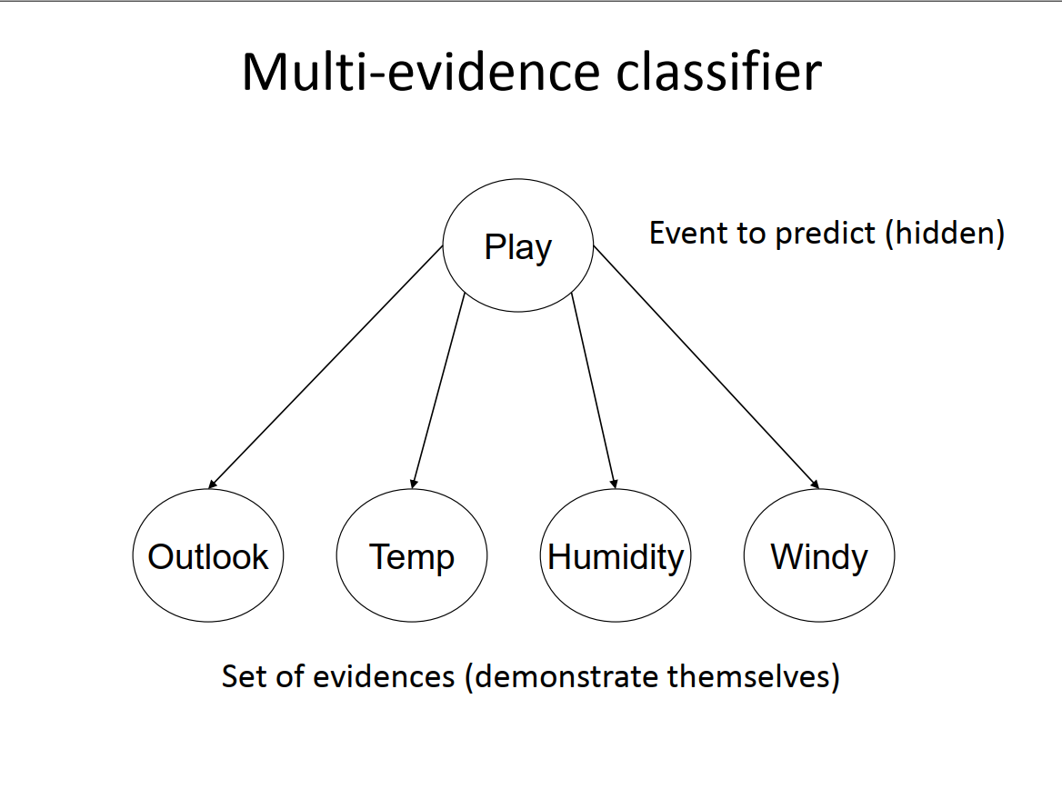

Slide 23
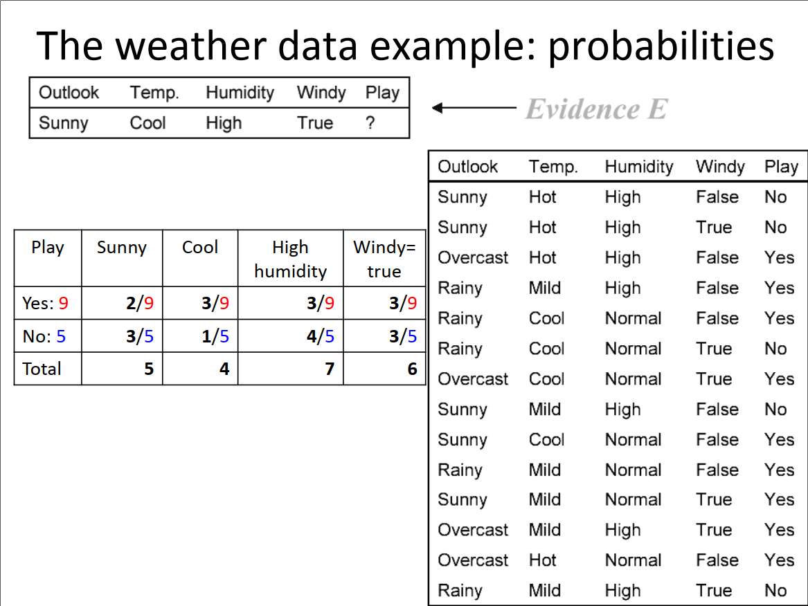

Slide 24
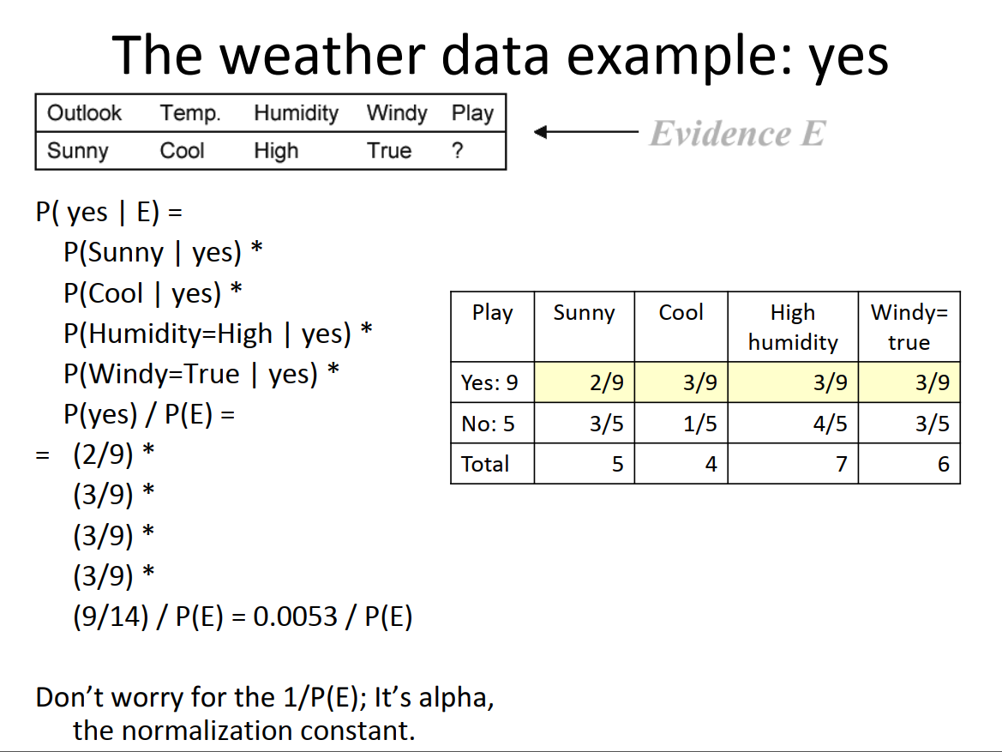

Slide 25
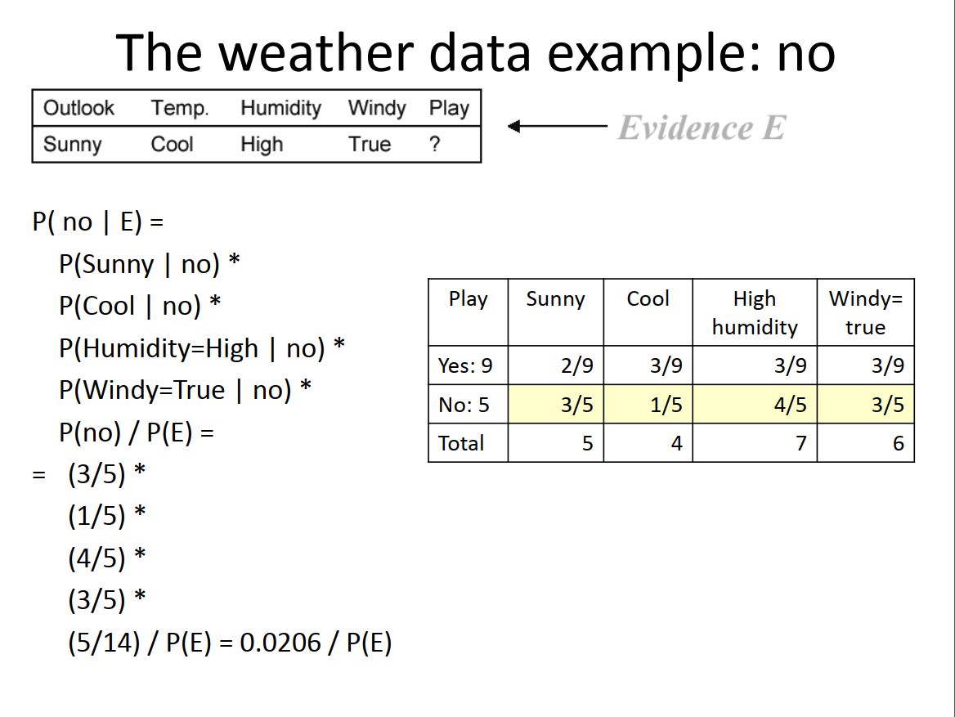

Slide 26
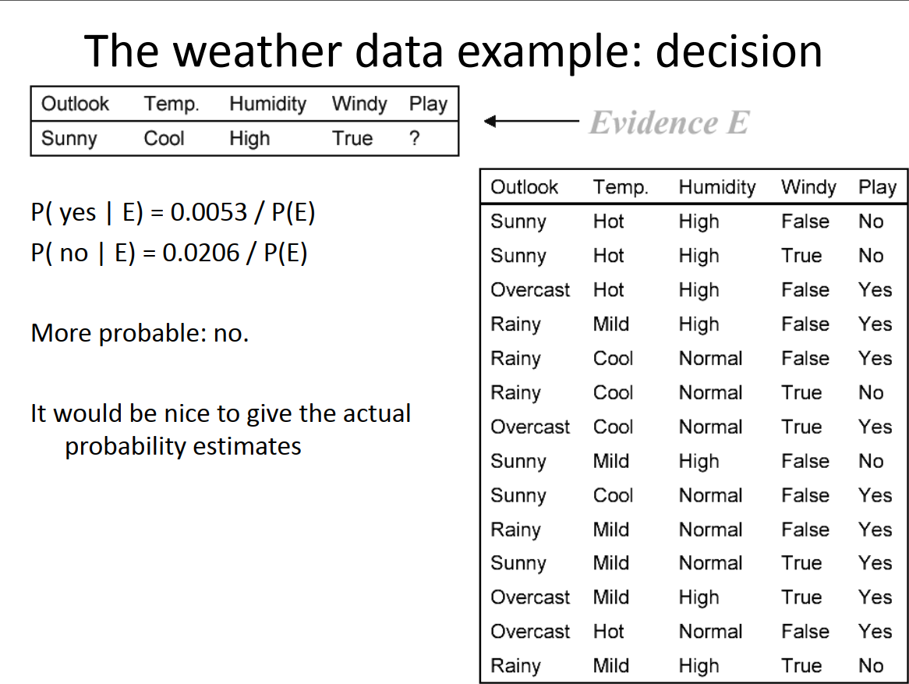

Slide 27
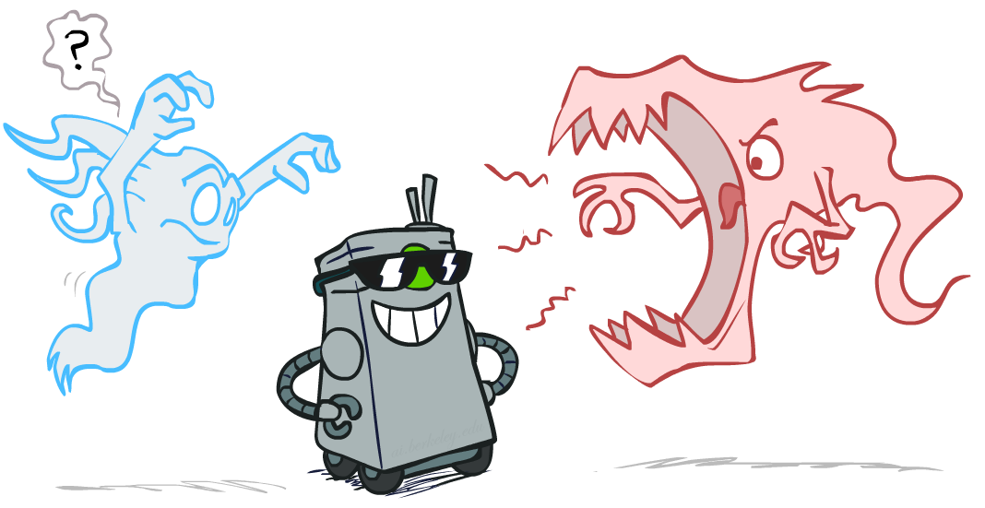
Smoothing

Slide 28

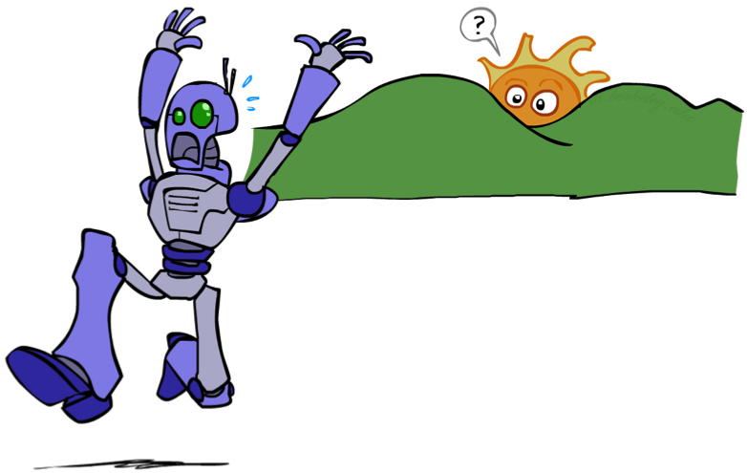
Unseen Events

Slide 29













Example: Overfitting
2 wins!!

Slide 30
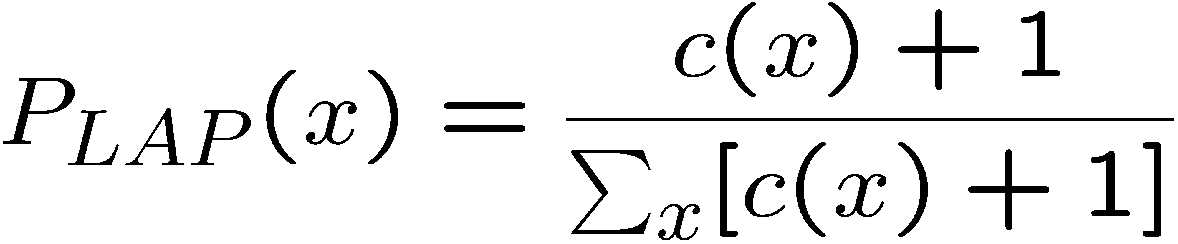
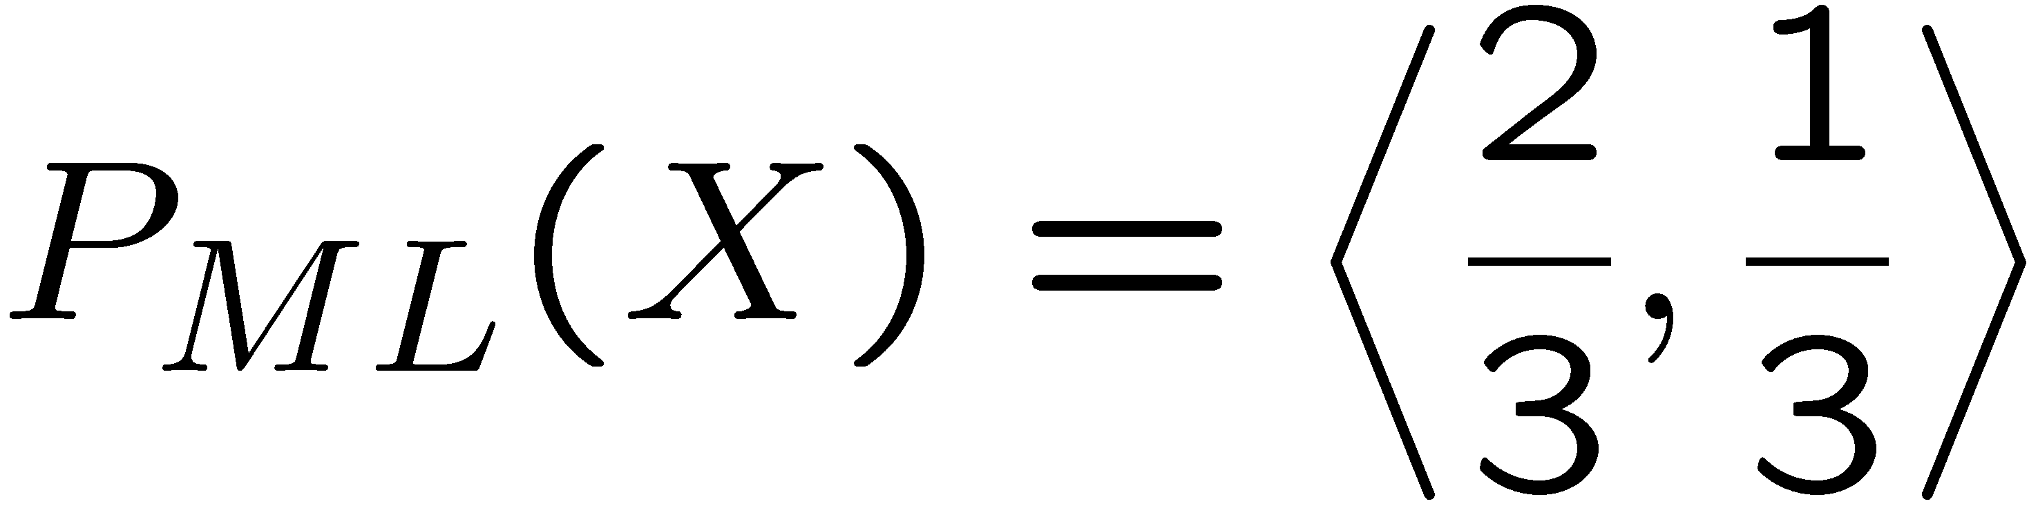
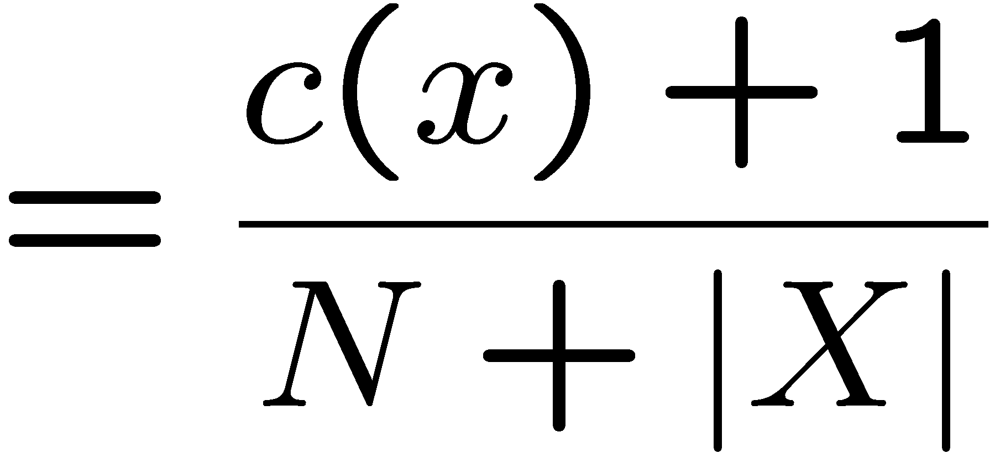
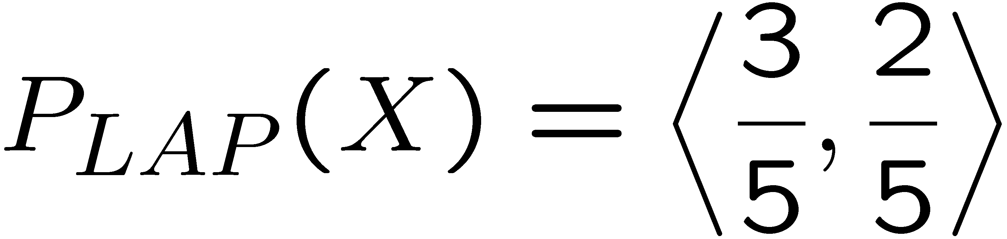
Laplace Smoothing
Laplace’s estimate:
Pretend you saw every outcome once more than you actually did
r
r
b
Notes:
The bigger is the K param, the harder its gonna be to move away from uniform distribution.

Slide 31
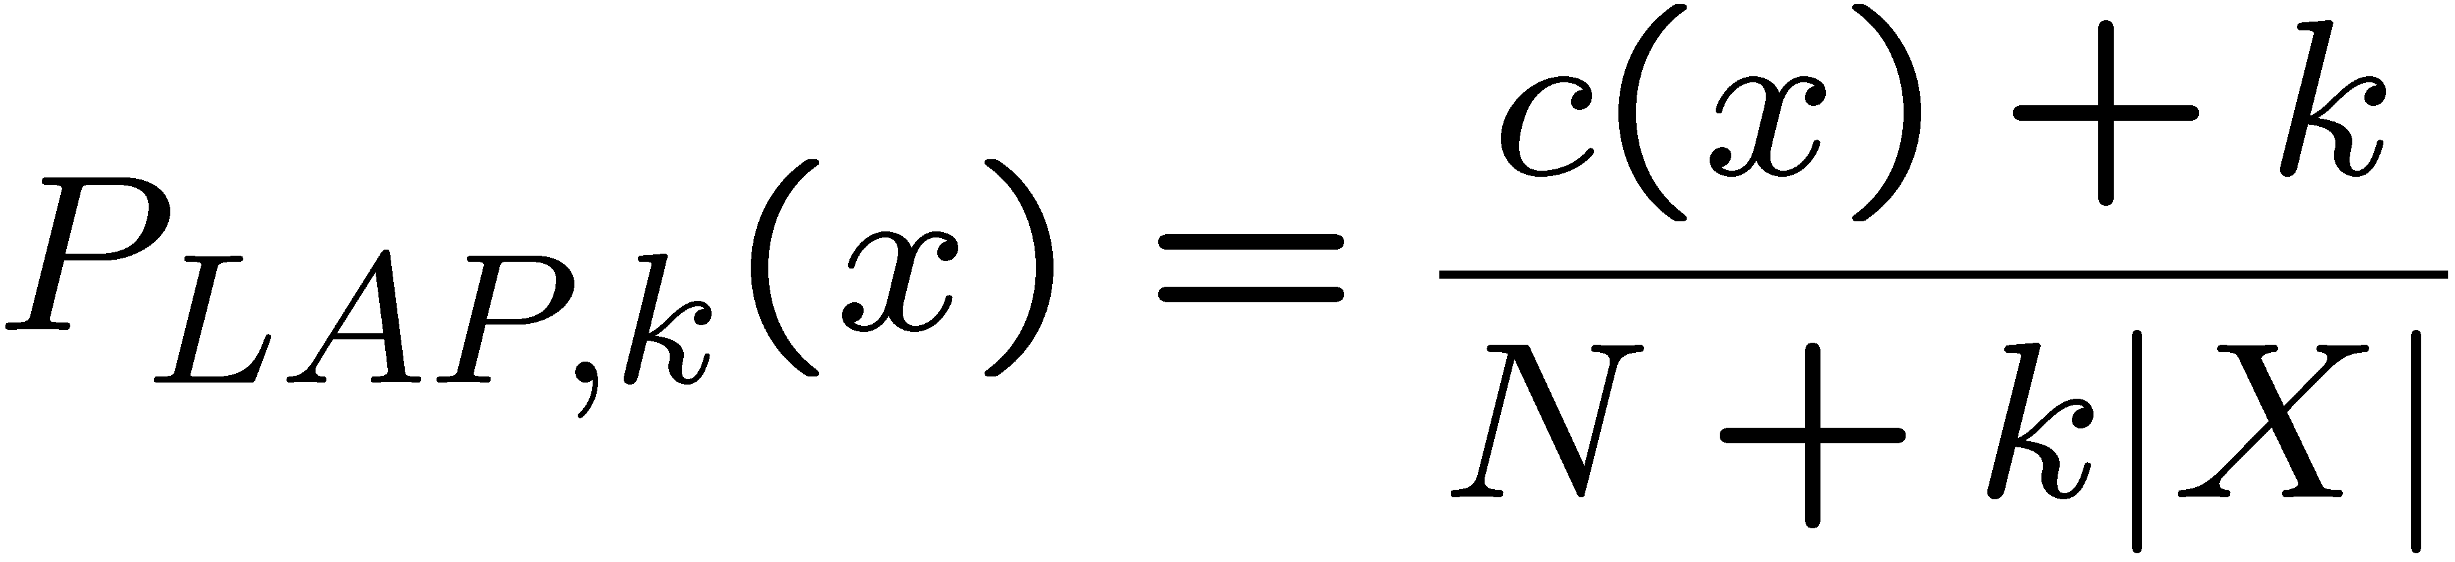
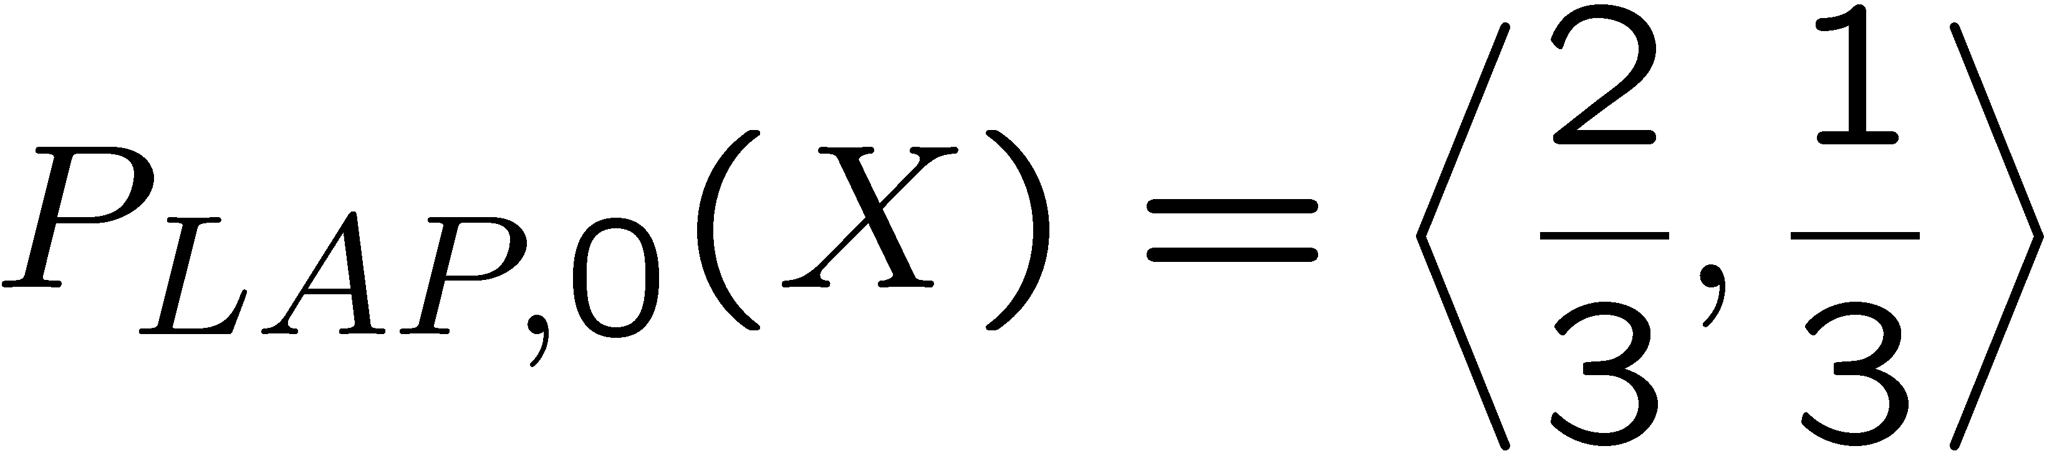
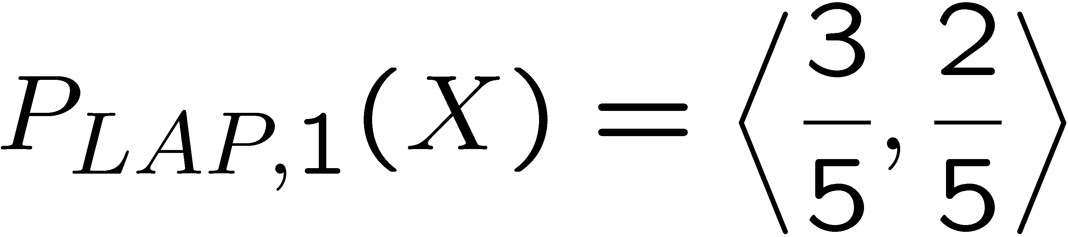
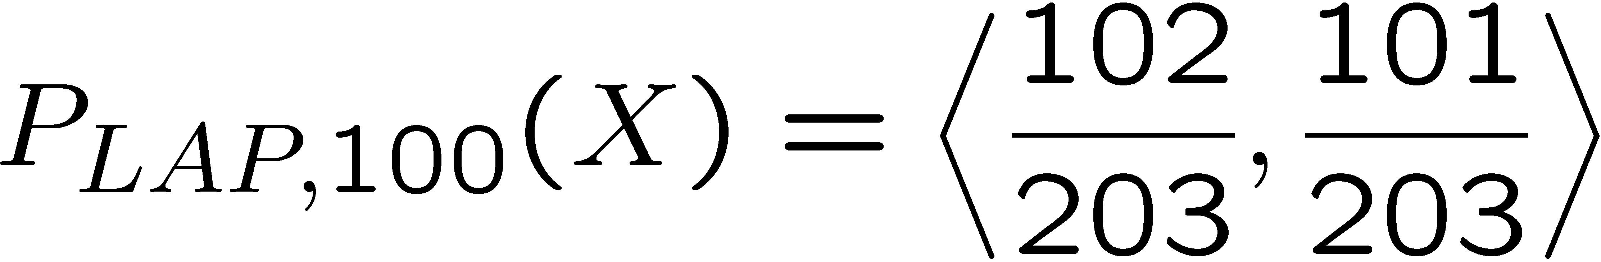
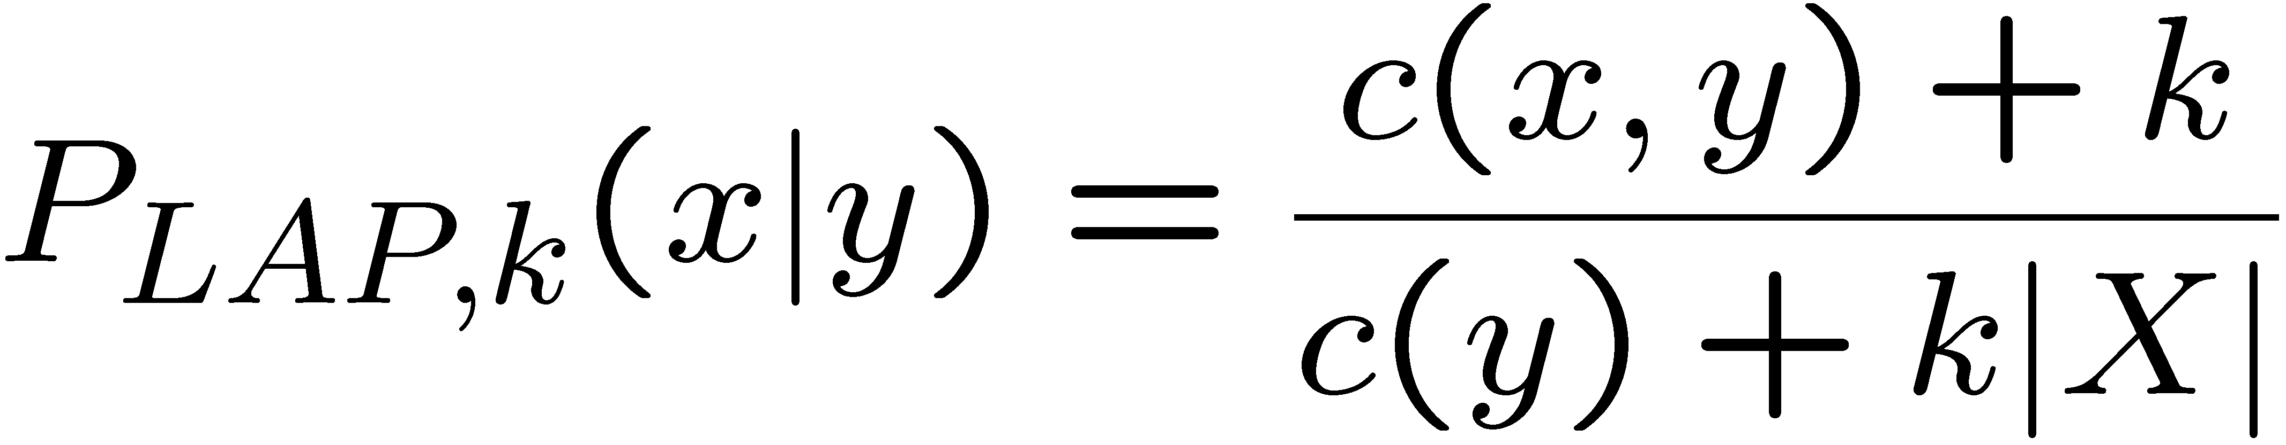
Laplace Smoothing
Laplace’s estimate (extended):
Pretend you saw every outcome k extra times
What’s Laplace with k = 0?
k is the strength of the prior
Laplace for conditionals:
Smooth each condition independently:
r
r
b

Slide 32

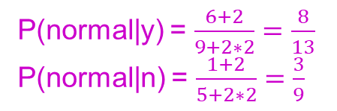

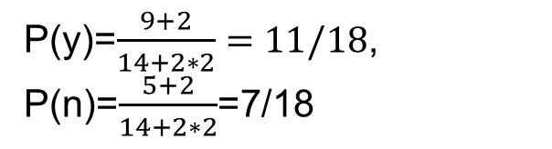
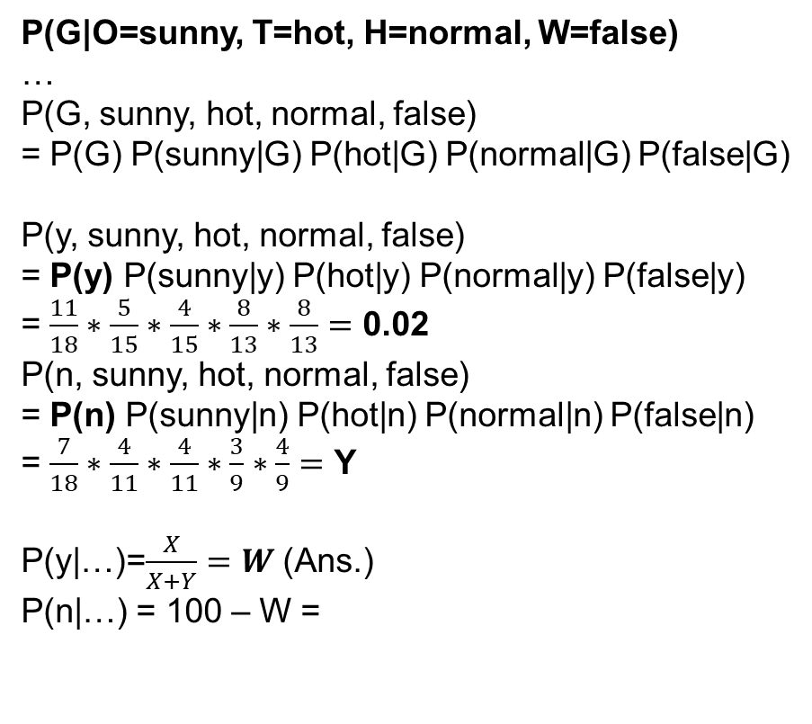

Example
G
Today is Sunny, Hot, Humidity Normal and No wind. What is probability of playing golf?
Assume k=2 for laplace smoothing.
|X|=3
|X|=3
|X|=2
|X|=2
|X|=2
P(G|O=sunny, T=hot, H=normal, W=false)
…
P(G, sunny, hot, normal, false)
= P(G) P(sunny|G) P(hot|G) P(normal|G) P(false|G)
P(y, sunny, hot, normal, false)
= P(y) P(sunny|y) P(hot|y) P(normal|y) P(false|y)
= $\frac{11}{18}∗\frac{5}{15}∗\frac{4}{15}∗\frac{8}{13}∗\frac{8}{13}=$ 0.02
P(n, sunny, hot, normal, false)
= P(n) P(sunny|n) P(hot|n) P(normal|n) P(false|n)
= $\frac{7}{18}∗\frac{4}{11}∗\frac{4}{11}∗\frac{3}{9}∗\frac{4}{9}=$ Y
P(y|…)=$\frac{X}{X+Y}=W$ (Ans.)
P(n|…) = 100 – W =
O
T
H
W
P(y)=$\frac{9+2}{14+2∗2}=11/18$,
P(n)=$\frac{5+2}{14+2∗2}$=7/18
P(hot|y) = $\frac{2+2}{9+2∗3}=\frac{4}{15}$
P(hot|n) = $\frac{2+2}{5+2∗3}$=$\frac{4}{11}$
P(sunny|y) = $\frac{3+2}{9+2∗3}=\frac{5}{15}$
P(sunny|n) = $\frac{2+2}{5+2∗3}=\frac{4}{11}$
P(false|y) = $\frac{6+2}{9+2∗2}=\frac{8}{13}$
P(false|n) = $\frac{2+2}{5+2∗2}=\frac{4}{9}$
P(normal|y) = $\frac{6+2}{9+2∗2}=\frac{8}{13}$
P(normal|n) = $\frac{1+2}{5+2∗2}=\frac{3}{9}$

Slide 33
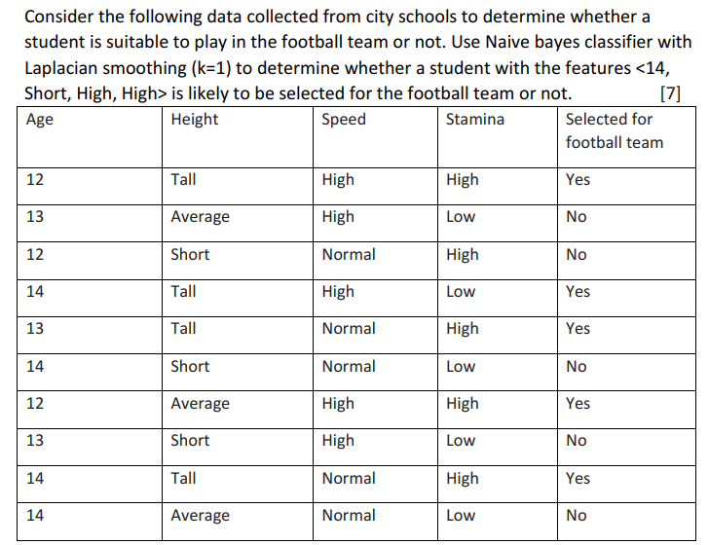
Practice

Slide 34
Practice
P(F,14, short, high, high) = P(F)P(14|F) P(short|F)
P( Sp = high | F) P(St = high | F)
P(F=y) = 6/12
P(F=n) = 6/12
P(14| yes) = 3/8
P(14| no ) = 3/8
P(short | yes ) = 1/8
P (short | no) = 4/8
P (Sp = high | yes) = 4/7
P (Sp = high | no) = 3/7
P (St = high | yes) = 5/7
P (St = high | no) = 2/7

Slide 35
Practice
P(F,14, short, high, high) = P(F)P(14|F) P(short|F)
P( Sp = high | F) P(St = high | F)
P(F=y) = 6/12
P(F=n) = 6/12
P(14| yes) = 3/8
P(14| no ) = 3/8
P(short | yes ) = 1/8
P (short | no) = 4/8
P (Sp = high | yes) = 4/7
P (Sp = high | no) = 3/7
P (St = high | yes) = 5/7
P (St = high | no) = 2/7
P(yes,14, short, high, high)
= P(yes)P(14|yes) P(short|yes) P( Sp = high | yes) P(St = high | yes)
= 6/12 * 3/8 * 1/8 * 4/7 * 5/7 = 15/(32*49) = 0.0096
P(no, 14, short, high, high)
= 6/12 * 3/8 * 4/8 * 3/7 * 2/7 = 9 / (16 * 49) = 0.0115

Slide 36
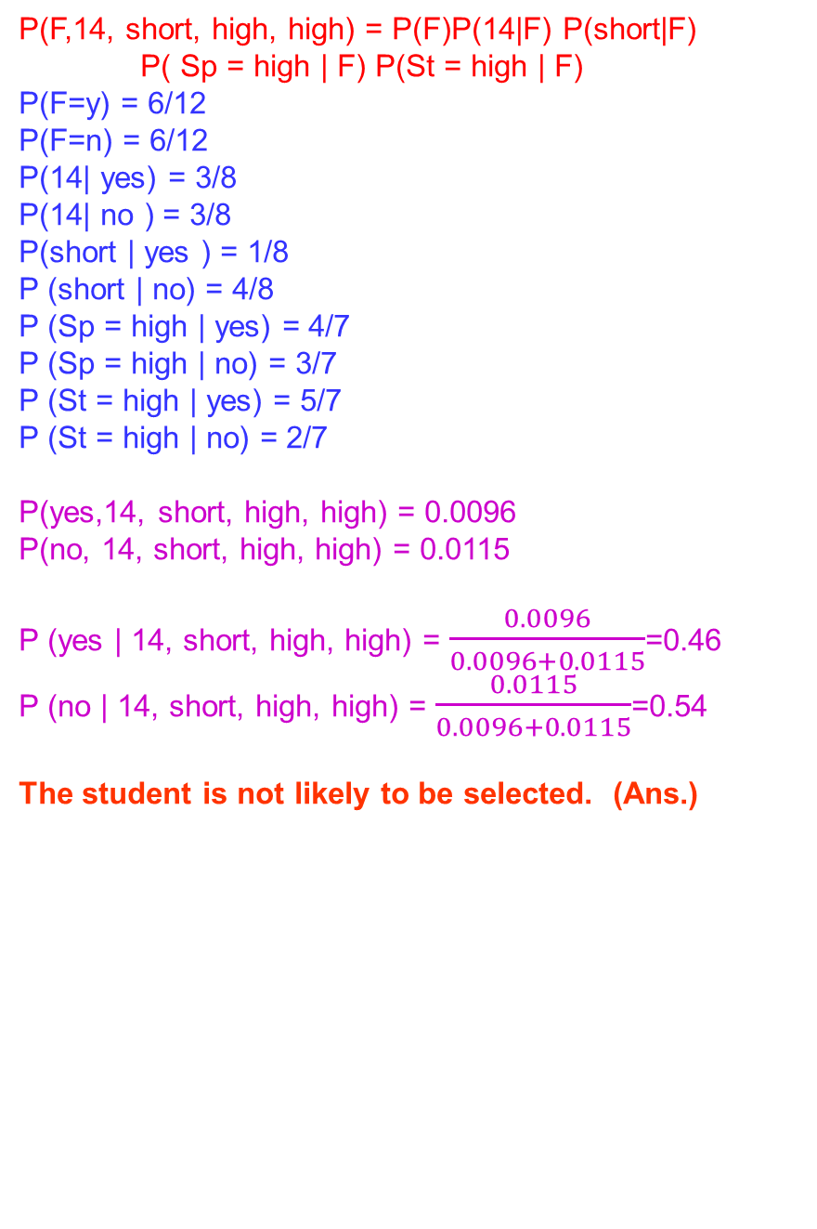
Practice
P(F,14, short, high, high) = P(F)P(14|F) P(short|F)
P( Sp = high | F) P(St = high | F)
P(F=y) = 6/12
P(F=n) = 6/12
P(14| yes) = 3/8
P(14| no ) = 3/8
P(short | yes ) = 1/8
P (short | no) = 4/8
P (Sp = high | yes) = 4/7
P (Sp = high | no) = 3/7
P (St = high | yes) = 5/7
P (St = high | no) = 2/7
P(yes,14, short, high, high) = 0.0096
P(no, 14, short, high, high) = 0.0115
P (yes | 14, short, high, high) = $\frac{0.0096}{0.0096+0.0115}$=0.46
P (no | 14, short, high, high) = $\frac{0.0115}{0.0096+0.0115}$=0.54
The student is not likely to be selected. (Ans.)

