Slide 1
ML models using Residential Energy Consumption Survey (RECS) for predicting occupant characteristics
Current Progress

Slide 2
Current Progress
Dataset exploration
Dataset pre-processing
Selecting target columns
Feature subset selection
Selecting models for training
Training
Testing

Slide 3
Target Columns
NUMADULT
Number of adults
HHAGE
Age of surveyed
EMPLOYHH
Employment status
EDUCATION
Highest degree obtained by surveyed
MONEYPY
Total household income

Slide 4
Dataset Processing
Handling INF and NaN values
Encoding categorized data (4)
Train set 80%
Test set 20%
K-fold cross validation (10-fold) random shuffle

Slide 5
Categorized Data Values
METROMICRO
['METRO' 'NONE' 'MICRO']
UATYP10
['U' 'R' 'C']
CLIMATE_REGION_PUB
['Hot-Dry/Mixed-Dry' 'Hot-Humid' 'Mixed-Humid' 'Cold/Very Cold' 'Marine']
IECC_CLIMATE_PUB
['3B-4B' '1A-2A' '3A' '4A' '5A' '6A-6B' '5B-5C' '4C' '3C' '2B' '7A-7B-7AK-8AK']

Slide 6
Training models
LogisticRegression
LinearDiscriminantAnalysis
KNeighborsClassifier
DecisionTreeClassifier
GaussianNB
SVM
--RNN, DNN
--Random Forest
--Adaboost

Slide 7
Feature subset selection
Methods
Mean Absolute Difference (MAD)
Chi-square Test
Fisher’s Score
Forward Feature Selection
Backward Feature Elimination
ANOVA F-

Slide 8
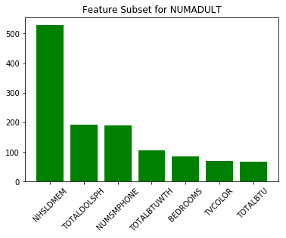
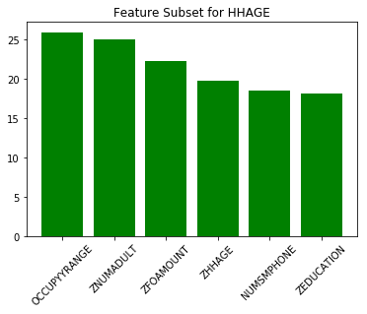
Feature subset selection (ANOVA-F)

Slide 9
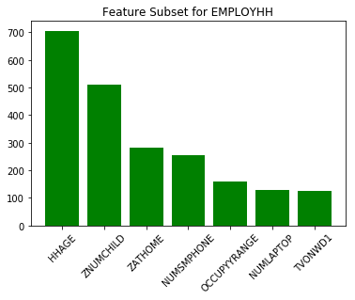
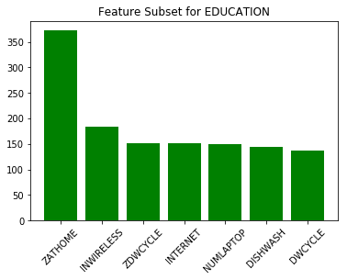
Feature subset selection (ANOVA-F)

Slide 10
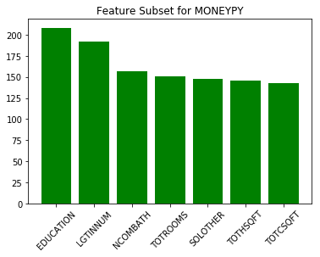
Feature subset selection (ANOVA-F)

Slide 11
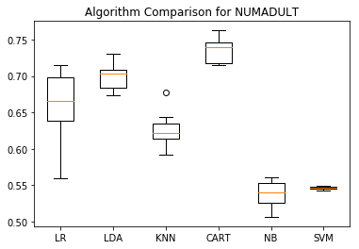
Training models (NUMADULT)
LR: 0.657726 (0.047442)
LDA: 0.699049 (0.016995)
KNN: 0.625338 (0.023188)
CART: 0.734568 (0.015998)
NB: 0.538461 (0.016430)
SVM: 0.546406 (0.002078)
Notes:
Model name – accuracy – standard deviation

Slide 12
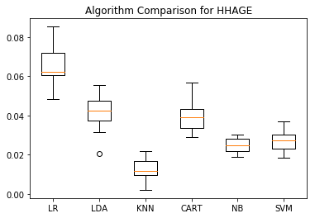
Training models (HHAGE)
LR: 0.065494 (0.009758)
LDA: 0.041600 (0.009852)
KNN: 0.012589 (0.005350)
CART: 0.039456 (0.007574)
NB: 0.024864 (0.003677)
SVM: 0.027263 (0.005652)
Notes:
Model name – accuracy – standard deviation

Slide 13
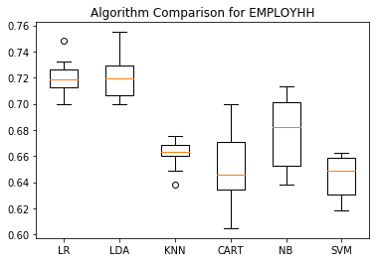
Training models (EMPLOYHH)
LR: 0.719897 (0.013560)
LDA: 0.721440 (0.017266)
KNN: 0.661396 (0.010224)
CART: 0.649959 (0.026936)
NB: 0.678125 (0.026118)
SVM: 0.644924 (0.015909)
Notes:
Model name – accuracy – standard deviation

Slide 14
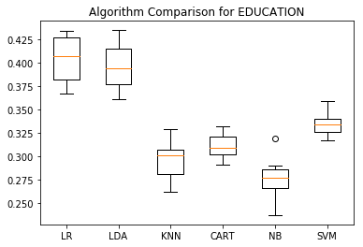
Training models (EDUCATION)
LR: 0.404347 (0.024218)
LDA: 0.396443 (0.024085)
KNN: 0.295709 (0.021133)
CART: 0.311328 (0.013420)
NB: 0.275290 (0.021410)
SVM: 0.335980 (0.013142)
Notes:
Model name – accuracy – standard deviation

Slide 15
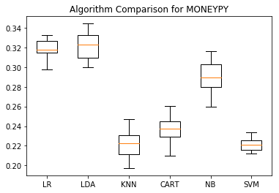
Training models (MONEYPY)
LR: 0.318394 (0.010042)
LDA: 0.321495 (0.013973)
KNN: 0.221442 (0.014590)
CART: 0.236790 (0.013936)
NB: 0.290085 (0.016660)
SVM: 0.221422 (0.006534)
Notes:
Model name – accuracy – standard deviation

Slide 16
Next steps
Testing
Changing feature selection parameter
5
10
20
50
100

