Slide 1
ML models using Residential Energy Consumption Survey (RECS) for predicting occupant characteristics

Slide 2
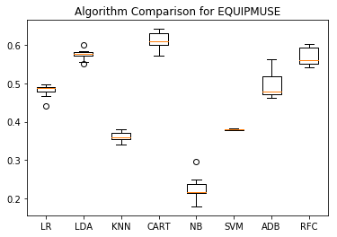
EQUIPMUSE
LR: 0.481500 (0.015923)
LDA: 0.574770 (0.013253)
KNN: 0.361070 (0.011670)
CART: 0.612293 (0.020875)
NB: 0.225811 (0.029856)
SVM: 0.379954 (0.001447)
ADB: 0.494067 (0.032300)
RFC: 0.569480 (0.022290)

Slide 3
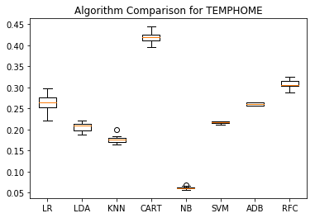
TEMPHOME
LR: 0.265378 (0.020669)
LDA: 0.206764 (0.011286)
KNN: 0.177063 (0.009794)
CART: 0.418715 (0.013917)
NB: 0.061999 (0.003419)
SVM: 0.216614 (0.002411)
ADB: 0.260590 (0.003075)
RFC: 0.308236 (0.010528)

Slide 4
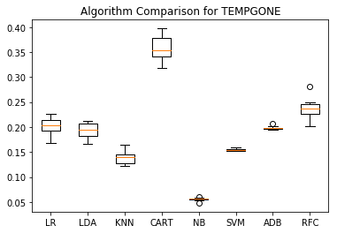
TEMPGONE
LR: 0.202107 (0.016969)
LDA: 0.193186 (0.014937)
KNN: 0.139644 (0.013049)
CART: 0.357297 (0.024299)
NB: 0.055419 (0.003113)
SVM: 0.154170 (0.002290)
ADB: 0.198358 (0.003362)
RFC: 0.236461 (0.020160)

Slide 5
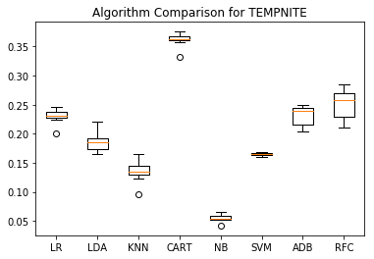
TEMPNITE
LR: 0.230430 (0.011791)
LDA: 0.186554 (0.016308)
KNN: 0.135749 (0.017386)
CART: 0.362413 (0.011595)
NB: 0.055119 (0.005924)
SVM: 0.164959 (0.002897)
ADB: 0.232096 (0.017180)
RFC: 0.251224 (0.024251)

Slide 6
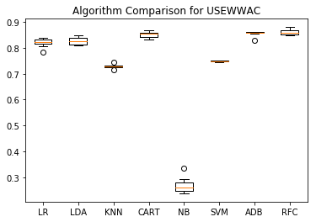
USEWWAC
LR: 0.819718 (0.015518)
LDA: 0.826539 (0.013654)
KNN: 0.728686 (0.006907)
CART: 0.851612 (0.011777)
NB: 0.267807 (0.027494)
SVM: 0.748689 (0.002131)
ADB: 0.856440 (0.009242)
RFC: 0.861258 (0.010564)

Slide 7
EQUIPMUSE
LR: 0.481500 (0.015923)
LDA: 0.574770 (0.013253)
KNN: 0.361070 (0.011670)
CART: 0.612293 (0.020875)
NB: 0.225811 (0.029856)
SVM: 0.379954 (0.001447)
ADB: 0.494067 (0.032300)
RFC: 0.569480 (0.022290)

Slide 8
EQUIPMUSE
LR: 0.481500 (0.015923)
LDA: 0.574770 (0.013253)
KNN: 0.361070 (0.011670)
CART: 0.612293 (0.020875)
NB: 0.225811 (0.029856)
SVM: 0.379954 (0.001447)
ADB: 0.494067 (0.032300)
RFC: 0.569480 (0.022290)

