Slide 1
CHOOSE IMAGE

Slide 2
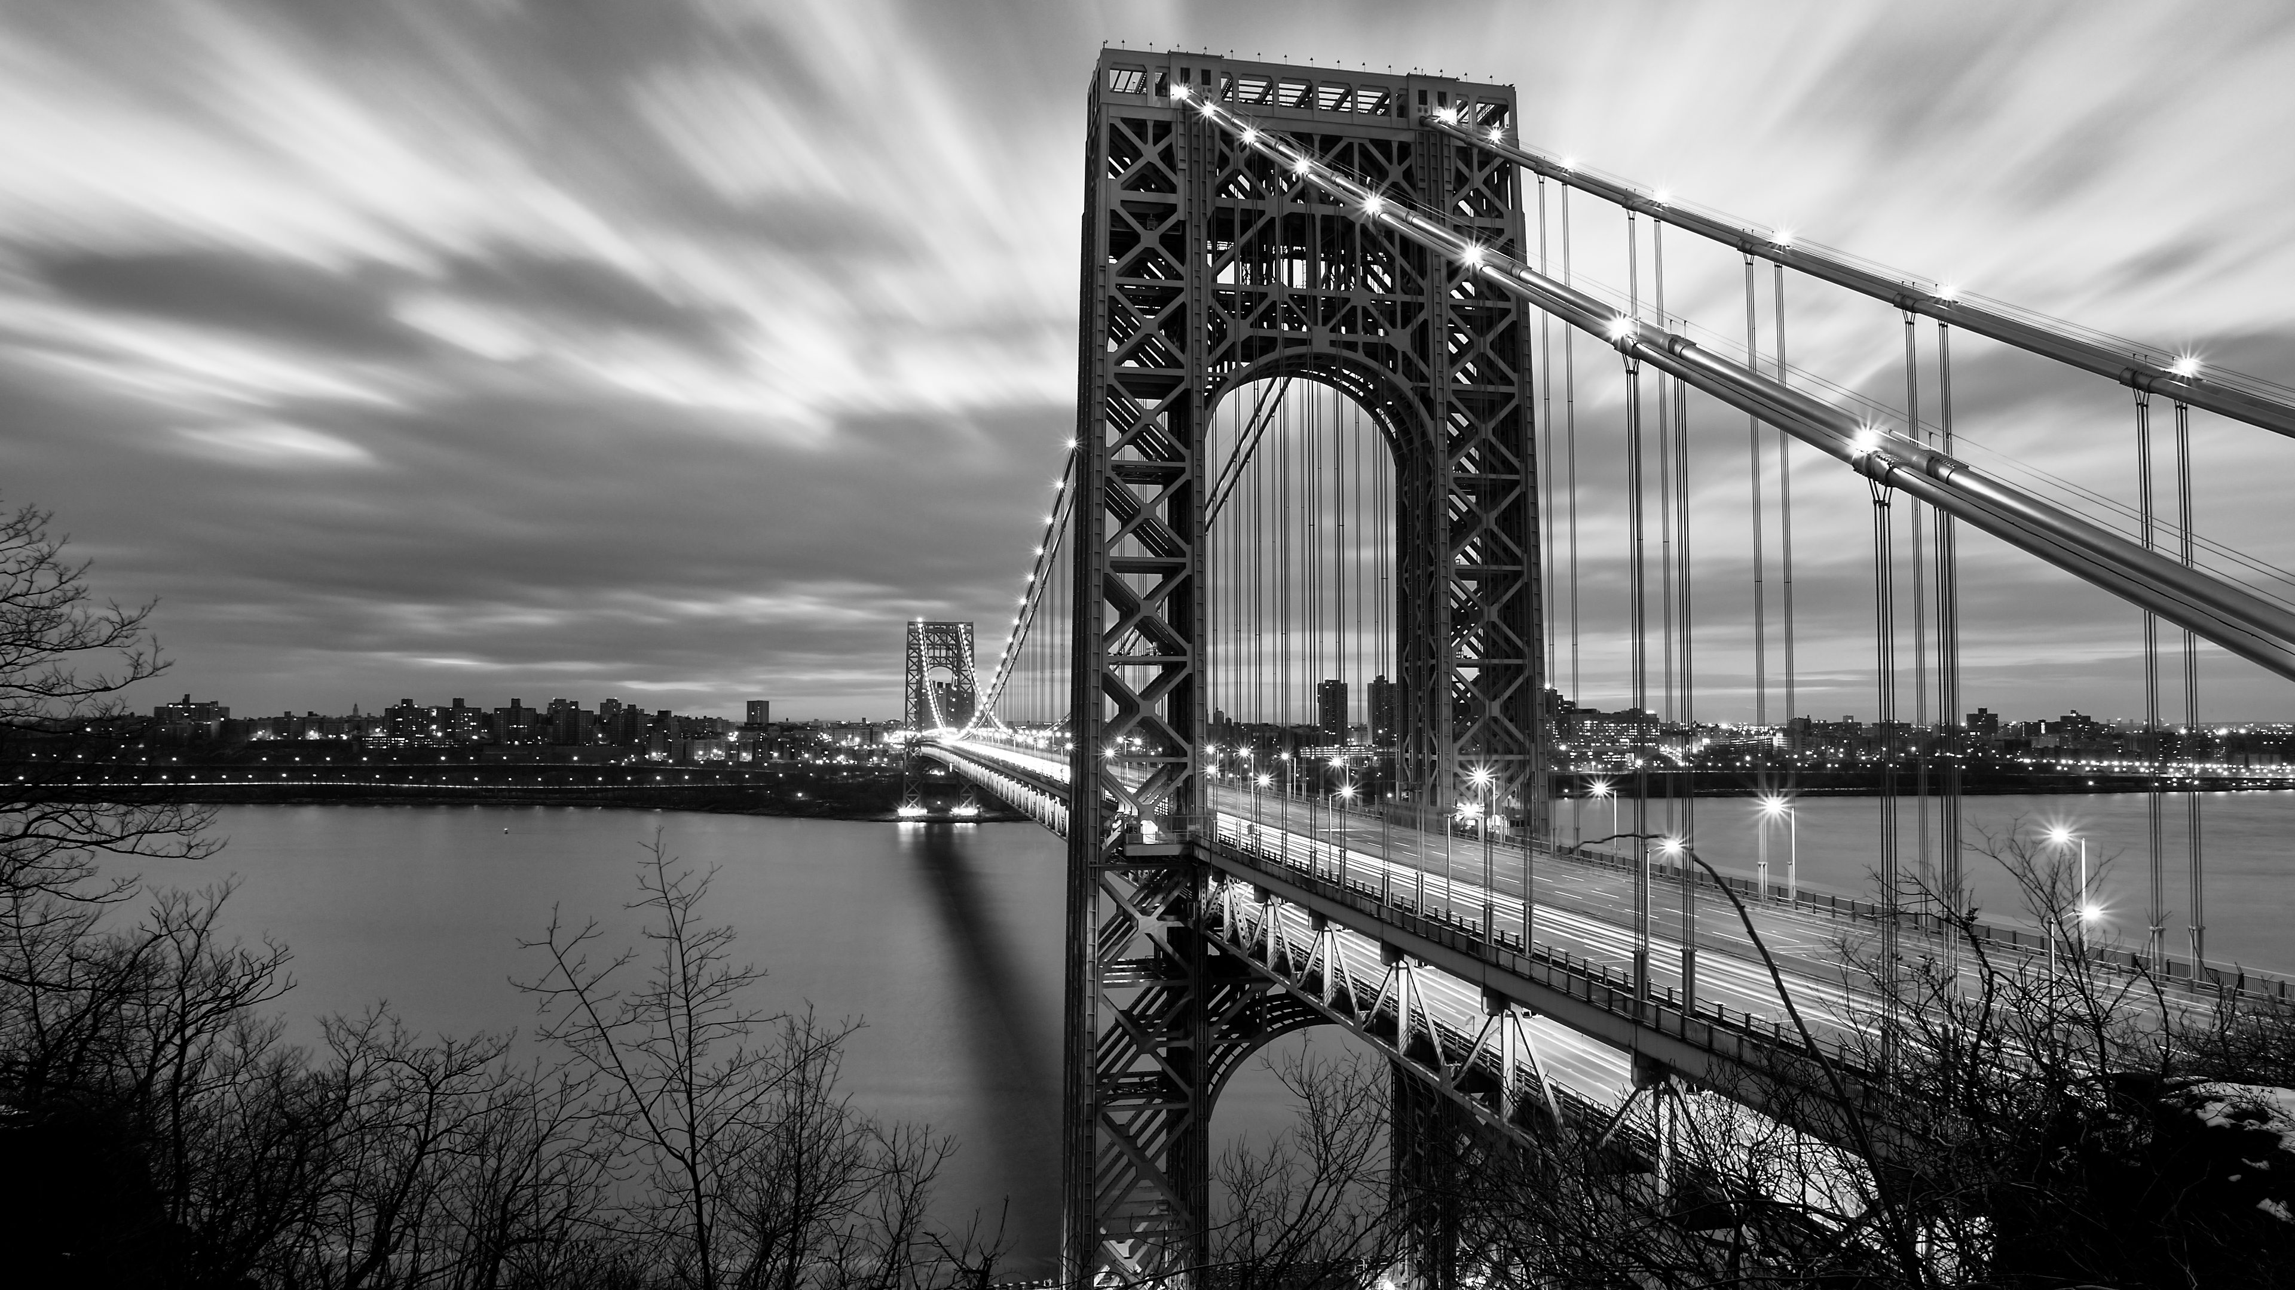
Here is the preview of your photo
CROP
ROTATE
REMOVE BACKGROUND
Image resolution
Width:
Not Set
Height:
Not Set
Unit:
Not Set
FORMAT:
JPG
COMPRESS & DOWNLOAD

