Slide 1


Agrobot: AI-Powered Agricultural Assistance System
Revolutionising Farming with Artificial Intelligence
Presented by:
Milestone 4
Anika Gangwar
Mentor:
Eldhose Mathew, Infosys Springboard 6.0
Connect with me on LinkedIn for further collaboration or inquiries.

Slide 2
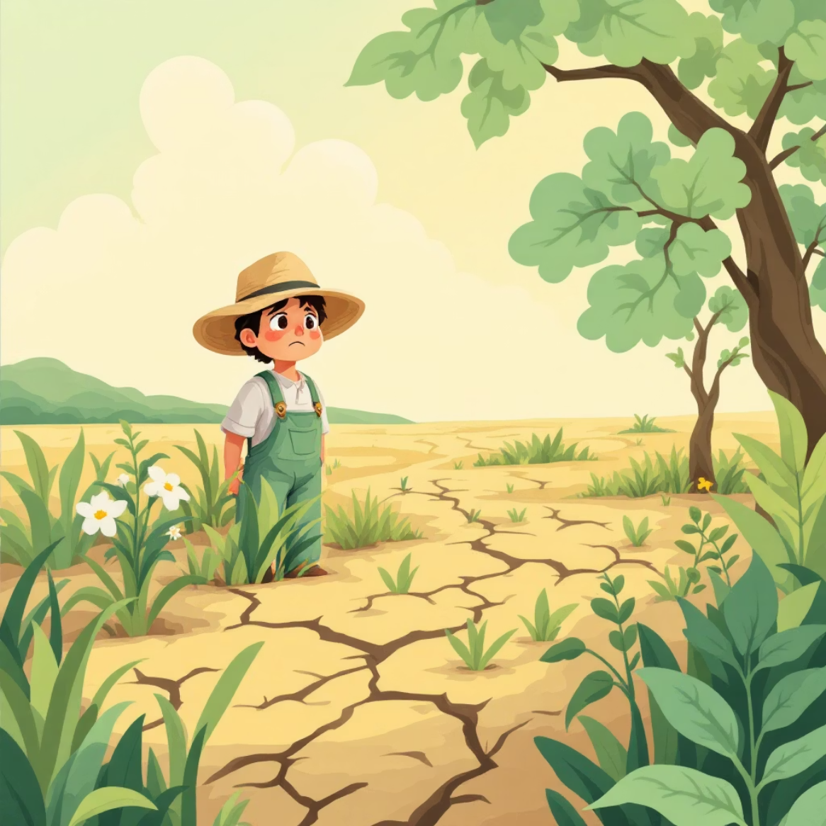
Introduction and the Challenge at Hand
Agrobot is an innovative web application designed to empower farmers by providing AI-driven insights for plant disease identification and prevention. Developed as part of Infosys Springboard 6.0, it addresses critical agricultural needs with a focus on accessibility and scalability.
The Core Problem:
Significant crop losses due to plant diseases globally.
Lack of timely access to agricultural experts, especially for small-scale farmers.
Exacerbated by linguistic diversity and limited digital literacy in regions like India.
Traditional diagnosis methods are often slow and impractical.
Crop diseases are a global threat to food security, particularly for small-scale farmers.
Our objective is to develop a real-time, multilingual AI tool that bridges this gap, offering disease diagnosis and prevention advice tailored to local languages and accessible via a user-friendly web interface.

Slide 3
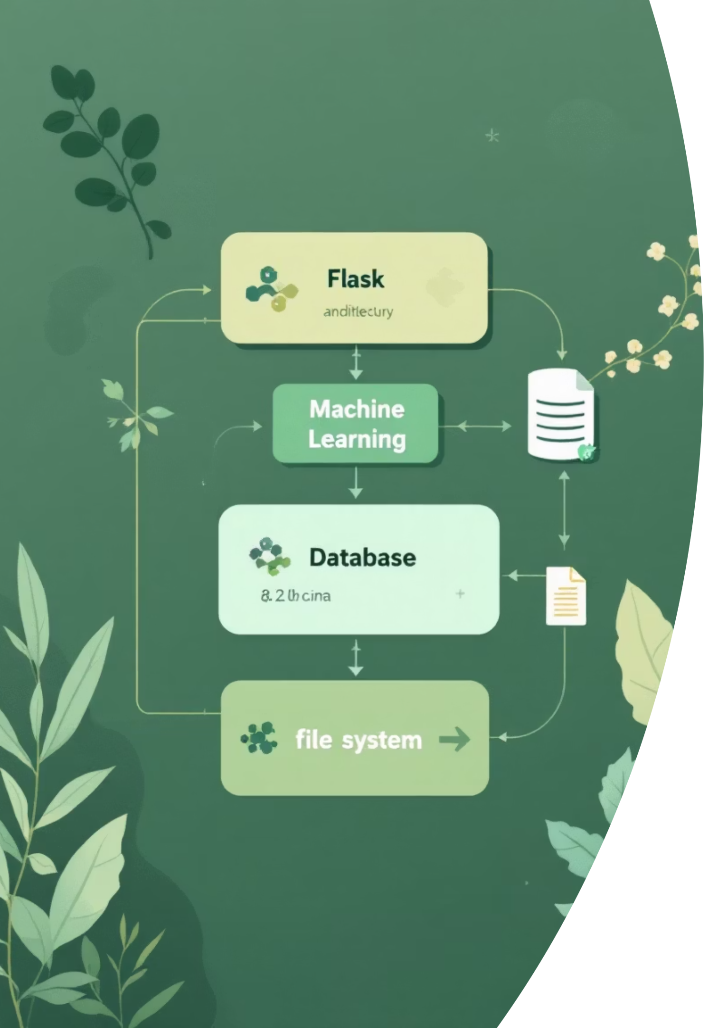
System Architecture Overview
Flask Backend
The core of our system, managing requests and data processing.
TensorFlow CNN Model
Trained on PlantVillage dataset for accurate disease detection.
NLP Module
Leveraging TF-IDF and IndicTrans2 for multilingual support.
SQLAlchemy SQLite DB
For secure user management and disease data storage.
The system follows a client-server model, ensuring a seamless flow from user input to intelligent, translated responses.

Slide 4
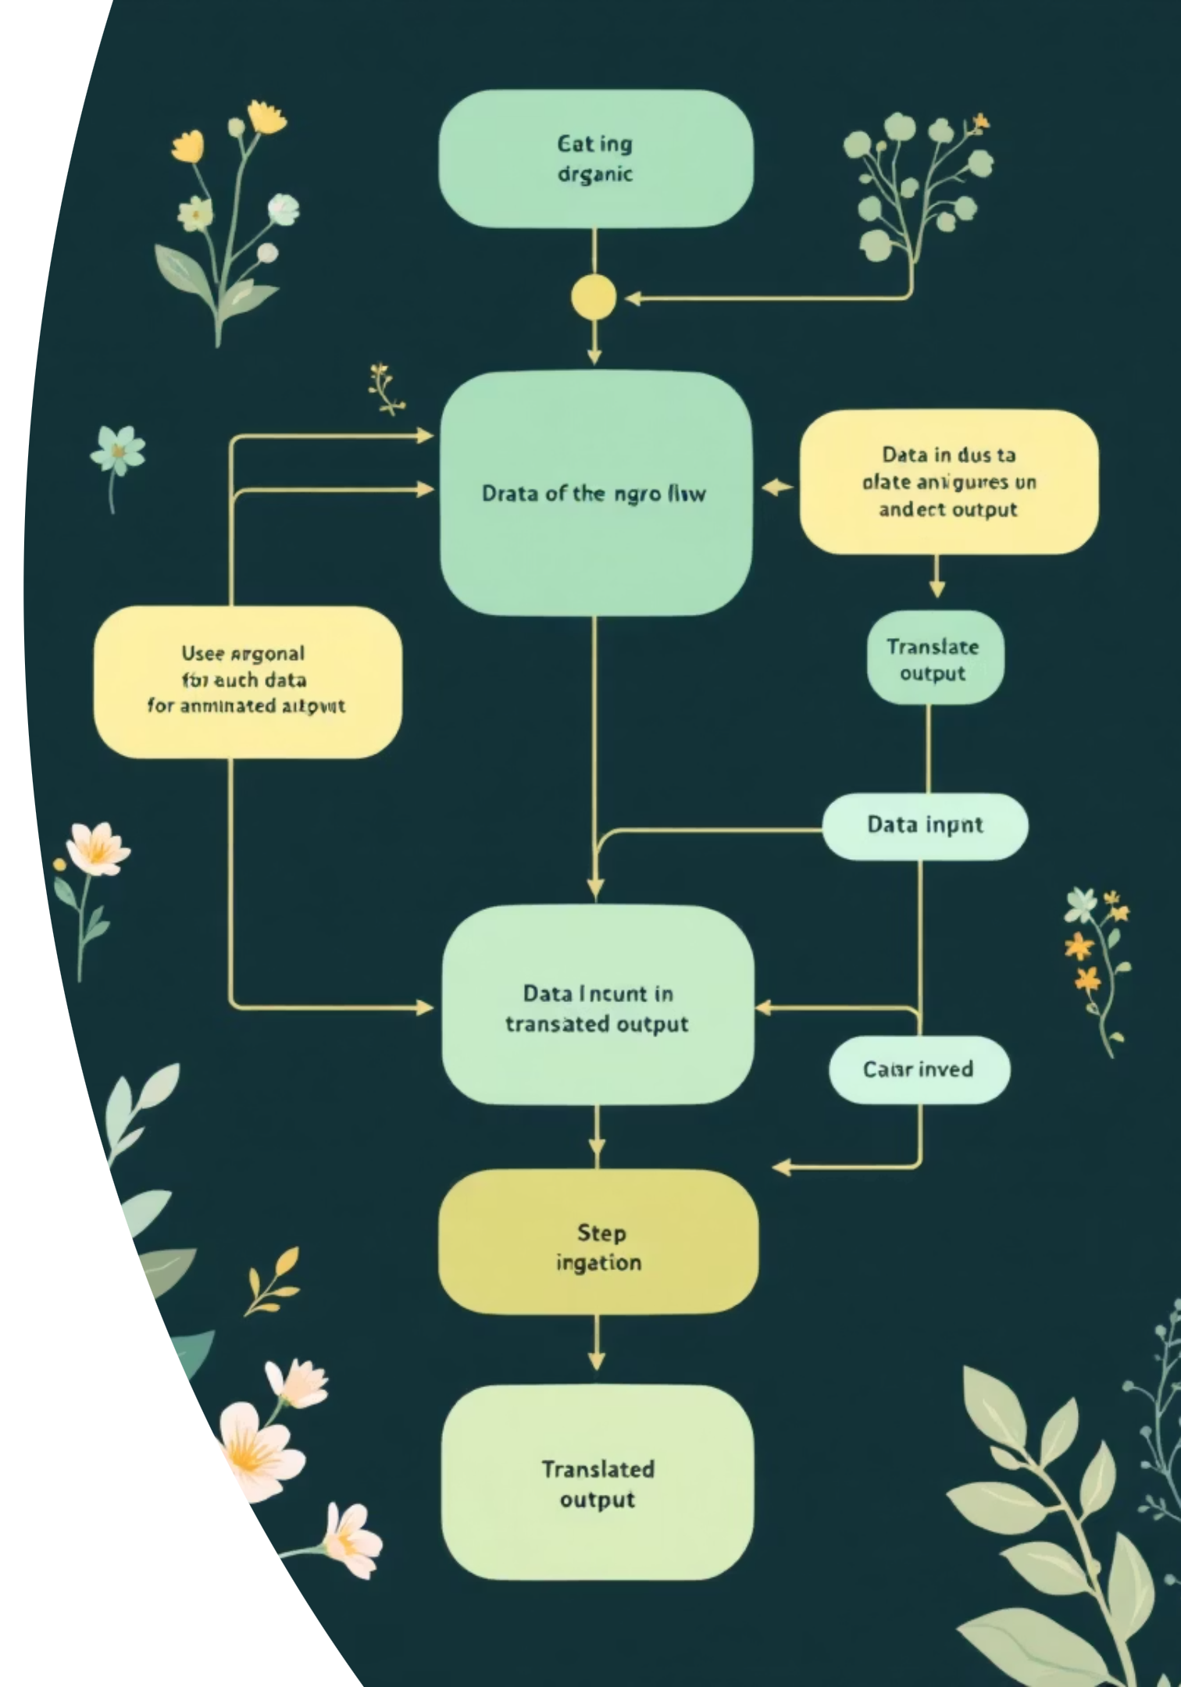
Implementation Workflow and Data Flow
01
User Authentication
Secure registration and login via Flask-Login, with role-based access for regular users and admins.
02
Chatbot Processing
Text inputs are language-detected, translated (IndicTrans2), and matched against TF-IDF. Images are preprocessed and analysed by the CNN for prediction.
03
Model Training
The train_model.py script handles data augmentation, CNN training, and saving the model as model.h5.
04
Multilingual Response
Disease data from the database is translated and returned to the frontend in the user's preferred language.

Slide 5



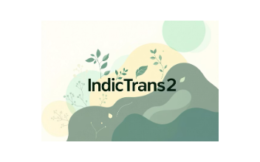
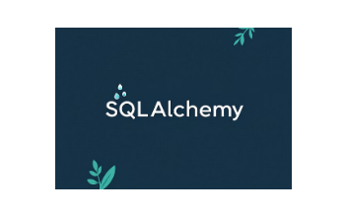

Technology and Tools Employed
Our robust technology stack underpins Agrobot's functionality and performance.
Flask Framework
TensorFlow
TF-IDF & IndicTrans2
A lightweight and scalable web framework for rapid development.
Powers the CNN, trained on over 1010 images for precise disease identification.
Enables sophisticated text analysis and real-time multilingual translations.
SQLAlchemy with SQLite
PlantVillage Dataset
Provides flexible ORM for managing user authentication and disease records.
A curated Kaggle dataset, forming the backbone for accurate model training.

Slide 6





Rationale Behind the Design
Scalability
Flask's modular design and lightweight SQLite database ensure easy scaling and optimal performance, even on resource-constrained systems.
Accuracy
Our TensorFlow CNN, rigorously trained on a diverse dataset, delivers high precision in image classification, validated through extensive testing.
Multilingual Support
IndicTrans2 seamlessly integrates to provide real-time translations, effectively addressing the diverse linguistic landscape of agricultural communities.
Cost-Effectiveness
By leveraging open-source tools and datasets, we minimise development costs, making Agrobot an accessible and sustainable solution.

Slide 7
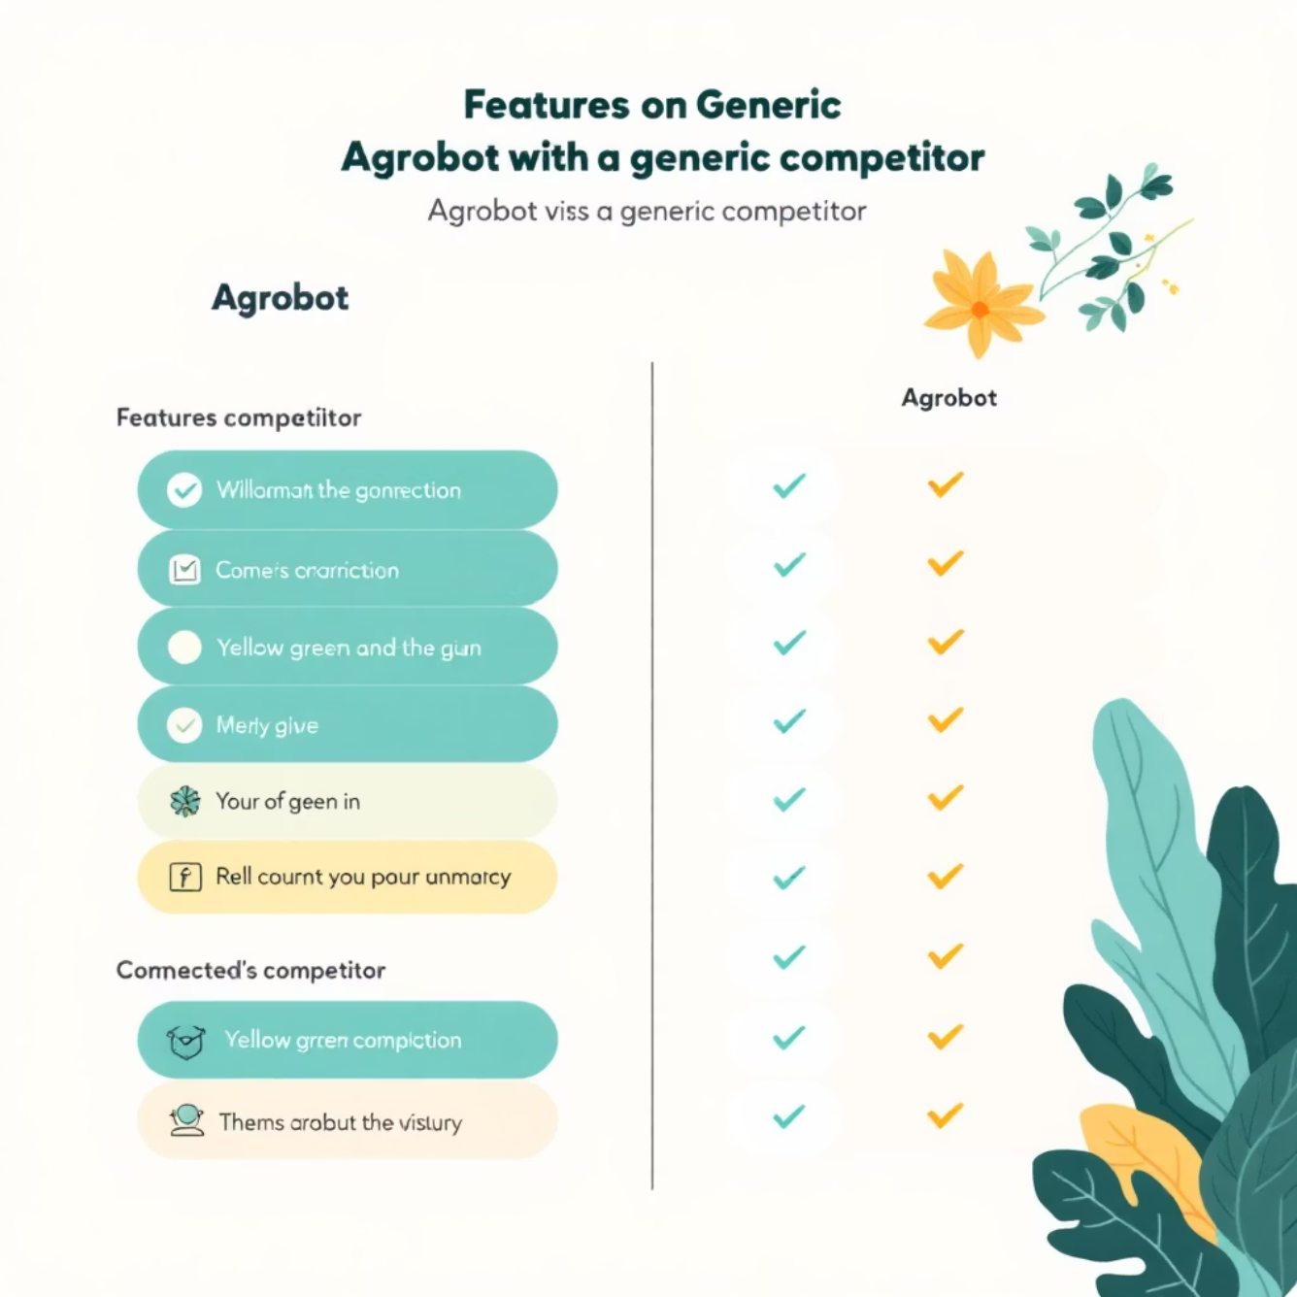
Competitive Edge of Agrobot
Hybrid Input System
Combines image-based CNN with text-based NLP, offering unparalleled flexibility for
users.
Extensive Multilingual Reach
Supports four languages, catering to diverse agricultural communities, a distinct advantage over monolingual tools.
Dynamic Admin Flexibility
The admin dashboard allows real-time updates to disease data, ensuring the system remains current without code changes.
Optimised Resource Efficiency
The lightweight Flask backend and pre-trained model enable deployment on modest hardware, ideal for rural areas.
Agrobot stands out by offering comprehensive and adaptive solutions for farmers globally.

Slide 8
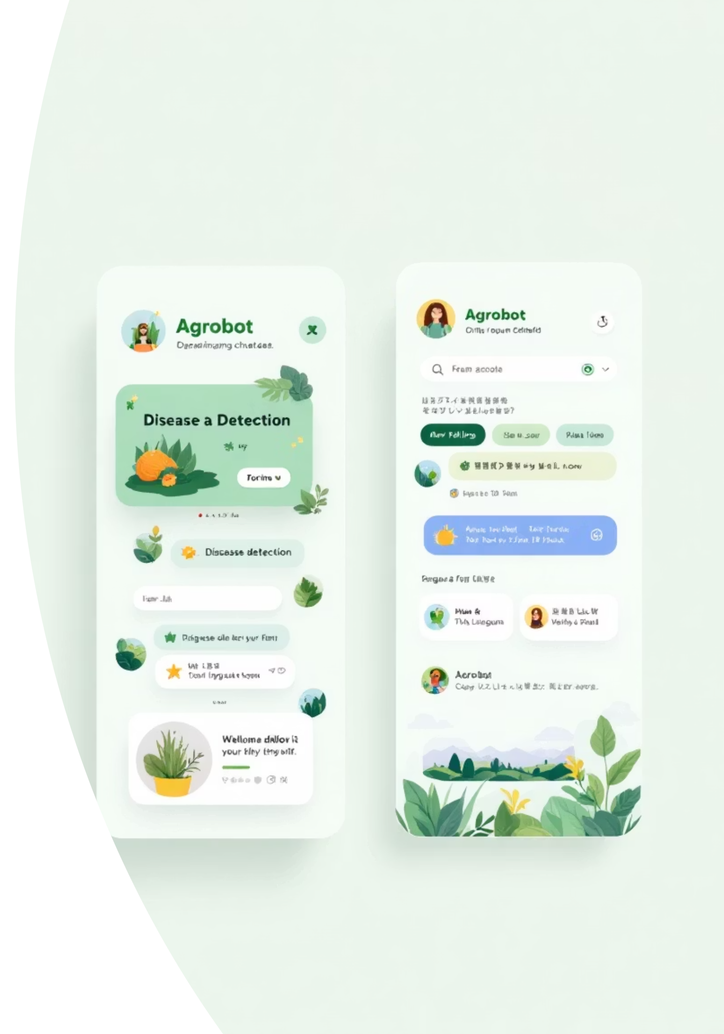
Achievements and Performance
88%
96%
Model Accuracy
Functional Validation
Achieved high precision in classifying plant diseases like Tomato Bacterial Spot and Potato Late Blight.
Multilingual chatbot and admin dashboard are fully operational and rigorously tested with sample inputs.
Impact Potential
Offers real-time advice to drastically reduce crop losses, poised for widespread adoption among farmers.
The successful training of model.h5 on the PlantVillage dataset underscores our commitment to accuracy and reliability.

Slide 9
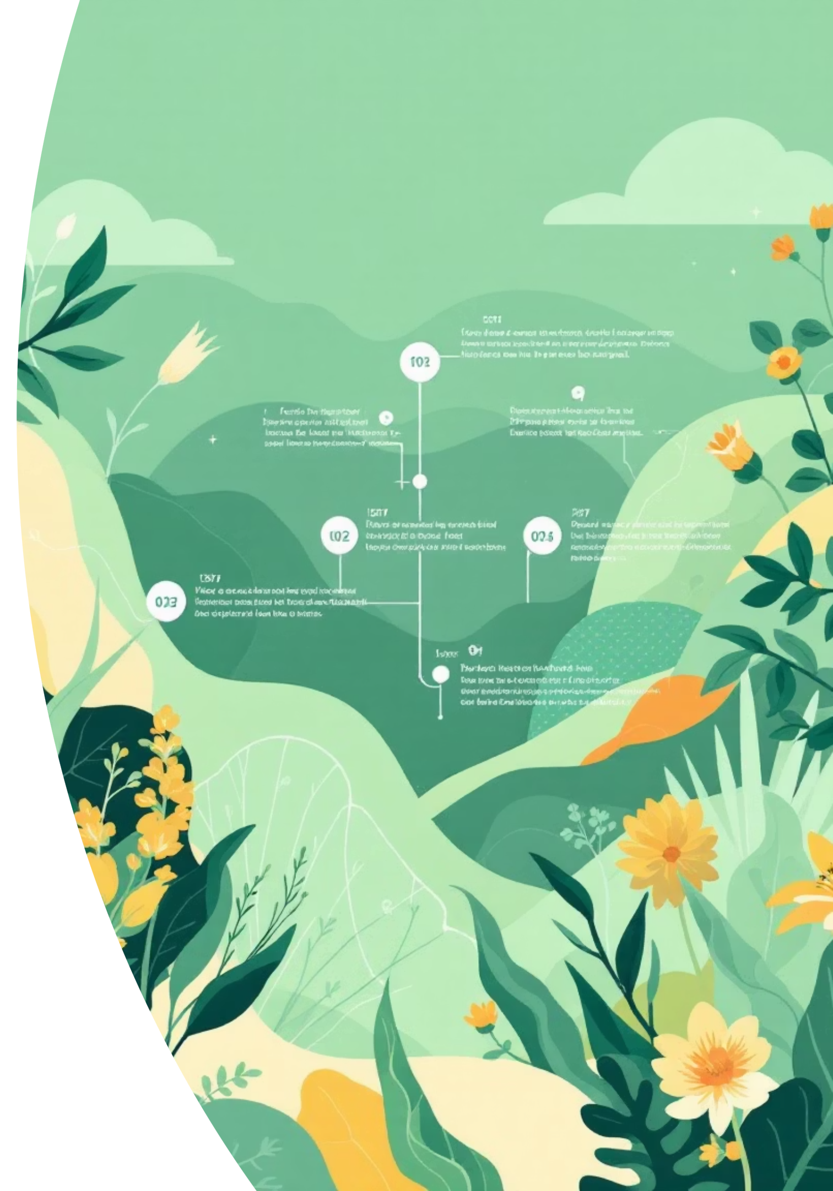
Summary and Future Directions
Conclusion
Agrobot delivers a practical AI solution for plant disease management, validated through its robust CNN and NLP integration.
Website
Development of a dedicated website for enhanced accessibility and seamless user experience across devices.
Weather Data Integration
Incorporating real-time weather data for more accurate disease prediction and prevention strategies.
Language Expansion
Expanding multilingual support to include additional regional and international languages.
Developed under Eldhose Mathew's mentorship, Agrobot is a testament to innovative agricultural technology with a clear path for future growth.

Slide 10




Thank You
Acknowledgements
Contact
Sincere thanks to PlantVillage dataset contributors, and my mentor Eldhose Mathew Sir.
For professional collaboration or further details, connect with me on LinkedIn.
Q&A
I welcome any questions or feedback to continue improving this project.

