Slide 1

MediCare
An app for instant medical help

Slide 2
Introduction :
Project created by :
Name | ID
Azrin Nahar Anika | 15162103308
Supervised By :
Md. Mamun Hossain
Lecturer, Dept. of Computer Science and Engineering,
Bangladesh University of Business and Technology
Date of Submission : 29th June, 2019.

Slide 3
Objectives :
Providing information of first aid of different injuries.
Helps to learn about diseases
Helps to create awareness about health
Provides contact numbers of Hospitals

Slide 4
Methodology:
Tools and Technology :
Operating System Windows 7
Android Studio 3.0.1
Java sdk
Google android sdk
Integrated Development Environment (IDE)
RAM 6GB,HardDrive 1TB,Processor 2.4 GHz
Language :
Java
Xml
UI tested on :
Virtual Emulator
Mobile

Slide 5
Methods and features :
The user will Enter Height and Weight to Calculate BMI.
User will check up of their health by selecting sympyoms they have.
User can make calls to Hospitals.
APIs :
API level 26
Implementations: 1.implementation fileTree 2.implementation Appcompact 3.implementation Constrain layout,Relative Layout,Linear Layout 4test Implementation androidTestImplementation 'com.android.support.test:runner:1.0.1' androidTestImplementation 'com.android.support.test.espresso:espresso-core:3.0.1'

Slide 6
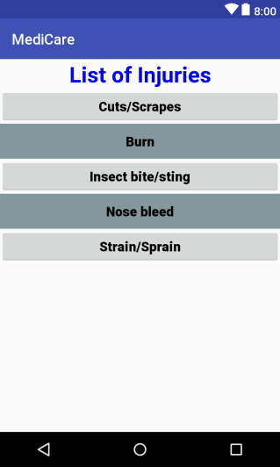
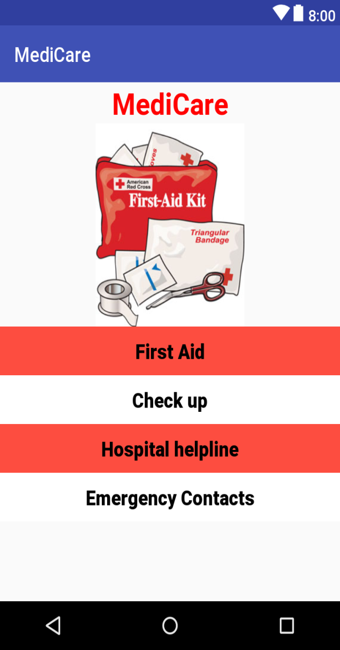
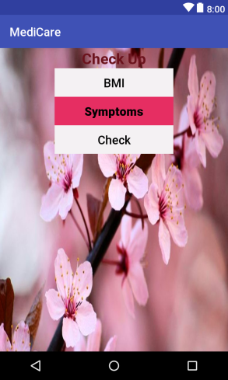
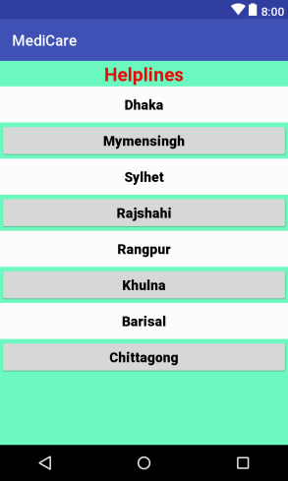
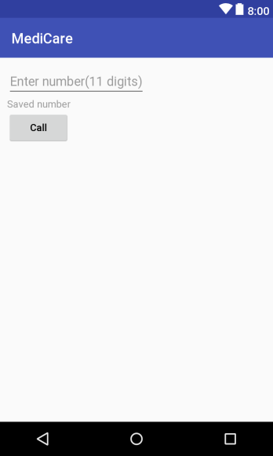
Design and Implementation

Slide 7

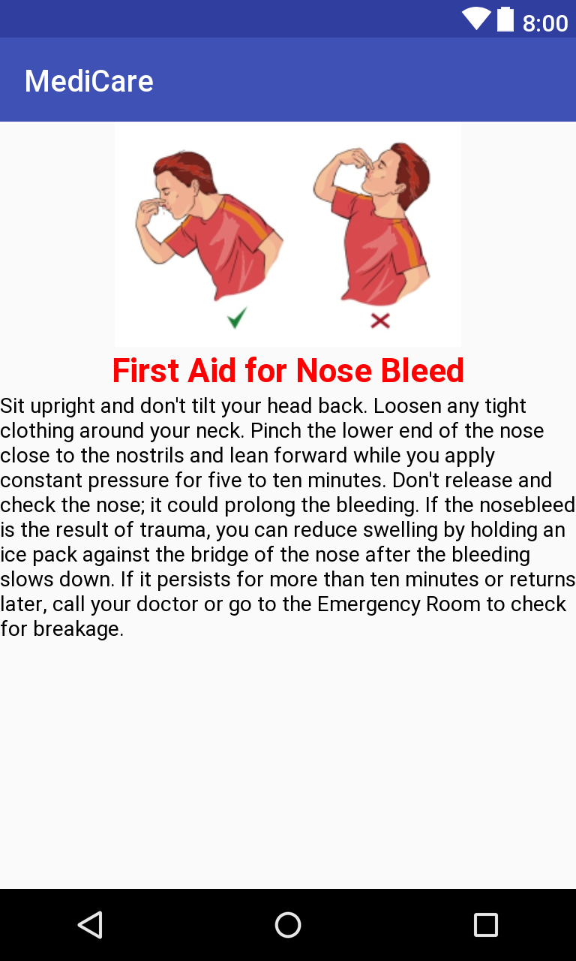
Providing First Aid :

Slide 8
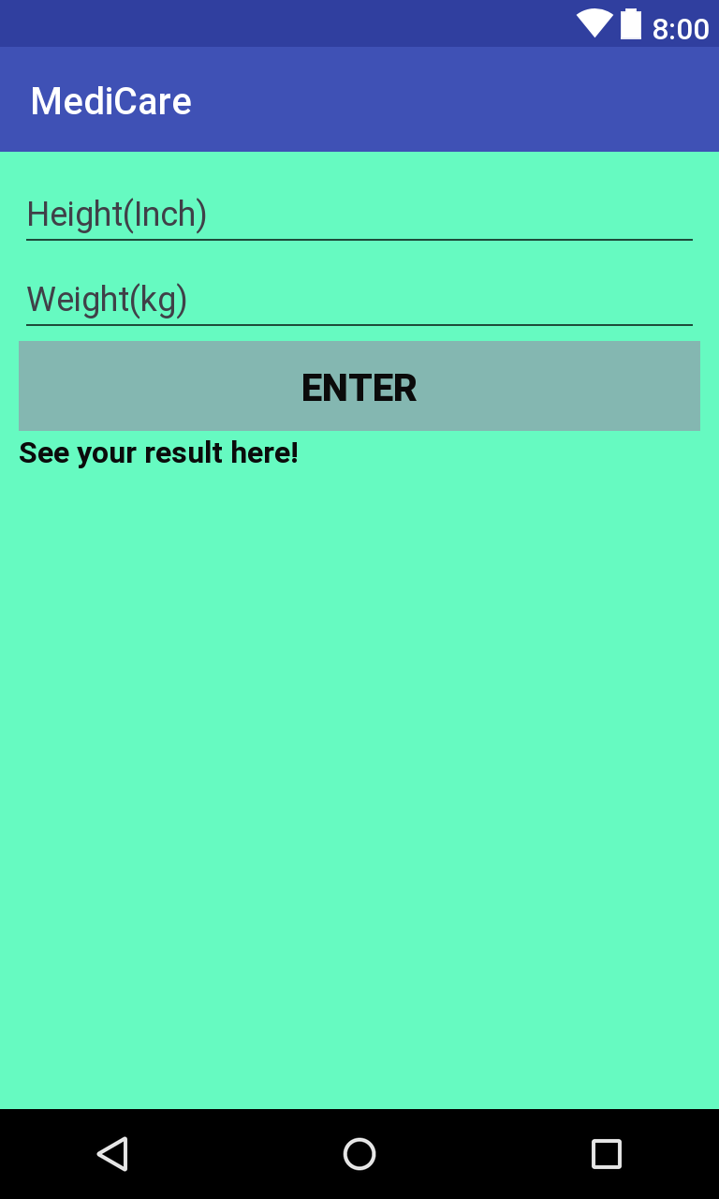

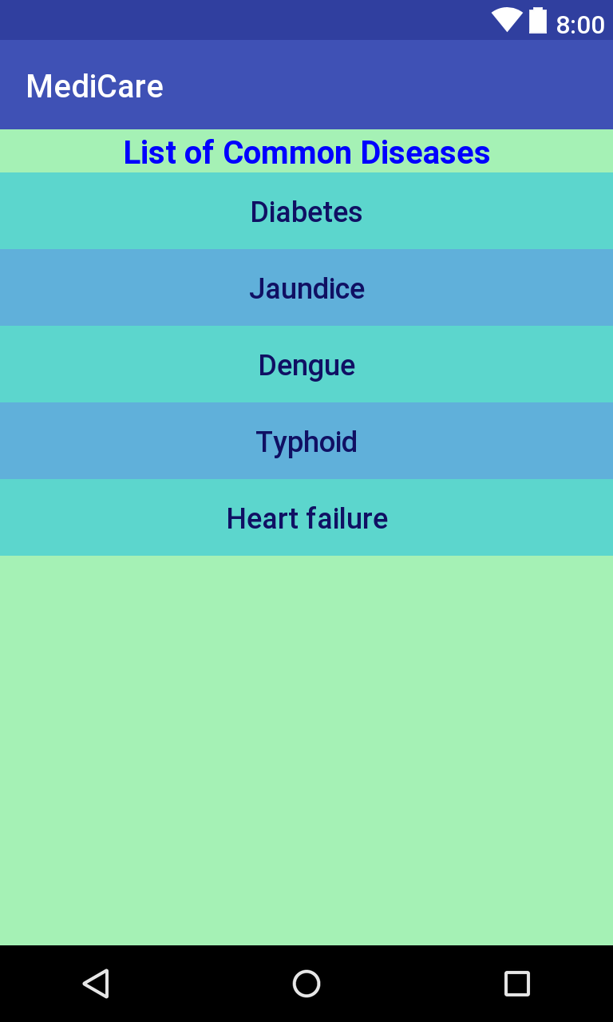
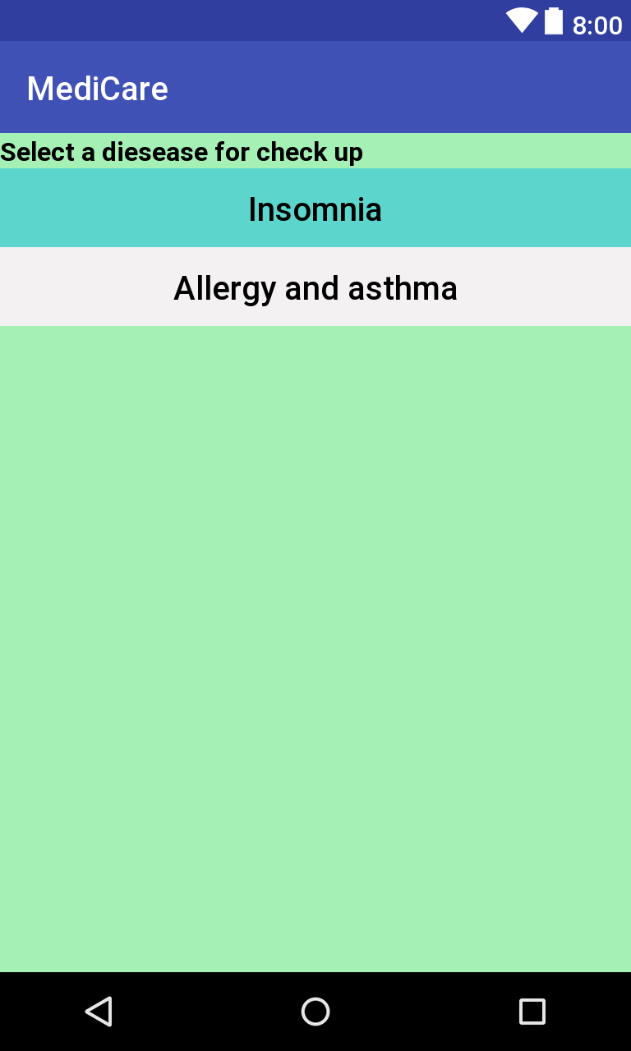
Check up :

Slide 9
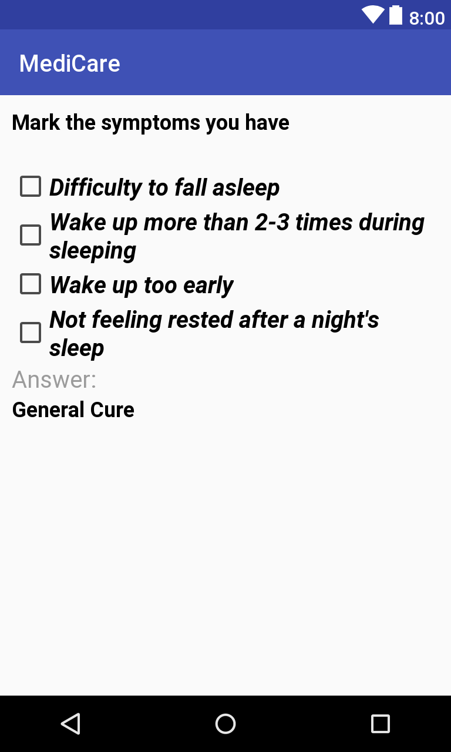

Slide 10

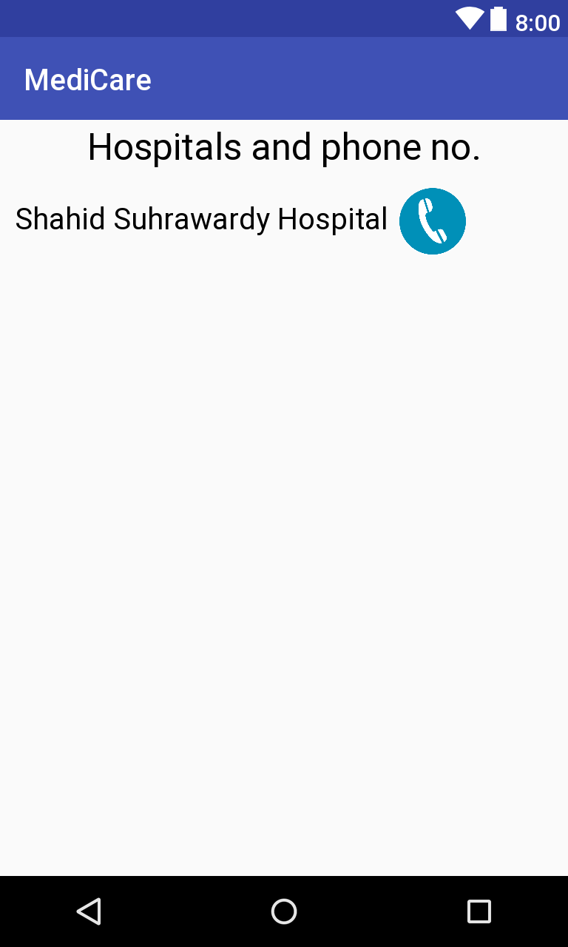
Hospital Helplines :
Call

Slide 11
Limitations :
Less amount of Information.
Check up by symptoms is not accurate
User will have to find hospital number manually from the list.

Slide 12
Future plan:
We will try to use gps to find nearest hospital and provide its number from database
Provide information of more injury and diseases
Increase accuracy of check up by analyzing more data.

Slide 13
Thank You

