Slide 1


An arcade game released in 1980
A presetation on Pac-Man by :-
Name : Azrin Nahar Anika.
ID : 15162103308
Intake : 32 Sec: 7
By Dept. of CSE of Bangladesh University of Business & Technology

Slide 2
Introduction :
In this game the player controls Pac-Man through a maze , eating food or dots. When all dots are eaten ,Pac-Man is taken to the next stage. There will be four enemeis of Pac-man roaming in th maze , trying to catch Pac-man. When enemy and Pac-Man in a same tile ,he considered to have collided with that ghost. When all lives have been lost,the game ends.
Pac-Man is an arcade game developed by Namco and first released in Japan in May 1980. It was created by Japanese video game designer Toru Iwatani. This game is widely popular from its original release to the present day. This game is an icon of 1980s popular culture.

Slide 3
Description of our game :
Our game is simplified from the actual game to lessen some complexity.
There will be a maze.
Pac-man or the hero of the game will be at the last row. The player will control the Pac-Man.
The ghost or enemy of the game will be at the first row. There will be only one ghost. The enemy will try to catch Pac-man.
The foods will appear randomly as dots (‘.’).
There is a point for each food Pac-man eats..
If the ghost catches Pac-Man the game is over.
The final score will be shown on the output screen.
There is only one stage in our game.

Slide 4
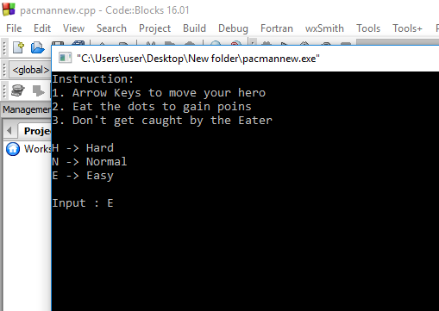
How to Play :

Slide 5
How it works :
When user presses an arrow key then the cursor is moved to that position. If there is a dot in that position then 1 point is added. Then the position of Pac-man and position of enemy is sent to the findpath function where enemy finds the shortest path to catch pac-man. If enemy succeed to occupy the same positon as pac-man the game is over. User loses and final score is shown.

Slide 6
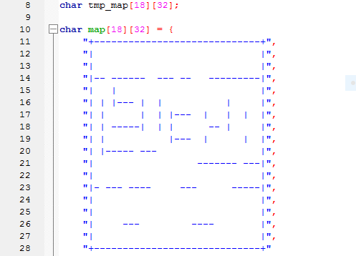
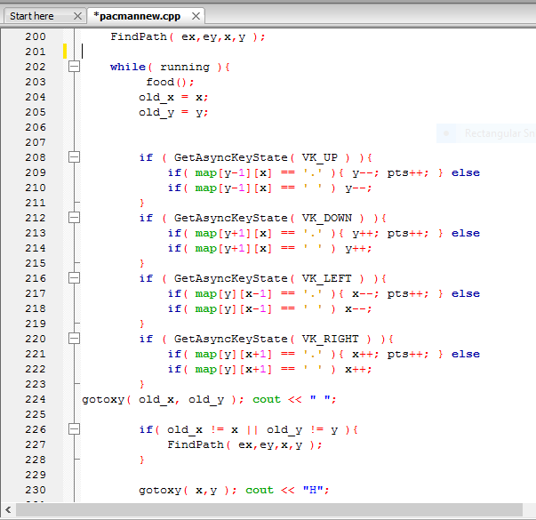
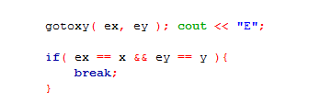

Slide 7
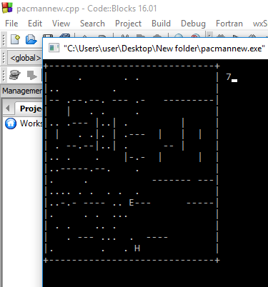
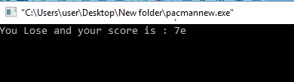
Screenshots of the game :

Slide 8
Game benefits :
This game is a great source of entertainment
This game helps to improve concentration
This game helps to increase decision making speed.
Limitations :
There is no graphical interface in our game.
No sound effect used
Our game is simplified from the actual version of this game.

Slide 9
Future scope :
Our aim is to make a good graphical interface for our game
Make good and original sound effect for this game
Add some new and interesting storyline to our game
We want to make better animation according to a new storyline for our game

Slide 10
Thank You
References:
1.http://www.wikipedia.com
2.http://www.cplus.com

