Slide 1

Welcome
to
Software Development Project 03
(CSE – 300)
Bangladesh University of Business and Technology
Dept. of Computer Science and Engineering
Intake 32, Section 7

Slide 2
SUPERVISED BY:
Arunavo Dey (AD)
Lecturer
Dept. of CSE
Bangladesh University
of
Business and Technology

Slide 3

University Ranking System
Name | ID
Azrin Nahar Anika | 15162103308

Slide 4
Outline
Introduction
Objectives
Background Analysis and Related Systems Study
Configuration and System Requirements
Using the System
Conclusion
References

Slide 5


Introduction
In Bangladesh, most people go to the university campus and visit the office when they need information about any university
For getting some simple information like the admission timeline, fees and waivers etc. people generally go there physically, spending time and money
For comparing different universities they need to visit multiple ones which costs even more
A solution to this situation is using online based university ranking system

Slide 6

Objectives
1. To study existing online based university ranking systems and similar related systems
2. To design an online based university ranking system with basic and enhanced functionalities like –
I. Providing various kinds of information about different universities of Bangladesh including - fees ,credit, grading system, waiver, faculty, research, result etc.
3. To develop the system with the required features
4. To perform extensive testing to check the completeness and correctness of the system

Slide 7

Background analysis and related systems Study
From our studies we have found that existing systems provide some basic functionalities and information
Most universities have their own website where some basic information can be found
There are different websites which provide ranking of universities, some websites [1, 2] offer global ranking, some provide nation based ranking [3]
However, there are no existing systems for providing ranking and information about only Bangladesh based universities
Our proposed system will provide the users with information about different universities of Bangladesh along with a ranking to make better comparison

Slide 8

Time table
No. | Description of work | Time
1. | Idea generation and Project proposal | 1 week
2. | Background study and Design | 2 weeks
3. | Implementation and Testing | 5 weeks
4. | Project Submission | 2 weeks

Slide 9

Configuration and system requirements
Coding language – PHP
Query language – SQL
Operating System – Microsoft Windows 7
Processors – Intel® core i5
Design - HTML

Slide 10

How to use the system?
Step 1: Homepage
First you have to go to our homepage.
Address : http://localhost/first/

Slide 11
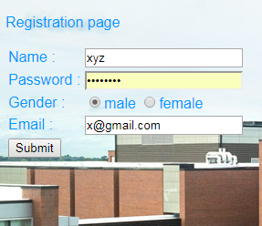
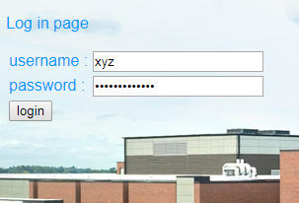
Step 2 : Registration
Step 3: Log in

Slide 12
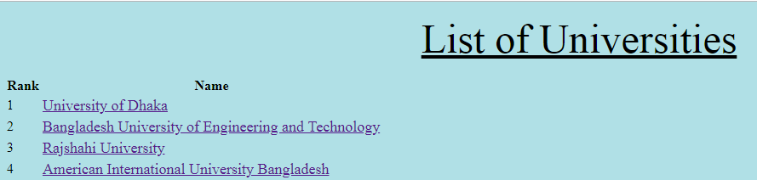
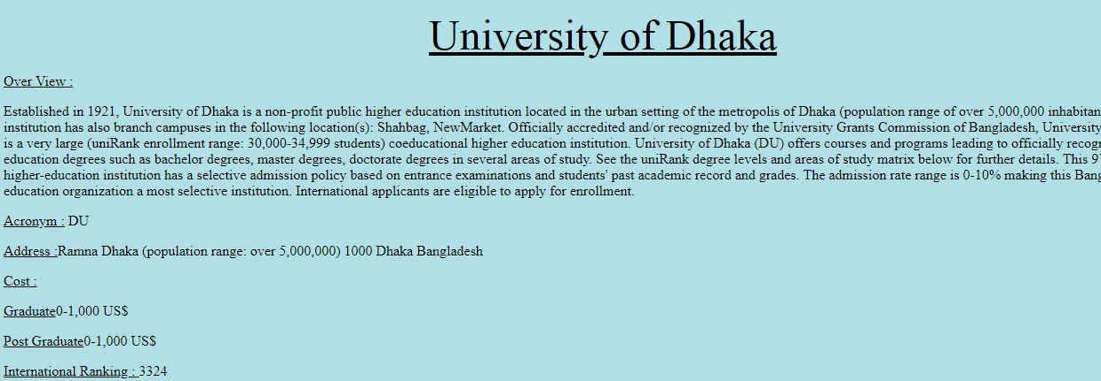
Step 4 : Choose name of the university from the list.
Prerequisite : Successful log in.

Slide 13


Limitations and future works
The system doesn’t provide faculty wise or department wise comparison, only an overall ranking is provided
We would try to add an enhanced feature for providing a ranking based on different subjects and disciplines
We will try to develop an android version of the system

Slide 14

Conclusion
This system will be very helpful for students and their parents
The system will help the students to make a choice among different universities
Time and money will be saved by using the system
Such kind of ranking will motivate university authorities to take initiatives for providing better standard of education

Slide 15
references
[1] http://www.webometrics.info/en/Asia/Bangladesh%20
[2] https://www.4icu.org/bd/
[3] https://www.usnews.com/best-colleges
[4] Software Engineering: A Practitioner's Approach by Roger S. Pressman
[5] Systems analysis and design by Alan Dennis

Slide 16


Slide 17


