Slide 1
Lighting/Illumination/Reflection Model

Slide 2
Some of the contents used in this lecture belong to…
Dr Jon Shiach, Manchester Metropoliton University, “Direct Lighting Model”, https://www.youtube.com/watch?v=7CdS8oOJtVA
Mr. Jacobson, University of Toronto, “WebGL Phong Shading”,
http://www.cs.toronto.edu/~jacobson/phong-demo/
RapidCompact, “Simplifying a 3D Mesh”, https://rapidcompact.com/doc/cli/latest/Simplify/index.html

Slide 3
Basic Terms
Illumination: the transport of energy from light sources to surfaces & points
Local illumination
Global illumination
Lighting model or Illumination model: Express the factors determining a surface’s color or luminous intensity (outgoing or reflected light) at a particular 3D point
Notes:
We calculate intensity of a point (light reflected from that point)

Slide 4











Slide 5



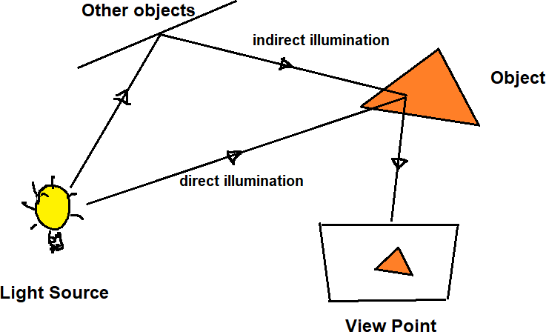

Slide 6
Components of Illumination
Two components of illumination:
Light sources
Surface properties
Light source described by a luminance/intensity ‘I’
Each color is described separately
I = [Ir Ig Ib]
Types of Light Sources:
Ambient Light
Diffuse Light
Spot Light

Slide 7







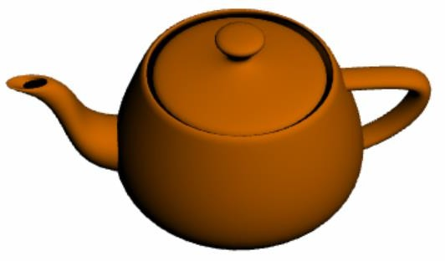

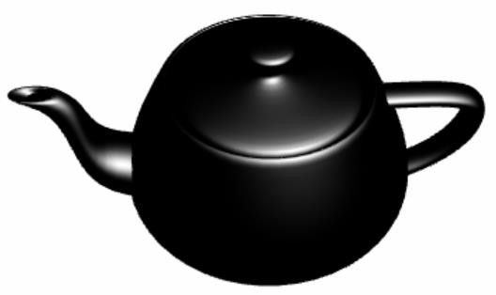







Slide 8
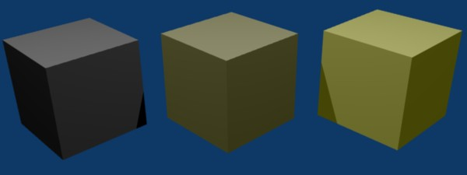
Ambient Light
No identifiable source or direction
Product of multiple reflections of light from the many surfaces present in the environment
Computationally inexpensive
Notes:
The scenes we observe around us always seem to be bathed in some soft non-directional light 🡪 Ambient light

Slide 9
Ambient Light
Categories:
Global ambient light
Independent of light source
Lights entire scene
Example: reflection of sunlight from several surfaces
Local ambient light
Contributed by additional light sources
Can be different for each light and primary color
Example: Reflection of fluorescent lamps from several surfaces
Notes:
Global ambient light – sunlight comes through window, get reflected from several surfaces
Local ambient light – tube light get reflected from several surface

Slide 10


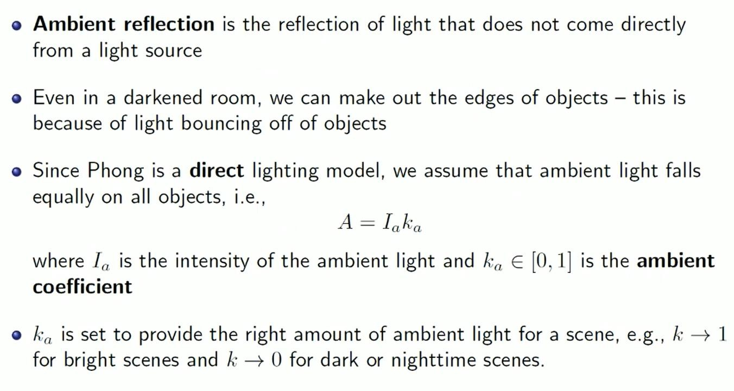









Slide 11
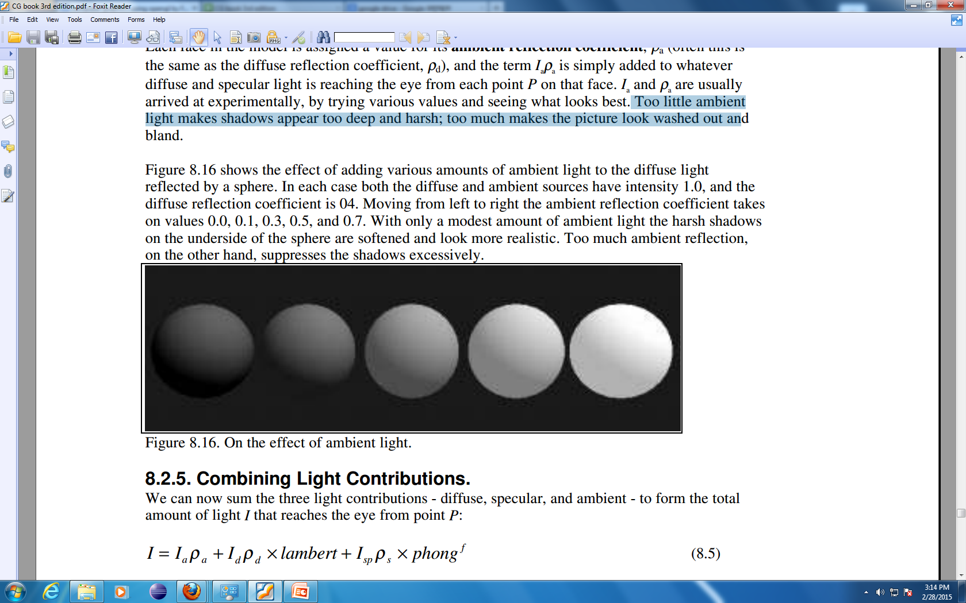
Ambient Reflection Coefficient
Effect of adding ambient light to the diffuse light reflected by a sphere
Diffuse source intensity is 1.0 Diffuse reflection coefficient is 0.4 Ambient source intensity is 1.0
Moving from left to right the ambient reflection coefficient takes on values: 0.0, 0.1, 0.3, 0.5, and 0.7
Too little ambient light makes shadows too deep and harsh
Too much makes the picture look washed out and bland

Slide 12

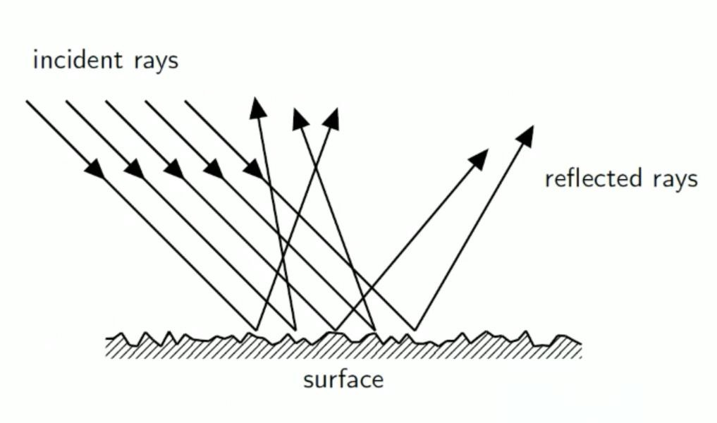




















Slide 13



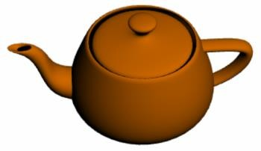
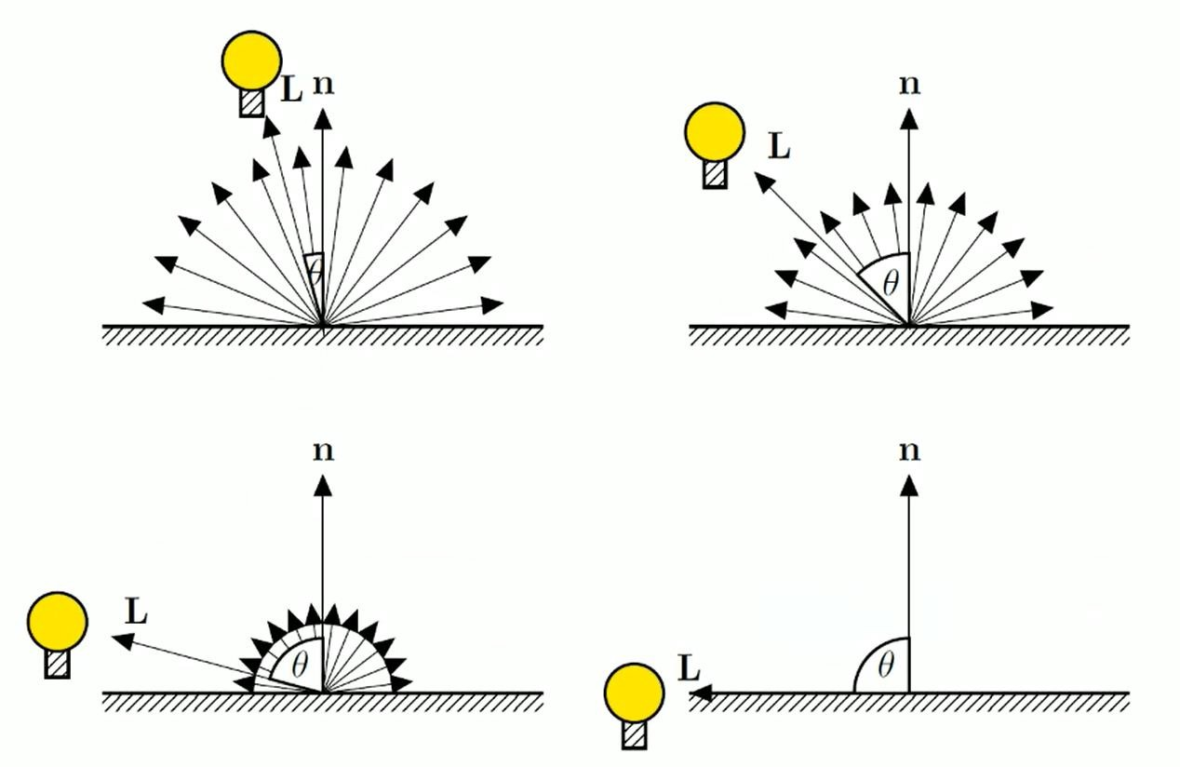






















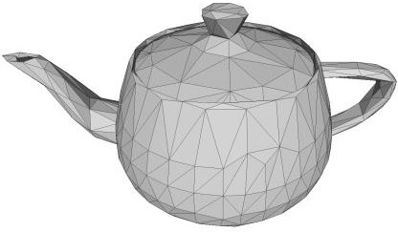


Slide 14
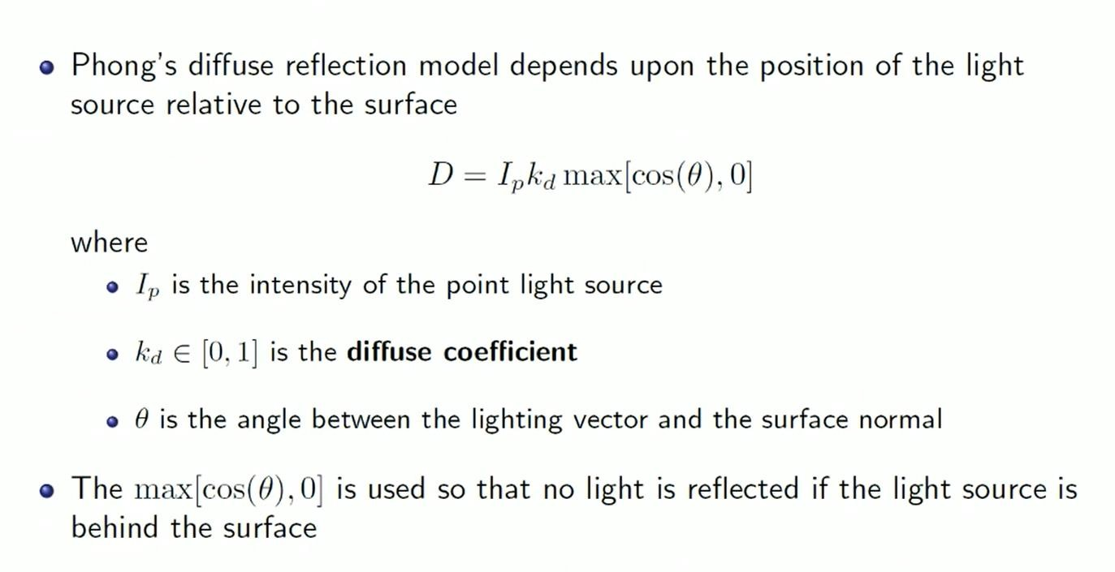

Slide 15



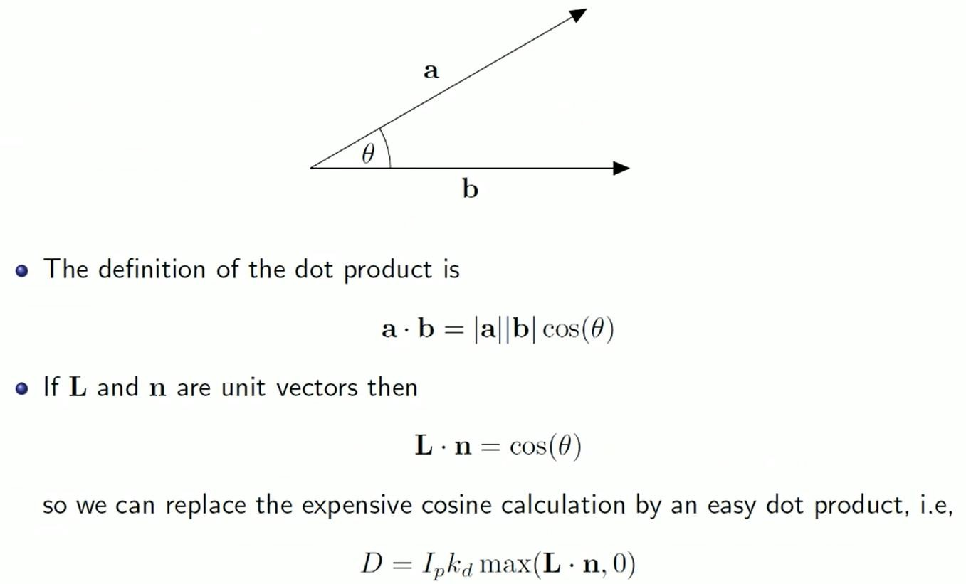

Slide 16
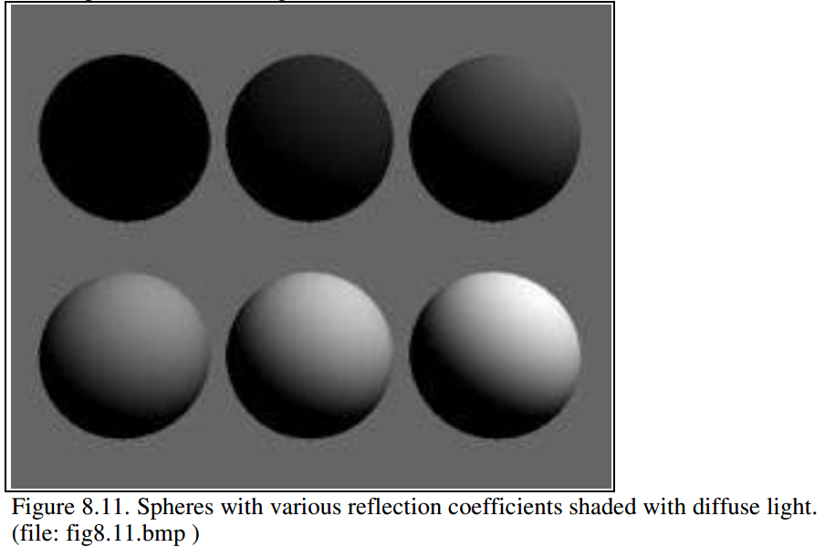
Diffuse Reflection Coefficient
I_{d} = max {I_{s} k_{d} cosθ, 0}
Source intensity is 1.0
Background intensity is 0.4
Sphere reflecting diffuse light, for six reflection coefficients: 0, 0.2, 0.4, 0.6, 0.8, and 1.
Angle θ between surface normal and incident light is > 90º
What is the ambient component here?
What is the specular component?
Notes:
Note that the sphere is totally black when kd is 0.0,
the shadow in its bottom half is also black. Since there the angle between surface normal and incident light is > 90 (dot product is negative)

Slide 17


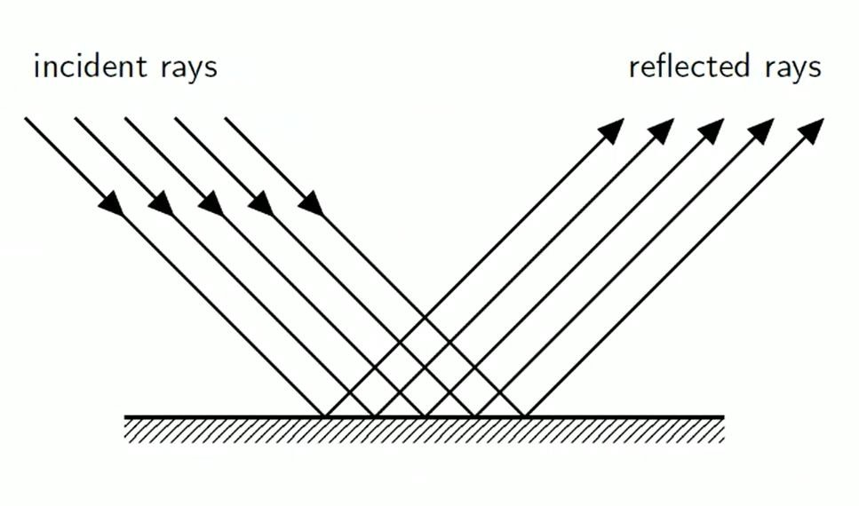

Slide 18
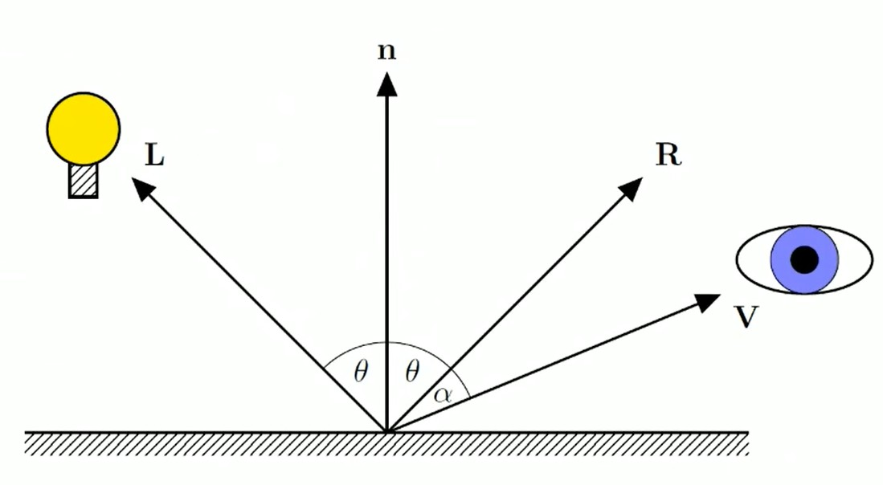

Slide 19
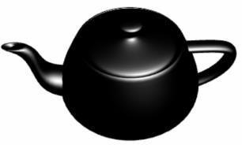
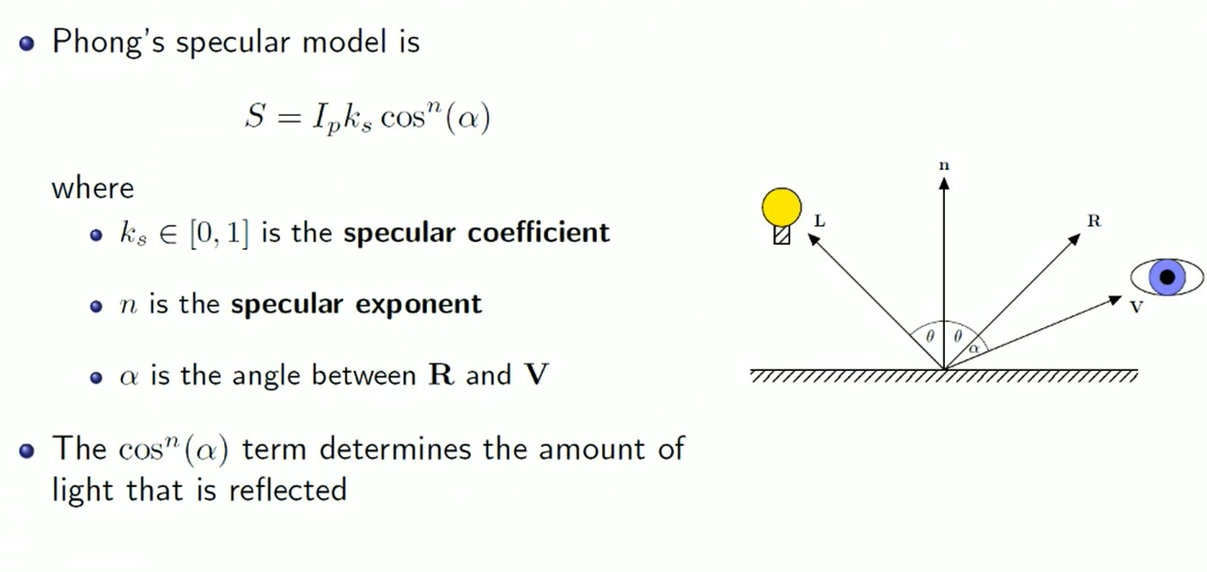


Slide 20




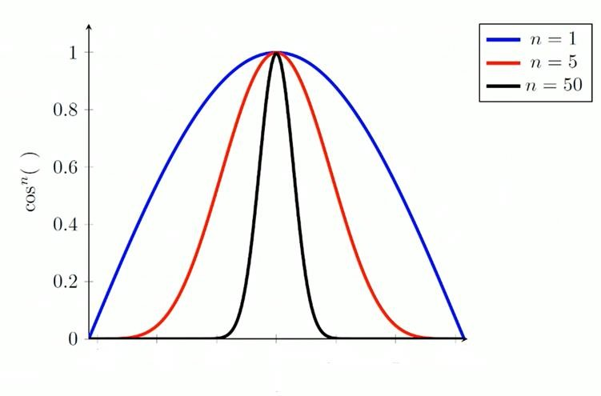
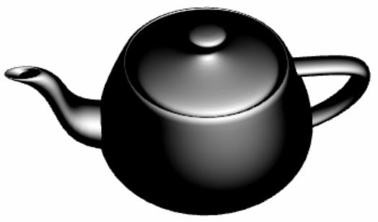
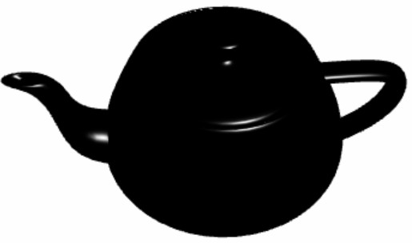



Slide 21





















Slide 22
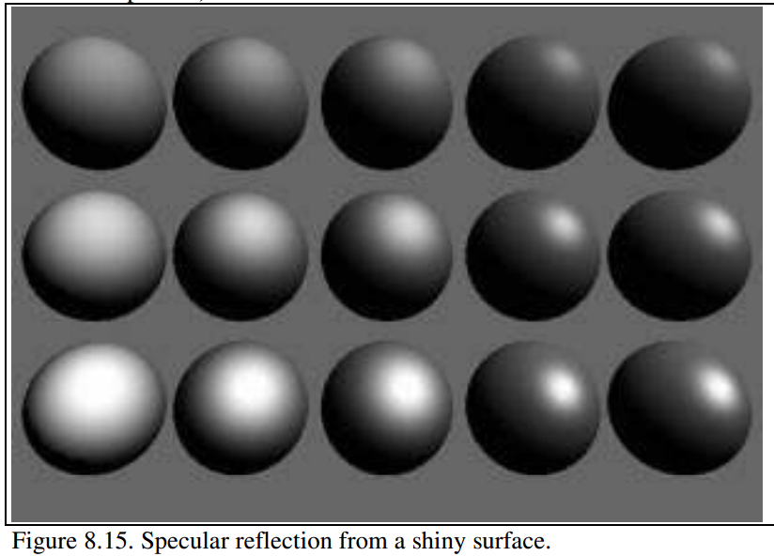
Specular Reflection Coefficient
The ambient and diffuse reflection coefficients are 0.1 and 0.4 for all spheres.
I_{d} = I_{s} k_{s} (cos φ)^{k}
More shiny and more highly concentrated along the direction r
Exponent, k
3
6
9
25
200
More mirror like, more focused reflection with increasing exponent
0.25
reflection coefficient, k_{s}
0.5
0.75
Notes:
As k increases, the reflection becomes more mirror-like and is more highly concentrated from left to right
The reflection coefficient ks varies from top to bottom with values 0.25, 0.5, and 0.75
exponent: user-chosen value that controls the apparent smoothness of the surface.

Slide 23
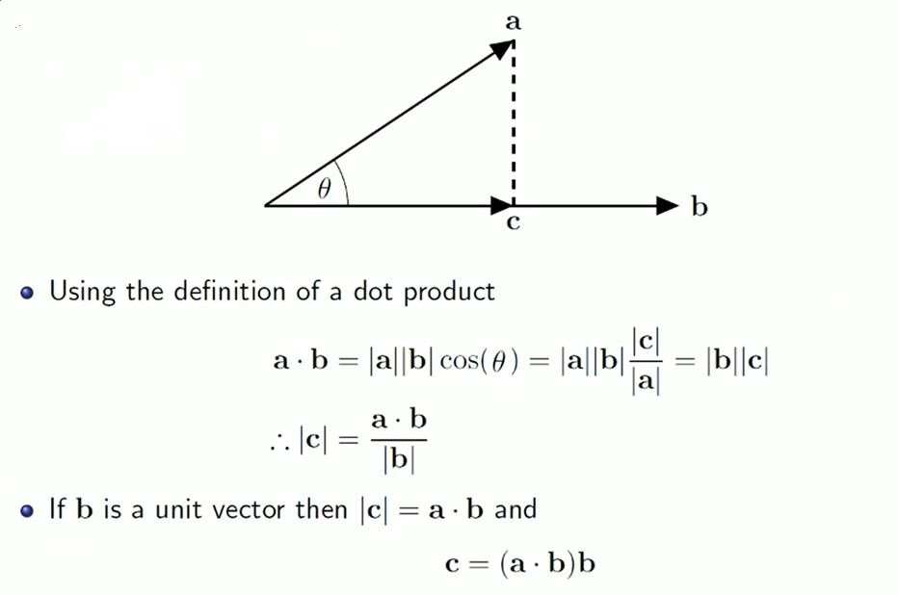


Slide 24
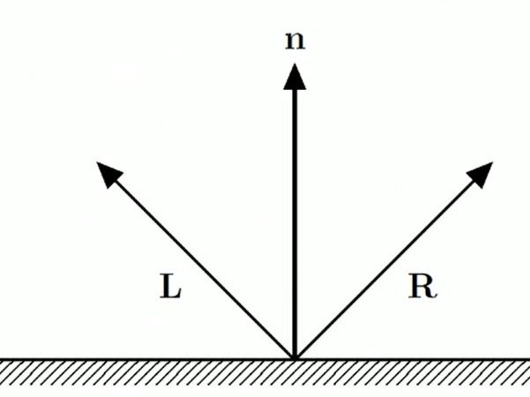
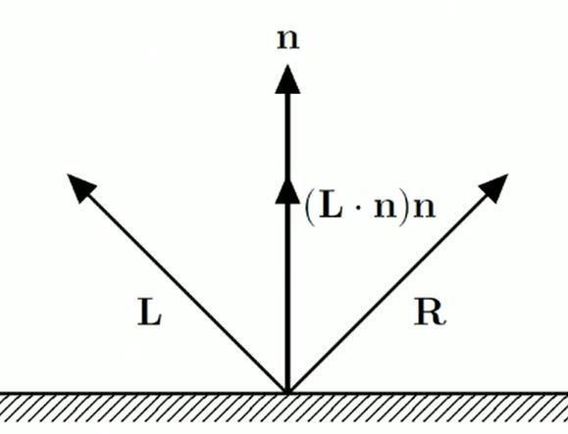
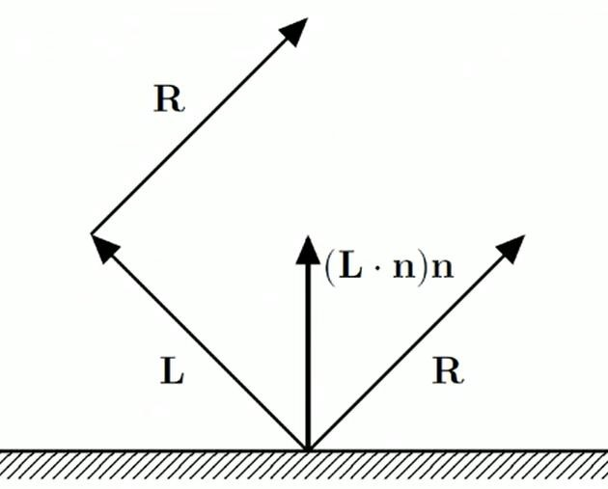
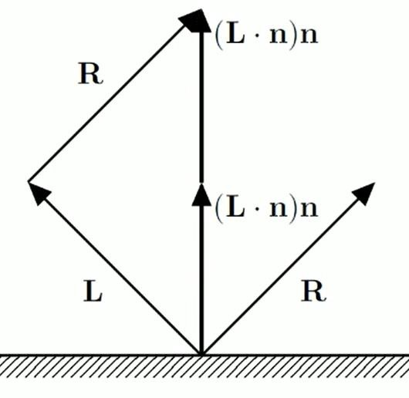
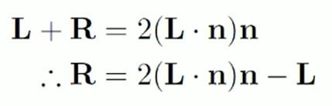

Slide 25






















Slide 26
Mathematical Calculation of Phong Model
We need to ircorporate the effect light present in environment. Thus total refelcted light also includes ambient component.
Ambient Component = I_{a}k_{a}
Total reflected light intensity from Q,
I = Ambient Component + Diffuse Component + Specular Component
= I_{a}k_{a} + I_{p} k_{d} (L.N) + I_{p} k_{s} (R.V)^{k}
More specifically,
I = I_{a}k_{a} + I_{p} [k_{d} max {(L.N),0} + k_{s} max{(R.V)^{k} ,0}]

Slide 27
Additional Issues
When there are n light sources in the scene, their effects are cumulative: Intensity at Q,
I = I_{a}k_{a} + ∑_{(i=1 to n)} I_{pi} {k_{d} (L.N) + k_{s} (R.V)^{k} }
The intesnsity of red, green and blue component of reflected light,
I_{r} = I_{a}k_{ar} + I_{p} k_{dr} (L.N) + I_{p} k_{s} (R.V)^{k}
I_{g} = I_{a}k_{ag} + I_{p} k_{dg} (L.N) + I_{p} k_{s} (R.V)^{k}
I_{b} = I_{a}k_{ab} + I_{p} k_{db} (L.N) + I_{p} k_{s} (R.V)^{k}
k_{s} : coefficient for specular component which is same as the color of light source, not affected by surface color.

Slide 28


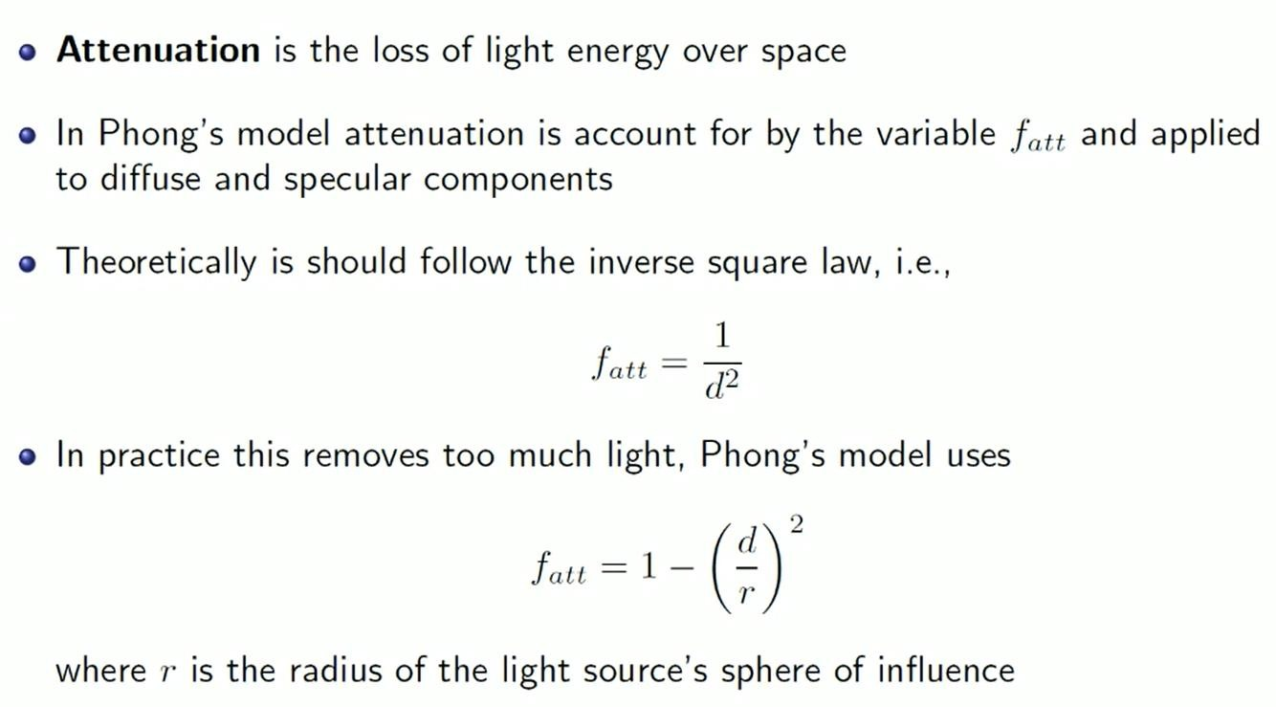



Slide 29
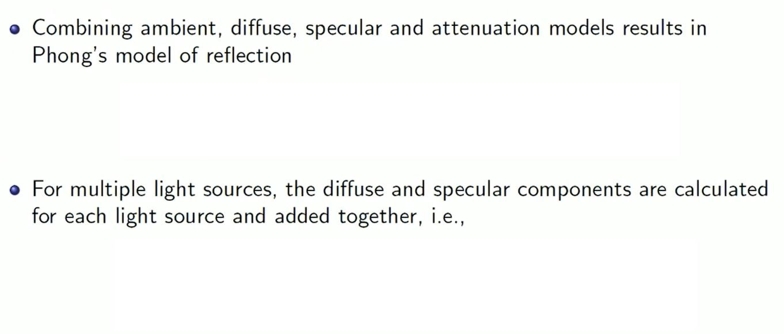

























Slide 30
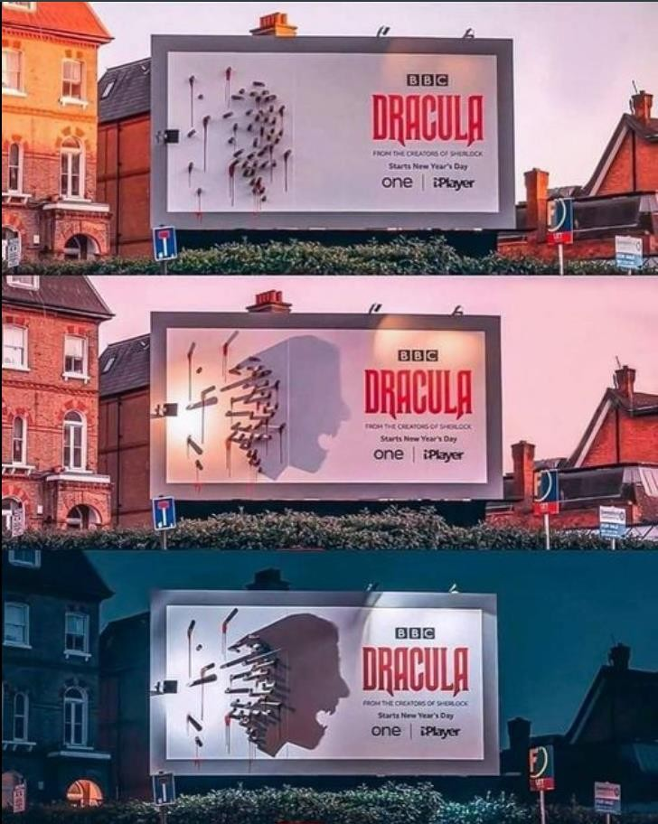




















Photo: Alex Canclini

Slide 31
Shading
The process of assigning colors to pixels.
Shading
Flat Shading
Smooth Shading
Gouraud Shading
Phong Shading

Slide 32
Shading Model
Flat Shading
Compute Phong lighting once for entire polygon
Gouraud Shading
Compute Phong lighting at the vertices and interpolate lighting values across polygon
Phong Shading
Interpolate normals across polygon and perform Phong lighting across polygon

Slide 33
Flat Shading
For each polygon
Determines a single intensity value at a chosen point on the polygon
Uses that value to shade the entire polygon
Assumptions
Light source at infinity
Viewer at infinity
The polygon represents the actual surface being modeled

Slide 34
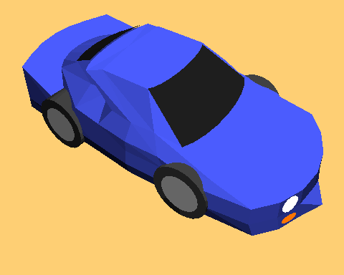
Problems of Flat Shading
Specular highlights tends to get lost
If chosen point on polygon is at location of the light source, then color of the polygon will be significantly distorted.
Flat Shading

Slide 35
Smooth Shading
Introduce vertex normals at each vertex
Used only for shading
Think of as a better approximation of the real surface that the polygons approximate
Finds color value for each point in the polygon individually
Two types
Gouraud Shading
Phong Shading (do not confuse with Phong Lighting Model)

Slide 36
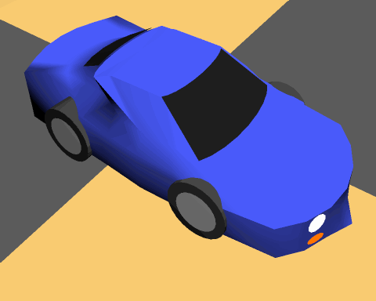
Gouraud Shading
Most common approach
Perform Phong lighting at the vertices
Linearly interpolate the resulting colors over faces
Along edges
Along scanline

Slide 37
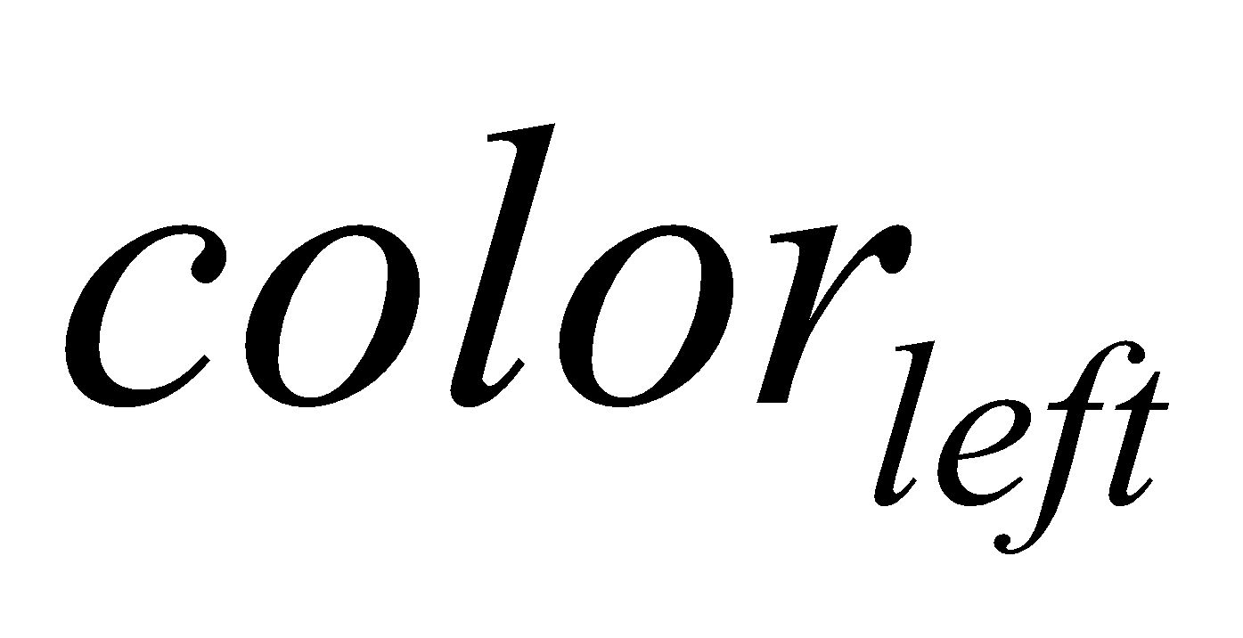
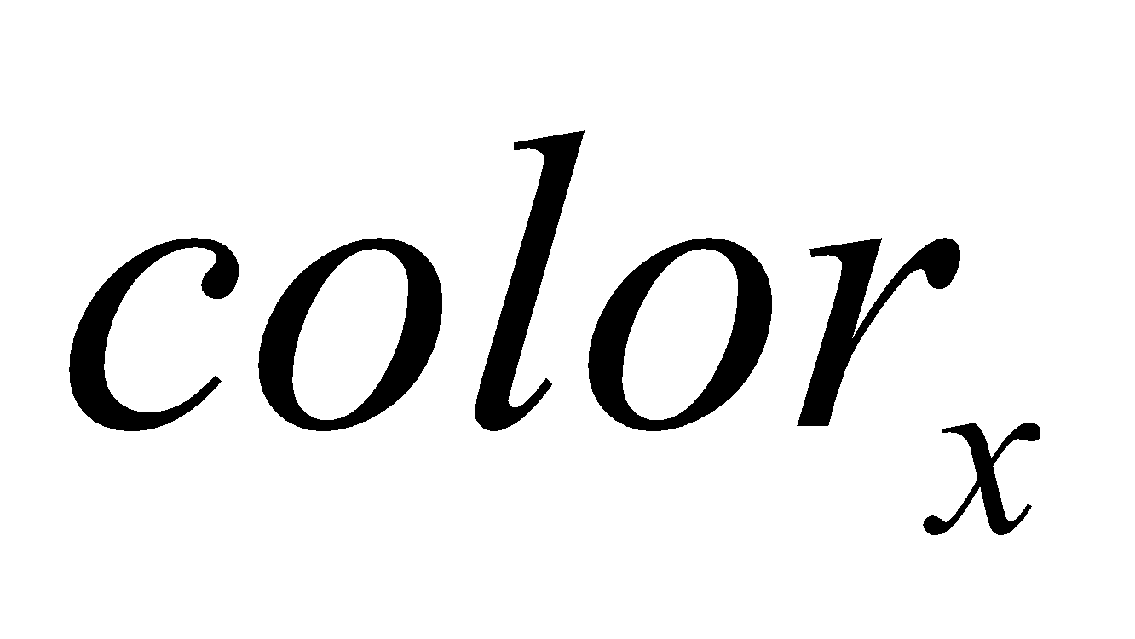
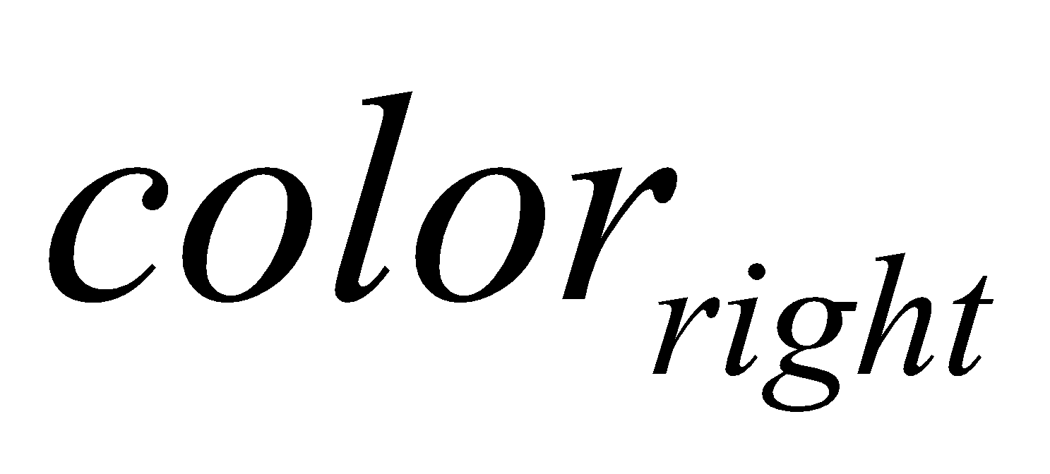
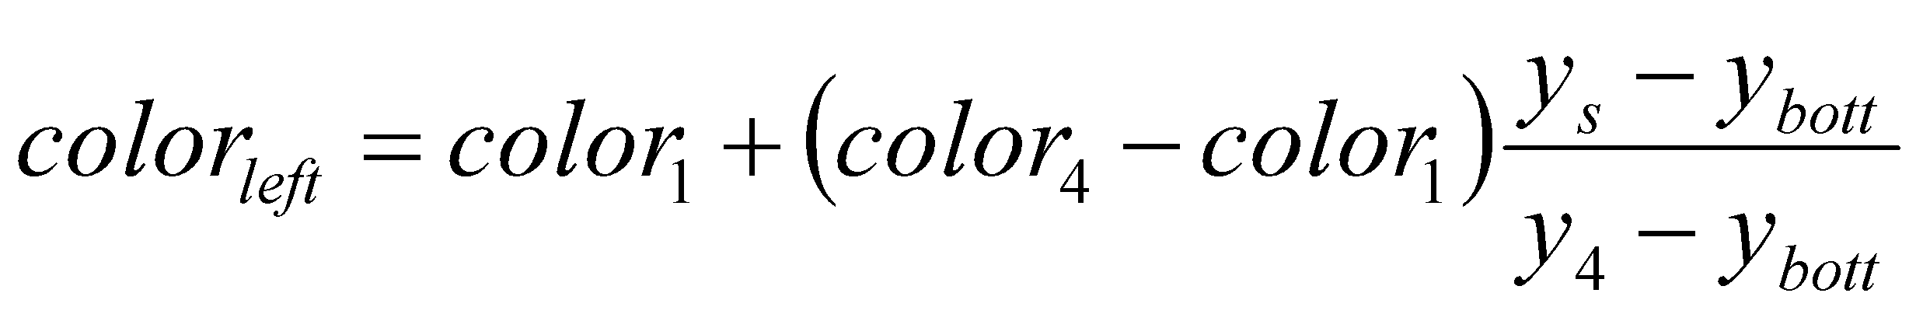
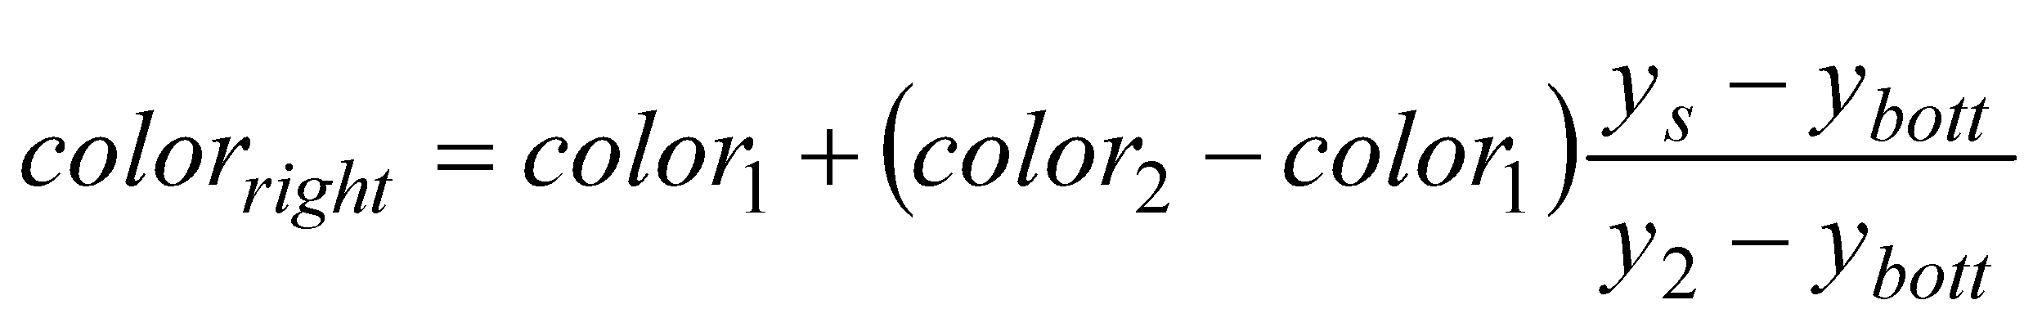
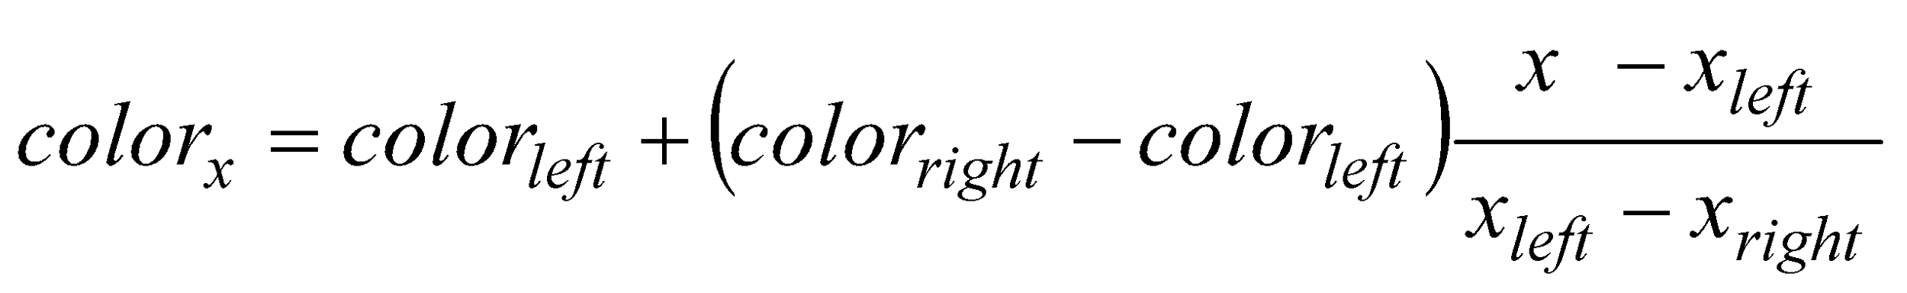
Gouraud Shading
y_{top}
color₃
y₄
color₄
color₂
y_{s}
y_{bott}
color₁
x_{left}
x_{right}
X_{right}- X_{left}

Slide 38
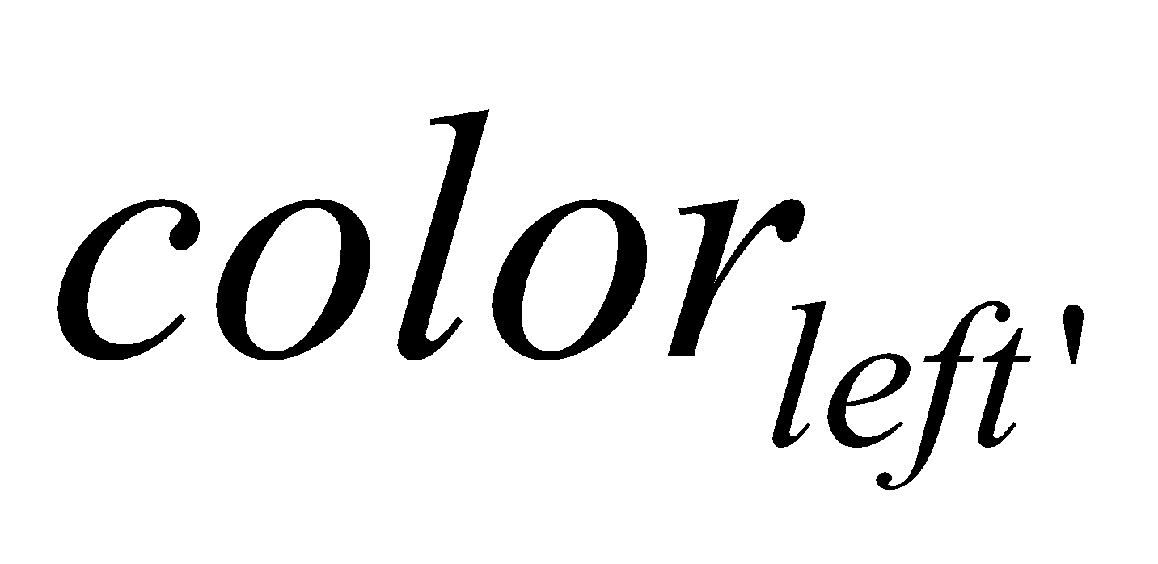
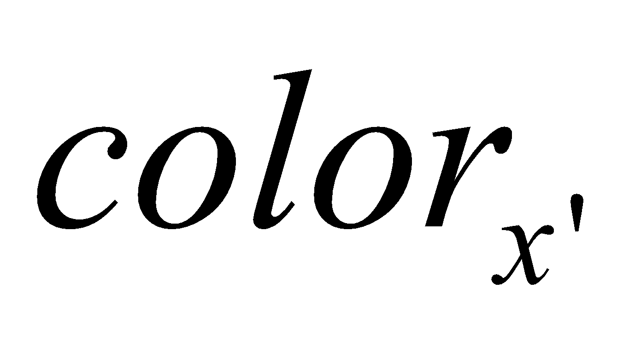
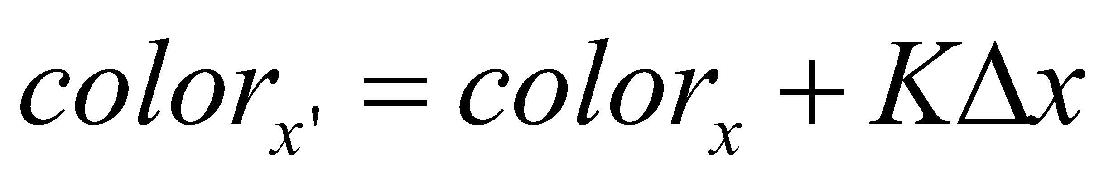
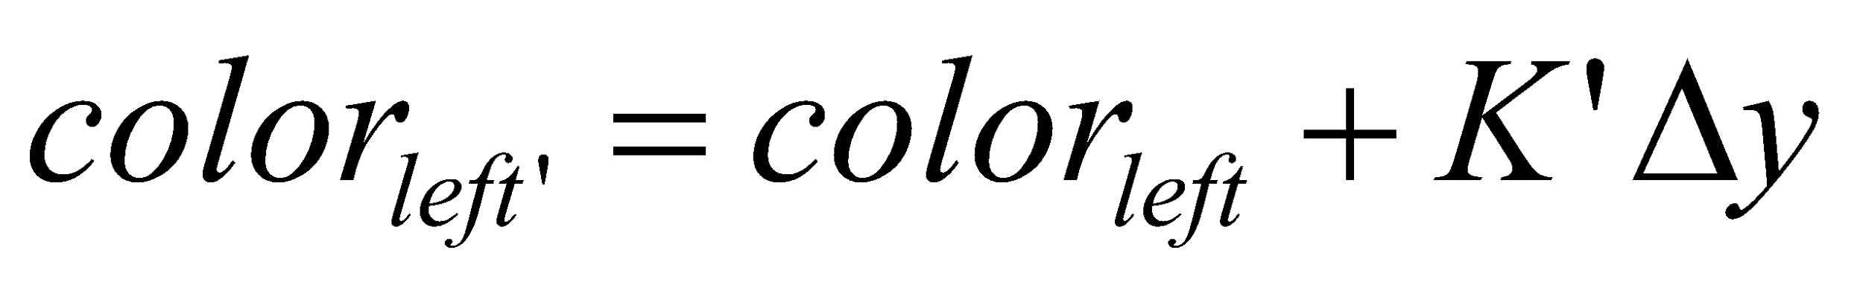
Gouraud Shading
y_{top}
color₃
y₄
color₄
color₂
y_{s}
y_{bott}
color₁
x_{left}
x_{right}
Calculate the surface normals along the scan line and the edge using incremental approach

Slide 39
Problem of Gouraud Shading
Often appears dull
Lacks accurate specular component
C₁
C₃
C₂
Can’t shade the spot light

Slide 40
Phong Shading
Interpolate normal vectors of face vertices at each pixel, then perform Phong lighting at each pixel.
m₃
y_{s} - y₁
m_{left} = m₁ + (m₄-m₁)
m₄
m₂
m_{left}
m_{right}
Y₄ - y₁
m_{x}
y_{s} - y₁
y_{s}
m_{right} = m₁ + (m₂-m₁)
m₁
Y₂ - y₁
x - x_{left}
x
m_{x}= m_{left} + (m_{right} - m_{left})
x _{right} - x_{left}
Calculate the surface normals along the scan line and the edge using incremental approach

Slide 41
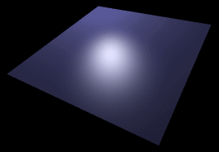
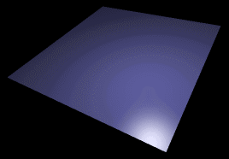
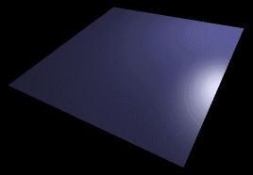
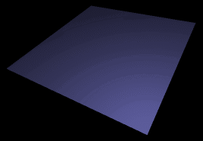
Phong vs Gouraud Shading
Phong shading is more smooth
If a highlight does not fall on a vertex, Gouraud shading may miss it completely, but Phong shading does not.

