Slide 1

Cigarette Smoking Rates Across Age Groups in NYC (2002-2017) In Relation to Average Price of a Pack of Cigarettes
Anika Kumbhakar

Slide 2
Data
The results of this project show how smoking rates and average number of cigarettes smoked have changed in different age groups, and whether there is any relationship between that change and the average price of a pack of cigarettes.
The project and resulting graphics use data from New York City's Community Health Survey (CHS), which is taken annually by the City Department of Health and Mental Hygiene since 2002. They also use cigarette price data from the CDC Study "The Tax Burden on Tobacco,1970-2017"(Orzechowski and Walker).

Slide 3
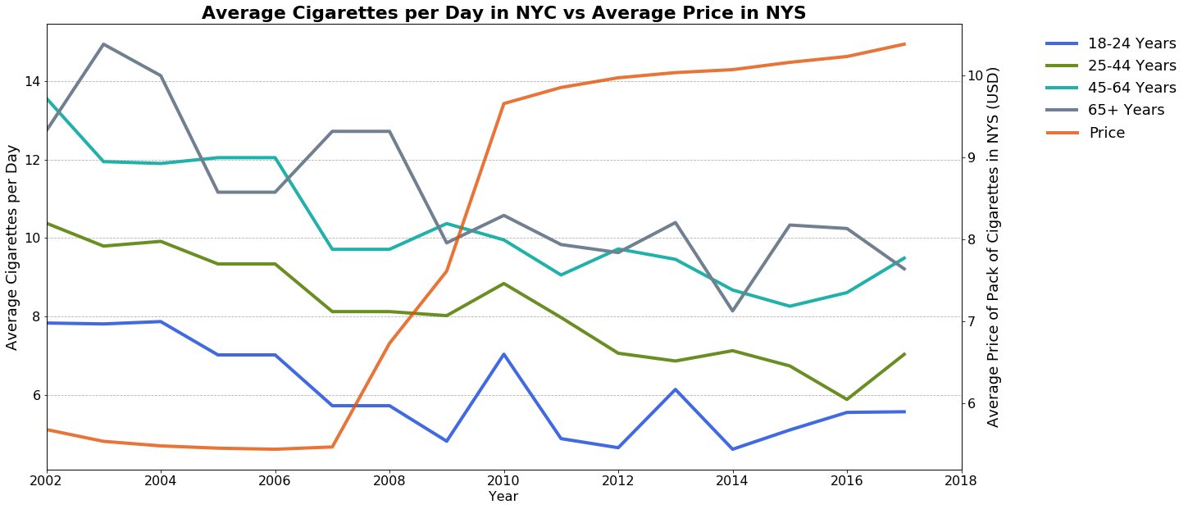
Average Cigarettes per Day
The average number of cigarettes smoked per day has decreased across all age groups
Price has more than doubled over the time period
Average across all groups was already declining before NYS raised the cigarette pack price minimum in 2007

Slide 4
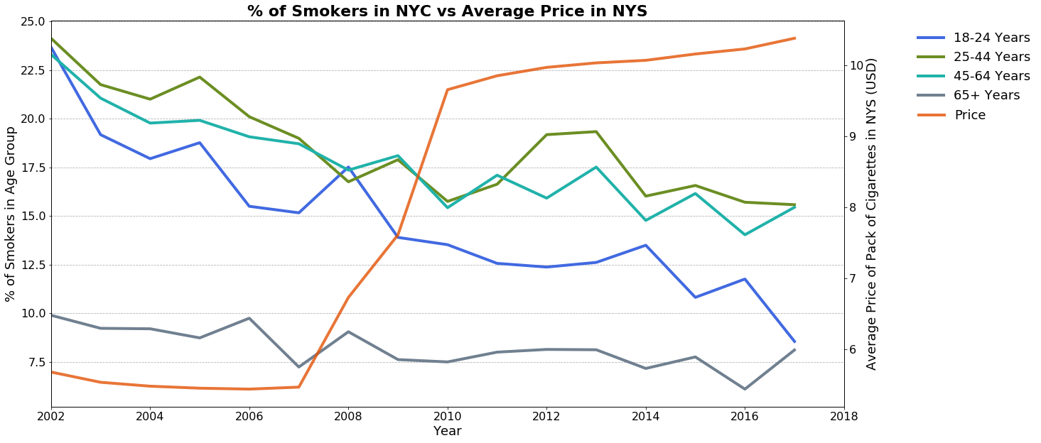
% of Smokers
% of Smokers has also declined across all age groups
Again, unclear whether this is related to price because rates were already declining post Clean Air Act (2002)
Youngest age group has declined the most- responsive to smoking policies, regardless of price policy or other

