Slide 1


Slide 2
Session Formation:
Breif Introduction about our course
Our recommendations on competitive programming
Strategies for improving in codeforces
OI format & strategies

Slide 3
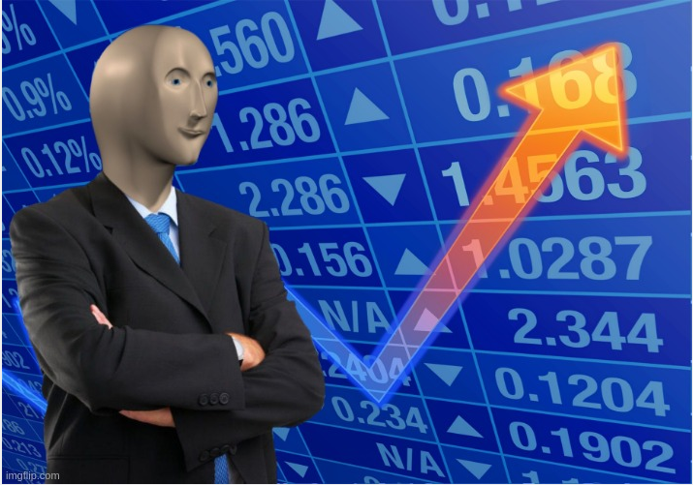
Skill

Slide 4
Our Course
Total of 16 classes
Expected a class per week
There will be a topic-wise contest after each class
You will be provided with the class lecture as PDF after each class
Anonymous Bot: Always here to help throughtout the whole course!

Slide 5
What is going to happen after this session?
Contest:
STL
Problem-Solving Round
PDF:
Standard Library and other C++ stuffs

Slide 6
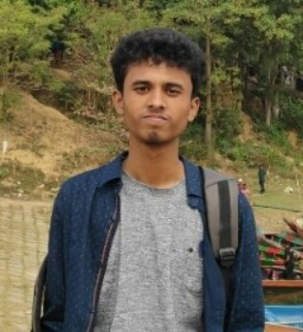
Meet Our Team!
Md Nafis Haque Ul Shifat
Hasan Ali Gov. High School
SSC-21
IOI 2021 Bronze Medalist
LZO 2021 Bronze Medalist
Codeforces Handle: qwerty190
Current Rating: 1979 Max Rating: 2049

Slide 7
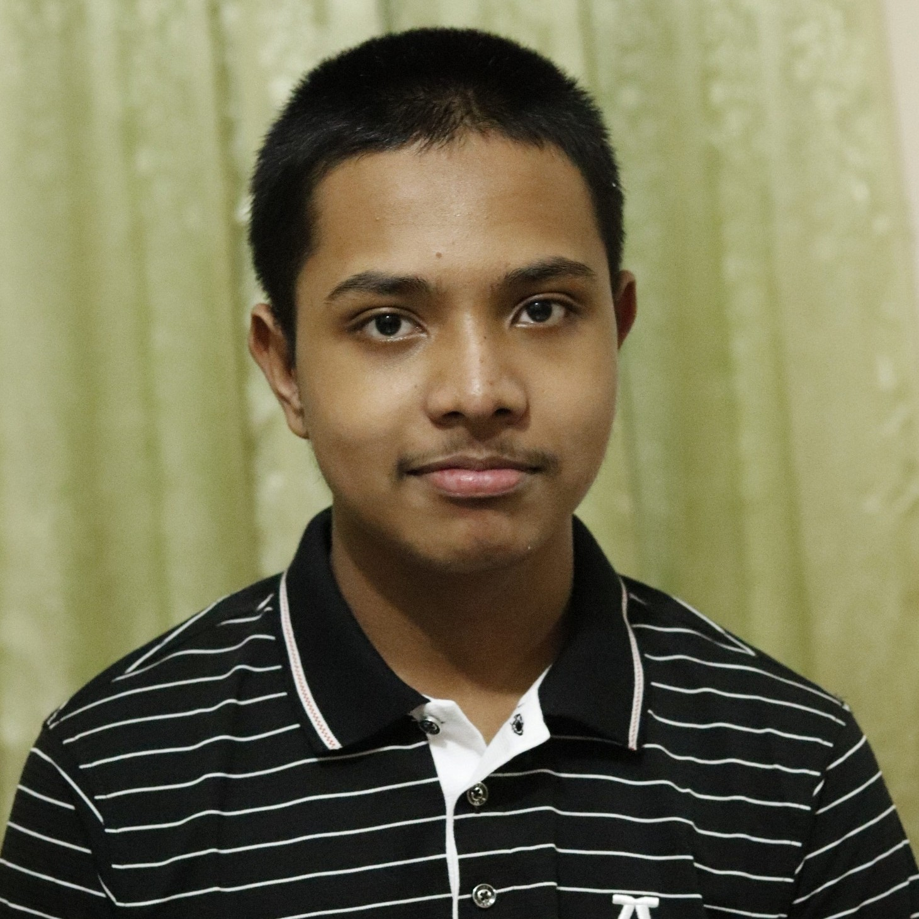
Meet Our Team!
Jarif Rahman
Rajshahi University School
SSC-22
NHSPC 21 Champion
IOI 21 Unofficial Team Member
Codeforces Handle: Jarif_Rahman
Current Rating: 2008 Max Rating: 2097

Slide 8
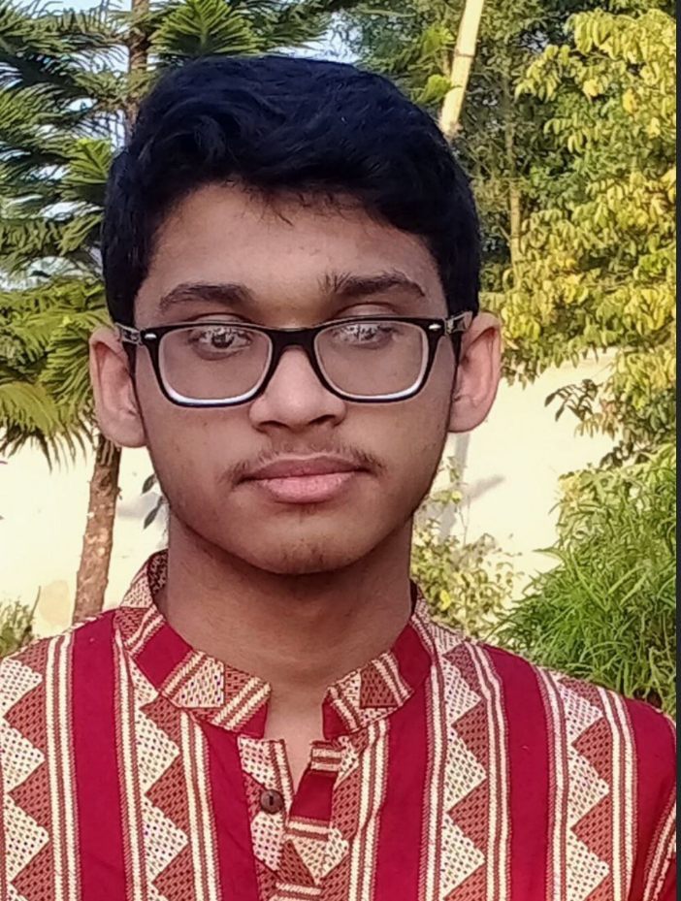
Meet Our Team!
Debojoti Das Soumya
Jalalabad Cantonment Public School And College
Class 10
Youngest Yellow in BD History
BDOI 22 Preliminary 1st Runners up
Codeforces Handle: Soumya1
Current Rating: 2181 Max Rating: 2187

Slide 9
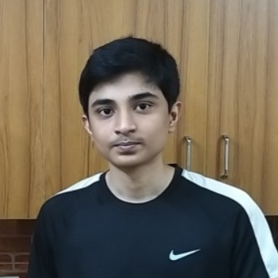
Meet Our Team!
Farhan Ahmad
Rajshahi University School
SSC-21
IOI 2021 Silver Medalist
LZO 2021 Silver Medalist
Codeforces Handle: Farhan132
Current Rating: 2121 Max Rating: 2228

