Slide 1
Predicting Daily Household Energy Consumption Using Kernel Methods and Gaussian Process Regression
Name: Animesh Kashid

Slide 2
01
02
03
04
Contents
05
06
07
08
09
Introduction
Dataset and Processing
Feature Engineering
Kernel Ridge Regression
Gaussian Process Regression
Experimental Setup
Results
Discussion
Conclusion
EECE 7397
Advanced Machine Learning

Slide 3
Why Energy Forecasting Matters
Demand planning & dynamic pricing
Grid stability & renewable load balancing
Energy-efficient resource allocation in smart grids
Our Approach: Kernel methods (KRR & GPR) capture nonlinear, seasonal patterns that linear models miss — with interpretable uncertainty via GPR posterior variance.
INTRODUCTION
EECE 7397
Advanced Machine Learning

Slide 4
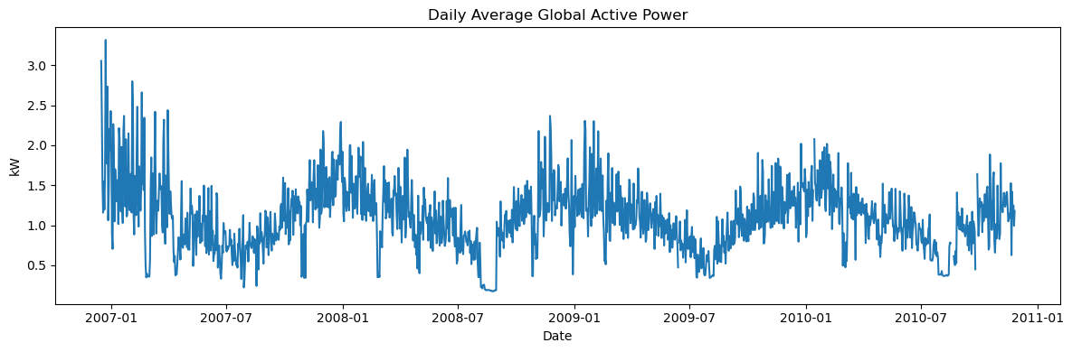
Dataset & Processing
UCI Household Electric Power Consumption Dataset
Minute-level data: Dec 2006 – Nov 2010
Variables: Active/Reactive power, voltage, intensity, sub-metering
Preprocessing:
Handle missing values (forward/backward fill)
Resample to daily averages
Standardize features (zero mean, unit variance)
EECE 7397
Advanced Machine Learning

Slide 5
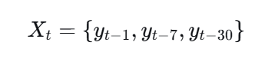
EECE 7397
Advanced Machine Learning
Univariate Model — Lagged Consumption
Multivariate Model — Electrical Covariates

Slide 6
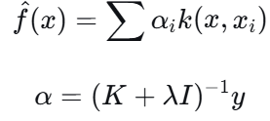
EECE 7397
Advanced Machine Learning
Kernel Ridge Regression (KRR)
Ridge regression + kernel trick; solution lives in RKHS via representer theorem
Solution form:
Kernels: RBF (smooth trends) · Polynomial (higher-order interactions)
Gaussian Process Regression (GPR)
Bayesian non-parametric model; outputs full predictive distribution
Hyperparameters optimized via log marginal likelihood maximization
Kernels: RBF · Periodic · RBF+Periodic · Matérn-1.5

Slide 7
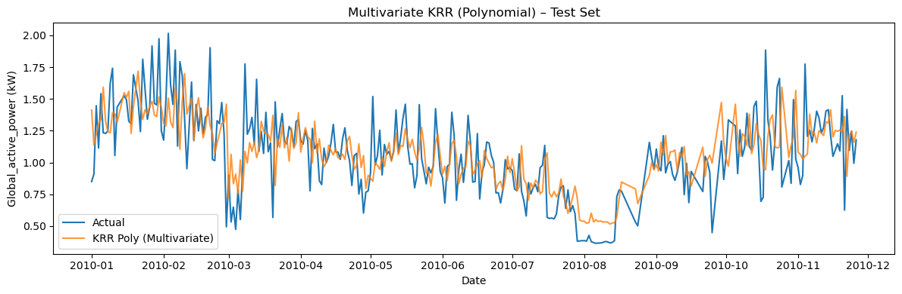
EECE 7397
Advanced Machine Learning
Experimental Setup
Baselines: Naïve (yₜ₋₁) and 7-day Moving Average MA(7)
Models: Univariate (lagged y) vs. Multivariate (electrical covariates) — KRR & GPR
Evaluation metrics: RMSE (primary) and MAE on held-out 2010 test set
Validation: TimeSeriesSplit (5 folds) — respects temporal ordering
Test period: Full year 2010 (~365 daily observations)

Slide 8
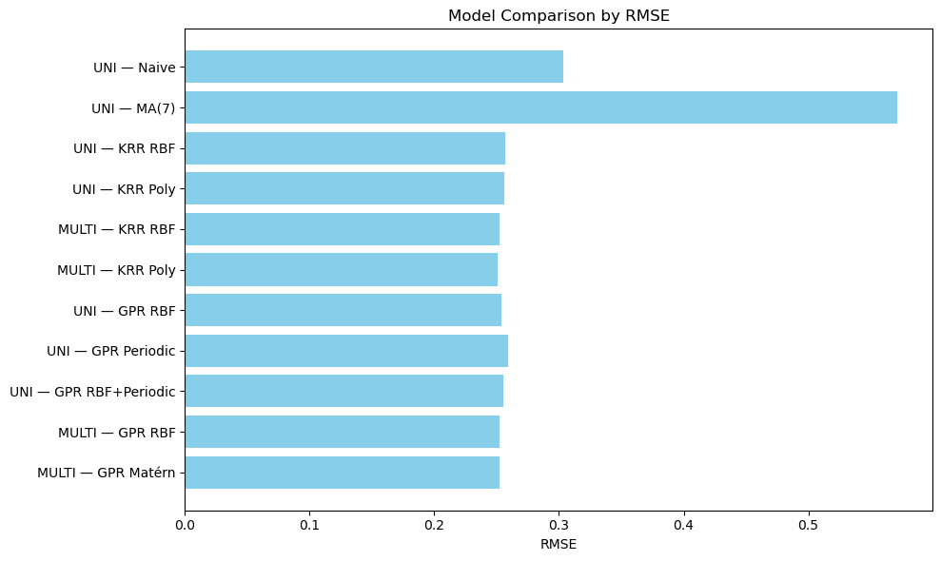
Results & Summary
Key Results (Test Set — 2010)
Best: Multi KRR (Poly) RMSE 0.2508 MAE 0.1856
2nd: Multi KRR (RBF) RMSE 0.2521 MAE 0.1902
3rd: Multi GPR (RBF) RMSE 0.2524 MAE 0.1860
EECE 7397
Advanced Machine Learning

Slide 9
EECE 7397
Advanced Machine Learning
Discussion & Insights
Multivariate > Univariate: Reactive power, voltage, intensity, and sub-metering carry predictive signal beyond lagged consumption alone.
Kernel Choice: Polynomial KRR wins — higher-order cross-feature interactions matter more than smooth global trends (RBF).
GPR Advantage: Matches KRR accuracy while delivering posterior variance — quantified uncertainty at each prediction step.
Seasonality: Periodic kernels underperform RBF — daily averaging smooths sharp seasonal cycles, making rigid periodicity assumptions harmful.

Slide 10
Conclusion
Future Work
Kernel methods (KRR & GPR) effectively capture nonlinear, non-stationary dynamics in household energy data.
Multivariate inputs (electrical covariates) yield significant accuracy gains over univariate lag-only models.
Multi-output GPR for joint forecasting of sub-meters
Deep kernel learning (neural network feature maps)
Incorporate exogenous variables: weather data, electricity pricing
Locally periodic kernels to model evolving seasonal structure
EECE 7397
Advanced Machine Learning

Slide 11
Thank You

