Slide 1

onekey
Securely store, manage, rotate, and call multiple API keys from one place — with zero plaintext leaks and unified interface.
deployment link goes —-> here
repository link goes —-> here
presented by
- Hack Overflow

Slide 2
Team Leader
Abhiraj Adhikary
(Dept - CSE-DS)
2nd Year
OUR TEAM
Team Member
Sreeja Maity
(Dept - IT)
2nd Year
Team Member
Anik Chand
(Dept - CSE)
2nd Year
Team Member
Radhika Kumari
(Dept - EE)
1st Year

Slide 3
INTRODUCTIONON
Developers today manage 10–50+ API keys across multiple AI providers (OpenAI, Anthropic, Groq, Gemini, etc.), often stored in scattered .env files, leading to security risks, accidental leaks, and chaotic workflows.
Plaintext keys on disk, inconsistent API signatures, no usage visibility, and manual key rotation create security vulnerabilities, surprise billing issues, and constant friction when switching providers.
onekey provides a unified, encrypted vault with a single proxy interface (/proxy/u/<provider>/<slug>), allowing developers to securely store, manage, rotate, and call multiple AI/LLM API keys — without vendor lock-in.
With AES-256 client-side encryption, NeonDB storage, JWT + OAuth authentication, normalized responses, built-in usage tracking, and a beautiful CLI + web dashboard, onekey ensures zero plaintext leaks and complete visibility across all providers.

Slide 4
APPROACH
Key features
What makes it unique?
Solution
AES-256 client-side encryption (zero plaintext leaks)
Unified proxy endpoint (/proxy/u/<provider>/<slug>)
CLI power tool with Rich UI (add, list, call, usage)
Built-in usage tracking (tokens, latency, errors)
JWT + OAuth authentication (GitHub / GitLab)
Unlike traditional secret managers or scattered .env files, onekey provides a normalized API layer across providers, automatic provider detection, and real-time usage analytics — all designed specifically for AI developers.
A secure API key management platform that intelligently stores, encrypts, rotates, and proxies multiple AI/LLM provider keys through one unified interface.
Developers can securely manage OpenAI, Anthropic, Groq, Gemini, and more — without plaintext exposure or vendor lock-in.
How it solves the problem
It centralizes all API keys into a single encrypted vault, standardizes provider interactions, tracks usage per key, and simplifies rotation — eliminating security risks, surprise billing, and integration complexity.

Slide 5
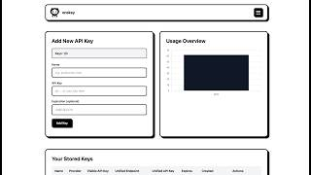
Walkthrough Video

Slide 6
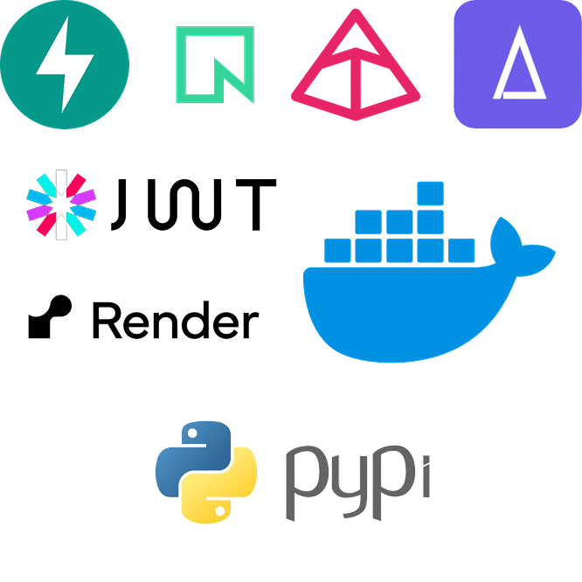
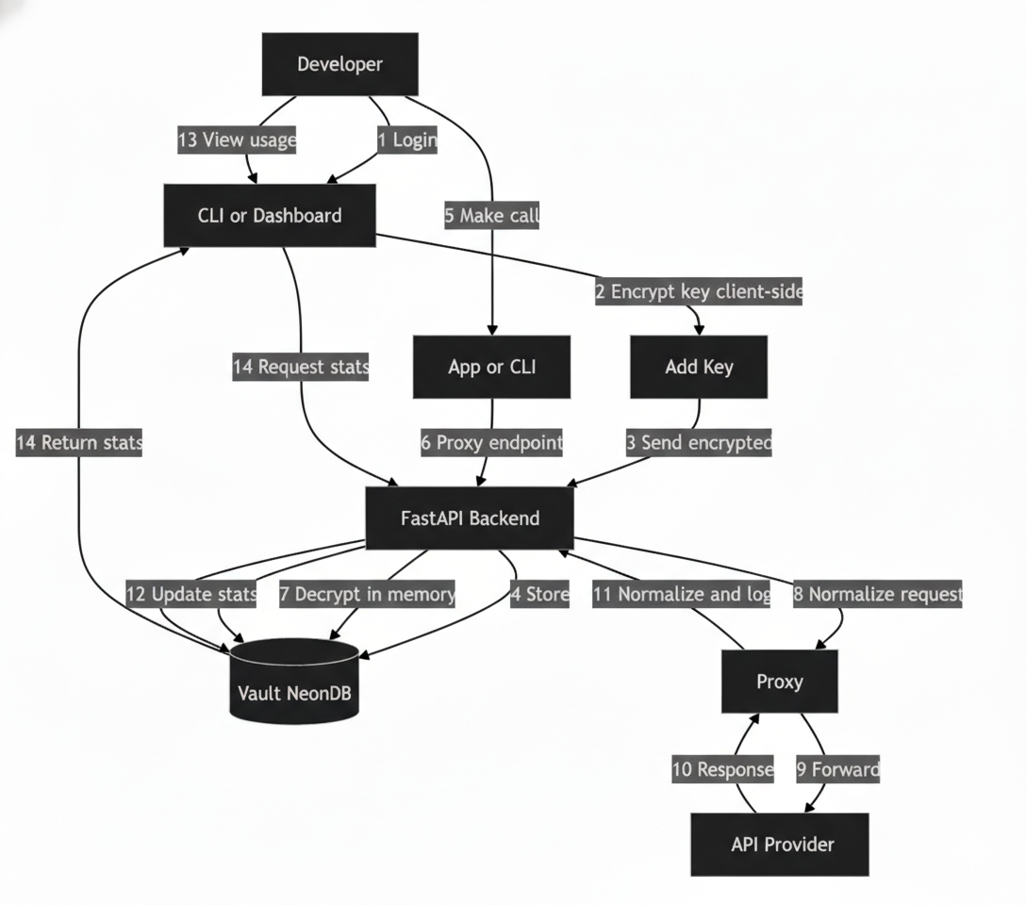
Technology Stack
Architecture Flow

Slide 7
FEASIBILITY / METHODOLOGY
Scalability
Resources
Backend: Python (FastAPI), PostgreSQL (NeonDB), AES-256 encryption
CLI: Typer + Rich (published on PyPI as onekey-cli)
Frontend: Vanilla JS, HTML, CSS
Authentication: JWT + OAuth (GitHub / GitLab), Argon2 hashing
Deployment: Docker + Render
AI Provider APIs: OpenAI, Anthropic, Groq, Gemini, and more
The architecture is inherently scalable: new AI providers (OpenAI, Anthropic, Groq, Gemini, etc.) can be added without modifying the core proxy system.
Unified routing and normalized responses allow seamless provider switching without changing client code.
Built with FastAPI + PostgreSQL (NeonDB), enabling high concurrency, efficient request handling, and production-ready deployment (Docker + Render).
Designed to scale from solo developers to startups and enterprise teams managing hundreds of API keys.

Slide 8
CONCLUSION
This project addresses a critical gap in AI development workflows by eliminating insecure, fragmented API key management and replacing it with a secure, unified, and developer-friendly system.
By encrypting keys client-side, normalizing multi-provider interactions, and providing real-time usage visibility, onekey significantly improves security, reliability, and control over AI integrations.

Slide 9
THANK
YOU
~Hack Overflow

