Slide 1
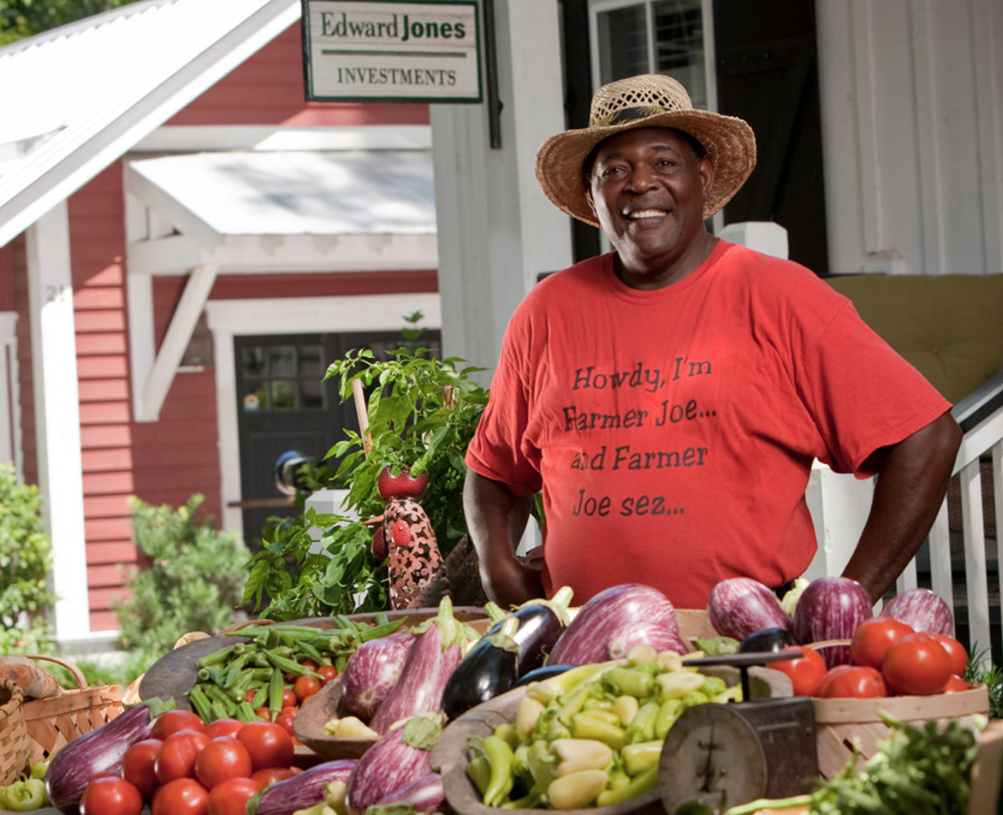
Image
Embedding
CNN
Trained by minimizing
cross entropy
blue
vegetables
children
yes
Question
Embedding
…
word2vec vectors
MLP +
Softmax
car
Pointwise
Multiplication
Sum=1
/ 5
What is the man selling

