Slide 1
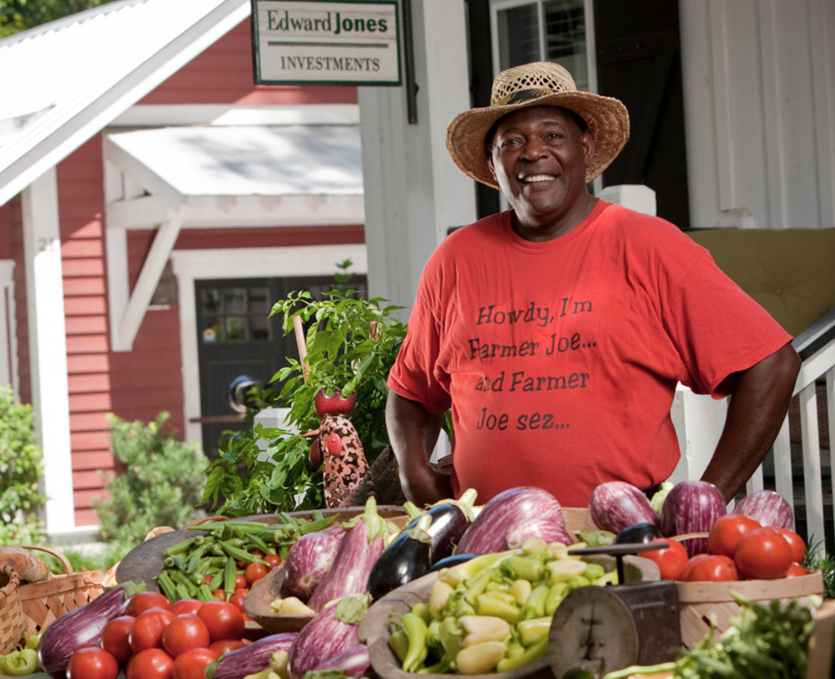
Open-Ended
K-way multiple choice
blue
vegetables
VQA
System
VQA
System
vegetables
children
yes
car
What is the
man selling ?
What is the
man selling ?
K (typically 1000)
classes

