Slide 1
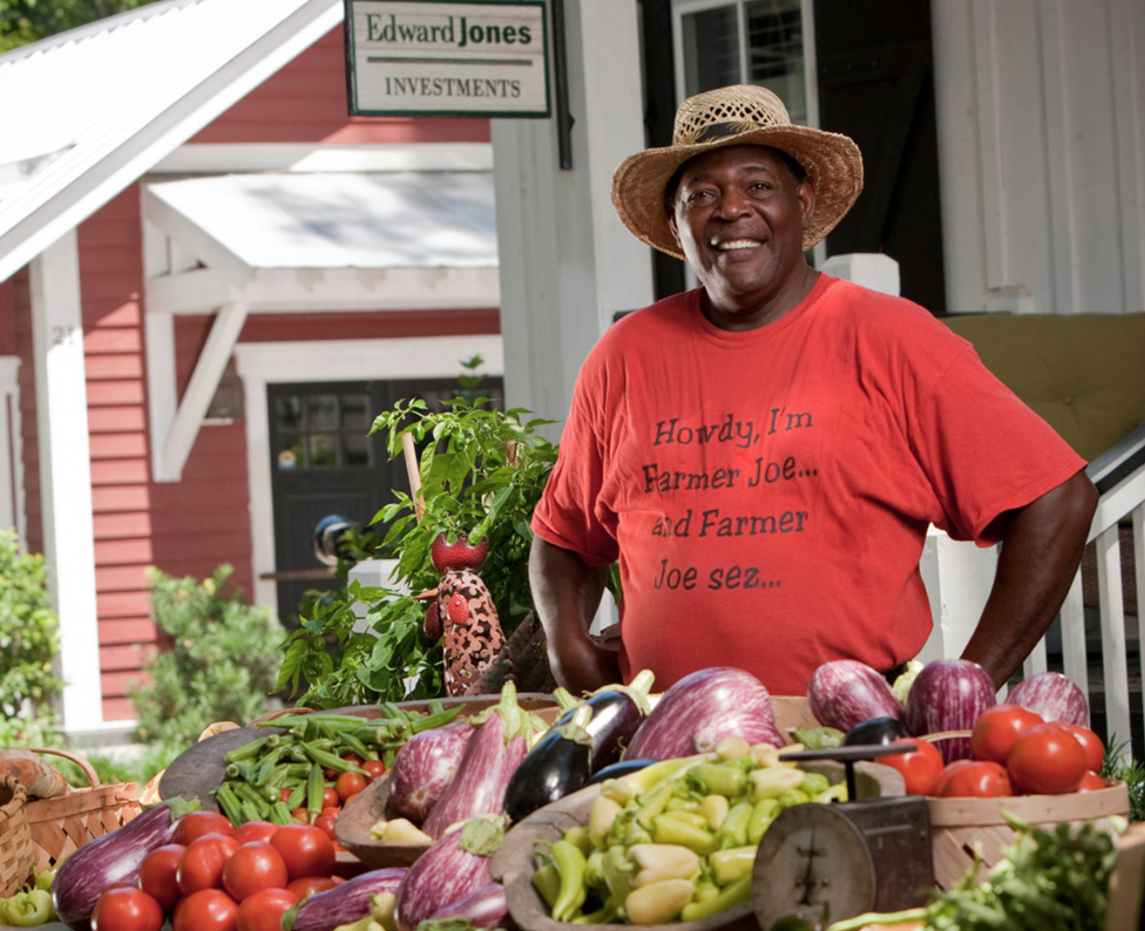
Image Embedding
Question Embedding
Combine
them
Image
Embedding
Text
Embedding
What is the man selling
/ 5
AlexNet
word2vec vectors
Concatenate
/ 5
VGG-19
Better representation such as Glove
Pointwise
Multiply
…
ResNet
+
Pointwise
Add
Recurrent Model
e.g. LSTM

