Slide 1
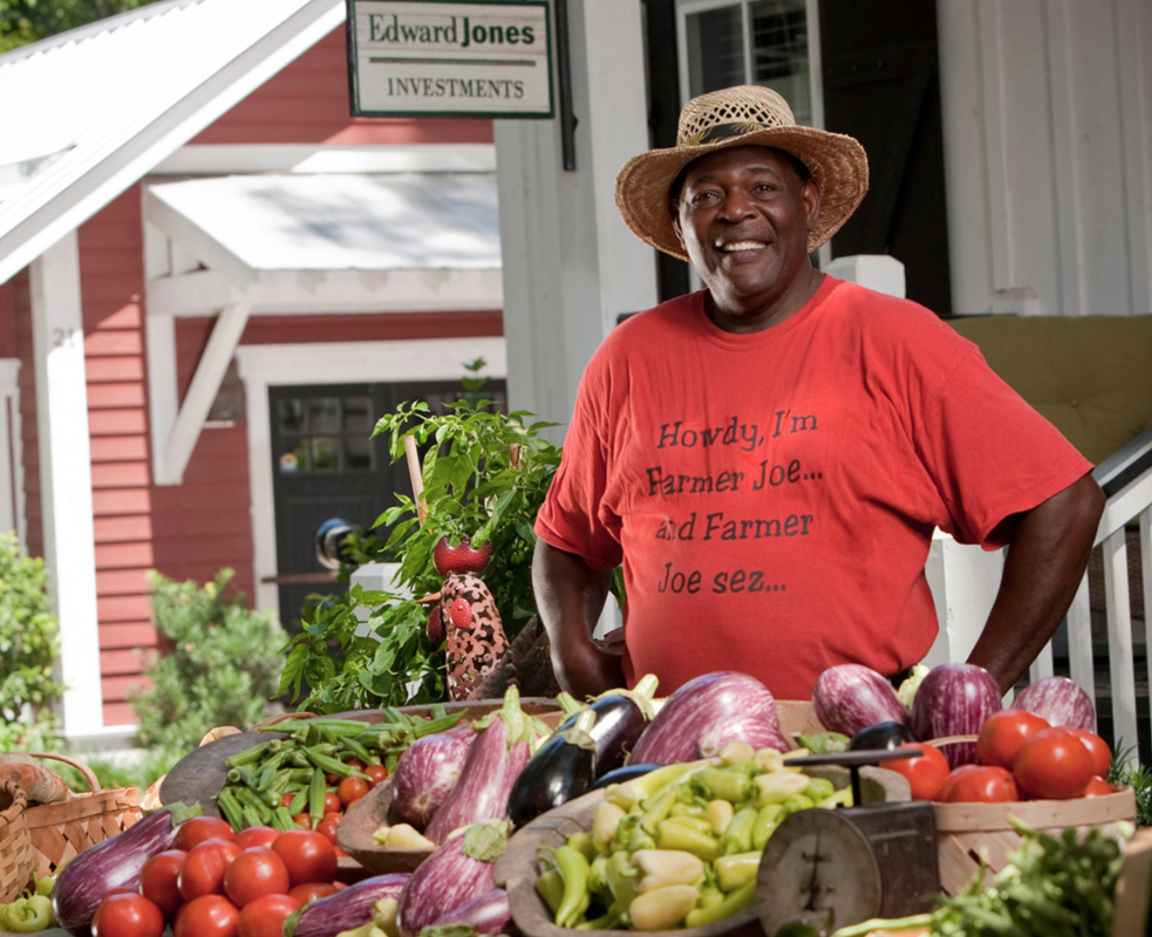
Image
Embedding
CNN
Trained by minimizing
binary cross entropy
True
or
False
Question
Embedding
word2vec vectors
MLP +
Sigmoid
Pointwise
Multiplication
/ 5
What is the man selling
Answer
Embedding
vegetables
word2vec

