Slide 1
MRA MILESTONE PROJECT 2
BY: ANIKET HIRGUDE

Slide 2
Summary
Exploratory Analysis.
Use of Market Basket Analysis (Association Rules).
Associations Identified.
A suggestion of Possible Combos with Lucrative Offers.

Slide 3
Problem Statement
A Grocery Store shared the transactional data with you. Your job is to identify the most popular combos that can be suggested to the Grocery Store chain after a thorough analysis of the most commonly occurring sets of menu items in the customer orders. The Store doesn’t have any combo meals. Can you suggest the best combo meals?

Slide 4
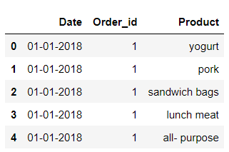
Exploratory Data Analysis
Checking the head of the dataset

Slide 5
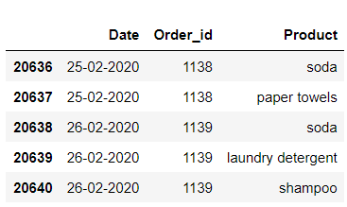
Exploratory Data Analysis
Checking the tail of the dataset

Slide 6
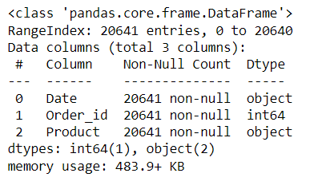
Exploratory Data Analysis
Checking the info of the data

Slide 7
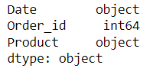
Exploratory Data Analysis
Checking the data types
From above we see that there are (1 int) & (2 objects) values.

Slide 8

Exploratory Data Analysis
Checking the shape of the data
From above we see that there are 20641 rows & 3 Columns.

Slide 9
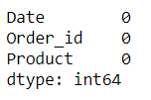
Exploratory Data Analysis
Checking the Null value in the dataset
From above we see that there are No Null value are present in datasets.

Slide 10
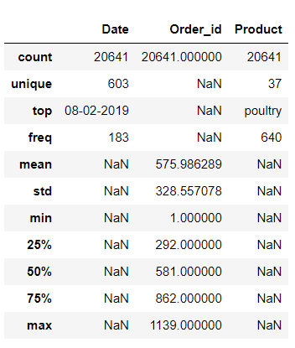
Exploratory Data Analysis
Checking the data description

Slide 11
EDA – Tableau Public Link
The EDA analysis is done in the Tableau tool – with the workflow published in Tableau public:
https://public.tableau.com/views/MRA_Milestone_Project_2_16761275794450/Top5ProductsOrderedinyear2018?:language=en-US&publish=yes&:display_count=n&:origin=viz_share_link

Slide 12
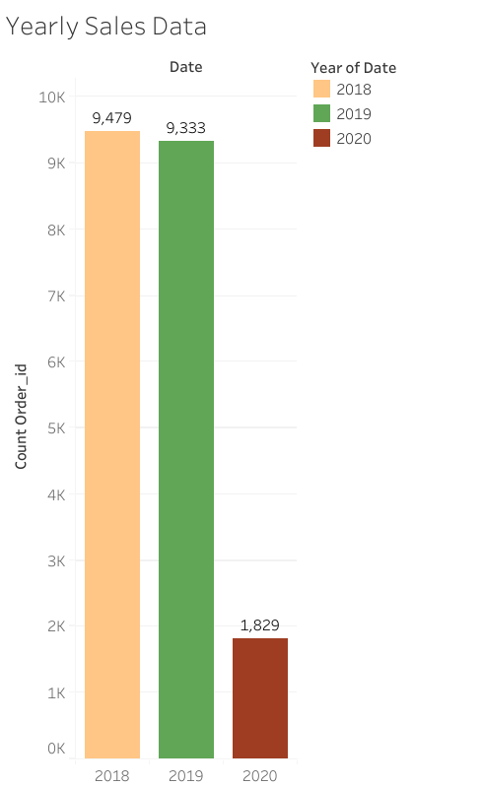
EDA – Orders over the years
Yearly Sales Data:
In 2018 the number of the orders are highest amongst the consolidated data and 2020 is the lowest numbers of orders.

Slide 13
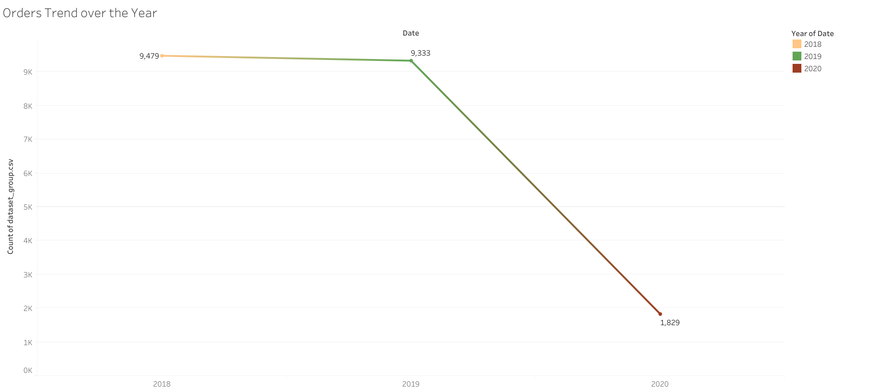
EDA – Orders Trend over the year
The orders trend for the given data is decreasing over the years with 2018 having highest orders and then followed closely by 2019 and then 2020 with the lowest number.

Slide 14
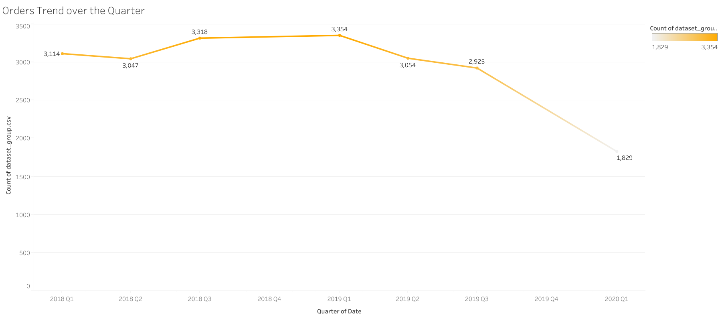
EDA – Orders Trend over the Quarter
The orders trend for the given data over the quarters indicate Q1 of 2019 with highest number of orders followed by Q3 of 2018.

Slide 15
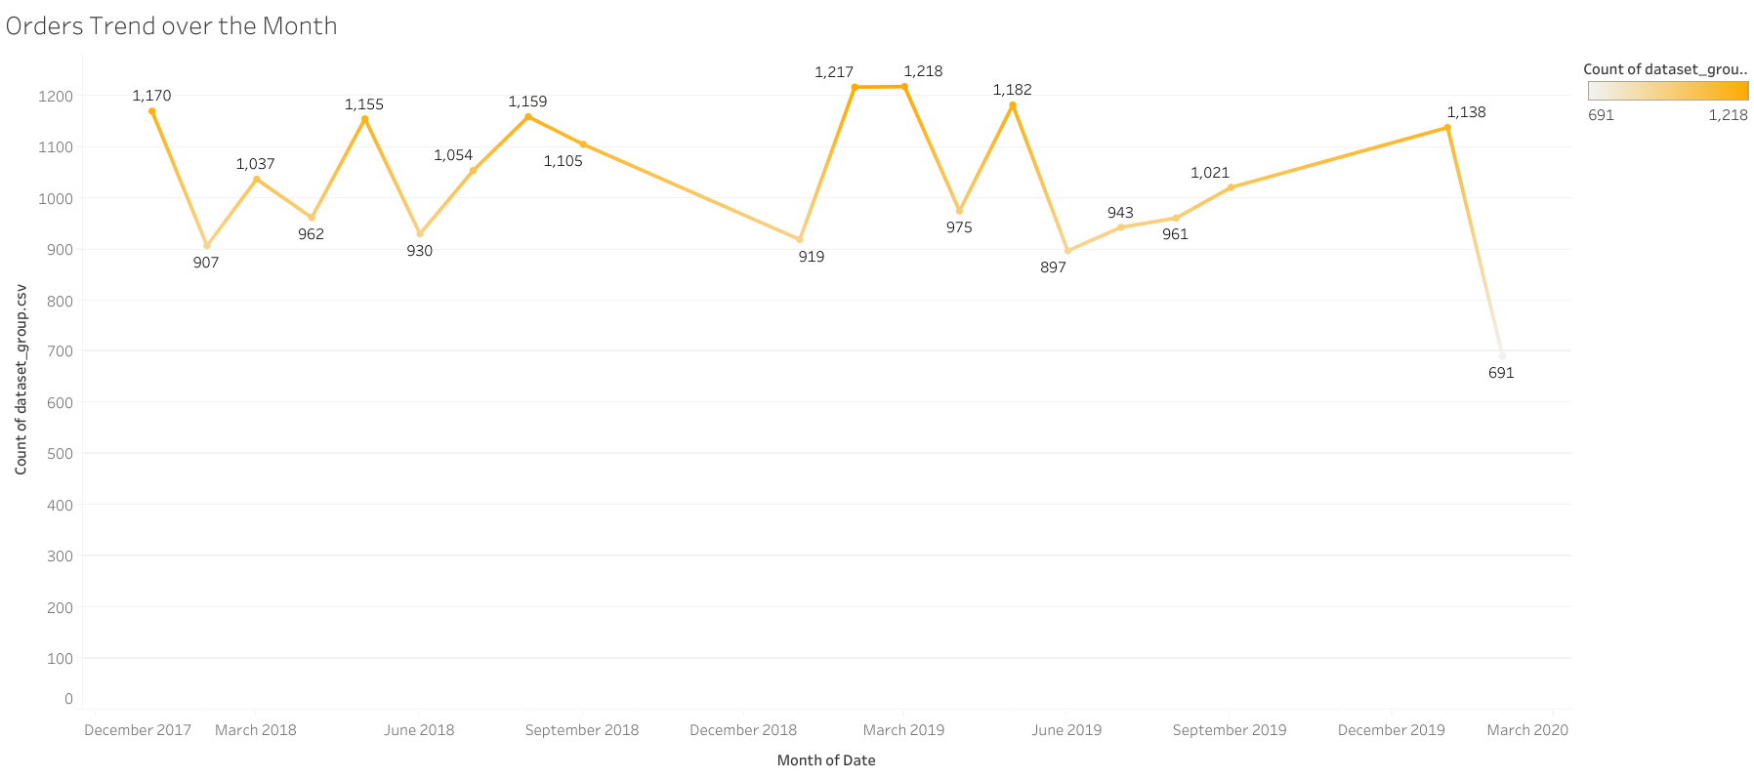
EDA – Orders Trend over the Month
The orders trend for the given data over the months. However indicate Feb & March being months where high orders are placed.

Slide 16
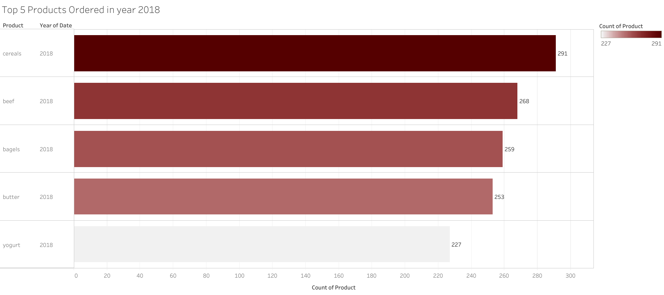
EDA – Highly ordered products over the years
Top 5 products ordered in 2018 are Cereals, Beef, Bagels, Butter & Yogurt with the mentioned no. of product orders.

Slide 17
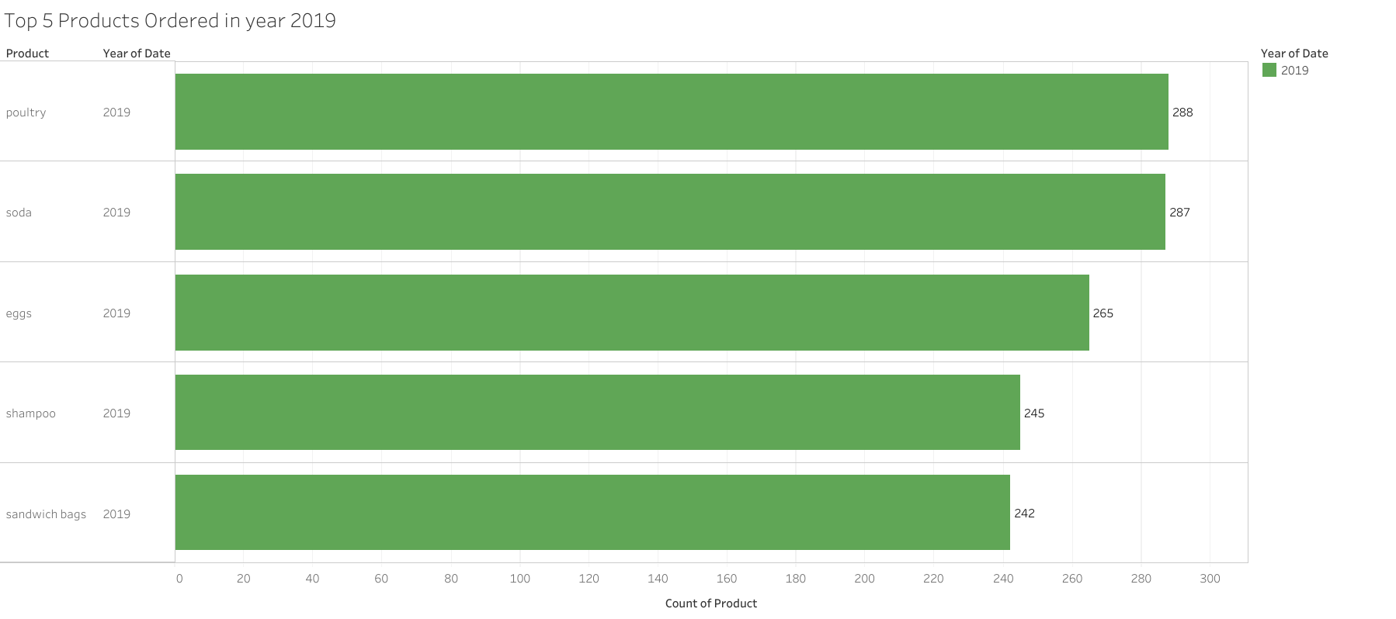
EDA – Highly ordered products over the years
Top 5 products ordered in 2019 are Poultry, Soda, Eggs, Shampoo & Sandwich bags liquid/Detergent, with the mentioned no. of product orders.

Slide 18
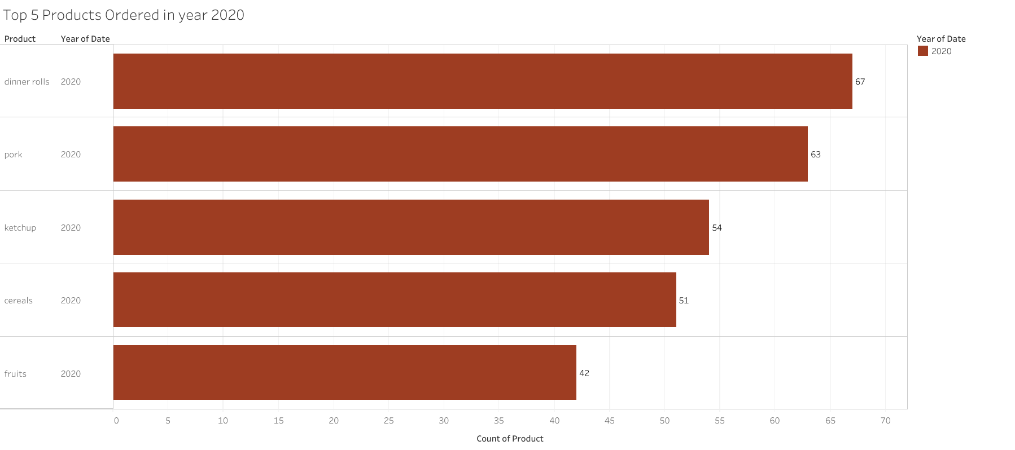
EDA – Highly ordered products over the years
Top 5 products ordered in 2020 are Dinner rolls, Ketchup, fruits, Cereals, & Pork, with the mentioned no. of product orders.

Slide 19
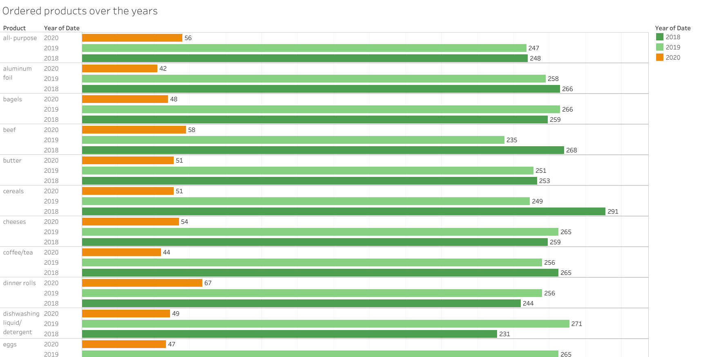
EDA – Highly ordered products over the years
Few less frequently sold products that could form part of a product deal to increase its sales for the year.
Comprehensive view of the ordered products over the year.

Slide 20
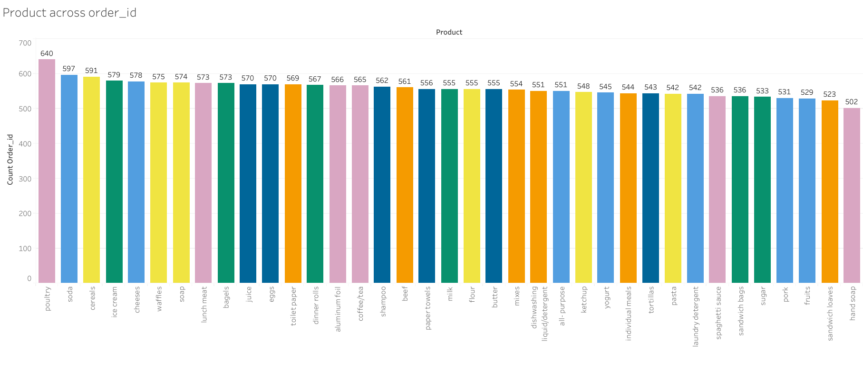
EDA – Product & Orders
From the chart below we see that Poultry has highest count of orders and followed by soda. And the lowest count of orders is hand soap and the second lowest count is sandwich loaves.

Slide 21
MARKET BASKET ANALYSIS
Market Basket Analysis is a technique that identifies the strength of association between pairs of products purchased together and identifies patterns of co-occurrence. A co-occurrence is when two or more things take place together.
Market Basket Analysis creates if-Then scenario rules, for example, if item A is purchased then item B is likely to be purchased. The rules are probabilistic in nature or, in other words, they are derived from the frequencies of co-occurrence in the observations. Frequency is the proportion of baskets that contain the items of interest. The rules can be used in pricing strategies, product placement, and various types of cross-selling strategies. In order to make it easier to understand, think of Market Basket Analysis in terms of shopping at a supermarket. Market Basket Analysis takes data at the transaction level, which lists all items bought by a customer in a single purchase. The technique determines relationships of what products were purchased with which other product(s). These relationships are then used to build profiles containing if-Then rules of the items purchased. The rules could be written as if {A} Then {B}
The, if part of the rule (the {A} above) is known as the antecedent and the THEN part of the rule, is known as the consequent (the {B} above).
The antecedent is the condition and the consequent is the result. The association rule has three measures that express the degree of confidence in the rule, Support, Confidence, and Lift.

Slide 22
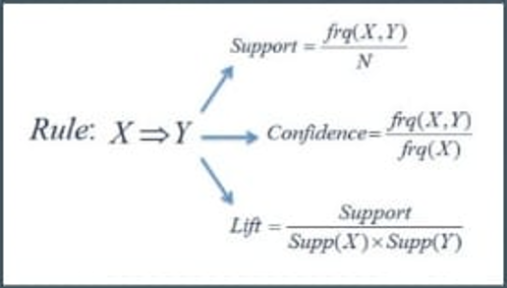
Threshold Values
Support: It’s the default popularity of an item. In mathematical terms, the support of item A is nothing but the ratio of transactions involving A to the total number of transactions.
Confidence: Likelihood that customer who bought both A and B. Its divides the number of transactions involving both A and B by the number of transactions involving B.
Lift: Increase in the sales of A when you sell B.

Slide 23
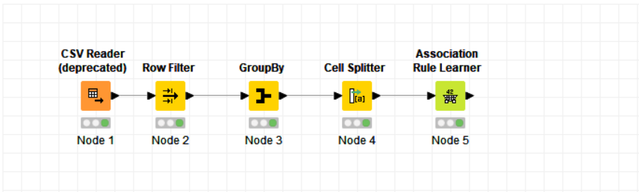
KNIME WORK-FLOW

Slide 24
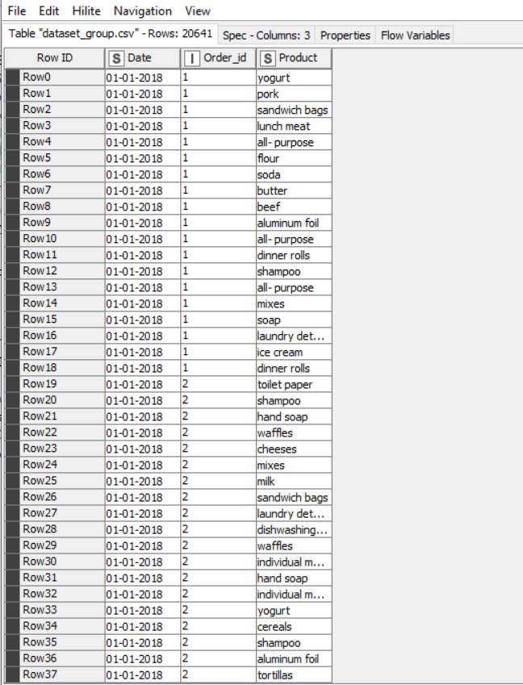
MBA – DATA LOAD
We can observe here that no. of rows are now 1,139 as compared to our data set it was 20,641, after filtering the data with out All-purpose so 20,090
This will help us classify the products for our further Market Basket Analysis

Slide 25
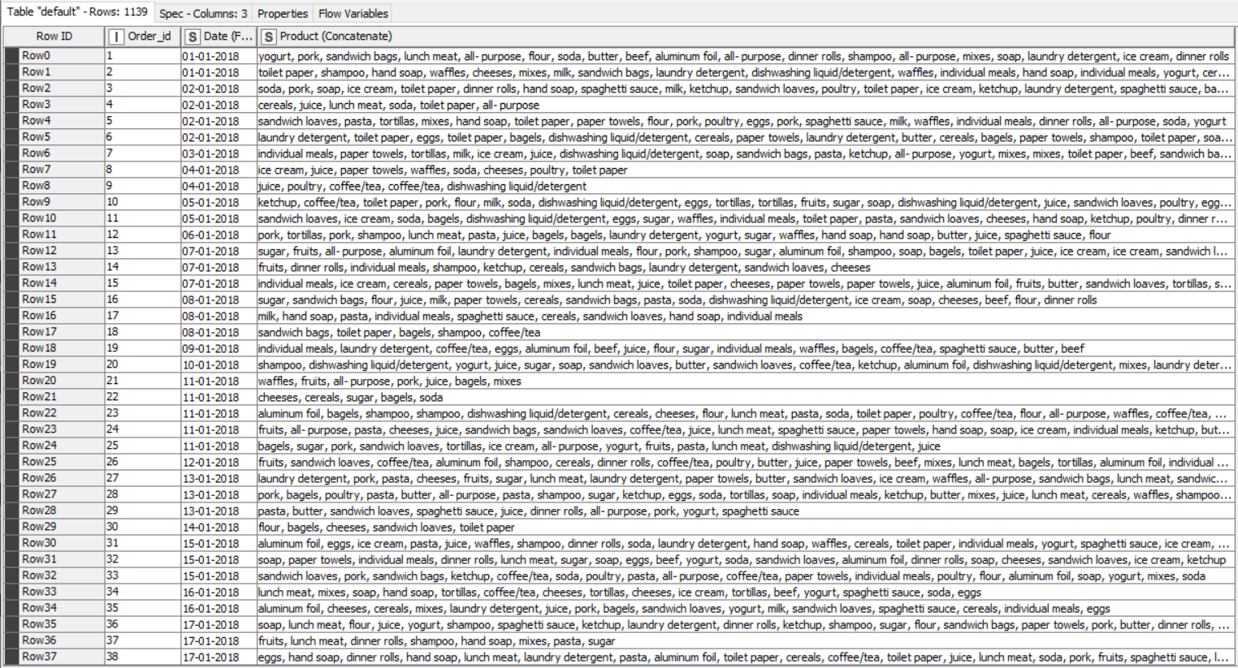
MBA – GROUPED BY
The filtered data then grouped with Order ID and the unique values of 1,139 rows
Grouped Data

Slide 26
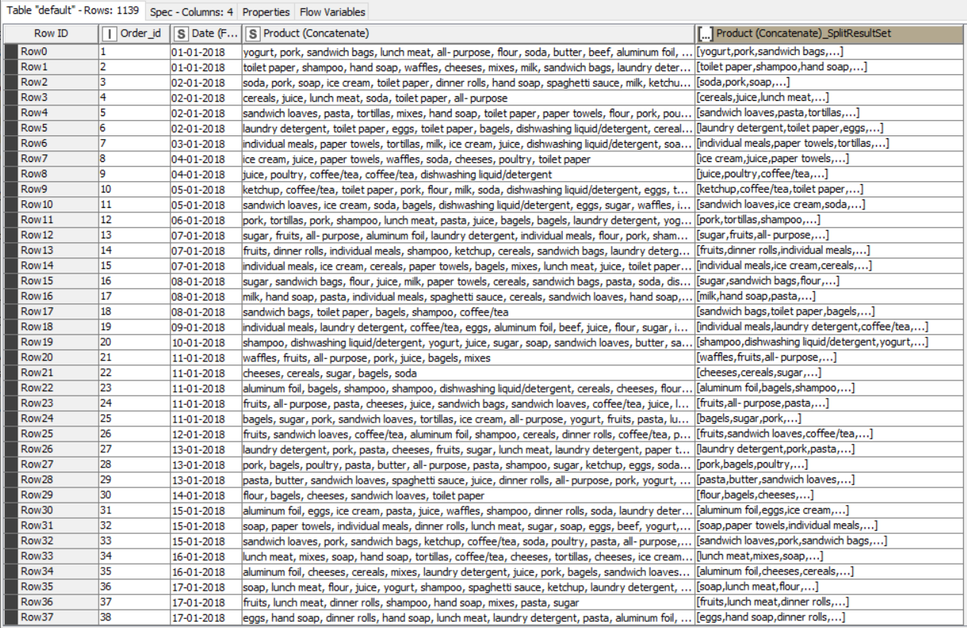
MBA – CELL SPLITTER
In this node ‘Cell Splitter’ we removed the duplicated products and concatenated them in a single group as per the purchase or order ID.
This again helped us to classify the items in the set format which is in square bracket.

Slide 27
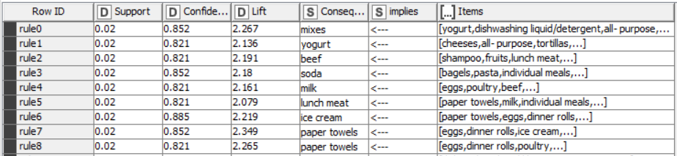
MBA – Association Rules
Association Rules – is the set of rules where the likelihood of buying a product is greater with a set of products.
In our case as an example the product paper towels being bought along with a set of [eggs, dinner rolls, ice cream, pasta, lunch meat] is 2.349 times higher when compared to it being bought individually which is just 0.02.
Like this with a minimum of below threshold values the association rules for the given data are calculated:
Support of minimum = 0.02
Maximum Item set length = 10
Minimum Confidence level = 0.8

Slide 28
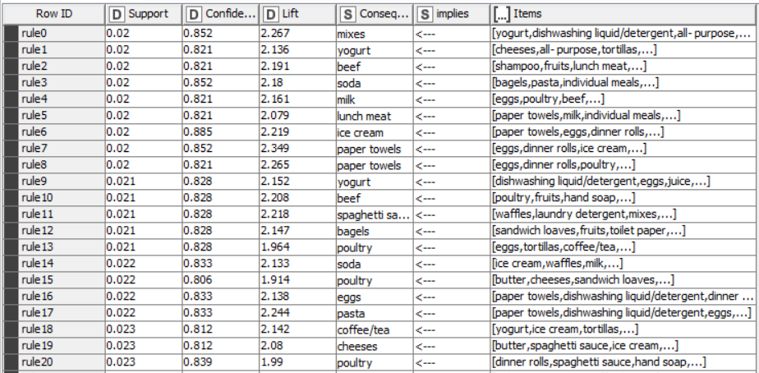
MBA – Association Rules
We have observed that, in the given data set we found out 39 association rules or combination.

Slide 29
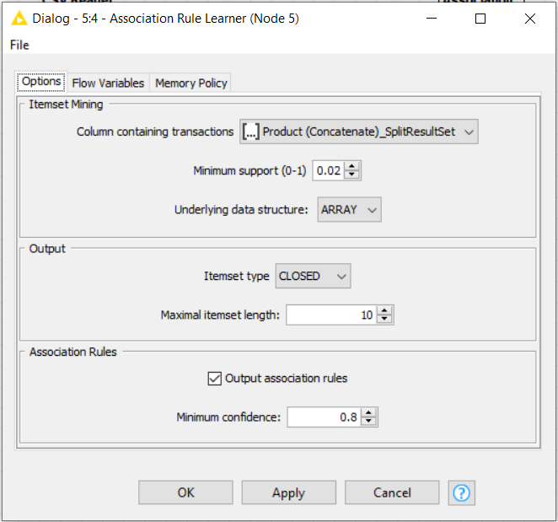
MBA – Association Rule Parameters
Threshold values are found out by various regressions and shown here:
Support of minimum = 0.02
Maximum Item set length = 10
Minimum Confidence level = 0.8

Slide 30
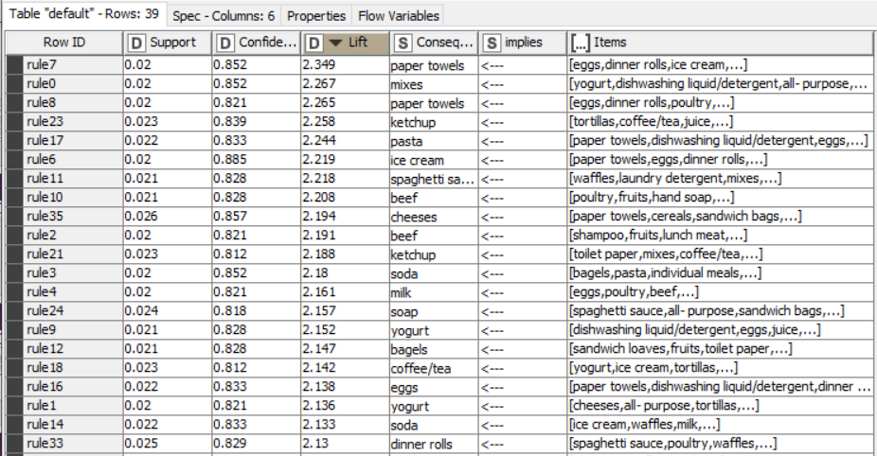
MBA – Suggestions & Recommendations
Poultry could be suggested as a combo meal with most of the food and snack items such as dinner rolls, eggs, ice cream & spaghetti sauce.
Soda could be another item that can be offered in a combo.
Top combo with good confidence are:

Slide 31
MBA – Suggestions & Recommendations
We can have an easy lift-up counter of the top combinations near the sales counter or billing counter to increase the sale of the preferred combinations.
We can have frequent sale offer on the least sold products to increase sales.
We can offer special discount coupons on the least sold products purchased, on the next shopping on all the products to increase the sale of the least productive and increase the frequency of the customers.
Since Poultry and soda are the most sold items and hand soap and sandwich loaves are the least – a combo offer of these would eventually increase a sale of Hand soap and sandwich loaves as well.

