Slide 1

Jal Jeevan Mission Undergraduate Project Presentation
Presented by:
Tejas Ramakrishnan (201050)
Aniket Suhas Borkar (210135)
Mentored by: Prof. Priyanka Bagade

Slide 2
Introduction
Access to clean water is a critical issue in rural India
It leads to significant economic losses and health hazards.
The Jal Jeevan Mission project aims to address this issue.
Initial focus is to develop and deploy an effective water leakage detection system that is cheap, accurate, and scalable.
This presentation outlines the methodology used in the project, the literature review conducted, creation of survey paper, the test bed design, and future work.

Slide 3
Methodology
Literature Review to understand existing methods for accurate leakage detection.
To test the feasibility of selected methods for large scale usage, while taking into consideration their efficacy and cost.
Creation of survey paper as a resource for the same.
Creation of test bed with these sensors to see how they work practically and to see if they can be used in our setting.
Collection of data and application of various methods like leak noise correlation to detect leaks.

Slide 4
Literature Review
A summary of Leak detection methods

Slide 5
Water Flow Meters
Water Flow meters are a low cost method to detect water leakages.
Two types – ultrasonic and hall effect based.
Water flow meters can be used along with Arduino and nodeMCU to collect and transmit the data for storage. A simple comparison of water flow rates between the upstream and downstream water flow sensors can be used to detect a leakage.
The leak can also be localised. If the flow starts to decrease, and eventually attains a stable value, which is lesser than the normal initial flow, the system detects a leakage. The Arduino converts the initial and final flow meter readings into velocities, and then applies the basic equation of motion to calculate the distance of the leak from the sensor.
However, there is a possibility that the flow meters mispredict actual tap usage as water leakage. Thus care must be taken to account for the same.

Slide 6
Accelerometers
Piezoelectric accelerometers can be used to measure the leakage signals noninvasively.
These accelerometers can measure a vibration to the acceleration level objectively. The raw data can then be processed to remove the high frequency components. This is then sent for further feature extraction and analysis.
The data used is in the form of a time series. For example, a convolutional layer has been used for feature extraction using learnable kernel filters.
Finally the extracted features are passed through deep neural networks, or machine learning algorithms and the predictions are provided. Ensemble models may also be used.
Custom fabricated piezoelectric sensors have also been used for the purpose of detecting vibration of the pipeline and predict leakages.

Slide 7
Noise Loggers
Leak noise loggers are placed in utility holes without any trenching or drilling.
They operate by implementing sophisticated algorithms to identify leak noise.
This technology is automatic thus eliminating human error.
Can improve accuracy by using self-learning/collective thinking algorithms which allow the computational end of the system to keep improving constantly with new data.
Additionally, logger systems require more efficient filtering algorithms that can eliminate “non-leak” noises that are often confused for leaks by such systems

Slide 8
Acoustic data analysis
The general process: gathering raw sound signals, pre-processing the signals, transforming the signals using fast Fourier transform (FFT), identifying signal features, and classifying them.
De-noised using discrete wavelet transform(DWT) to improve Signal-to-Noise(SNR) Ratio.
A Mel-Frequency transformation is applied, after which MFCC features are extracted by a series of steps: frame separation, then application of FFT, conversion to Mel spectrum and finally application of Discrete Cosine transform. The extracted MFCCs are used to train three models: CNN, KNN and SVM.
FFT followed by a series of transformations. Level, spread, and frequency distribution are used as inputs to ML models. The weights of these parameters are calculated using Shannon entropy algorithm.

Slide 9
Smart Balls
Multiple robotic devices were developed to perform in pipe inspection and determine leak locations in sewers. One example is “smart ball”.
Smart-ball technology is composed of a foam ball with an aluminum alloy core, within the aluminum core, a highly sensitive detection instrument is placed.
Smart-ball does not create any noise when passing through the pipeline. Hence, it can detect tiny leaks.
It has a location accuracy within 3 m of estimated leak location, it is very flexible due to its small size.
The acoustic sensors within the smart-ball device listen to all the sounds emitted inside the pipe, and can be used to identify the locations of leaks, valves, as well as air pockets.
Not in consideration currently due to cost issues.

Slide 10
Other methods
Thermography (IR) camera measures and images the emitted infrared radiation from an object. It has been tested on non-metallic pipelines and has shown accurate results, yet these results were not as accurate as those provided by acoustic technologies
Tracer gases is a leak detection technique that utilizes pressurizing nontoxic and insoluble gasses into leaks, these gasses contain ammonia, halogens, and helium, where helium is the most sensitive. Given that the utilized gasses are lighter than air they will tend to go out through leaks and then seep out through the soil or pavements. Later on, these gasses are traced and detected using a man operated detector to identify the locations of leaks through detecting the seepage of tracer gasses.
GPR technology utilizes electromagnetic waves and transmits them into the ground to identify leak location via imaging the sub-terrain including the pipe and the leak. It can detect leaks regardless of the material of the pipe, for any diameter size above one inch and reaching to a depth of 5 m. It is however very expensive, and requires trained operators.

Slide 11
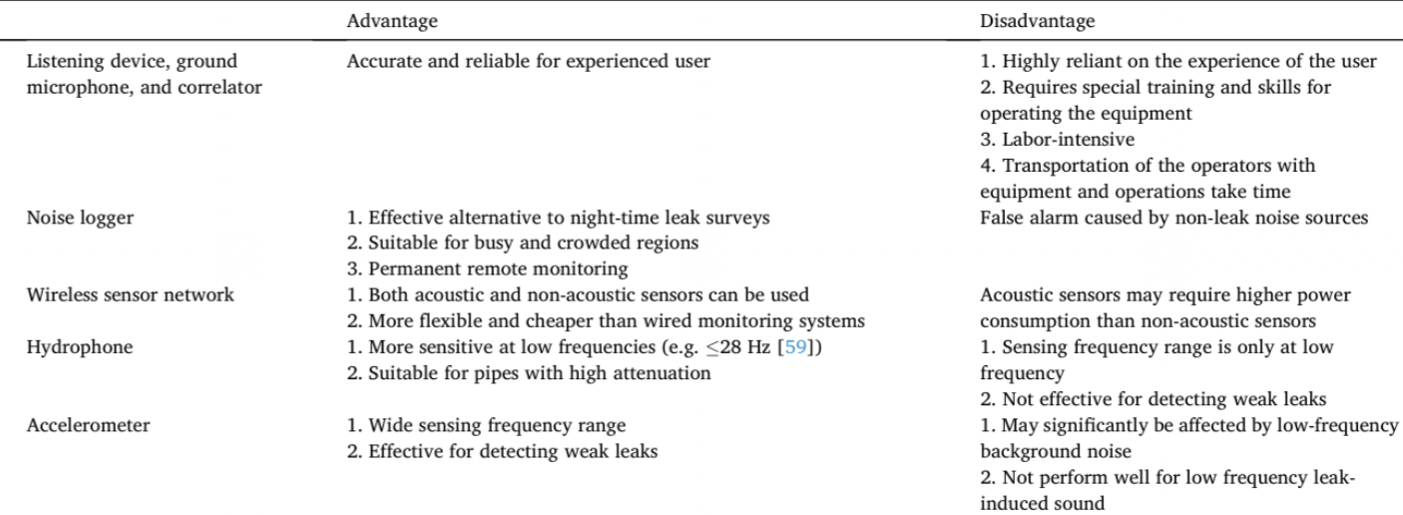

Slide 12
Survey Paper
Created a thorough analysis of data-driven and model-based leak detection methods.
Each technique's generic foundation is outlined and contrasted.
Specific apporaches to improve the generic methods that have been employed in varuious settings are summarized.
Will add our findings once we perform leak detection on our test bed.
Hopes to be a helpful resource for academics and business in the ongoing development of sophisticated acoustic leak detection techniques.

Slide 13
Testbed Design
Main considerations for the design of the testbed

Slide 14
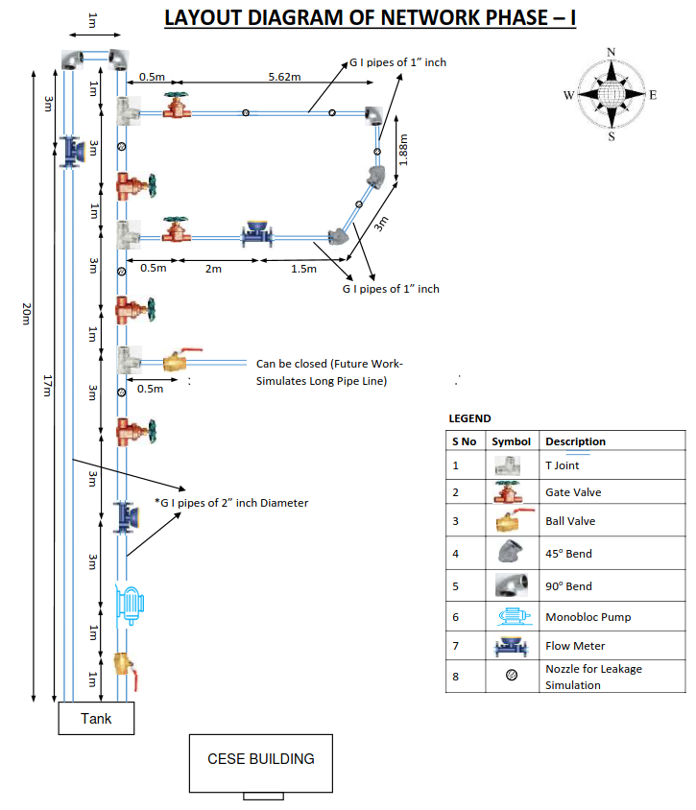
Layout Diagram
In order to simulate actual conditions, we included
Bends and 90 degree turns
A main cycle of 2-inch diameter pipes
A subsidiary cycle of 1-inch diameter pipes
3 ultrasonic water flow meters were installed. The chosen water flow meters provide a complete solution from data collection to transmission and storage.
One after the pump
One in the recycle pipe
One in the subsidiary cycle
Accelerometers are going to be added to the testbed.

Slide 15
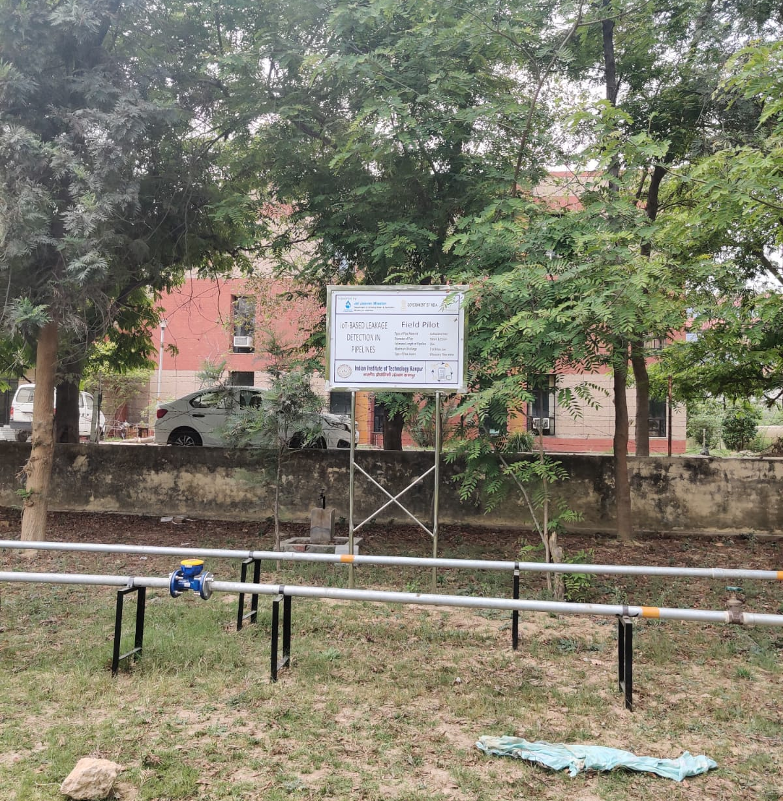
Testbed
The testbed has been layed out in front of the Environmental Science Engg. Building.
Keeping in view that the actual pipelines of the IITK water network use 4 and 2 inch diameter pipes, we decided to go with 2 and 1 inch diameter pipes
Use of metal GI pipes
Attempt to make the test bed simulate the real WDN so that developed models will generalize well on deployment.

Slide 16
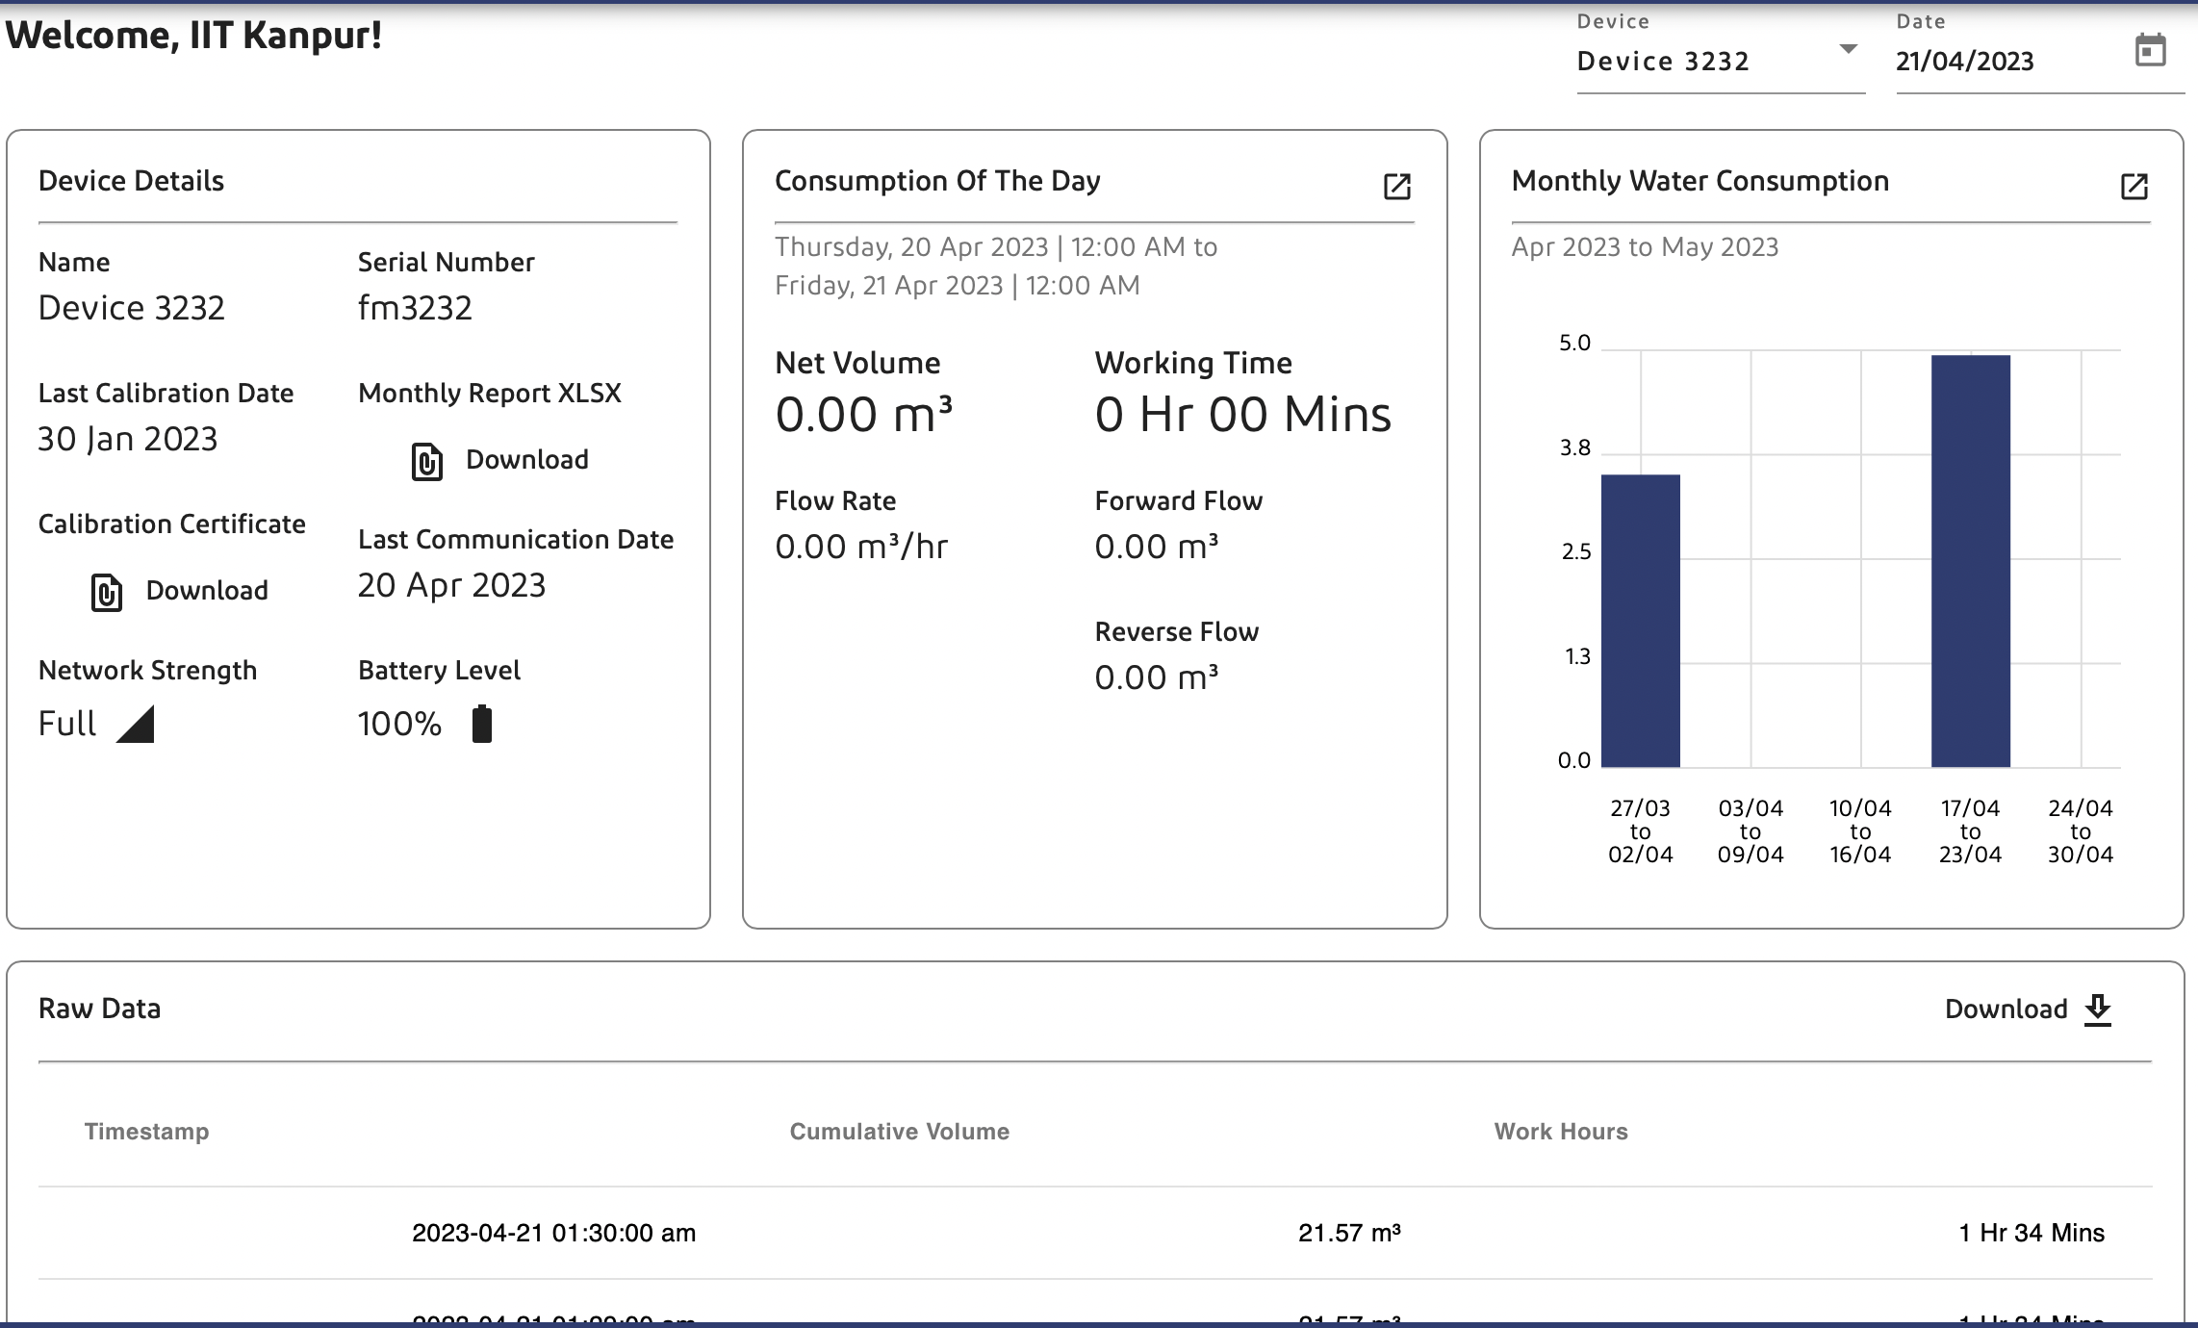

Slide 17
Future Work
The future work in this project will involve analyzing the data collected from the test bed and selecting the optimal method of leakage detection.
This will involve comparing the accuracy and cost-effectiveness of combinations of different sensors and data processing methods to determine the best approach for detecting water leakage.
Another factor which the project plans to address is how well the taps in the pipes of the testbed emulate actual leaks.
This is a major factor in deciding how the models trained on the data collected from the testbed will actually behave in the actual environment.

Slide 18
Conclusion
The Jal Jeevan Mission project aims to develop an effective water leakage detection system that is cheap, accurate, and scalable.
The project followed a three-step methodology involving a literature review, test bed design, and data analysis.
The literature review identified the ideal methods for water leakage detection, and the test bed was designed with an initial focus on using water flow meters and acoustic sensors.
The focus of future work will be on selecting the optimal method of leakage detection and deploying it to address this critical issue.

Slide 19
Thank you!

