Slide 1

Yelp Dataset Challenge
Presented by
Charwad, Nayana Yashwant
Chintala, Sri Laxmi
Deshmukh, Renuka
Gaikwad, Aniket Sambhaji
Indana, Venkata Prudhvi Raj

Slide 2
Task 1 : Category Prediction For Businesses
Approach 1: Indexing using Lucene and applying POS tagging for every review and tip text.
Drawback: POS tagging is costly and time consuming.
Approach 2: Generate Index for each category and train data.
Drawback: Tedious task and redundant.
Issues:
Combining reviews and tips data for each Business ID.
Notes:
How presentation will benefit audience: Adult learners are more interested in a subject if they know how or why it is important to them.
Presenter’s level of expertise in the subject: Briefly state your credentials in this area, or explain why participants should listen to you.

Slide 3


Why MongoDB
Document oriented storage (JSON format)
Easy access based on index of an attribute
Huge data collections
Why Lucene
Better for quickly searching high volumes of unstructured text for the presence of any word or combination of words
Rich text search capabilities
Sophisticated relevancy ranking tools for ordering results
Notes:
Lesson descriptions should be brief.

Slide 4
Algorithm (Part 1) : Indexing
Yelp Dataset
Mongo DB
Test and Train Data Collection
Index Generation for Test and Train Files
Notes:
Example objectives
At the end of this lesson, you will be able to:
Save files to the team Web server.
Move files to different locations on the team Web server.
Share files on the team Web server.

Slide 5
Algorithm (Part 1) : Query Generation and Category Prediction
Get all documents for each category
Apply POS Tagging on the reviews and tips of retrieved results to extract nouns
Find top 100 words (query) based on TF_IDF score
Run the queries on test collection for various algorithms

Slide 6
Steps
Import the review, tip and business data into MongoDB.
Create training and test collections (Business ID, category, review, tip, review-rating).
Generate Index for both training and test collections using Lucene.
Use training Index to get all results for each category and apply POS tagging to get nouns from the review and tip data.
Based on TF_IDF get the top nouns and these form the query.
The generated queries are run on test collection to predict the categories.

Slide 7
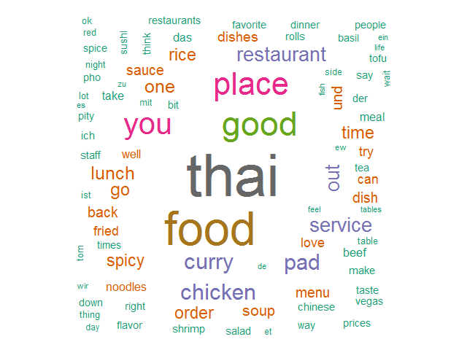
THAI
Word cloud for the “Thai” category as obtained by our algorithm

Slide 8

Task 2 : Predicting the restaurant rating with respect to user
How’s this prediction useful to Yelp ?
Two Approaches
Use features describing user and business
Sentiment Analysis

Slide 9
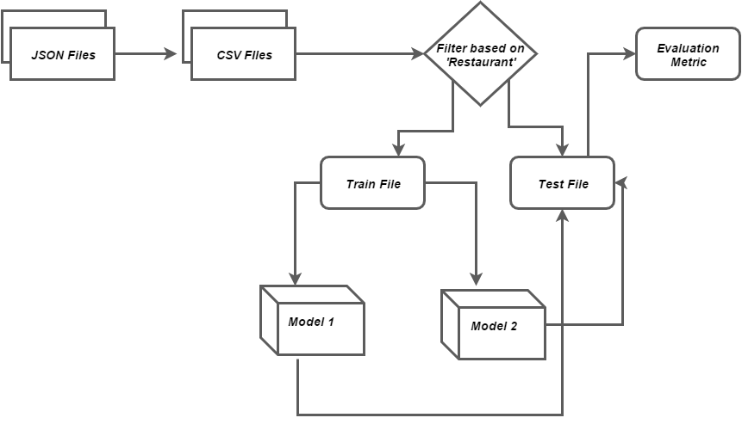
Approach

Slide 10
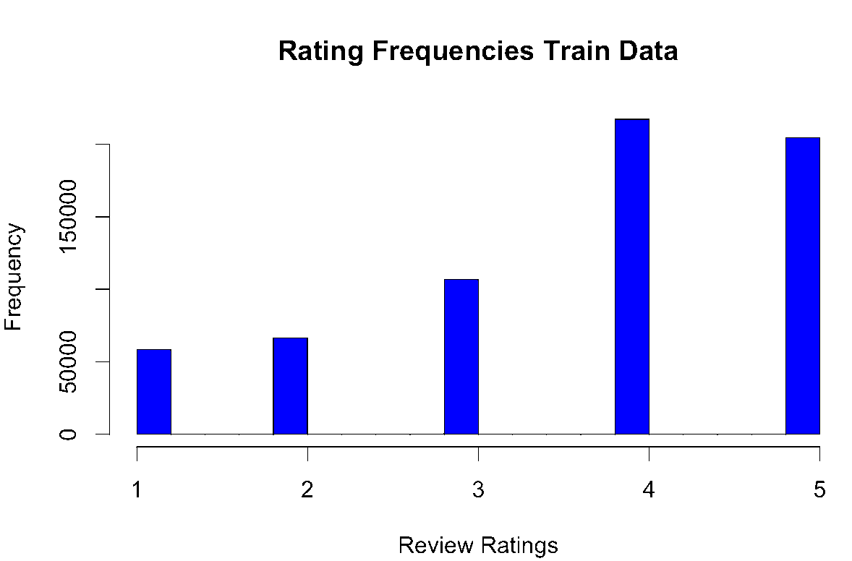
Class Label Distribution

Slide 11
Steps : Model 1
1.Vectorize the class labels to get binary features (782)
2.Select features from Business file like ‘Ambience_classy’,’Good_For_brunch’,’Parking_lot’ etc
3.Use category as features.
4.Split train data using 10 fold cross validation
5.Apply feature selection like ‘PCA’,’KbestFeatures’,’BeliefNetwork’
6.Use classifiers from Python-sklearn library to learn model.
7.Test on test data and evaluate

Slide 12
Classifiers Used
Regression Problem :
Gradient Boost Regressor
Evaluation :
Gaussian SVM
Sigmoid SVM
Decision Tree Regressor
Random Forest Regressor
Recall
Precision
Accuracy
RMSE

Slide 13

Sentimental Analysis
How well can you guess reviews rating from it’s text alone?
Sentimental Analysis
Determine the attitude of a user with respect to a particular business.
Check if expressed opinion in review is positive, negative or neutral
Determine emotional of states of user such as “Happy”, “Angry” or “Sad”

Slide 14

Data Preprocessing
Divide reviews based on ratings
Preprocess text (Remove stop words, stemming)

Slide 15
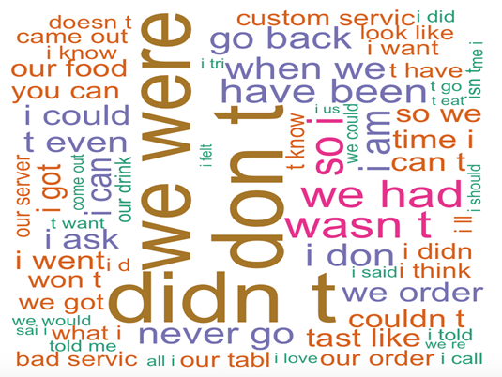

Rating One

Slide 16
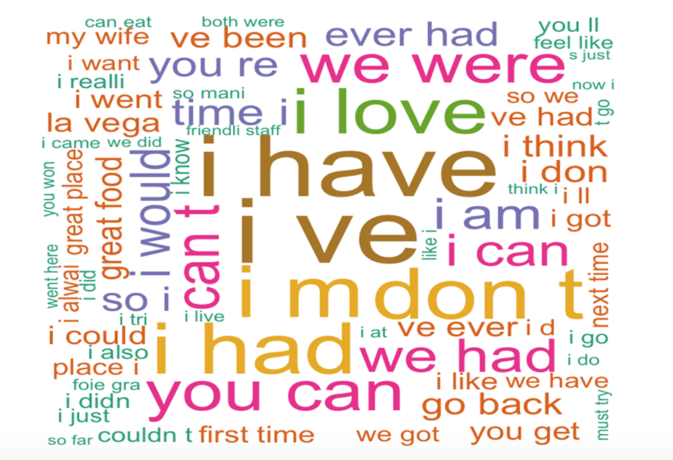

Rating Five

Slide 17

Algorithms Used
Naive Bayes
Random Forest
Classification
Regression
Support Vector Machine
Regression

Slide 18

Evaluation : Task 1
Algorithms Used
LMJ similarity
LMD similarity
BM25 similarity
VSM similarity
LMJ similarity was performing better than other similarities

Slide 19
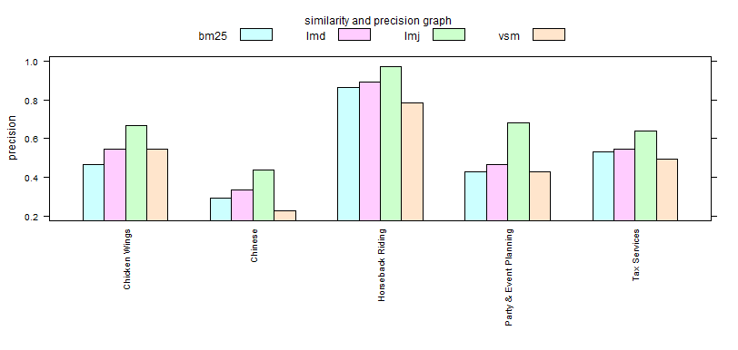
Compare Precision across Algorithms

Slide 20
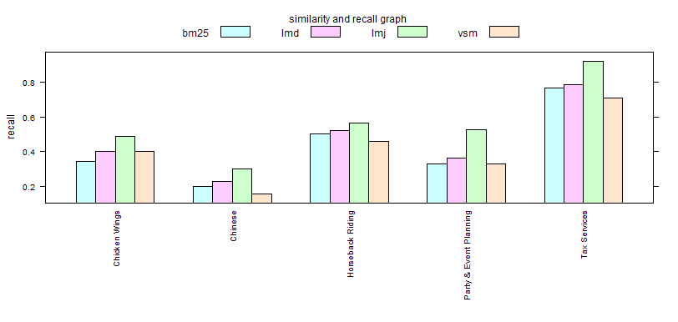
Compare Recall across Algorithms

Slide 21
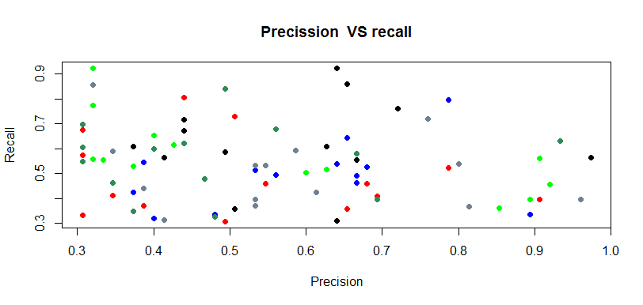

Slide 22
Evaluation: Task 2 – Model 1
Regression with 10 fold cross validation
Leaner | RMSE | R2 score
Gradient Boost | 1.2147 | -0.0968
Naive Bayes | 1.6135 | -0.5953
SVM with RBF kernel | 1.3434 | -0.1057
Decision Tree | 1.2318 | 0.0713
Logistic Regression | 1.4491 | -0.2837
Random Forest | 1.2279 | 0.0769

Slide 23
Evaluation: Task 2 – Model 2
Regression RMSE
Random Forest | 1.076
SVM | 1.05
Naive Bayes Classification
Rating | 512 Features | 1096 Features
Exact match | 36.3389 | 45.3695
(+1,-1) match | 63.0954 | 71.4332

Slide 24
Toolkits and APIs
Lucene
Java
Stanford POS Tagger
Mongo DB
R - packages (Random Forest, E1071, Word Cloud)
Python - (SKLearn)

Slide 25

Thank You!

