Slide 1
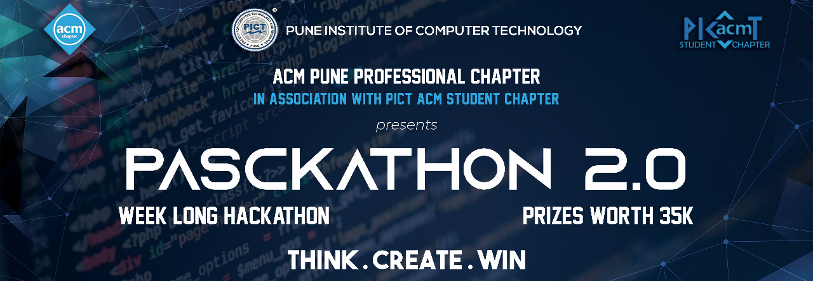
Aniket Malpure
Srushti Chandak
Ganesh Mehta

Slide 2
Machine Learning
Machine Learning is an application of artificial intelligence that provides systems the ability to automatically learn and improve from experience without being explicitly programmed.
Applications of machine learning are vast and varied such as product recommendation , traffic prediction , self driven cars , image recognition and many more. We wish to expand its applications to help us trace stolen cars.

Slide 3
Problem Statement
Humans cannot practically keep an eye everywhere but can use machines to do so. Our aim is to use concepts of Machine Learning to trace stolen cars or vehicles which could further lead the trail of investigation from the data which has been made available to us.

Slide 4

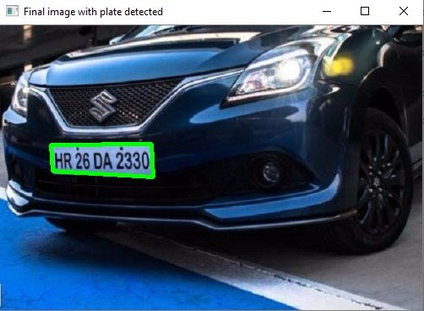
3. Character Recognition: Now, the new image that we obtained in the previous step is sure to have some characters (Numbers/Alphabets) written on it. So, we can perform OCR (Optical Character Recognition) on it to detect the number.
1. License Plate Detection: The first step is to detect the License plate from the car. This gets trickier if the image does not even have a car, in this case we will an additional step to detect the car and then the license plate
2. Character Segmentation: Once we have detected the License Plate we have to crop it out and save it as a new image. Again this can be done easily using OpenCV.

Slide 5

1. Let's consider a simple image of a car whose number plate is clearly visible.
2. Resize the image to the required size and then grayscale it.
3. Use Bilateral filter. Using a bilateral filter(Blurring) will remove the unwanted details from an image.
4. The next step is performing edge detection using canny edge method.
5. Now we can start looking for contours on our image. Once the contours have been detected we sort them from big to small
6. Among the obtained results after contouring , we filter the license plate image by looping through all the results and check which has a rectangle shape contour with four sides and closed figure.
7. Proceed with masking the entire image except the number plate .
8. The next step in Number Plate Recognition is to segment the license plate out of the image by cropping it and saving it as a new image.
9. The final step is to actually read the number plate information from the segmented image using pytesseract package.
10. The characters thus obtained are mapped with the database so as to find licensed user of that number plate and result is displayed
SOLUTIONS

Slide 6
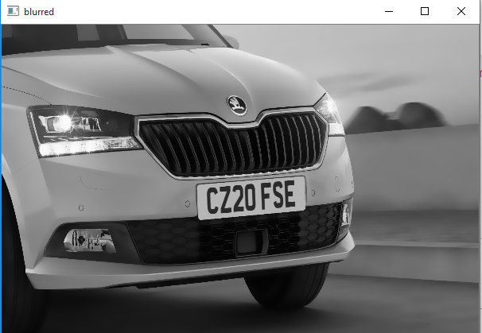
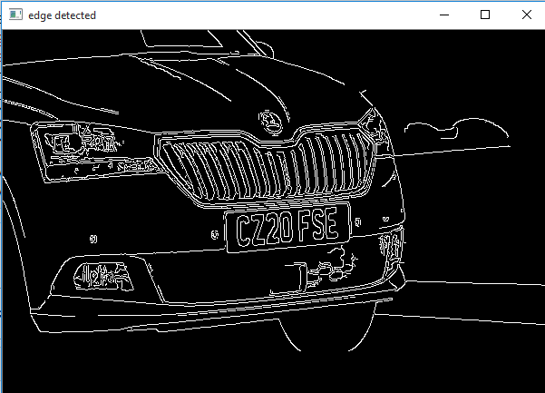
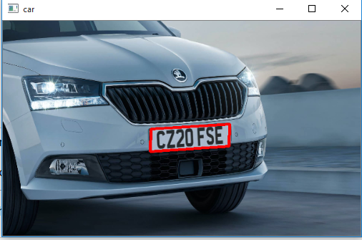
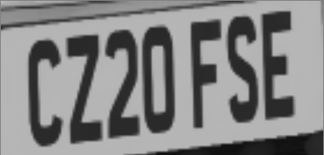
.
.
After Edge
Determination
Number plate detection
CZ20 FSE
Using
Pyteserract
Masking

Slide 7





TECH STACK
Pycharm
Pytesseract

Slide 8
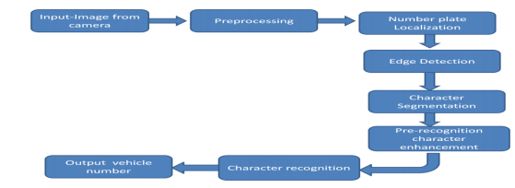
Case Diagram

