Slide 1
EE5351
Applied Parallel Programming
Tiled Convolution Analysis
© David Kirk/NVIDIA and Wen-mei W. Hwu
ECE408/CS483/ECE498al University of Illinois, 2007-2011

Slide 2
First, a little review…
Notes:
* These review slides are optional. They are a review of previous lecture material. I added them in a year when many students were confused about shifting between input and output coordinates.

Slide 3
Shifting from output coordinates to input coordinates
Thread (0,0)
Thread (0,0)
COMPUTING
(output coordinates):
Computation only performed for internal elements
Without shifting input coordinates
LOADING (input coords):
Each thread loads one element
Notes:
* Input tile is not the same size as output tile (it’s bigger), so we need to shift the indices from the output to the input coordinates
* What is the shift relationship in our case?
→ shift by MASK_SIZE/2

Slide 4
Setting Block Size
#define BLOCK_SIZE (TILE_SIZE + MASK_SIZE-1)
// TILE_SIZE = 28
// MASK_SIZE = 5
// BLOCK_SIZE = 28 + 5 – 1 = 32
dim3 dimBlock(BLOCK_SIZE, BLOCK_SIZE);
TILE_SIZE = 28
32 = BLOCK_SIZE
Notes:
* In this example, we need 32 elements, but we can’t just load input from 0 to 32 for the first tile; we need to shift the indices up and to the left to get the correct halo elements

Slide 5
Shifting from output coordinates to input coordinates
int tx = threadIdx.x;
int ty = threadIdx.y;
int row_o = blockIdx.y * TILE_SIZE + ty;
int col_o = blockIdx.x * TILE_SIZE + tx;
int n = MASK_SIZE/2;
int row_i = row_o – n; // row_o - 2
int col_i = col_o – n; // col_i - 2
Notes:
* Shift up and to the left by MASK_SIZE/2 to align into the shared memory
-- The upper left corner of the input tile is up and to the left of the upper left corner of the output tile by MASK_WIDTH/2
* The thread and block indices can be used directly for the output tile, but only use a subset of them, since there are more threads than output elements (by MASK_SIZE-1 in each dimension)

Slide 6
Moving the halo to the correct location
-2
0
28
30
0
28
32
Notes:
* Input tile is not the same size as output tile (it’s bigger), so we need to shift the indices from the output to the input coordinates
* What is the shift relationship in our case?
→ shift by MASK_SIZE/2

Slide 7
Coordinate shifting example
-2
0
28
30
56
26
58
Notes:
* Input block needs to be big enough to get all the elements we need, but we need to shift it left and up to get the correct elements
* 58 = 28 + 32 – 2
* In this example, there are 32^2 input elements, so we declare a block of 32^2 threads (BLOCK_SIZE = 32). There are only 28^2 output elements, so only a subset of the threads perform computations (TILE_SIZE = 28).

Slide 8
Loading the input
float output = 0.0f;
// ghost element condition
if((row_i >= 0) && (row_i < N.height) &&
(col_i >= 0) && (col_i < N.width) ) {
Ns[ty][tx] = N.elements[row_i*N.width + col_i];
}
else{
Ns[ty][tx] = 0.0f;
}
Notes:
* We load into shared memory using the shifted coordinates (row_i, col_i)
* If the shifted coordinates are outside the input matrix, we write a 0 for a ghost element

Slide 9
Writing the output
if(row_o < P.height && col_o < P.width)
P.elements[row_o * P.width + col_o] = output;
0
28
56
84
112
140
Notes:
* We write output using the original coordinates, but only for the subset of threads that lie within the output tile

Slide 10
Now, on to our next topic…

Slide 11
Objective
To learn about tiled convolution algorithms
  Some intricate aspects of tiled algorithms
  Output tiles versus input tiles
  Performance analysis of tiled algorithms
Notes:
* We have learned about tiling to reduce global memory bandwidth, but we need to be able to analyze the benefits we are getting from tiling in order to figure out what tile size we should use, etc.

Slide 12
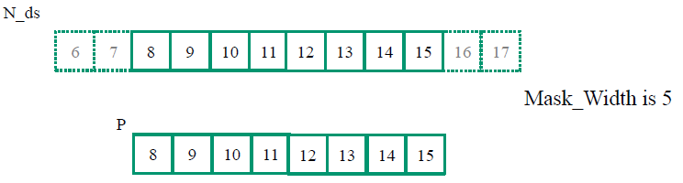
1D Tiled Convolution with
8-element tile
For Mask_Width = 5, we load 8+5-1 = 12 elements (12 global memory loads)
Notes:
* 1D tiled convolution
– for each tile, we load TILE_WIDTH+MASK_WIDTH-1 elements from global into shared

Slide 13
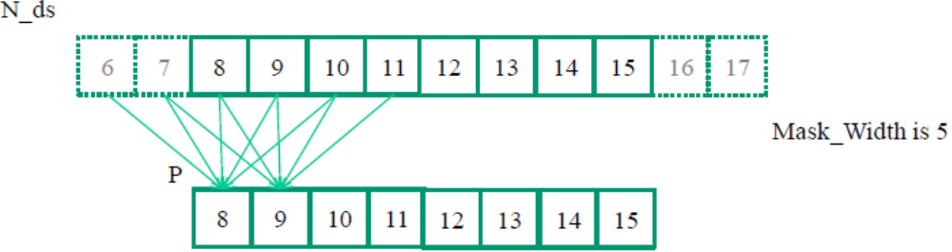
Each output element uses 5 elements of N (in N_ds)
P[8] uses N[6], N[7], N[8], N[9], N[10]
P[9] uses N[7], N[8], N[9], N[10], N[11]
P[10] uses N[8], N[9], N[10], N[11], N[12]
…
P[14] uses N[12], N[13], N[14], N[15], N[16]
P[15] uses N[13], N[14], N[15], N[16], N[17]
Notes:
* Once we load all the TILE_WIDTH+MASK_WIDTH-1 elements into the shared memory, we replace a lot of global memory accesses with shared memory accesses
* Each computation of a product element uses MASK_WIDTH elements from the input (in this example, MASK_WIDTH = 5)

Slide 14
A simple way to calculate tiling benefit
(8+5-1) = 12 elements loaded from global memory into shared memory
8*5 global memory accesses replaced by shared memory accesses
This gives a bandwidth reduction of
40/12 = 3.3
Notes:
* 3.3 is a reasonable reduction, but not huge
* This begs the question: How much do we WANT to reduce global memory bandwidth?

Slide 15
Question…
How much bandwidth reduction is enough?
What is GPU’s peak performance?
What is GPU’s max bandwidth?
Notes:
* The point of tiling is to reduce global memory bandwidth.
* In order to choose a good tile size, we need to know how much bandwidth reduction we are shooting for.
* Think of the computation we did for matrix multiplication or convolution. One FLOP per global memory load gives us a peak performance of ~37.5 GFLOPS.
* What is the peak performance of our GPU? (1 TFLOPS) → The GPU can only perform computations as fast as it can retrieve the operands for those computations. → Maximum bandwidth is ~150 GB/s. → In order for the GPU to achieve peak of 1 TFLOPS, we need to be able to satisfy our computations with 150 GB/s, which means we need to perform about 27 FLOPs per global memory load.
-- (1 TFLOPS / 150 GB/s) = (X FLOPS / 1 global memory load per second) = (X FLOPS / 4 B/s) ➔ X = ~27 FLOPs / global memory load

Slide 16
In general . . .
Tile_Width+Mask_Width-1 elements loaded from global memory to shared memory
Tile_Width*Mask_Width global memory accesses replaced by shared memory access
This gives bandwidth reduction of:
(Tile_Width * Mask_Width)
(Tile_Width + Mask_Width - 1)
Notes:
* Let’s evaluate bandwidth reduction for our tiled algorithm in the general case.
* In the limit (limit as tile width approaches infinity), reduction ratio approaches MASK_WIDTH

Slide 17
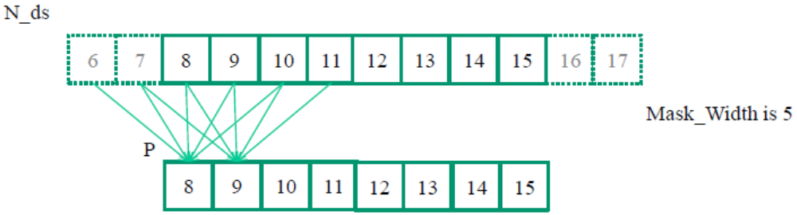
Another way to look at reuse
N[6] is used by P[8] (1X)
N[7] is used by P[8], P[9] (2X)
N[8] is used by P[8], P[9], P[10] (3X)
N[9] is used by P[8], P[9], P[10], P[11] (4X)
N[10] is used by P[8], P[9], P[10], P[11], P[12] (5X)
… (5X)
N[14] is uses by P[12], P[13], P[14], P[15] (4X)
N[15] is used by P[13], P[14], P[15] (3X)
Notes:
* Each output element always uses 5 input elements, but not all input elements are used 5 times.
– This is why we fall short of the perfect reduction ratio.

Slide 18
Another way to look at reuse
The total number of global memory accesses (to the (8+5-1) = 12 elements of N) replaced by shared memory accesses is:
1 + 2 + 3 + 4 + 5 * (8-(5-1)) + 4 + 3 + 2 + 1
= 10 + 20 + 10
= 40
So the reduction is:
40/12 = 3.3
Notes:
* If I add up all these accesses, I get the same value of 40

Slide 19
Ghost elements change ratios
For a boundary tile, we load
Tile_Width + (Mask_Width-1)/2 elements
  10 elements in our example of Tile_Width=8 and Mask_Width=5
Computing boundary elements do not access global memory for ghost cells
  Total accesses is 3 + 4 + 6*5 = 37 accesses
The reduction is 37/10 = 3.7
Notes:
* Considering ghost elements, the reduction ratio is slightly better for boundary tiles.

Slide 20
In general for 1D
The total number of global memory accesses to the
(Tile_Width+Mask_Width-1) N elements replaced by shared memory accesses is:
1 + 2 + … + Mask_Width-1
+ Mask_Width * (Tile_Width-(Mask_Width-1))
+ Mask_Width-1 +… + 2 + 1
= (Mask_Width-1) * Mask_Width
+ Mask_Width * (Tile_Width-(Mask_Width-1))
= Mask_Width * Tile_Width
Notes:
* Sum[n=1,N](n) = (N+1)*(N/2)
* Sum[n=1,MASK_WIDTH-1](n) = MASK_WIDTH*(MASK_WIDTH-1)/2

Slide 21
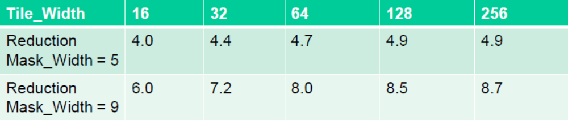
Bandwidth Reduction for 1D
The bandwidth reduction is:
Mask_Width * (Tile_Width)
(Tile_Width+Mask_Width-1)
Notes:
* You can see that the limit is approaching MASK_WIDTH and the TILE_WIDTH increases.
* Easy way to think of this is that in the un-tiled case, you would have MW*TW accesses to global memory (MW for each element of the tile), but in the tiled case, you only have (TW+MW-1)

Slide 22
2D output Tiling (P)
Use a thread block to calculate a tile of P
  Output tile dimension is TILE_WIDTH in x and y
col_o = blockIdx.x * TILE_WIDTH + tx;
row_o = blockIdx.y * TILE_WIDTH + ty;

Slide 23
Input tiles need to be larger than output tiles
3
4
5
6
7
2
3
4
5
6
1
2
3
4
5
2
3
5
6
7
Input Tile
0
1
1
3
1
Output Tile
3
4
5
6
7
2
3
4
5
6
1
2
3
4
5
2
3
5
6
7
0
1
1
3
1
Number of halo cells can be significant
Notes:
* Overlap at edges determines how much larger input tile must be than output tile
* The width of the perimeter (halo) is MASK_WIDTH/2
* These halo cells can take up a significant amount of memory!
* Imagine 10x10 = 100 element output tile – For MASK_WIDTH=5, this means a 14x14 = 196 element input tile → Input tile is almost double the size of the output tile!

Slide 24
Simple analysis for a small 8x8 output tile example
12 x 12 = 144 input elements need to be loaded from global into shared memory
The calculation of each output element needs to access 5 x 5 = 25 input elements
8 x 8 x 25 = 1600 global memory accesses are converted into shared memory accesses
A bandwidth reduction of 1600 / 144 = 11x
Lower BW reduction because of halo
Notes:
* 8x8 = 64 output elements vs 12x12 = 144 input elements – input tile is more than double the size of the output tile!
* BW Reduction can be up to 25 – but we didn’t reach this limit because of the big halo (which more than doubles the number of global memory loads)

Slide 25
In general . . .
(Tile_Width+Mask_Width-1)² input elements need to be loaded from global memory
The calculation of each output element needs to access Mask_Width² input elements
Tile_Width² * Mask_Width² global memory accesses are converted into shared memory accesses
The bandwidth reduction is:
Tile_Width² * Mask_Width²
(Tile_Width+Mask_Width-1)²

Slide 26
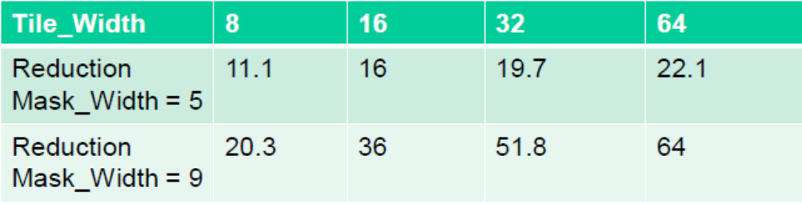
Bandwidth Reduction for 2D
The reduction is
Mask_Width² * Tile_Width²
(Tile_Width+Mask_Width-1)²
Notes:
* We have to use somewhat smaller TILE_WIDTH to make sure that tiles fit into shared memory
* We need about 27x BW reduction to reach the peak performance of the GPU (assuming ratio of FLOPS to Loads in kernel is 1:1) – DO CALCULATION
4 B/s : 1 FLOPS :: 150 GB/s : 37.5 GFLOPS → 1 TFLOPS / 37.5 GFLOPS = 26.7
* At some point, enough is enough – it’s like submitting a paper to a conference – When you reach ~30x BW reduction, stop and optimize something else

Slide 27
Ghost elements change ratios
Left as homework
3
4
5
6
7
3
4
5
6
7
3
4
5
6
7
2
3
4
5
6
2
3
4
5
6
2
3
4
5
6
1
2
3
4
5
1
2
3
4
5
1
2
3
4
5
2
3
5
6
7
2
3
5
6
7
2
3
5
6
7
0
1
1
3
1
0
1
1
3
1
0
1
1
3
1
3
4
5
6
7
3
4
5
6
7
3
4
5
6
7
2
3
4
5
6
2
3
4
5
6
2
3
4
5
6
1
2
3
4
5
1
2
3
4
5
1
2
3
4
5
2
3
5
6
7
2
3
5
6
7
2
3
5
6
7
0
1
1
3
1
0
1
1
3
1
0
1
1
3
1

Slide 28
QUESTIONS?
READ CHAPTER 8
Notes:
* Play around with the different ways of implementing convolution – explore the tradeoffs
-- basic
-- constant memory caching
-- shared memory tiling
-- constant + shared

