Slide 1
EE5351
Applied Parallel Programming
Lecture 13:
Parallel Computation Patterns – Parallel Prefix Sum (Scan)
© David Kirk/NVIDIA and Wen-mei W. Hwu
ECE408/CS483/ECE498al, University of Illinois, 2007-2011

Slide 2
Objective
To master parallel Prefix Sum (Scan) algorithms
  Frequently used for parallel work assignment and resource allocation
  A key primitive in many parallel algorithms to convert serial computation into parallel computation
  Based on reduction tree and reverse reduction tree
Reading:
Mark Harris, Parallel Prefix Sum with CUDA
  http://developer.download.nvidia.com/compute/cuda/1.1-Beta/x86_website/projects/scan/doc/scan.pdf
Notes:
* Convert operations where there is a dependence chain into something that can be done in parallel
-- e.g., Allocate memory in parallel
* Scan is heavily based on reduction tree
* This algorithm will allow us to take another look at work efficiency
* Prefix sum is like carry-lookahead adder – compare RCA to CLA architecture
* Also read Chapter 9 in the textbook

Slide 3
(Inclusive) Prefix-Sum (Scan) Definition
Definition: The all-prefix-sums operation takes a binary associative operator ⊕, and an array of n elements
[x₀, x₁, …, x_{n-1}],
and returns the array
[x₀, (x₀ ⊕ x₁), …, (x₀ ⊕ x₁ ⊕ … ⊕ x_{n-1})].
Example: If ⊕ is addition, then the all-prefix-sums operation on the array [3 1 7 0 4 1 6 3],
would return [3 4 11 11 15 16 22 25].
Notes:
* every element is a reduction of the elements up to and including that element
* Inclusive means that it includes the element at that position
* Example associative operators:
-- concatenation, addition, multiplication, GCD, LCM, set intersection or union

Slide 4
Inclusive Scan Application Example
Assume we have a 100-inch sandwich to feed 10
We know how many inches each person wants
  [3 5 2 7 28 4 3 0 8 1]
How do we cut the sandwich quickly?
How much will be left?
Method 1: cut the sections sequentially: 3 inches first, 5 inches second, 2 inches third, . . .
Method 2: calculate Prefix scan and cut in parallel
  [3, 8, 10, 17, 45, 49, 52, 52, 60, 61] (39 inches left)
Notes:
* draw sandwich and students on the board, then draw sections going to students sequentially
VS
* everyone with knifes cutting at specific points in parallel

Slide 5
Typical Applications of Scan
Scan is a simple and useful parallel building block
  Convert recurrences from sequential :
  for(j=1;j<n;j++)
  out[j] = out[j-1] + f(j);
  into parallel:
  forall(j) { temp[j] = f(j) };
  scan(out, temp);
Useful for many parallel algorithms:
Radix sort
Quicksort
String comparison
Lexical analysis
Stream compaction
Polynomial evaluation
Solving recurrences
Tree operations
Histograms
Etc.
Notes:
* Think of applications you know that have a recurrence like this. These are examples where scan can turn a sequential operation into a parallel operation.

Slide 6
Other Applications
Allocating memory to parallel threads
Allocating memory buffer for communication channels
Assigning space in farmers market
…

Slide 7
An Inclusive Sequential Prefix-Sum
Given a sequence [x₀, x₁, x₂, ... ]
Calculate output [y₀, y₁, y₂, ... ]
Such that y₀ = x₀
y₁ = x₀ + x₁
y₂ = x₀ + x₁+ x₂
…
Using a recursive definition
y_{i} = y_{i − 1} + x_{i}

Slide 8
A Work Efficient C Implementation
y[0] = x[0];
for (i=1; i < Max_i; i++)
y[i] = y[i-1] + x[i];
Computationally efficient:
N-1 additions needed for N elements → O(N)
Notes:
* very similar to reduction, except we write the partial result back into the array as we go along

Slide 9
A Naïve Inclusive Parallel Scan
Assign one thread to calculate each y element
Have every thread add up all x elements needed for the y element
y₀ = x₀
y₁ = x₀ + x₁
y₂ = x₀ + x₁+ x₂
Parallel programming is easy as long as you don’t care about performance.
Notes:
* What are the problems with this implementation?
-- lots of redundant work
-- load imbalance between threads
-- divergence
-- high memory bandwidth usage

Slide 10
A Slightly Better Parallel Inclusive Scan Algorithm
Read input from device memory to shared memory
T0 | 3 | 1 | 7 | 0 | 4 | 1 | 6 | 3
Each thread reads one value from the input array in device memory into shared memory array T0. Thread 0 writes 0 into shared memory array.

Slide 11
A Slightly Better Parallel Scan Algorithm
T0 | 3 | 1 | 7 | 0 | 4 | 1 | 6 | 3
1. Read input from device memory to shared memory
2. Iterate log(n) times: Threads stride to n: Add pairs of elements stride elements apart. Double stride at each iteration. (note: must double buffer shared mem arrays)
Stride 1
T1 | 3 | 4 | 8 | 7 | 4 | 5 | 7 | 9
Active threads: stride to n-1 (n-stride threads)
• Thread j adds elements j and j-stride from T0 and writes result into shared memory buffer T1 (ping-pong)
Iterate #1
Stride = 1
Notes:
* Each number is needed by 2 threads (not the case for reduction, where a value is only used by 1 thread)
-- therefore, we need 2 buffers (and synchronization) – read from one, write to the other

Slide 12
A Slightly Better Parallel Scan Algorithm
T0 | 3 | 1 | 7 | 0 | 4 | 1 | 6 | 3
1. Read input from device memory to shared memory
2. Iterate log(n) times: Threads stride to n: Add pairs of elements stride elements apart. Double stride at each iteration. (note: must double buffer shared mem arrays)
Stride 1
T1 | 3 | 4 | 8 | 7 | 4 | 5 | 7 | 9
Stride 2
T0 | 3 | 4 | 11 | 11 | 12 | 12 | 11 | 14
Active threads: stride to n-1 (n-stride threads)
• Thread j adds elements j and j-stride from T1 and writes result into shared memory buffer T0 (ping-pong)
Iterate #2
Stride = 2
Notes:
* The algorithm is forming a reduction tree for each position

Slide 13
A Slightly Better Parallel Scan Algorithm
T0 | 3 | 1 | 7 | 0 | 4 | 1 | 6 | 3
1. Read input from device memory to shared memory
2. Iterate log(n) times: Threads stride to n: Add pairs of elements stride elements apart. Double stride at each iteration. (note: must double buffer shared mem arrays)
3. Write output from shared memory to global memory
Stride 1
T1 | 3 | 4 | 8 | 7 | 4 | 5 | 7 | 9
Stride 2
T0 | 3 | 4 | 11 | 11 | 12 | 12 | 11 | 14
Stride 4
T1 | 3 | 4 | 11 | 11 | 15 | 16 | 22 | 25
A reduction tree for every output array position
Iterate #3
Stride = 4
Notes:
* This allows us to do the reductions for all array positions in log(n) steps

Slide 14
Work Efficiency Considerations
Our first attempt at Scan executes log(n) parallel iterations
  The steps do (n-1), (n-2), (n-4),..(n - n/2) adds
  Total adds: n * log(n) - (n-1) → O(n*log(n)) work
This scan algorithm is not work efficient
  Sequential scan algorithm does O(n) adds
  A factor of log(n) hurts: 20x for 10^6 elements!
A parallel algorithm can be slow when execution resources are saturated, due to low work efficiency
Notes:
* The extra log(N) factor can kill performance when N is large
* e.g., processing 500 elements on 500 cores → log(512) = 9 → instead of 500x speedup, we get ~50x
* Does the work efficiency really always matter? It seems that as long as the resources are not saturated, the less efficient naïve algorithm may even run faster because it takes log(N) steps rather than 2*log(N)

Slide 15
Improving Efficiency
A common parallel algorithm pattern: Balanced Trees
  Build a balanced binary tree on the input data and sweep it to and from the root
  Tree is not an actual data structure, but a concept to determine what data the threads access at each step
For scan:
  Traverse down from leaves to root, building partial sums at internal nodes in the tree (reduction)
    Root holds sum of all leaves
  Traverse back up the tree building the scan from the partial sums
Notes:
* A balanced tree has the same number of nodes in its right and left sub-trees

Slide 16
Let’s Look at the Reduction Tree Again
3
1
7
0
4
1
6
3
+
+
+
+
4
7
5
9
+
+
11
14
+
25
Notes:
* We actually already have a lot of partial results that we need

Slide 17
Parallel Scan – Reduction Step
x₀
x₁
x₂
x₃
x₄
x₅
x₆
x₇
+
+
+
+
Time
∑x_{0..}x₁
∑x_{2..}x₃
∑x_{4..}x₅
∑x_{6..}x₇
+
+
∑x_{0..}x₃
∑x_{4..}x₇
+
In place calculation
∑x_{0..}x₇
Final value after reduce
Notes:
* Some positions are finished
* Some positions have part of what they need
-- e.g., partial result in position 1 added to position 2 finishes the result for position 2 in one more step
* some positions are missing A LOT (like 6)

Slide 18
Inclusive Post Scan Step
x₀
∑x_{0..}x₁
x₂
∑x_{0..}x₃
x₄
∑x_{4..}x₅
x₆
∑x_{0..}x₇
+
∑x_{0..}x₅
Move (add) a critical value to a central location where it is needed
Notes:
* Start with the results from the reduction and shift each value to the place where it will help the most (neighbors are in bad shape)

Slide 19
Inclusive Post Scan Step
x₀
∑x_{0..}x₁
x₂
∑x_{0..}x₃
x₄
∑x_{4..}x₅
x₆
∑x_{0..}x₇
+
∑x_{0..}x₅
+
+
+
∑x_{0..}x₂
∑x_{0..}x₄
∑x_{0..}x₆

Slide 20
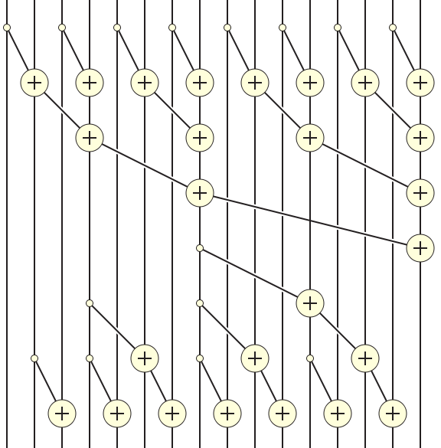
Putting it Together
Notes:
* The top is just a reduction tree
* The bottom is like a mirror of the reduction tree, it distributes partial sums in tree fashion
* Both top and bottom take log(n) steps
* Reduction tree takes n-1 operations, and we are doing it twice (once forward, once in reverse), so we do 2x as much work as the sequential algorithm
* This is the most efficient known scalable scan algorithm

Slide 21
Reduction Step Kernel Code
// scan_array[2*BLOCK_SIZE] is in shared memory
int stride = 1;
while(stride <= BLOCK_SIZE)
{
int index = (threadIdx.x+1)*stride*2 - 1;
if(index < 2*BLOCK_SIZE)
scan_array[index] += scan_array[index-stride];
stride = stride*2;
__syncthreads();
}
threadIdx.x+1 = 1, 2, 3, 4….
stride = 1, index =
Notes:
* Index calculation:
-- 1st step, want all odd indices (multiples of 2, minus 1) [mapping non-negative integers to odd integers]
-- 2nd step, want all multiples of 4, minus 1
-- …
* Add the element that is stride behind you in the array
* No double buffering needed, because in a round, any value is only used by one thread (look at previous slide to confirm)

Slide 22
Putting it together
Sum of left half
Notes:
* Partial sums get distributed to all following elements in tree fashion
* Partial sums get distributed to all the following elements that need them
-- e.g., the sum of the let half gets distributed to all elements in the right half

Slide 23
Post Scan Step
int stride = BLOCK_SIZE/2;
while(stride > 0)
{
int index = (threadIdx.x+1)*stride*2 - 1;
if((index+stride) < 2*BLOCK_SIZE)
{
scan_array[index+stride] += scan_array[index];
}
stride = stride/2;
__syncthreads();
}
Notes:
* Using the most efficient partial sums to update all the elements that come later (look at the picture)

Slide 24
(Exclusive) Prefix-Sum (Scan) Definition
Definition: The all-prefix-sums operation takes a binary associative operator ⊕, and an array of n elements
[x₀, x₁, …, x_{n-1}],
and returns the array
[0, x₀, (x₀ ⊕ x₁), …, (x₀ ⊕ x₁ ⊕ … ⊕ x_{n-2})].
Example: If ⊕ is addition, then the all-prefix-sums operation on the array [3 1 7 0 4 1 6 3],
would return [0 3 4 11 11 15 16 22].
Notes:
* Inclusive scan told where to cut the sandwich – exclusive scan gives the beginning location of sandwich segment
* For memory allocation, exclusive scan gives beginning of allocated memory chunks (pointers to allocated memory chunks)

Slide 25
Why Exclusive Scan
To find the beginning address of allocated buffers
Inclusive and Exclusive scans can be easily derived from each other; it is a matter of convenience
[3 1 7 0 4 1 6 3]
Exclusive [0 3 4 11 11 15 16 22]
Inclusive [3 4 11 11 15 16 22 25]
Notes:
* Easy to get exclusive scan from inclusive scan (shift and append zero)

Slide 26
Exclusive Post Scan Step
(Add-move Operation)
x₀
∑x_{0..}x₁
x₂
∑x_{0..}x₃
x₄
∑x_{4..}x₅
x₆
0
0
+
∑x_{0..}x₃
Notes:
* An elegant algorithm for exclusive scan
* We don’t need the final value, so we can put a zero and do add-move

Slide 27
Exclusive Post Scan Step
x₀
∑x_{0..}x₁
x₂
∑x_{0..}x₃
x₄
∑x_{4..}x₅
x₆
0
0
+
∑x_{0..}x₃
+
+
0
∑x_{0..}x₁
∑x_{0..}x₃
∑x_{0..}x₅
+
+
+
+
0
x₀
∑x_{0..}x₁
∑x_{0..}x₂
∑x_{0..}x₃
∑x_{0..}x₄
∑x_{0..}x₅
∑x_{0..}x₆
Notes:
* The zero propagates to the beginning of the array and the partial sums get distributed to the locations where they are needed

Slide 28
Exclusive Post Scan Step
if (threadIdx.x==0) scan_array[2*blockDim.x-1] = 0;
int stride = BLOCK_SIZE;
while(stride > 0)
{
int index = (threadIdx.x+1)*stride*2 - 1;
if(index < 2* BLOCK_SIZE)
{
float temp = scan_array[index];
scan_array[index] += scan_array[index-stride];
scan_array[index-stride] = temp;
}
stride = stride / 2;
__syncthreads();
}
Notes:
* index selects threads that will do the add-move operation
-- add-move is similar to a swap

Slide 29
Exclusive Scan Example – Reduction Step
T | 3 | 1 | 7 | 0 | 4 | 1 | 6 | 3
Assume array is already in shared memory

Slide 30
Reduction Step (cont.)
T | 3 | 1 | 7 | 0 | 4 | 1 | 6 | 3
Stride 1
Iteration 1, n/2 threads
T | 3 | 4 | 7 | 7 | 4 | 5 | 6 | 9
Each corresponds to a single thread.
Iterate log(n) times. Each thread adds value stride elements away to its own value

Slide 31
Reduction Step (cont.)
T | 3 | 1 | 7 | 0 | 4 | 1 | 6 | 3
Stride 1
T | 3 | 4 | 7 | 7 | 4 | 5 | 6 | 9
Stride 2
Iteration 2, n/4 threads
T | 3 | 4 | 7 | 11 | 4 | 5 | 6 | 14
Each corresponds to a single thread.
Iterate log(n) times. Each thread adds value stride elements away to its own value

Slide 32
Reduction Step (cont.)
T | 3 | 1 | 7 | 0 | 4 | 1 | 6 | 3
Stride 1
T | 3 | 4 | 7 | 7 | 4 | 5 | 6 | 9
Stride 2
T | 3 | 4 | 7 | 11 | 4 | 5 | 6 | 14
Stride 4
Iteration log(n), 1 thread
T | 3 | 4 | 7 | 11 | 4 | 5 | 6 | 25
Each corresponds to a single thread.
Iterate log(n) times. Each thread adds value stride elements away to its own value.
Note that this algorithm operates in-place: no need for double buffering

Slide 33
Zero the Last Element
T | 3 | 4 | 7 | 11 | 4 | 5 | 6 | 0
We now have an array of partial sums. Since this is an exclusive scan,
set the last element to zero. It will propagate back to the first element.

Slide 34
Post Scan Step from Partial Sums
T | 3 | 4 | 7 | 11 | 4 | 5 | 6 | 0

Slide 35
Post Scan from Partial Sums (contd.)
T | 3 | 4 | 7 | 11 | 4 | 5 | 6 | 0
Stride 4
Iteration 1
1 thread
T | 3 | 4 | 7 | 0 | 4 | 5 | 6 | 11
Each corresponds to a single thread.
Iterate log(n) times. Each thread adds value stride elements away to its own value,
and sets the value stride elements away to its own previous value.

Slide 36
Post Scan From Partial Sums (cont.)
T | 3 | 4 | 7 | 11 | 4 | 5 | 6 | 0
Stride 4
T | 3 | 4 | 7 | 0 | 4 | 5 | 6 | 11
Stride 2
Iteration 2
2 threads
T | 3 | 0 | 7 | 4 | 4 | 11 | 6 | 16
Each corresponds to a single thread.
Iterate log(n) times. Each thread adds value stride elements away to its own value,
and sets the value stride elements away to its own previous value.

Slide 37
Post Scan From Partial Sums (cont.)
T | 3 | 4 | 7 | 11 | 4 | 5 | 6 | 0
Stride 4
T | 3 | 4 | 7 | 0 | 4 | 5 | 6 | 11
Stride 2
T | 3 | 0 | 7 | 4 | 4 | 11 | 6 | 16
Stride 1
Iteration log(n)
n/2 threads
T | 0 | 3 | 4 | 11 | 11 | 15 | 16 | 22
Each corresponds to a single thread.
Done! We now have a completed scan that we can write out to device memory.
Total steps: 2 * log(n).
Total work: 2 * (n-1) adds = O(n) Work Efficient!
Notes:
* This is slower because it requires add-move rather than just add

Slide 38
Work Analysis
The parallel Inclusive Scan executes 2*log(n) parallel iterations
  log(n) for reduction and log(n) for post scan
  The iterations do n/2, n/4, …, 1, 1, …, n/4, n/2 adds
  Total adds: 2* (n-1) → O(n) work
The total number of adds is no more than twice that done in the efficient sequential algorithm
  The benefit of parallelism can easily overcome the 2X work when there is sufficient hardware
Notes:
* Even though we do 2x as many operations as in the sequential version, since we have a lot more than 2x the number of execution units, the parallel version will be faster

Slide 39
Working on Arbitrary Length Input
Build on the scan kernel that handles up to 2*blockDim.x elements
Assign each section of 2*blockDim elements to a block
Have each block write the sum of its section into a Sum array indexed by blockIdx.x
Run parallel scan on the Sum array
  May need to break down Sum into multiple sections if it is too big for a block
Add the scanned Sum array values to the elements of corresponding sections
Notes:
* Remember in reduction we had to reduce the block results – similar thing happens with scan
-- We need to scan the scan results, then we need to add the scanned sums back to the corresponding blocks

Slide 40
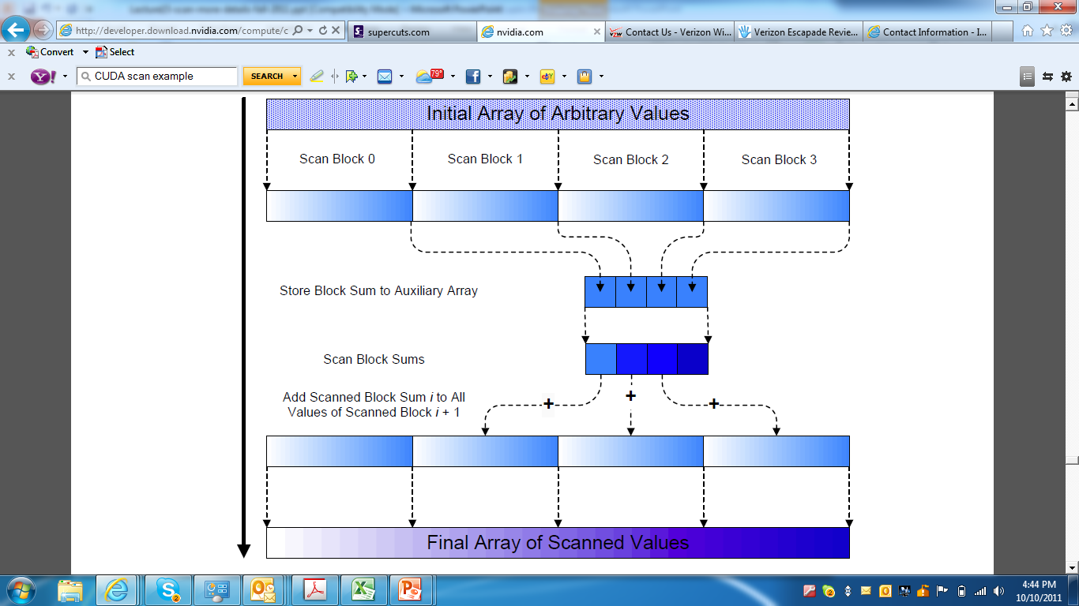
Overall Flow of Complete Scan
Notes:
* low-level scan
* high-level scan
* vector add

Slide 41
QUESTIONS?
READ CHAPTER 9 on Scan
(link also on Moodle)
Notes:
* 2nd edition of book has Chapter 9 on scan

