Slide 1
EE5351
Applied Parallel Programming
Convolution, Constant Memory, and Constant Caching
© David Kirk/NVIDIA and Wen-mei W. Hwu
ECE408/CS483/ECE498al University of Illinois, 2007-2011
Notes:
* Convolution, constant memory, and constant cache

Slide 2
Objective
To learn convolution, an important parallel computation pattern
  Widely used in signal, image, and video processing
  Foundational to stencil computation used in many science and engineering applications
Important techniques
  Taking advantage of cache memories

Slide 3
Convolution Applications
A popular array operation that is used in various forms in signal processing, digital recording, image processing, video processing, and computer vision
Convolution is often performed as a filter that transforms signals and pixels into more desirable values
  Examples:
  Some filters smooth out the signal values so that one can see the big-picture trend
  Others, like Gaussian filters, can be used to sharpen boundaries and edges of objects in images
Notes:
* convolution takes a weighted sum (scalar product) of a mask and the signal
-- mask gives the weights
* Examples:
-- 1D: filtering out noise in an audio file
-- 2D: detecting eyes or edges in an image
-- 3D: simulating heat transfer in metal object

Slide 4
Convolution Computation
An array operation where each output data element is a weighted sum of a collection of neighboring input elements
The weights used in the weighted sum calculation are defined by an input mask array, commonly referred to as the convolution kernel
  We will refer to these mask arrays as convolution masks to avoid confusion
  Typically, the same convolution mask is used for all elements of the array
Notes:
* To avoid confusion with the CUDA term kernel (the function that runs on the GPU), we will use the term mask, rather than kernel, to refer to the array of weights.

Slide 5
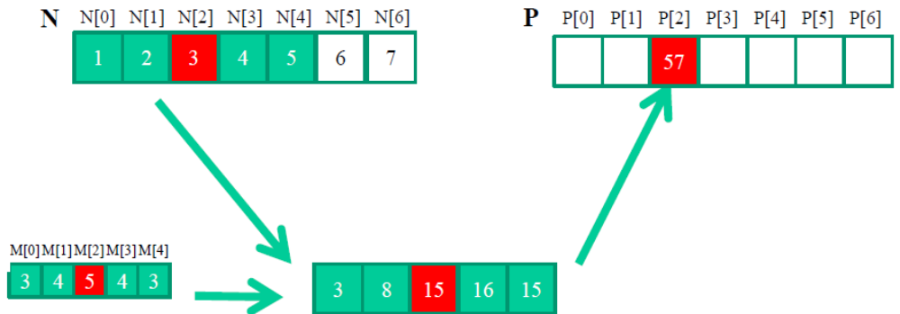
1D Convolution Example
Commonly used for audio processing
  Mask size is usually an odd number of elements for symmetry (5 in this example)
Calculation of P[2]
M
Notes:
* Go over examples of computing output elements on board
* What should the value of P[3] be? → 6+12+20+20+18 = 76

Slide 6
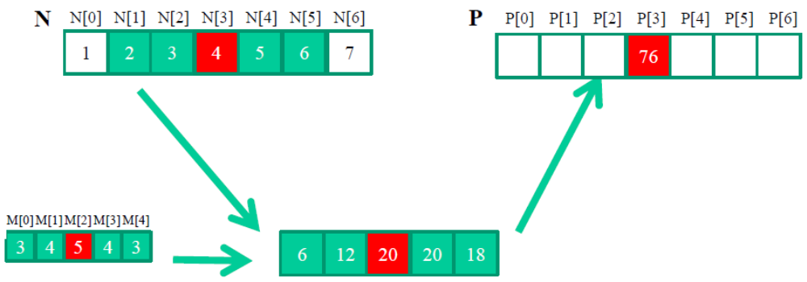
1D Convolution Example
(inside elements)
Calculation of P[3]
M

Slide 7
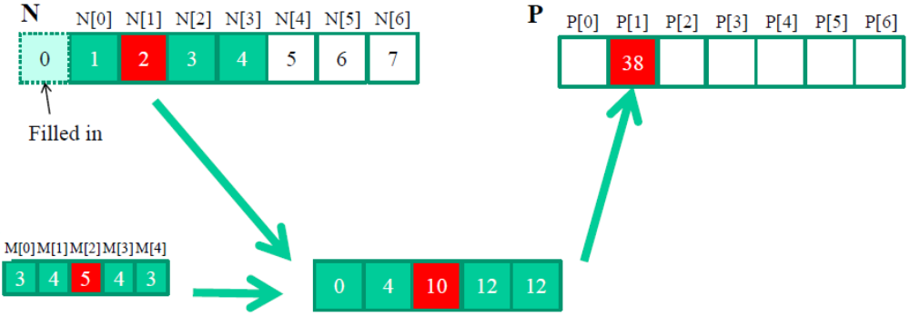
1D Convolution Boundary Condition
Calculation of output elements near the boundaries (beginning and end) of the input array need to deal with “ghost” elements
  Different policies (0, replicate boundary values, etc.)
M
Notes:
* What do we do for elements at the boundary, where mask hangs over the edge of the input signal?
-- How to treat ghost elements is application-dependent.
* Examples:
-- In audio processing, zeros could be used to denote that volume is zero outside of audio signal
-- In heat transfer, ambient temperature value could be used outside of object

Slide 8
A 1D Convolution Kernel with Boundary Condition Handling
This kernel forces all elements outside the input to 0
__global__ void convolution_1D_basic_kernel(float *N, float *M, float *P, int Mask_Width, int Width) {
int i = blockIdx.x * blockDim.x + threadIdx.x;
float Pvalue = 0.0;
int N_start_point = i - (Mask_Width/2);
for (int j = 0; j < Mask_Width; j++) {
if (N_start_point + j >= 0 && N_start_point + j < Width){
Pvalue += N[N_start_point + j]*M[j];
}
}
P[i] = Pvalue;
}
Notes:
* simple code for 1D convolution -- step through code
* What performance issues may we encounter with this code?
– Potential for divergence at boundaries of input array
-- limited by DRAM bandwidth (1 global memory access per 1 FLOP)
– We need to come up with optimizations to significantly reduce the global memory bandwidth usage

Slide 9
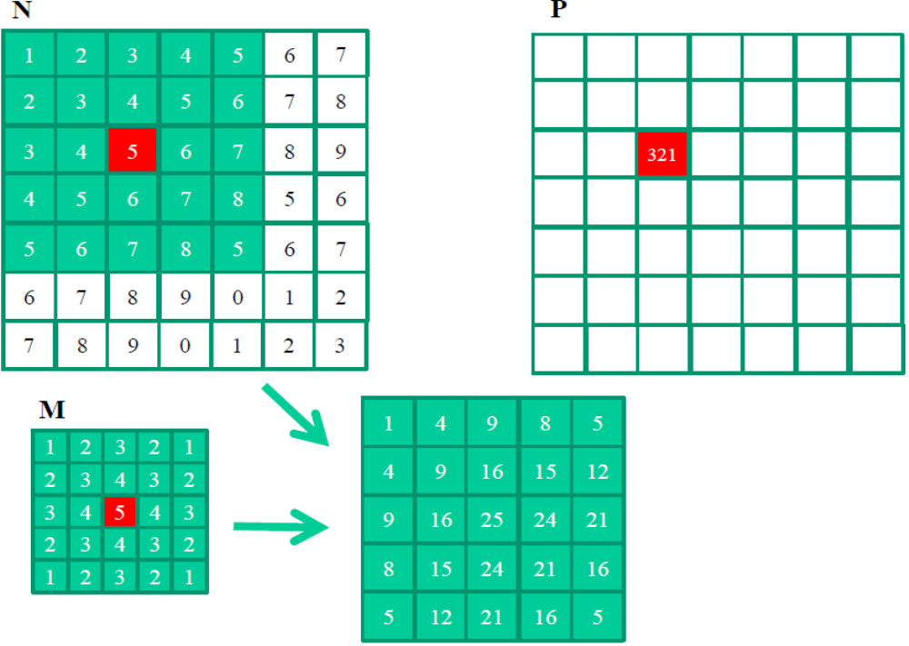
2D Convolution
Notes:
* Same concept in 2 dimensions
-- Center mask over computed location and take the scalar product of all overlapping elements with the mask
* Concept can also be extended to N dimensions – 3D is common

Slide 10
2D Convolution – Inside Cells
N
P
3
4
5
6
7
2
3
4
5
6
1
2
3
4
5
235
2
3
5
6
7
0
1
1
3
1
3
8
15
12
7
1
2
3
2
1
4
9
16
15
12
2
3
4
3
2
M
3
4
5
4
3
3
8
15
16
15
2
3
4
3
2
4
9
20
18
14
1
2
3
2
1
0
2
3
6
1

Slide 11

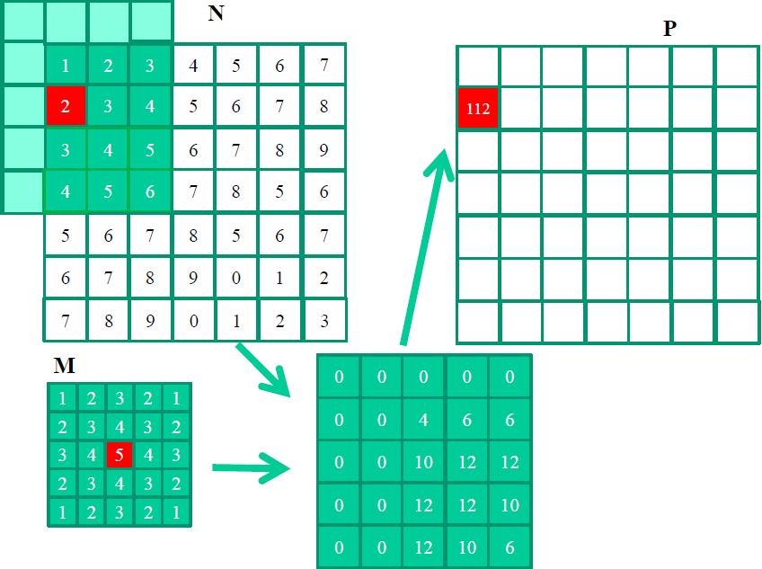
2D Convolution Boundary Condition
Notes:
* Near the boundary, where the mask goes past the edge of the input matrix, we multiply ghost elements with the mask
-- Here, ghost elements are assumed to be zero

Slide 12
2D Convolution – Ghost Cells
0
0
0
0
0
N
P
0
3
4
5
6
0
2
3
4
5
179
0
3
5
6
7
+
0
1
1
3
1
0
0
0
0
0
1
2
3
2
1
0
9
16
15
12
0
2
3
4
3
2
*
ghost cells
3
4
5
4
3
0
8
15
16
15
(apron cells, halo cells)
M
2
3
4
3
2
0
9
20
18
14
1
2
3
2
1
0
2
3
6
1
Notes:
* You might encounter many different names for what we refer to as ghost elements – halo cells, apron cells, …

Slide 13
Access Pattern for M
M is referred to as the convolution mask (a.k.a. kernel, filter, etc.)
  Elements of M are called mask coefficients
Calculation of all output P elements need M
M is not changed during entire kernel computation
Bonus – M elements accessed in the same order by all threads when calculating all P elements
M is a good candidate for Constant Memory
Notes:
* M never changes – constant for all threads
* M is accessed in same order by all threads – cacheable
→ good candidate for constant memory

Slide 14
Programmer View of CUDA Memories
(Review)
Each thread can:
  Read/write per-thread registers (~1 cycle)
  Read/write per-block shared memory
  (~5 cycles)
  Read/write per-grid global memory
  (~500 cycles)
  Read-only per-grid constant memory
  (~5 cycles with caching)
Grid
Block (0, 0)
Block (1, 0)
Shared Memory/L1 cache
Shared Memory/L1 cache
Registers
Registers
Registers
Registers
Thread (0, 0)
Thread (1, 0)
Thread (0, 0)
Thread (1, 0)
Host
Global Memory
Constant Memory
Notes:
* Constant memory can be R/W by host, but only read by device
* When we declare a device variable as constant, it will be cached when accessed by the SMs
-- Constant memory is a segment of the global memory that is cached locally on the SMs in the constant cache
* Look back at code – all mask values need to be accessed by every single thread
-- If we can get them from the cache instead of the global memory (DRAM), we will eliminate a LOT of long-latency, limited bandwidth global memory traffic

Slide 15
Memory Hierarchies
If every time we needed a piece of data, we had to go to main memory to get it, computers would take a lot longer to do anything
On today’s processors, main memory accesses take hundreds of cycles
One solution: Caches
Notes:
* How are caches used in CPUs?
* How are caches used in our GPU?

Slide 16
Cache
In order to keep cache fast, it needs to be small → cache cannot fit the entire data set
The chip
Processor
regs
L1 Cache
L2 Cache
Main Memory
Notes:
* Use analogy of backpack (cache) vs library (main memory)
-- All the books are in the library, but it takes a long time to go and get something from the library.
-- I can only fit a few books in my backpack, but it is quick to access them.
* Main memory – GBs of memory
-- L2$ -- 3-4 MB (regular CPU) up to 16 MB (Server); 1MB in GPU
-- L1$ -- 16 kB up to 128 kB
-- L1$ on our GPU is configurable between 16 and 48 kB
* caches are small compared to main memory because they need to fit on chip and they need to be fast
-- larger cache has longer, higher-capacitance / delay wires

Slide 17
Cache – Continued
Cache is unit of volatile memory storage
A cache is an array of cache lines
Cache line can usually hold data from several consecutive memory addresses
When data are requested from memory, an entire cache line is loaded into the cache, in an attempt to reduce main memory requests
Notes:
* volatile = memory loses state when power off
* Remember DRAM burst? – burst fills one cache line of 64-128 B
* Why do we access cache at granularity of entire cache line?
-- long latency to access memory, so we burst out entire line to amortize access cost
-- spatial locality – neighboring elements may get used around the same time
-- checking whether element is in cache uses tag store CAM, and tag for each word in cache would be expensive in performance, area, and power, so we use one tag per cache line

Slide 18
Caches – Continued
Some definitions:
  Spatial locality: is when the data elements stored in consecutive memory locations are accessed consecutively
  Temporal locality: is when the same data element is access multiple times in a short period of time
Caches exploit both spatial locality and temporal locality
Notes:
* Spatial locality in CPU -- think of loop that iterates over consecutive array elements
* Temporal locality in CPU – think of mask in convolution
* In GPU, spatial locality should be within warp – threads in same warp access elements on same cacheline
* In GPU, best temporal locality is multiple threads in a warp accessing element at same time
* In convolution, all threads access SAME ELEMENTS in the SAME ORDER
-- This pattern exhibits both spatial and temporal locality

Slide 19
Scratchpad vs. Cache
Scratchpad (shared memory in CUDA) is another type of temporary storage used to relieve main memory contention
In terms of distance from the processor, scratchpad is similar to L1 cache
Unlike cache, scratchpad does not necessarily hold a copy of data that is in main memory
Scratchpad requires explicit data transfer instructions; cache doesn’t
Notes:
* What is the scratchpad in our GPU? → shared memory
* What is the difference between scratchpad and cache?
→ Cache is transparent (HW-controlled); scratchpad is SW-controlled

Slide 20
Cache Coherence Protocol
A mechanism for caches to propagate updates by their local processor to other caches (processors)
The chip
Processor
Processor
Processor
…
regs
regs
regs
L1 Cache
L1 Cache
L1 Cache
Main Memory
Notes:
* Cache coherence deals with keeping local copies of a value coherent in a shared memory system
* Analogy:
-- what if I open multiple editors with the same file and make changes to each?
-- Have you ever used CVS (coherence) or RCS (token/lock)?
* Common cache coherence protocol is MESI

Slide 21
CPU and GPU have different caching philosophies
CPU L1 caches are usually coherent
  L1 is also replicated for each core
  Even data that will be modified can be cached in L1
  Updates to local cached copy invalidate (or less commonly, update) copies in other caches
  Expensive in terms of hardware and disruption of services
GPU L1 caches are usually incoherent
  Do not cache data that will be modified
Notes:
* In GPU, only constant data is cached in the L1 constant cache
-- This is because GPU L1 constant caches are incoherent
→ changes to data made in one cache would not be propagated to other cached copies of the same data

Slide 22
How to Use Constant Memory
Host code allocates and initializes variables the same way as any other variables that need to be copied to the device
Use cudaMemcpyToSymbol(dest,src,size)
to copy a global variable into device memory
This copy function tells the device that the variable will not be modified by the kernel and thus, can be safely cached
Notes:
* Constant memory is declared at global scope, outside of the kernel function
* Constants don’t need to be re-declared in the kernel function – they have global scope
* __constant__ or const __restrict__ keyword can be used to declare constant memory

Slide 23
More on Constant Caching
Each SM has its own L1 cache
  Low latency, high bandwidth access by all threads
L1 also has broadcast mechanism
However, there is no way for threads in one SM to update the L1 cache in other SMs
  No L1 cache coherence
Grid
Block (0, 0)
Block (1, 0)
Shared Memory/L1 cache
Shared Memory/L1 cache
Registers
Registers
Registers
Registers
Thread (0, 0)
Thread (1, 0)
Thread (0, 0)
Thread (1, 0)
Host
Global Memory
Constant Memory
No cache coherence is not a problem if a variable is NOT modified by a kernel
© David Kirk/NVIDIA and Wen-mei W. Hwu ECE408/CS483/ECE498al University of Illinois, 2007-2011
Notes:
* L1 cache has broadcast mechanism – if threads in same warp use the same value, it gets loaded once and broadcasted to all threads
-- This can save up to (warp size – 1) loads from global memory
-- This type of access pattern is used when accessing the mask in convolution

Slide 24
Some Header File Stuff for M
#define MASK_SIZE 5
// Matrix Structure declaration
typedef struct {
unsigned int width;
unsigned int height;
unsigned int pitch;
float* elements;
} Matrix;
Notes:
* You have seen this struct in your MPs
* pitch refers to the actual width between lines in the matrix – this can be used to ensure coalescing by ensuring that matrix lines do not cross cache line boundaries
-- Show picture with pitch being cache line size and matrix width being a smaller size

Slide 25
AllocateMatrix
// Allocate a device matrix of dimensions height*width
// If init == 0, initialize to all zeros.
// If init == 1, perform random initialization.
// If init == 2, initialize matrix parameters, but do not allocate memory
Matrix AllocateMatrix(int height, int width, int init)
{
Matrix M;
M.width = M.pitch = width;
M.height = height;
int size = M.width * M.height;
M.elements = NULL;
Notes:
* Note that size might have been pitch * height if pitch is different from width

Slide 26
AllocateMatrix (Cont.)
// don't allocate memory on option 2
if(init == 2) return M;
M.elements = (float*) malloc(size*sizeof(float));
for(unsigned int i = 0; i < M.height * M.width; i++)
{
M.elements[i] = (init == 0) ? (0.0f) :
(rand() / (float)RAND_MAX);
if(rand() % 2) M.elements[i] = -1.0*M.elements[i];
}
return M;
}

Slide 27
Host Code
// global variable, outside any function
__constant__ float Mc[MASK_SIZE][MASK_SIZE];
…
// allocate N, P, initialize N elements, copy N to Nd
Matrix M;
M = AllocateMatrix(MASK_SIZE, MASK_SIZE, 1);
// initialize M elements
….
cudaMemcpyToSymbol(Mc, M.elements,
MASK_SIZE*MASK_SIZE*sizeof(float));
ConvolutionKernel<<<dimGrid, dimBlock>>>(Nd, Pd);
Notes:
* No need to pass the mask pointer in kernel parameters, because it is a global variable
* Eliminate 99% of global memory accesses because of all the reuse of the mask data
* on newer CUDA GPUs, use const __restrict__, otherwise limited to 64kB of constant memory
-- __restrict__ tells compiler that a variable won’t be aliased (e.g., int * a; int * c = a;) → aliased variable could be modified through the alias
-- const __restrict__ allows newer GPU to put data that is guaranteed not to be modified into a read-only data cache
-- see section on Read-only Data Cache in CUDA Programming Guide: http://docs.nvidia.com/cuda/kepler-tuning-guide/#read-only-data-cache

Slide 28
QUESTIONS?
MP2 due tonight
MP3 released today
READ CHAPTER 8
Notes:
* How can we apply tiling to convolution?
-- Load block plus ghost elements

