Slide 1
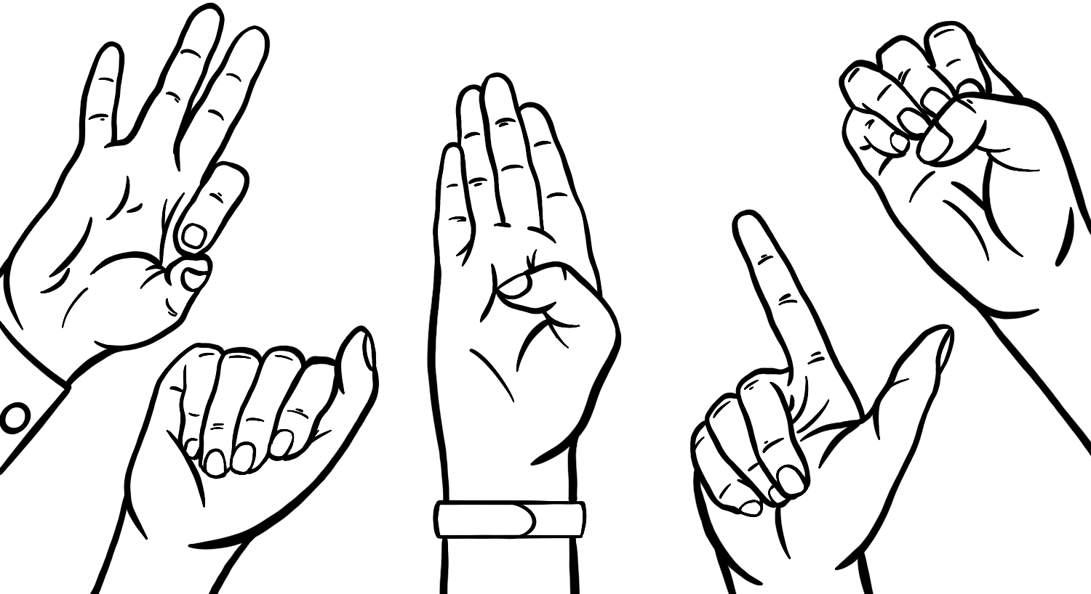
Sign Language Recognition for Deaf and Hard of Hearing Communication with Real-Time Detection and Translation of the American Sign Language (ASL) Fingerspelling to Text
Presenter : Aniket Singla
Date : June 2024
Institution : LIVERPOOL JOHN MOORes UNIVERSITY

Slide 2
Introduction
Background of the Study
Communication Challenges:
Individuals who are deaf or hard of hearing face significant communication barriers.
Most people do not know sign language, making everyday interactions difficult.
Statistics on the global DHH population.
Importance of Fingerspelling:
Fingerspelling is crucial for expressing specific names, technical terms, and proper nouns.
Essential component of American Sign Language (ASL) that requires precise interpretation.

Slide 3
Problem Statement
There is a significant gap in the availability of accurate ASL fingerspelling recognition systems due to challenges like variations in handshapes and gestures. This research aims to develop a robust recognition system using advanced machine learning techniques to improve communication accessibility for the Deaf and Hard of Hearing community.
Current Solutions :
Existing sign language recognition systems lack accuracy and speed.
Challenges with environmental conditions and hand positions.
Need for a reliable system for translating ASL fingerspelling to text.
Difficulty in real-time interpretation of ASL fingerspelling.
Need for Improvement :
A reliable system is needed to translate ASL fingerspelling into text.
The system must handle varying environmental conditions and different hand positions

Slide 4
Aim & Objective
Aim :
Develop a robust, accurate, and user-friendly sign language recognition system.
Objective :
Algorithm Development: Create algorithms for accurate fingerspelling recognition.
Real-Time Performance: Optimize the system for real-time performance.
Accuracy Enhancement: : Improve the accuracy of recognition.
Feature Engineering: Conduct thorough feature engineering to improve model performance.
Evaluate system performance through user studies.

Slide 5
Literature Review - Sign Language Recognition
Sign Language and ASL:
Sign language is crucial for communication in the Deaf and Hard of Hearing (DHH) community.
American Sign Language (ASL) is one of the most prominent sign languages used globally.
Technological Advancements:
Early recognition systems required substantial human intervention.
Introduction of computer vision and AI advanced the field significantly.
Key Milestones:
Early efforts: Manual recognition systems with limited accuracy.
Integration of machine learning algorithms in the late 20th century.
Emergence of deep learning techniques, especially CNNs, for improved accuracy.
Shift towards real-time recognition systems to enhance accessibility.

Slide 6
Machine Learning in Sign Language Recognition
Role of ML in Enhancing Recognition Systems:
Machine learning enables models to learn and adapt to complex gestures.
Early approaches: Support Vector Machines (SVMs) and k-Nearest Neighbors (KNN).
Deep Learning Techniques:
Convolutional Neural Networks (CNNs): Extract hierarchical features from image data.
Recurrent Neural Networks (RNNs) and Long Short-Term Memory (LSTM): Model temporal dependencies in gesture sequences.
Recent Advancements:
Transfer Learning: Uses pre-trained models to improve performance with limited data.
Data Augmentation and Synthetic Data Generation: Address dataset limitations.
Integration of Transformers: Utilize self-attention mechanisms for improved accuracy in recognizing complex hand movements.

Slide 7
RESEARCH METHODOLOGY
Systematic Approach:
Conceptualization to Evaluation: Detailed design process for reliable ASL fingerspelling recognition.
Multidisciplinary Framework: Combines insights from linguistics, computer vision, and machine learning.
Key Methodologies:
Transformer Models: Used for handling sequential data and capturing long-range dependencies.
Data Collection:
Source: Public repository with video recordings of ASL gestures.
Format:
Video Frames: Segmented to capture temporal aspects.
Landmark Coordinates: Annotated key points on the signer's body.
Volume:
Training Set: Thousands of sequences.
Validation Set: Subset for hyperparameter tuning.
Test Set: Separate for unbiased evaluation.

Slide 8
Machine Learning in Sign Language Recognition
Role of ML in Enhancing Recognition Systems:
Machine learning enables models to learn and adapt to complex gestures.
Early approaches: Support Vector Machines (SVMs) and k-Nearest Neighbors (KNN).
Deep Learning Techniques:
Convolutional Neural Networks (CNNs): Extract hierarchical features from image data.
Recurrent Neural Networks (RNNs) and Long Short-Term Memory (LSTM): Model temporal dependencies in gesture sequences.
Recent Advancements:
Transfer Learning: Uses pre-trained models to improve performance with limited data.
Data Augmentation and Synthetic Data Generation: Address dataset limitations.
Integration of Transformers: Utilize self-attention mechanisms for improved accuracy in recognizing complex hand movements.

Slide 9
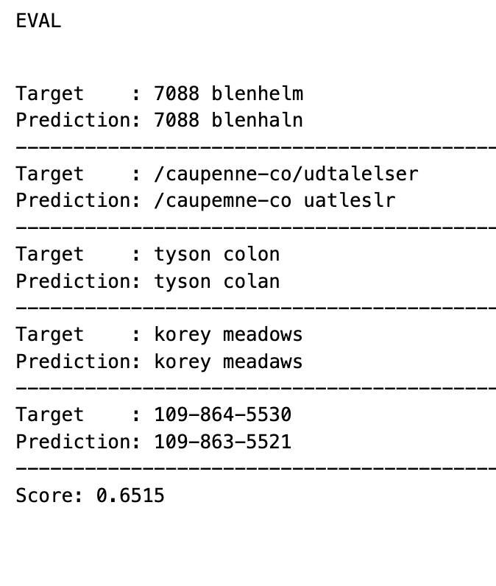
Results & Discussion
Baseline Model Results
Initial accuracy and performance metrics.
Challenges identified.
Performance of simple architectures with CTC.
Key limitations and areas for improvement.

Slide 10
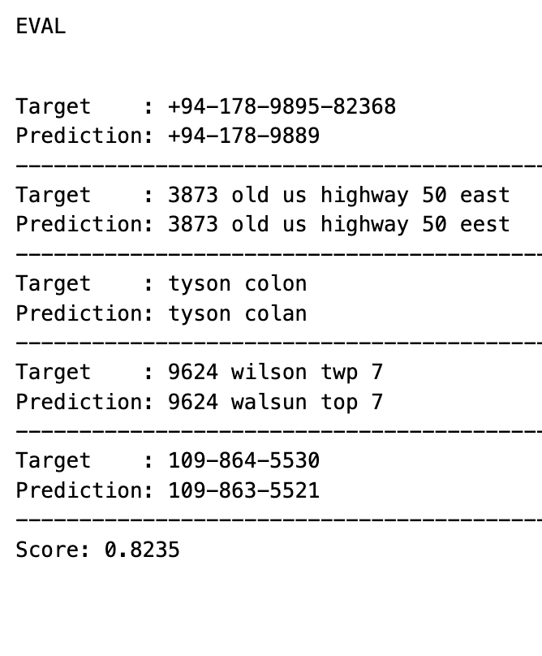
Enhanced Model Results
Improvements with deeper and wider models.
Integration of attention mechanisms.
Detailed analysis of enhanced model performance.
Impact of advanced architectures on accuracy and robustness.

Slide 11
Ensemble Learning and Advanced Decoding
Use of ensemble learning.
Joint decoding with CTC and attention mechanisms.
Comparative performance of ensemble methods.
Benefits of combining multiple models.

Slide 12
Performance Analysis
Comparison of models using various metrics.
User study results.
Detailed analysis of user feedback and satisfaction.
Summary of key performance indicators.
Model | Throughput (iterations/s) | Latency (ms) | Normalized Total Levenshtein Distance
CTC-Greedy | 20.14 | 49.66 | 0.807
ATT-Greedy | 10.16 | 98.42 | 0.808
CTC-ATT-Joint Greedy | 5.26 | 190.22 | 0.812
CTC-ATT-Joint Greedy -2xseed | 2.71 | 368.95 | 0.817
CTC-ATT-Joint Greedy -3xseed | 1.75 | 570.77 | 0.819

Slide 13
Conclusion & Future Recommendations
Summary of findings.
Impact on communication accessibility for the DHH community.
Key achievements and contributions.
Broader implications for assistive technology.

Slide 14
Future Recommendations
Expanding the system to other sign languages.
Continuous improvement with larger datasets.
Addressing ethical considerations in data use.
Exploring integration with wearable devices.
Potential for commercial application and deployment.

