Slide 1
SYNTHESIS OF SIGMOID FUNCTION USING PIECEWISE SECOND-ORDER APPROXIMATION
Project Mentor:
Group Members:
Dr. Prasanna Kumar Misra
Assistant Professor Department of ECE, IIIT Allahabad
VIVEK RAJ (IEC2017002)
RITIK RANJAN (IEC2017005)
ANIKET DUKARE (IEC2017058)

Slide 2
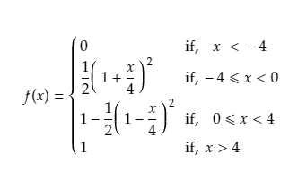
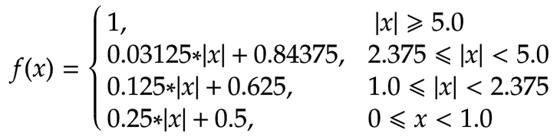
Methods of Approximation of Sigmoid function
Piecewise Linear Approximation
Piecewise Second Order Approximation
Approximation | Max error (%) | Mean error (%)
Piecewise Linear | 2.04 | 1.08
Piecewise NonLinear | 1.22 | 0.78

Slide 3
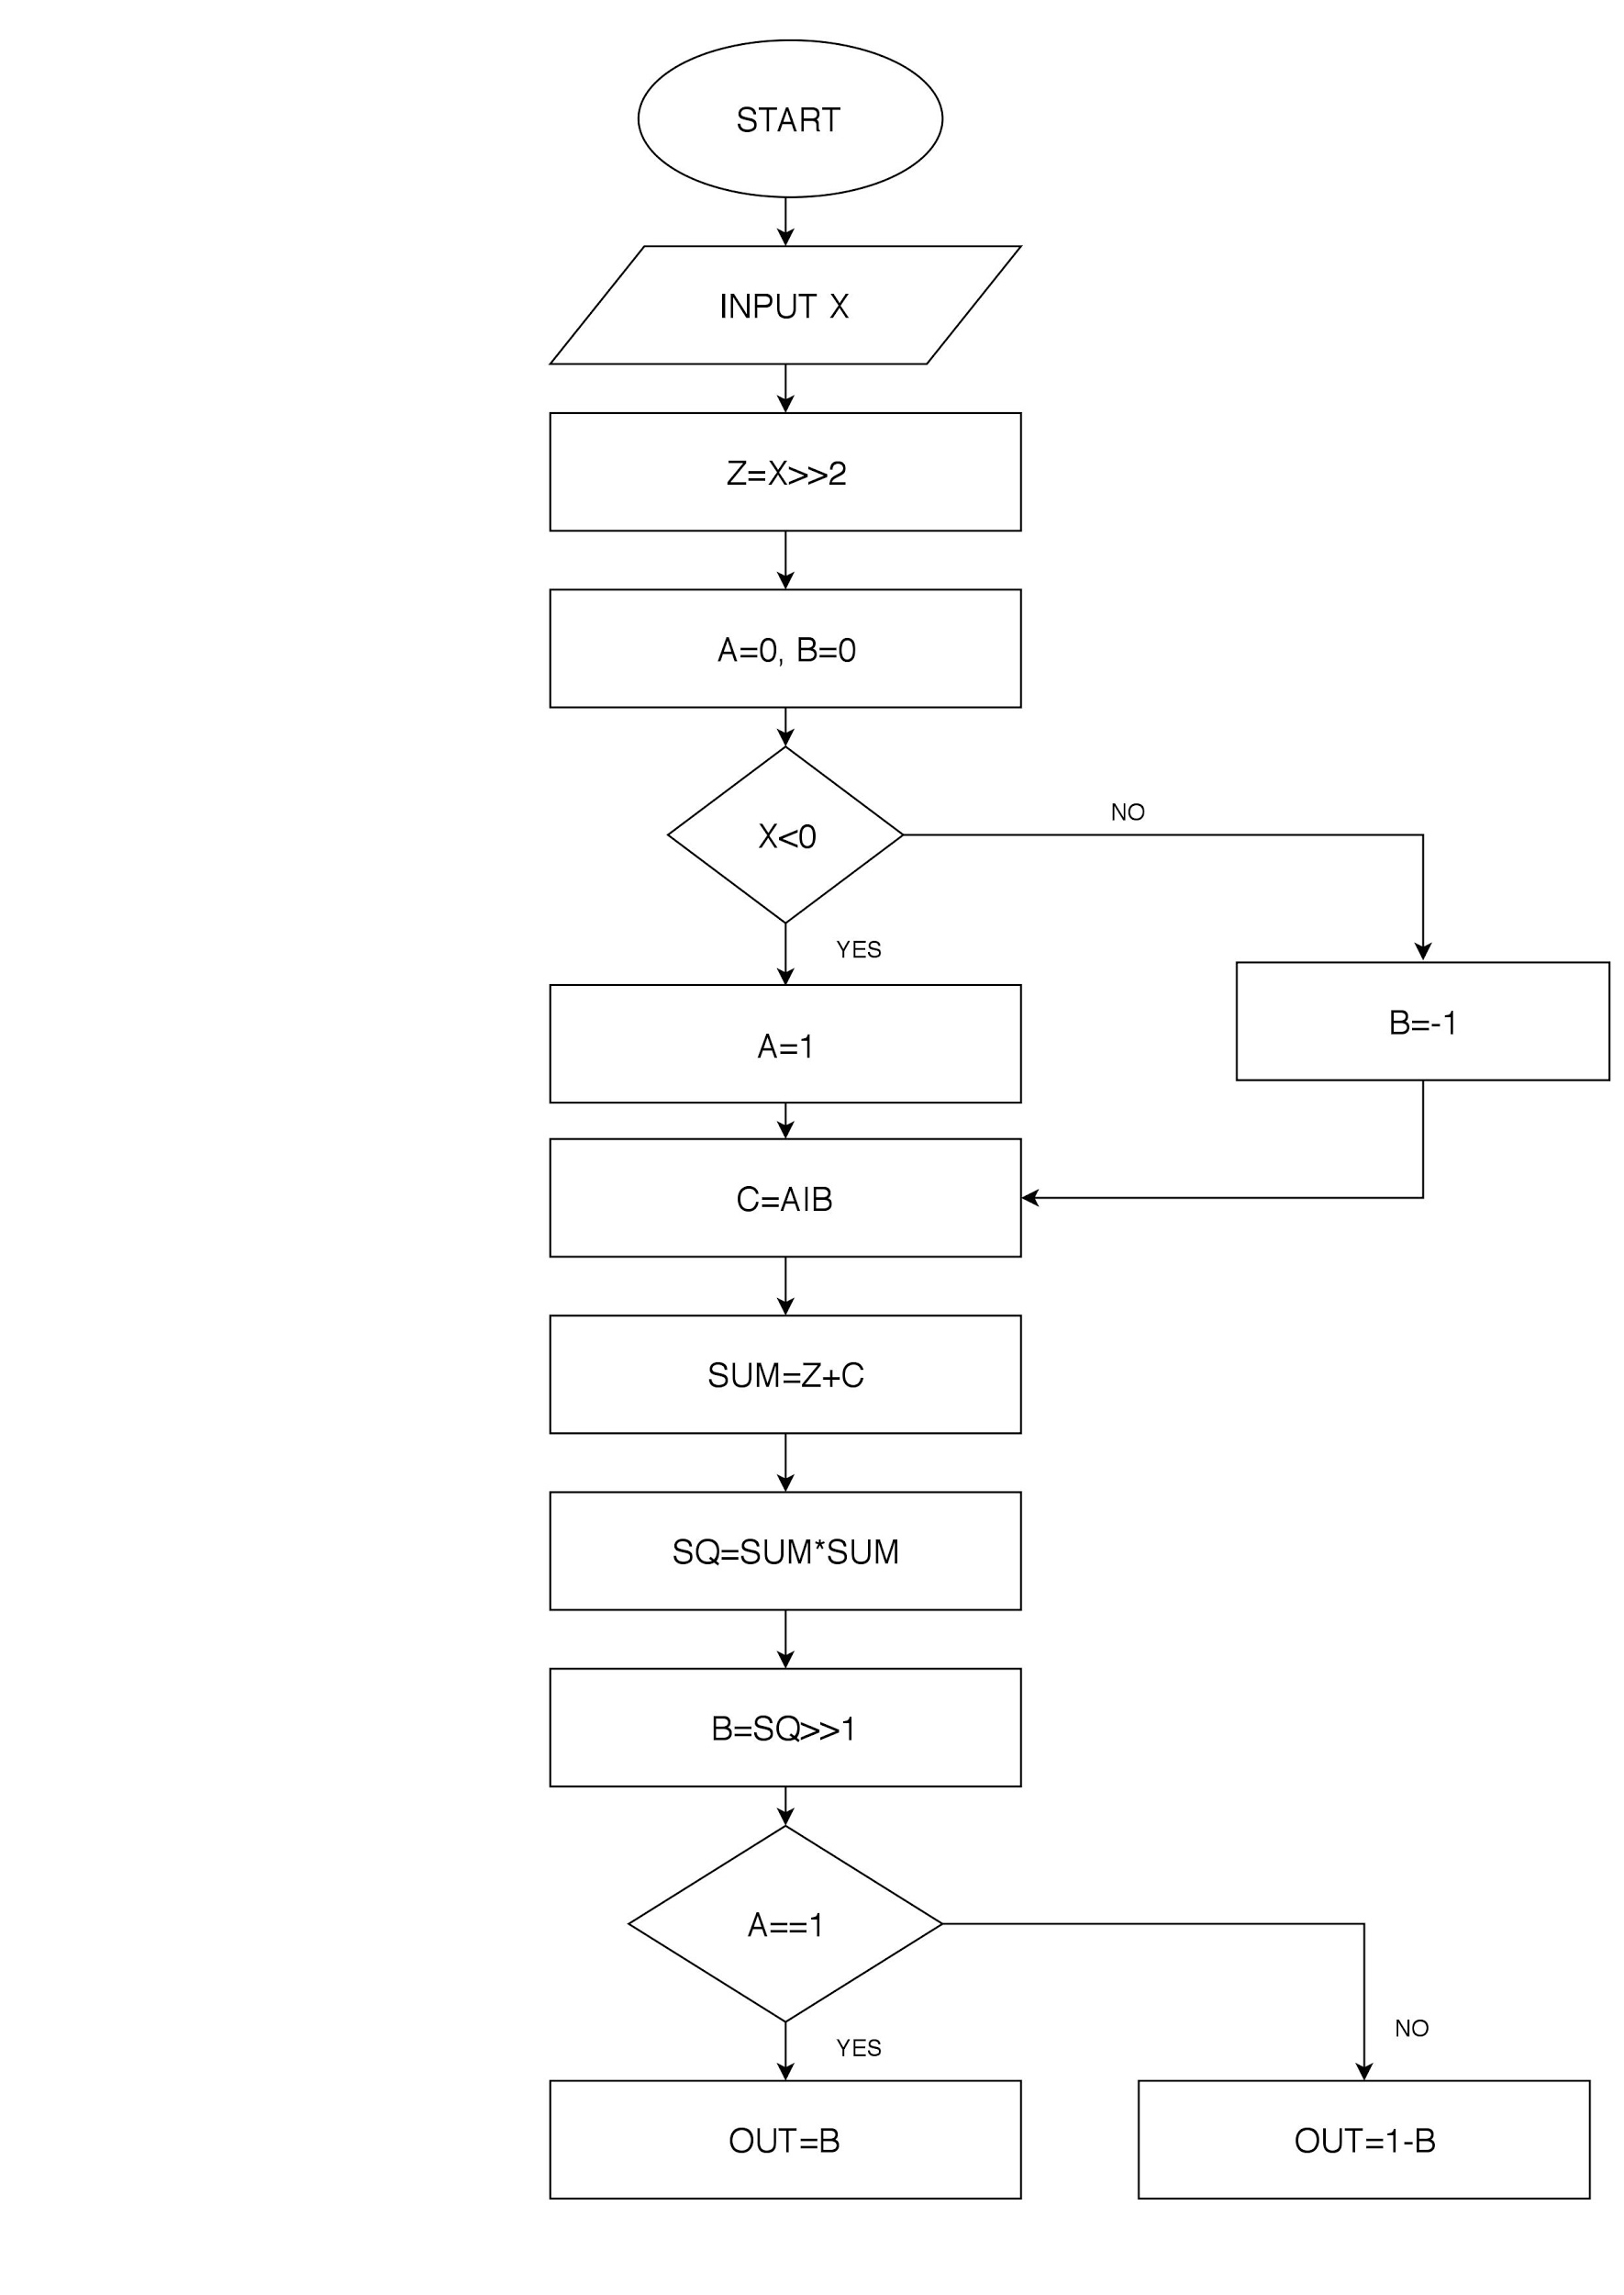
ALGORITHM

Slide 4
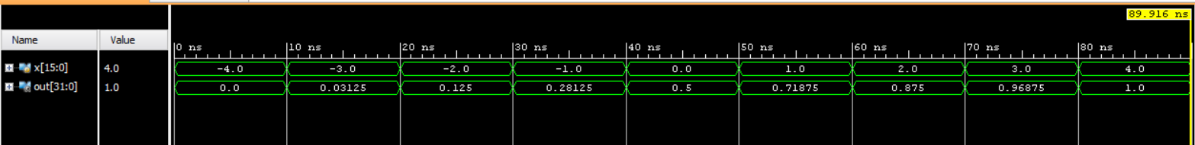
SIMULATIONS RESULT
X(INPUT) | Result (Output) | Actual Output
-3 | 0.03125 | 0.047
-2 | 0.125 | 0.119
-1 | 0.28125 | 0.269
1 | 0.71875 | 0.731
3 | 0.96875 | 0.9526
4 | 1.0 | 1

Slide 5
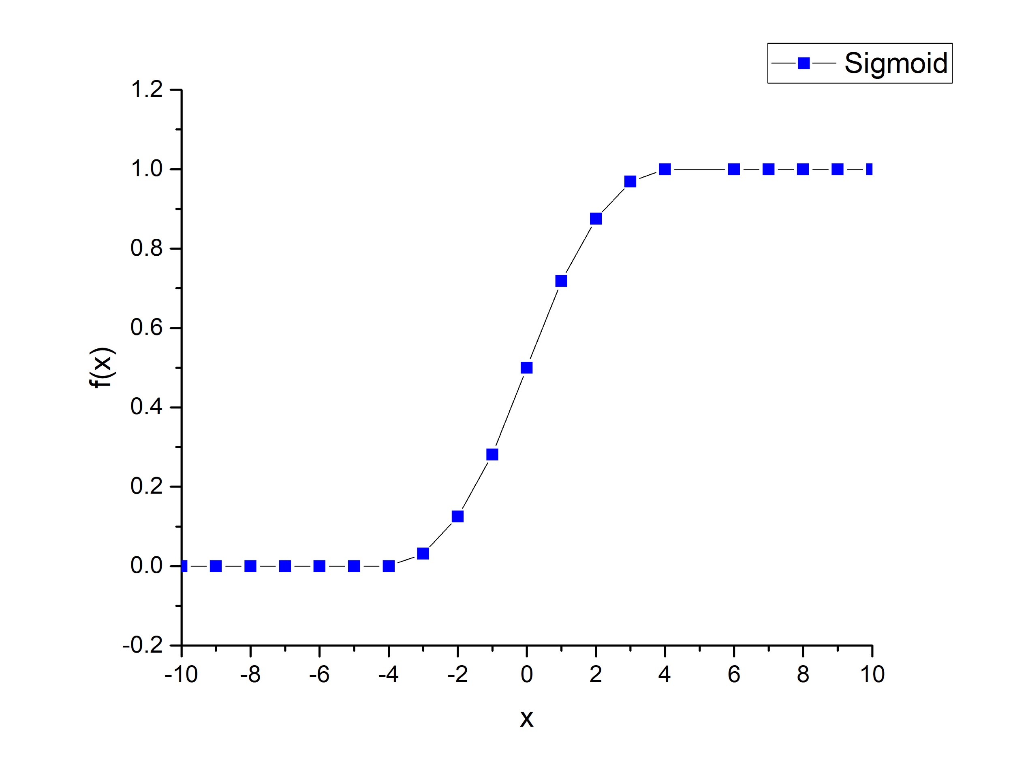
POWER AND AREA (GENUS RESULTS)
Total Cells | Dynamic power(nw) | Total Power(mW) | Total Area(m^2) | Power(mW)
748 | 10.885 | 0.639744229 | 0.015486480 | 0.639755114
ORIGIN PLOT

Slide 6
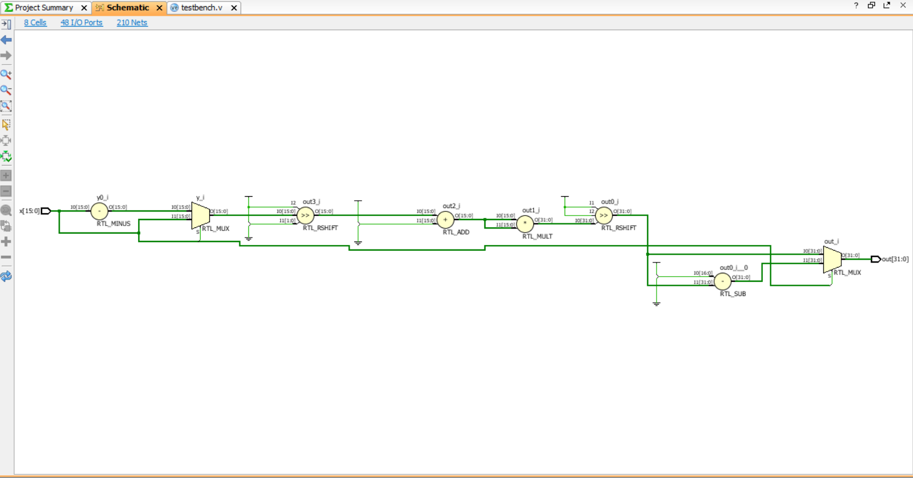
RTL SCHEMATIC

Slide 7
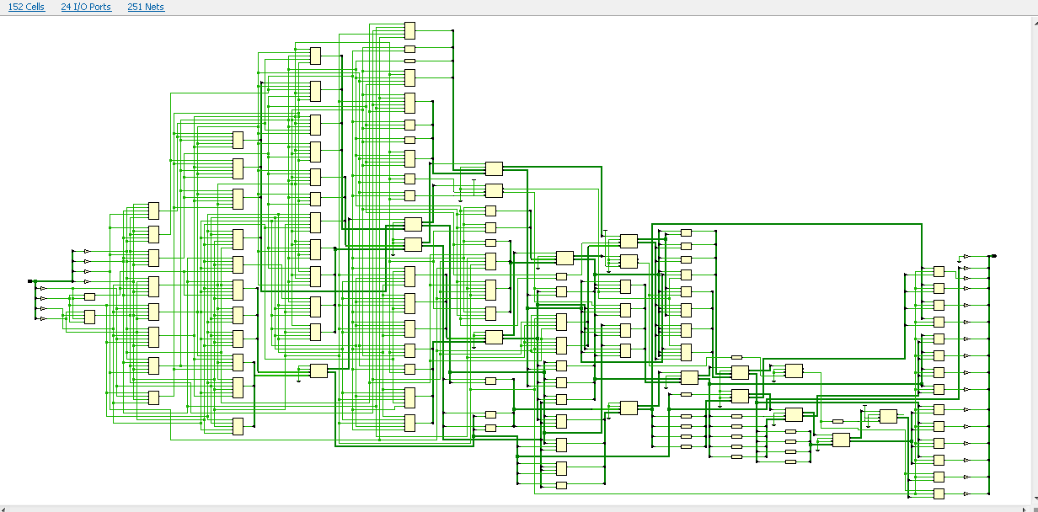
RTL NETLIST

Slide 8
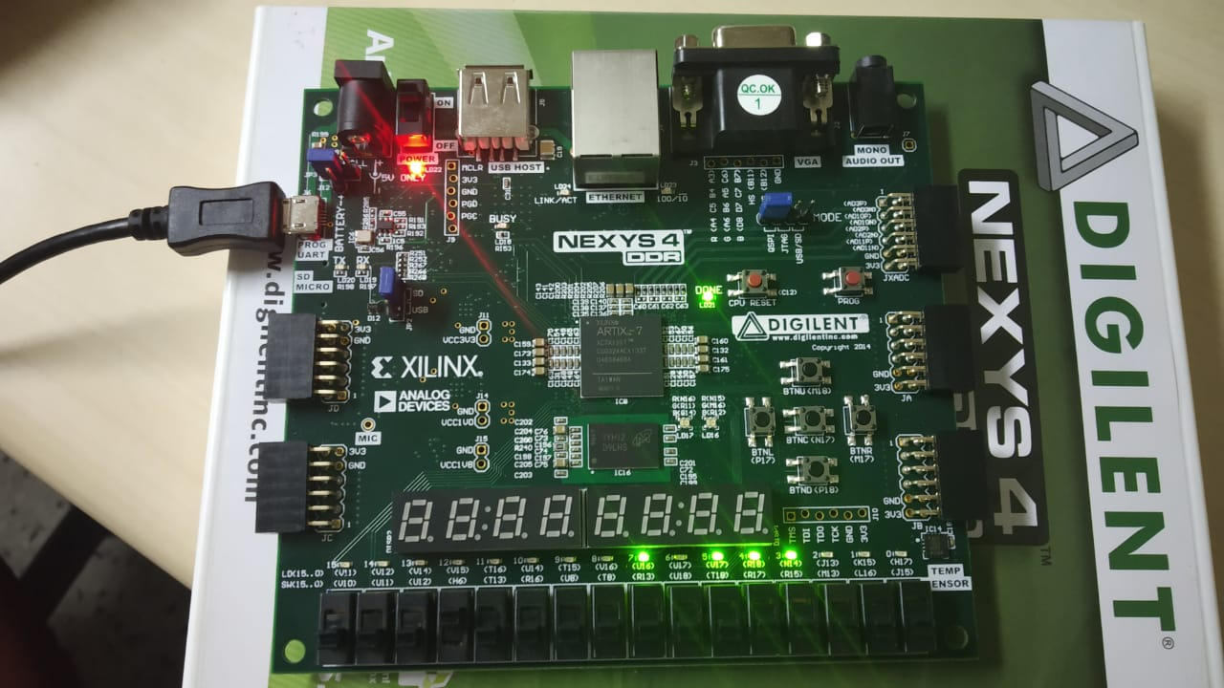
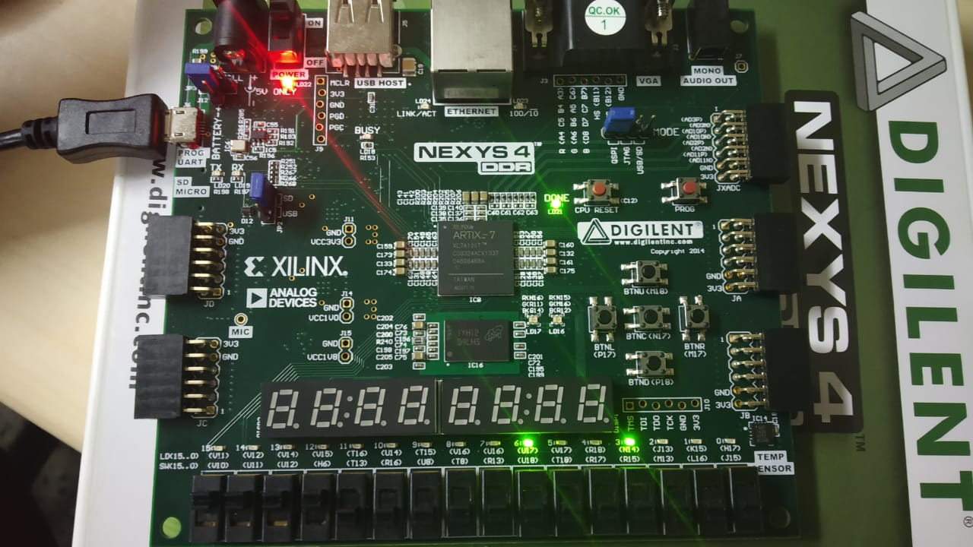
FPGA RESULTS
X=1
X=-1

Slide 9
ADVANTAGES
The proposed method avoids the use of exponential function.
This algorithm provides high performance with minimum power consumption as compared to first order approximation.
Most accurate results are produced by this approximated algorithm with low implementation cost.
LIMITATIONS
This method requires use of one multiplier .
Number of gates required is more as compared to piecewise linear model.

Slide 10
REFERENCES
[1].DIGITAL IMPLEMENTATION OF THE SIGMOID FUNCTION FOR FPGA CIRCUITS Alin TISAN, Stefan ONIGA, Daniel MIC, Attila BUCHMAN Electronic and Computer Department, North University of Baia Mare, Baia Mare, Romania Str. Dr. Victor Babeş, nr. 62A, tel. 0362-401265 ext. 234, alin.tisan@ubm.ro
[2].Syahrulanuar Ngah, Rohani Abu Bakar”Sigmoid Function Implementation Using the Unequal Segmentation of Differential Lookup Table and Second Order Nonlinear Function” Vol 9, No 2-8 page no.-103-108
[3].Ashkan Hosseinzadeh Namin, Karl Leboeuf, Roberto Muscedere, Huapeng Wu, and Majid Ahmadi,”Efficient hardware implementation of the hyperbolic tangent sigmoid function” Publisher: IEEE Published in: 2009 IEEE International Symposium on Circuits and Systems
[4]. Zhang, M., et all.: “Sigmoid generators for neural computing using piecewise approximations”, IEEE Trans. Comput.,45,(9),pp. 1045–1049, 1996.

