Slide 1
Customer Spending Prediction
Machine Learning Project | Regression | Streamlit Dashboard

Slide 2
Problem Statement
Estimate customer spending from available demographic and purchase-behaviour attributes.
Use supervised regression because spending is a continuous numeric target.
Build a reproducible pipeline and a simple interactive dashboard.

Slide 3
Dataset Overview
1,000 records and 8 columns in the supplied dataset.
Target: spending.
Inputs: age, gender, education, income, country, purchase_frequency.
Customer name is excluded from model features.

Slide 4
Data Cleaning & Preparation
Trim whitespace and standardize blank text values as missing.
Remove duplicate rows.
Impute missing numeric values with median and categorical values with mode.
One-hot encode categorical features; split data 80/20 for train/test.

Slide 5
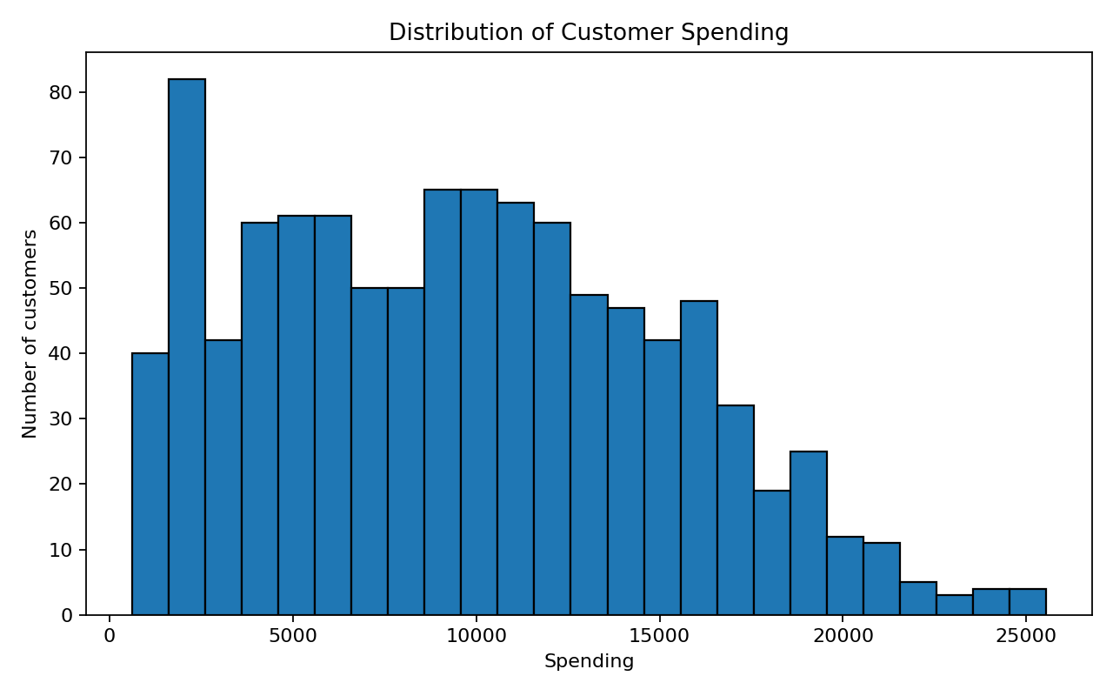
Exploratory Data Analysis: Spending
Spending distribution in the supplied dataset

Slide 6
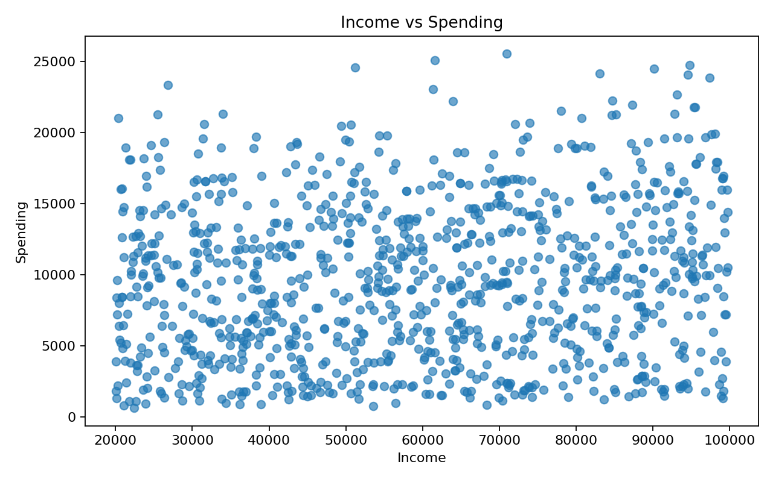
Exploratory Data Analysis: Income
Relationship between income and spending (association only)

Slide 7
Models Compared
Linear Regression
Ridge Regression
Random Forest Regressor
Extra Trees Regressor
HistGradientBoosting Regressor

Slide 8
Model Evaluation Results
Model | MAE | RMSE | R²
Hist Gradient Boosting | 269.01 | 385.76 | 0.995
Random Forest | 589.30 | 777.33 | 0.980
Extra Trees | 594.95 | 830.72 | 0.977
Ridge Regression | 1,007.12 | 1,318.98 | 0.942
Linear Regression | 1,097.94 | 1,439.45 | 0.931

Slide 9
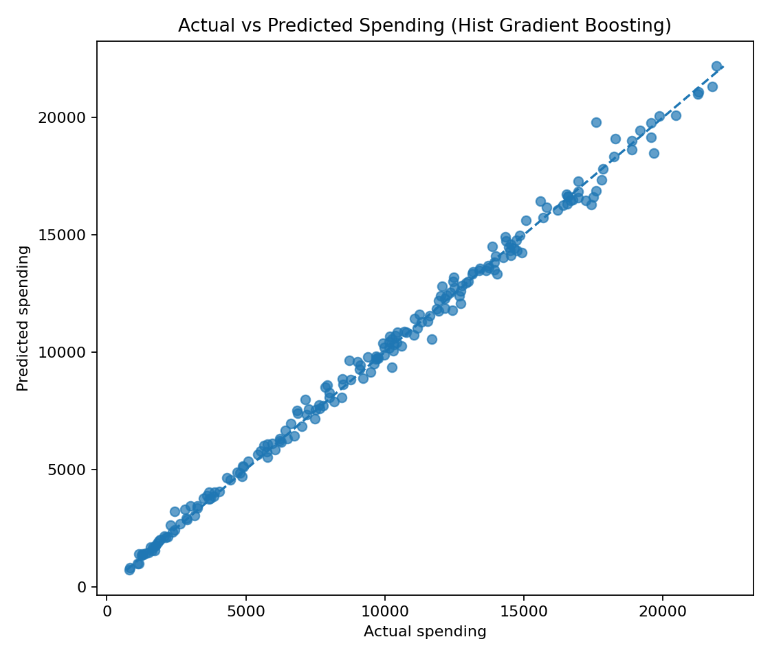
Actual vs Predicted
Selected model: Hist Gradient Boosting

Slide 10
Dashboard Demo
Tab 1: enter customer attributes and receive estimated spending.
Tab 2: browse dataset rows and EDA charts.
Tab 3: compare model metrics and inspect actual-versus-predicted values.
Launch using: streamlit run app.py

Slide 11
Limitations & Future Work
Verify dataset provenance and the meaning/units of purchase_frequency.
Results depend on the supplied data and may not generalize to real customers.
Correlation is not causation; predictions are estimates, not guarantees.
Future work: cross-validation, tuning, explainability and temporal validation.

Slide 12
Conclusion
Selected model by lowest test RMSE: Hist Gradient Boosting.
The project includes data cleaning, EDA, model comparison, saved model, report, and app.
This is an educational prototype; validate data and performance before real-world use.

