Slide 1
A Dynamic Load Balancing Mechanism For Multi-Core Operating System
This paper proposes a centralized global dynamic multi-core load balancing approach for multi core systems.

Slide 2
Balancing Decision Algorithm
1
Step 1
Rootserver traverses load of all cores.
2
Step 2
Calculate sum of time-slice sizes.
3
Step 3
Identify most and least loaded cores.
4
Step 4
Determine if task migration is needed.
5
Step 5
Select task with smallest time-slice size.
6
Step 6
Return task thread for migration.

Slide 3
Task Migration
Task Value Check
Task Migration Information
Inter-Core Task Migration
Check if task value returned is empty.
Parse task migration information.
Call inter-core task migration function.

Slide 4
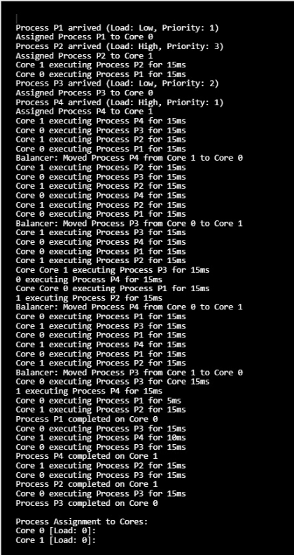
Performance Test
Round Robin Algorithm

Slide 5
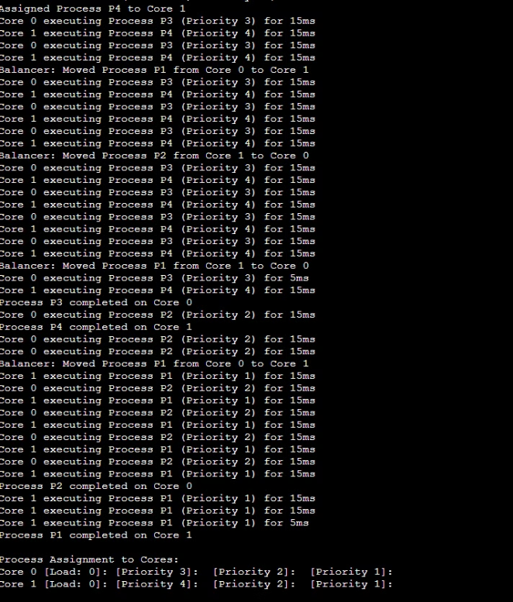
Priority Round Robin Algorithm

Slide 6
Dynamic Load Balancer Overview In XV6
Objective: Implement a dynamic load balancer in XV6 to optimize process allocation across multiple CPU cores.
Each core maintains its own process queue.
Tracks idle time of each core to facilitate process migration.
Load balancer function executed at fixed intervals.

Slide 7



Process Allocation and Execution
Process Allocation
Modified the allocproc() function to assign processes to cores in a round-robin fashion. Each process is assigned a unique core ID, ensuring a balanced distribution across available cores.
Execution Logic
Updated the scheduler() function to enforce the execution of a process only on its designated core. The scheduler checks if the current core's ID matches the process's core ID before allowing execution. If no runnable processes are found, the scheduler increments idle ticks, indicating a period of inactivity on the core.
Initialization
During CPU setup, the idle_ticks counter is set to zero in the mpmain() function. This ensures that the idle time measurement for each core starts from a clean slate.

Slide 8
Load Balancer Implementation
Load Balancer Function: Located in proc.c, called from the trap function during hardware interrupts. Only Core 0 invokes the load balancer to prevent race conditions.
Balancing Logic: Calculates average idle time across cores, determines the threshold for load balancing, identifies the most overloaded and underloaded cores, migrates processes from overloaded to underloaded cores if the difference exceeds the threshold, and resets idle_ticks for all cores post-load balancing to ensure fair monitoring.
Testing: Implemented one CPU-bound and one I/O-bound process to evaluate load balancing effectiveness. Added ps syscall for process status visibility.

Slide 9
Thank You!!

