Slide 1

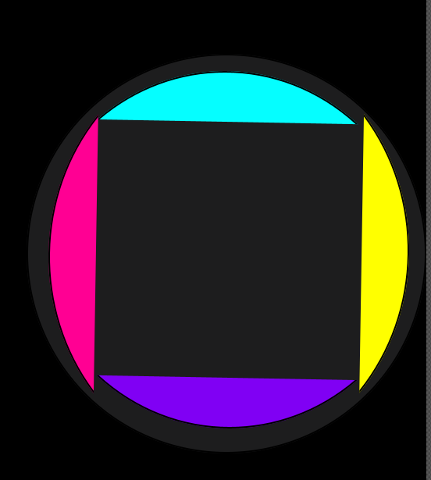



Advanced Programming Project
Triangular Obstacle
Circular Obstacle
Made by :- Aniket Verma 2019233
Mixed Shape Obstacle
Star
Play Button

Slide 2
Design And Implementation
The game is designed using Javafx libraries
It comprises of 3-4 obstacles,a ball, a star and a colorswitch circle
The ball jumps while mouse is clicked and the screen moves down as the game progresses
Used several design patterns using singleton design pattern and template design patterns
Each time a new score is set and you can claim rewards each time you play

Slide 3
Contributions and Work Done
Deadline 1:
Uml class and case diagram done by both Aniket and Siddharth.(1:1 work distribution)
Deadline 2:
The whole deadline was done by Aniket Verma
No work done by Siddharth Singh Kiryal (0%)
0%
0%
Deadline 3:
0% work done by Siddharth Singh Kiryal and the whole game developed by Aniket Verma
0%

Slide 4
Bonus Components Added
1) music added while playing the game and can be controlled by the user
2) Game is full of animations and giving the illusion that screen is moving down
3) user friendly functionalities that makes game much more interesting
4) options to save the game and load it again
5) game saved by logging in through different accounts

Slide 5
Thank you !
Made by Aniket Verma 2019233 (till Deadline 3) and Siddharth Singh Kiryal 2019277(till Deadline 1).

