Slide 1
Attention Is All You Need
Ashish Vaswani, Noam Shazeer, Niki Parmar, Jakob Uszkoreit, Llion Jones, Aidan N. Gomez, Lukasz Kaiser, and Illia Polosukhin
Reimplementation & Demo:
Aniket Pandey
Adel Alkhamisy

Slide 2
Motivation
In our NLP class we worked on Dialectal Question Answer using BERT which is based on this Transformer.
Breakthrough for NLP especially machine translation and state-of-art.
We admire the author Ashish Vaswani and his work.
Transformers were developed to solve the problem machine translation and sequence transduction, or neural machine translation... but they do so much more!
Great performance in computer vision like ViT (Dosovitskiy, 2020)
Image Classification (CoCa Transformer)
Semantic Segmentation (ex: FD-SwinV2-G Transformer)
Object Detection (ex: FD-SwinV2-G Transformer)

Slide 3
Context
What issue is the paper trying to solve?
Previous work RNN, LSTM, and GRU slow to train. Factorization trick helps but still slow.
Suffers from exploding and vanishing gradients.
Cannot handle very long-term dependency.
In Seq-Seq models, decoder only accesses last hidden state. Early information in sentence can be lost.
Question?
How would a RNN, LSTM, and GRU fill in the word mask?
Encode word inside cell state.
Transfer cell state from one word to another.
Decode word from previous cell state.
Definitely not ideal! There has to be a better way...

Slide 4
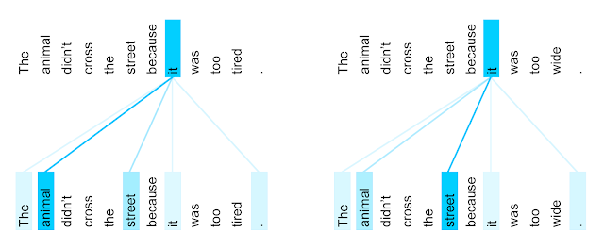
Self-Attention
Each element attends to every other element.
Each element becomes query, key, and value from the input embeddings by multiplying by a weight matrix.
Idea Behind Attention?
Learn how to pick relevant information from input data.
Create three vectors from each of encoder’s input value (query, key, value).
Calculate a score for how much to focus on each part of the input when we encode words at specific positions.
How? Actual math was covered in class lecture.
key | value
name | Quinn
position | quarterback
handedness | right
Keys and values
are actually word
embeddings,
not words.
Source: Google Blog

Slide 5
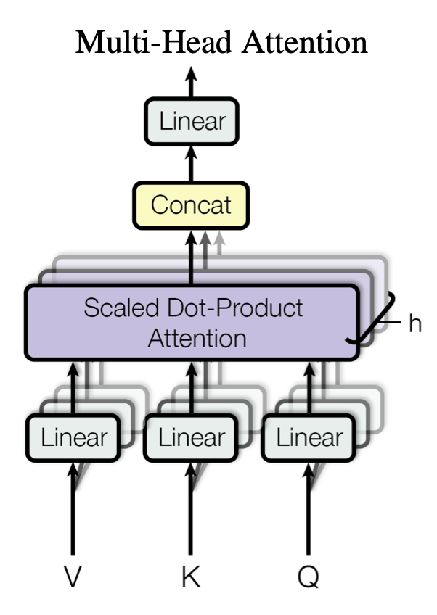
Multi-Head Attention
Idea:
Stack linear layers (weight matrices without biases) that are independent each for keys, queries, values.
Concatenate output of attention heads to form (plus non-linearity) output layer.
Why?
Allows for model to focus on different positions.
Gives attention layer multiple “representation subspaces”
No longer need to oversaturate one attention mechanism.
Key Point
Calculate 8 different attention heads and combine them.
Attention heads are independent of each other.
Source: Attention Is All You Need

Slide 6
Positional Encoding
Need for information about the position and order of tokens in a sequence.
Positional Embedding: Vector that represents position of each token.
Element wise addition the position embedding to the word embedding vector.
Positional embedding be fixed or learned.
From paper: “We chose this function because we hypothesized it would allow the model to easily learn to attend by relative positions, since for any fixed offset k, PE_{pos+k} can be represented as a linear function of PE_{pos}”.

Slide 7
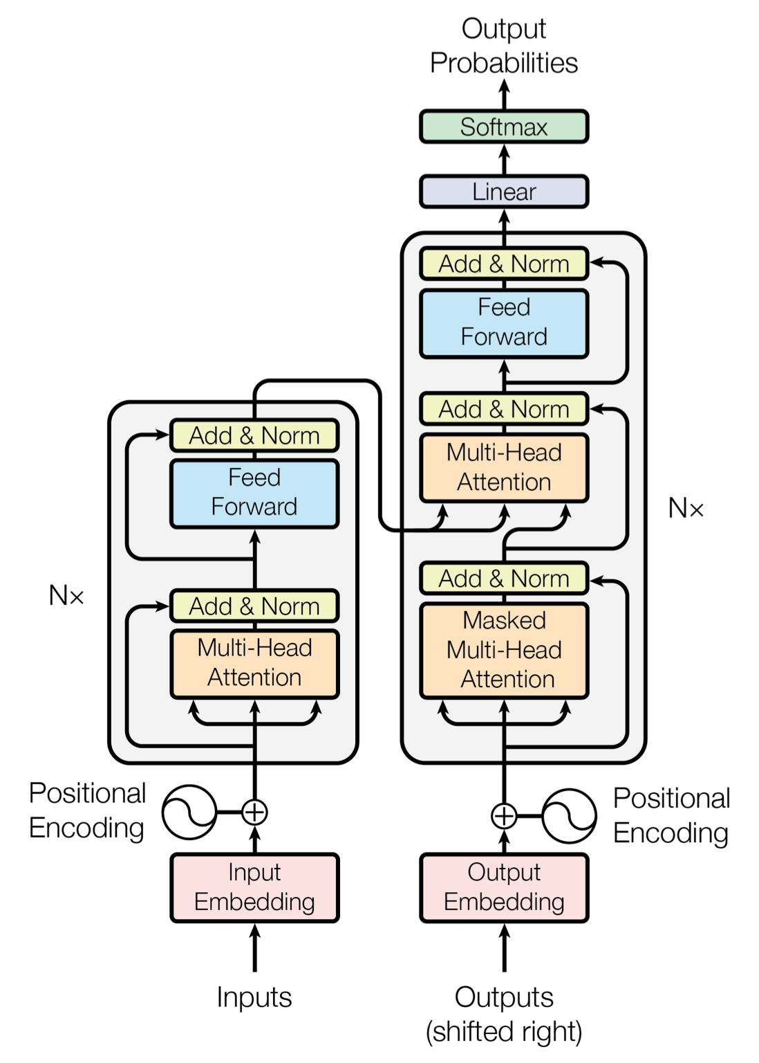
Complete Architecture
Residual connections and layer normalization
Feed-forward network:
after taking information from other tokens, take a moment to think and process this information
Feed-forward network:
after taking information from other tokens, take a moment to think and process this information
Decoder - Encoder self-attention:
target tokens look at the source
queries – from decoder state; keys and values from encoder states
K
V
Q
Skip Connection:
attention + query
Skip Connection:
attention + query
Encoder self-attention:
tokens look at each other
queries, key, value are computed from encoder states
Decoder self-attention (masked):
tokens look at previous tokens
queries, keys, values are computed from decoder states
K
Q
V
K
Q
V

Slide 8





Our Approach
Brainstorm/Research
Data Pipeline
Implementation
Train & Test
Analysis
Read the paper, watched YouTube videos, and tutorials to understand the details of model.
Created pipeline to efficiently read dataset into project and byte-pair encoding
Developed the model architecture as specified in paper.
Implemented the train pipeline to train the model and save the result. Also added a testing code to test the model and predict based on user input.
Used tensorboard to visualize the results and derived the output generated from the model.

Slide 9


Implementation
Multi30k
The dataset is based on WMT 2016 consists of English to German.
DATA PIPELINE
Preprocessing
Added preprocessing pipeline and used the library spacy for tokenizing. Specifically, de_core_news_sm and en_core_web_sm. Added padding for start, end, and unknown. Also, finding insights so that Transformer block can be build accordingly.
ATTENTION
Attention
Self & Multi Head Attention
Each element attends to every other element.
The self attention takes in embedding size and heads. The hidden dimension is calculated by dividing embedding size by heads. Make sure it is divisible by 8. e.g., 512//8. Add masking to key, value, and query.

Slide 10


Implementation
Encoder
Takes in Key, Value, and Query from input after positional encoding.
ENCODER BLOCK
6 layers of encoder
Stack of N=6 identical layers consisting of multi-head self attention and second is position wise fully connected feed-forward network followed by residual connection of layer normalization. This produces output of dimension d_{model}=512.
DECODER BLOCKS
Decoder
6 layers of decoder
Takes in output positional embedding and combines it to the output of encoder block.
Similar to encoder it is a stack of N=6 identical layers. In addition to two sublayers in the encoder block, it has a multi head attention layer over output of encoder block. Modify the self attention layer to prevent positions from attending to subsequent positions.

Slide 11


Implementation
Model Architecture
TRANSFORMER
Putting all the blocks of architecture together to form a complete structure as shown in paper.
Putting it all together
Added a new Transformer class to put together all the blocks of the model together. Encoder, Decoder, Attention and Positional Encoding along with trainer code to run and train the model.
TRAINING
Training and Testing
Optimizer & Regularization
Training regime for the model
Used Adam optimizer with beta1=0.9, beta2=0.98, and epsilon=10⁻⁹. Varied the learning rate with a factor of 0.5 as described in paper and added warmup step of 4000. Added dropout of 0.1 and label smoothing with value 0.1. Integrated tensorboard for loss and learning rate visualization.

Slide 12
Difference from Original Study
The implementation is in Tensorflow.
They use WMT 2014 English to German and English to French dataset
4.5 million sentence pairs (en-de)
36 million sentence pairs (en-fr)
The author doesn’t report their random seeding. And even if they did, even slight differences in the code structure could lead to different random sampling.
For English to German, they train their base model for 100,000 steps or 12 hours.
For English to French, they train the model 300,000 steps for 3.5 days.
Hardware: 8 NVIDIA P100 GPUs.
Our implementation is in PyTorch.
We use Multi30k based on WMT 2016 dataset.
Train 29000 sentence pairs
Valid 1040 sentence pairs
Test 1000 sentence pairs
We do a random seeding of 1337**
For English to German, we train our model for 6 hours over 1000 epochs.
Hardware: 4 NVIDIA A100-SXM-80GB GPUs.
4 cores/gpu
8 gb/core
**The Illustrated Transformer

Slide 13
Result
We trained for 100, 500, 1000, 1500, and 2000 epoch
The best performance was on 1000 epochs.
On 1500 epoch the kernel crashed with memory issue.
On 2000 epoch we were not able to run the complete epoch due to memory issue.
Task | Original Paper | Our Work
English to German | 28.4 | 29.4
English to French | 41.8 | NA

Slide 14
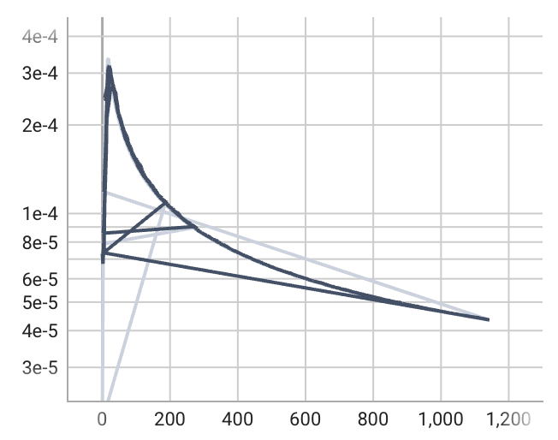
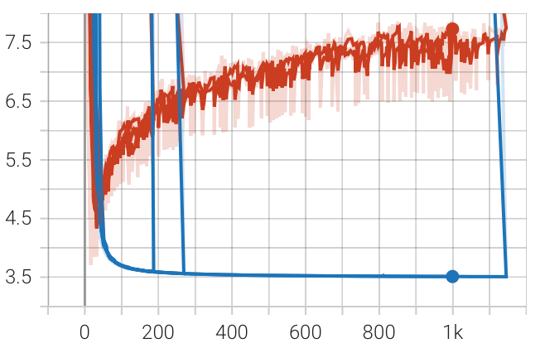
Result Analysis
Learning Rate
Loss

Slide 15
Limitation
The baseline transformer uses O(n²) in memory computation.
Increasing size of length increases computation quadratically.
Fixed length unlike RNN of arbitrary length.
Inability to process input sequentially.
Not like how human brain works.
Paper addressing limitation
Limited access to long memory.
Limited ability to update state.

Slide 16

Demo

Slide 17
Code Repository and Future Task
The complete working code with instructions on how to run and details is available at https://github.com/aniket414/vaswani-et-al-2017
If you like our work and want to contribute to the project, we are working on English to Hindi translation.
Dataset: IIT Bombay English-Hindi Corpus
Tokenizer: Indic language NLP library

Slide 18
Acknowledgement
The byte pair encoding parts are borrowed from subword-nmt.
Andrej Karpathy youtube video “Let's build GPT: from scratch, in code, spelled out”.
Aladdin Persson youtube video “Pytorch Transformers”.
The Illustrated Transformer by Jay Alammar.
Pytorch tutorial “LANGUAGE TRANSLATION WITH NN.TRANSFORMER AND TORCHTEXT”.

Slide 19
Thank You!

Slide 20
Why doesn’t the Transformer converge?
It is a known issue with Deep Transformers that they don’t converge well.
Transformer employs residual connection and layer normalization to ease the optimization difficulties caused by its multi-layer encoder/decoder structure. While several previous works show that even with residual connection and layer normalization, deep Transformers still have difficulty in training, and particularly a Transformer model with more than 12 encoder/decoder layers fails to converge.
Even the original paper** and official implementation# make a small change in implementation however they still aren’t able to converge significantly.
**Vaswani et al., 2017
#Vaswani et al., 2018

Slide 21
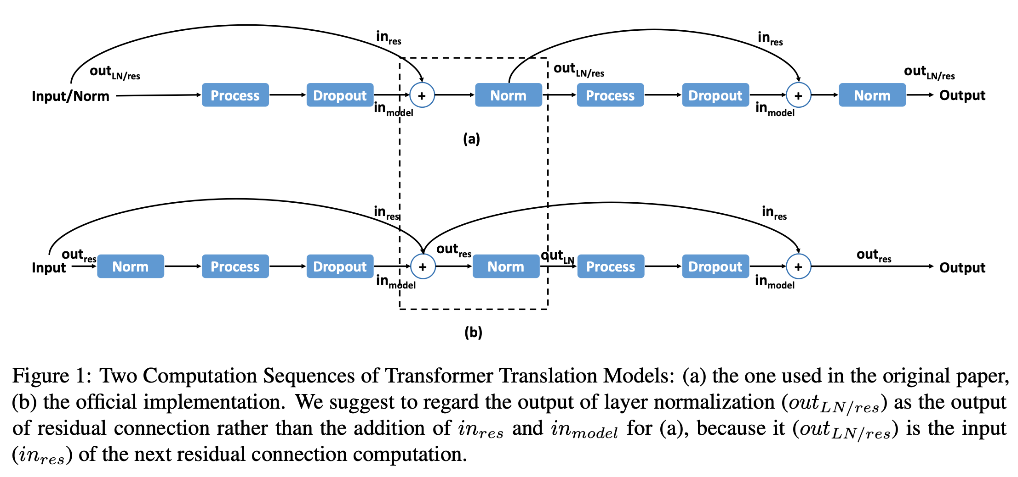
How to converge?
Possible convergence: Lipschitz Constrained Parameter Initialization.
Source: Hongfei Xu et al., 2020

